Slide 1
DualNet: Continual Learning, Fast and Slow Neural Information Processing Systems 34 (NeurIPS 2021)
Quang Pham, Chenghao Liu, Steven C.H. Hoi Salesforce Research Asia

Slide 2
Continual Learning
In response to external changes, evolution has empowered human and other organisms with strong adaptability to continually acquire knowledge.
Naturally, we expect artificial intelligence (AI) systems to adapt in a similar way.
Continual Learning: learn a sequence of contents one by one and behave as if they were observed simultaneously
As the contents (tasks) are provided incrementally over a lifetime, continual learning is also referred to as incremental learning or lifelong learning in much of the literature, without a strict distinction

Slide 3
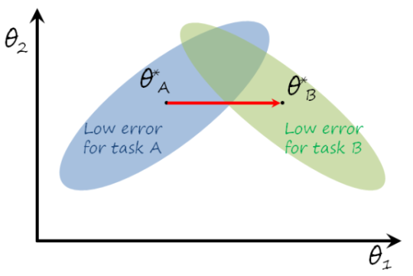
Continual Learning
Continual learning is characterized by learning from dynamic data distributions.
Catastrophic forgetting: Adaptation to a new distribution generally results in a largely reduced ability to capture the old ones.
Continual learning is primarily intended to ensure the resource efficiency of model updates, preferably close to learning only new training samples.

Slide 4
Dual Net’s General Idea
One reason why humans don’t experience catastrophic forgetting is described in the Complementary Learning Systems (CLS) Theory
Fast Learning System (Hippocampus): Responsible for rapid learning of specific experiences.
Slow Learning System (Neocortex): Gradual learning of general knowledge that supports long-term memory.
DualNet's Inspiration is replicating this dual-system approach in artificial neural networks for better continual learning.

Slide 5
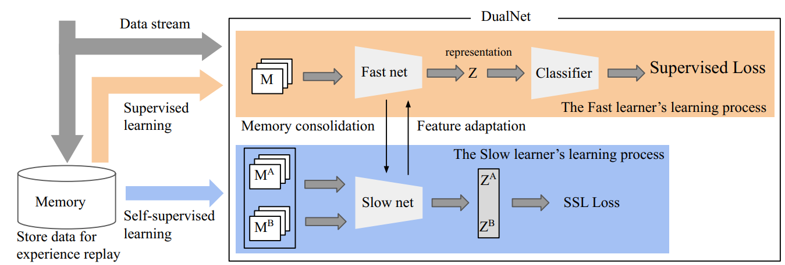
Dual Net’s Architecture
Dual Systems in DualNet:
Fast Learner focuses on supervised learning of specific tasks using labeled data.
Slow Learner utilizes Self-Supervised Learning (SSL) to learn task-agnostic, general representations.
Fast learner adapts slow learner’s representations to quickly learn new tasks.

Slide 6
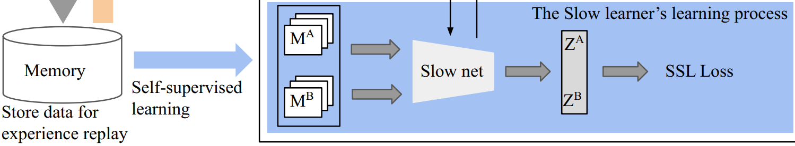
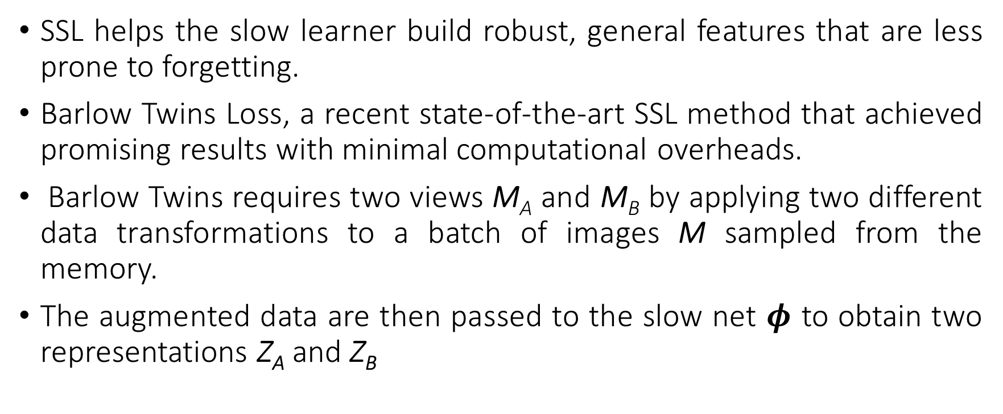
1. Slow Learner (SSL Model)
SSL helps the slow learner build robust, general features that are less prone to forgetting.
Barlow Twins Loss, a recent state-of-the-art SSL method that achieved promising results with minimal computational overheads.
Barlow Twins requires two views M_{A} and M_{B} by applying two different data transformations to a batch of images M sampled from the memory.
The augmented data are then passed to the slow net $φ$ to obtain two representations Z_{A} and Z_{B}

Slide 7

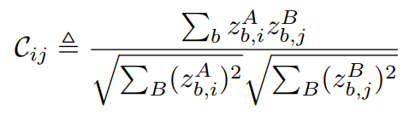
1. Slow Learner (SSL Model)

Slide 8
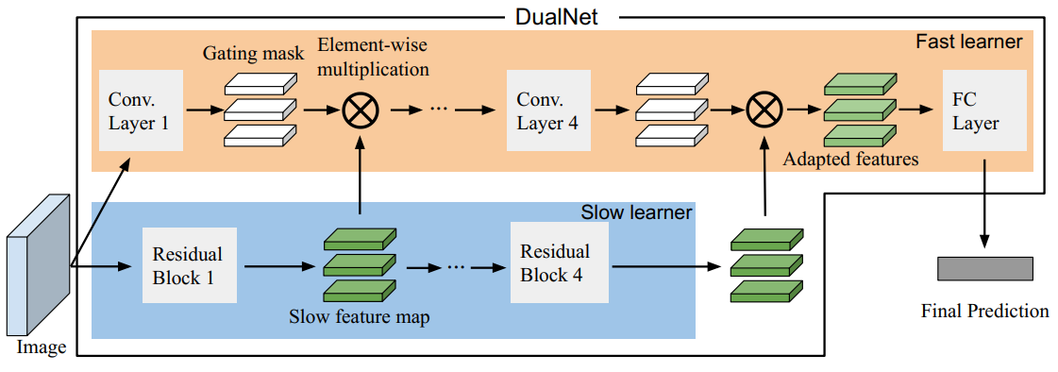
2. Fast Learner (SL Model)
Given a labeled sample {x, y}, the fast learner’s goal is utilizing the slow learner’s representation to quickly learn this sample via an adaptation mechanism.
The fast learner modifies the general representations from the slow learner to be task-specific.

Slide 9
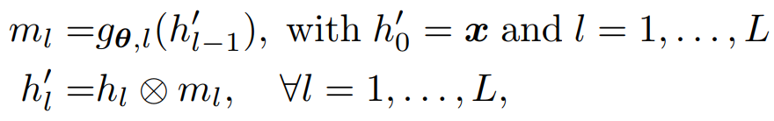

2. Fast Learner (SL Model)
Formally, let ${\{h_{i}\}}_{i=1}^{L}$ be the feature maps from the slow learner’s layers on the image x, e.g. $h_{1}$, $h_{2}$, $h_{3}$, $h_{4}$ are outputs from four residual blocks in ResNets .

Slide 10
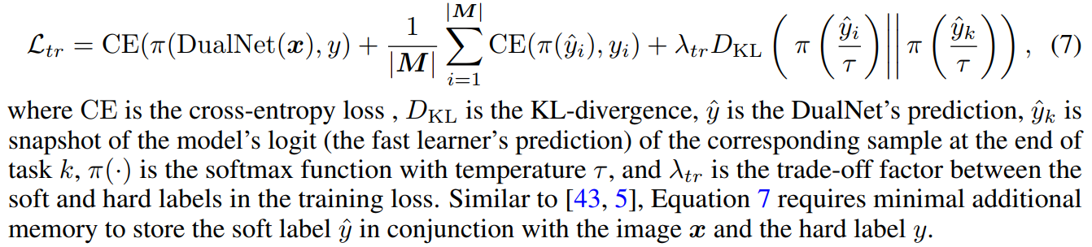
2. Fast Learner (SL Model)
Fast Learner leverages the episodic memory.
Given the incoming labeled sample {x, y} and a mini-batch of memory data M belonging to a past task k:

Slide 11
Experimental Setup
CORE50 and Split miniImageNet for evaluating the performance of DualNet, with 17, 10 continual learning tasks, respectively.
Evaluation Metrics:
Accuracy (ACC): Measures overall performance across tasks.
Forgetting Measure (FM): Quantifies how much the model forgets previous tasks.
Learning Accuracy (LA): Reflects how well the model learns new tasks.
Baselines:
ER [9], a simple experience replay method.
DER++, an ER variant that augments ER with a ℓ2 loss
CTN a recent state-of-the-art method on the online task-aware setting.

Slide 12
Experimental Setup
CORE50 and Split miniImageNet for evaluating the performance of DualNet, with 17, 10 continual learning tasks, respectively.
Evaluation Metrics:
Accuracy (ACC): Measures overall performance across tasks.
Forgetting Measure (FM): Quantifies how much the model forgets previous tasks.
Learning Accuracy (LA): Reflects how well the model learns new tasks.
Baselines:
ER [9], a simple experience replay method.
DER++, an ER variant that augments ER with a ℓ2 loss
CTN a recent state-of-the-art method on the online task-aware setting.

Slide 13
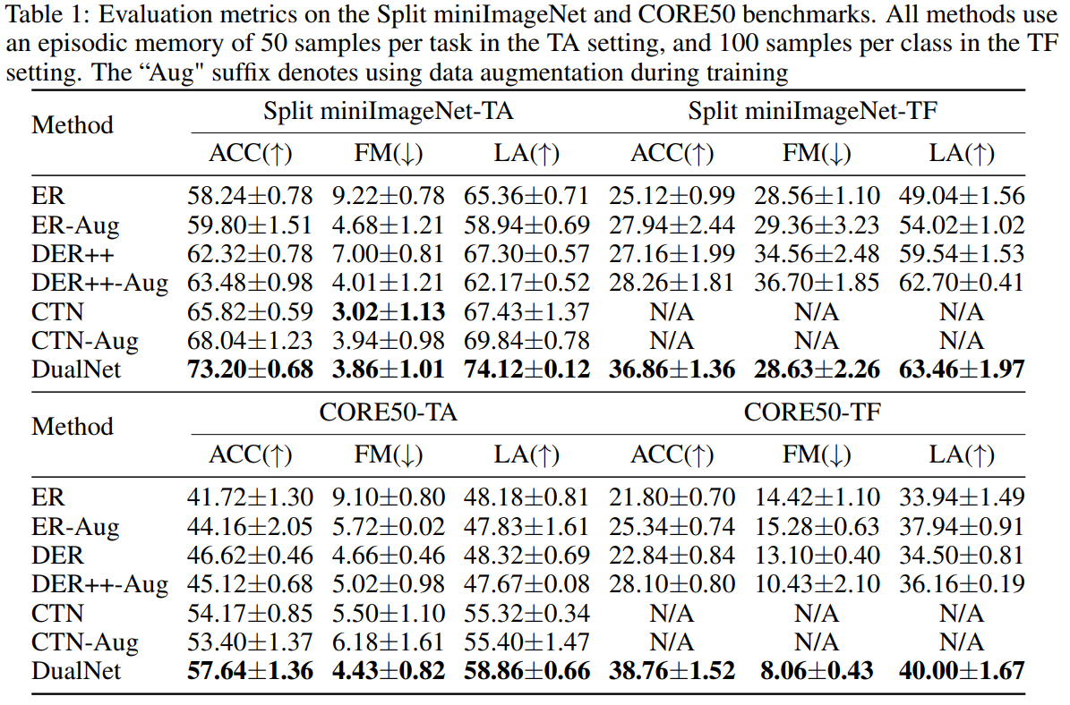
Results

Slide 14
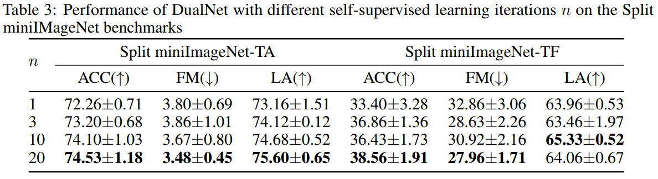
Results – Ablation of Self-Supervised Learning Iterations

Slide 15
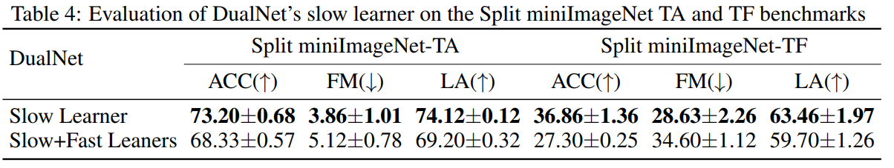
Results – Ablation Study of DualNet’s Fast Learner

Slide 16
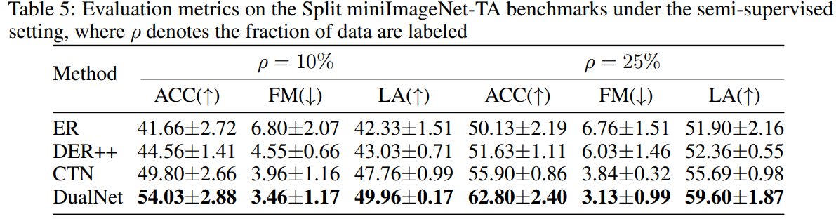
Results – Ablation Study of limited labeled data

