Slide 1
DNN Decision Boundaries in high dimensions

Slide 2
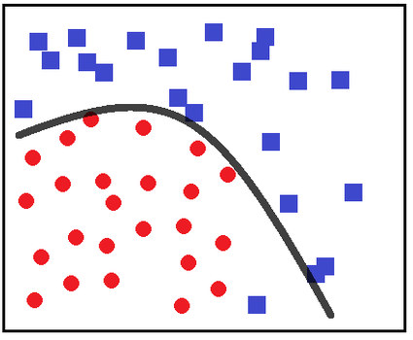
Context
Decision boundaries
Good to visualize for behavioral intervention
Linear decision boundaries are easier to follow
Non-linear ones are better for model performance
Non-linear one helps to manage health better
Marks in 1st exam
pass
fail

Slide 3
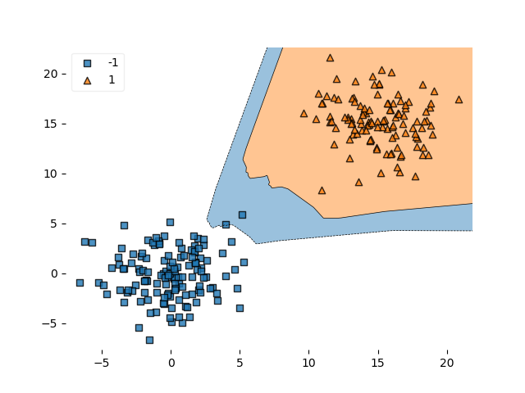
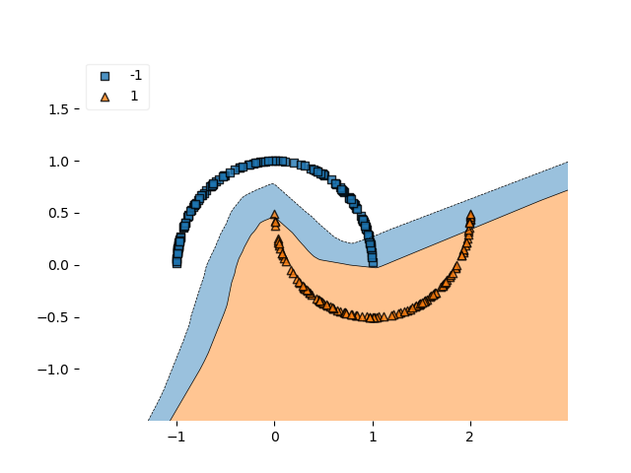
Decision Boundary visualization
Tools available to visualize decision boundaries in lower dimensions

Slide 4
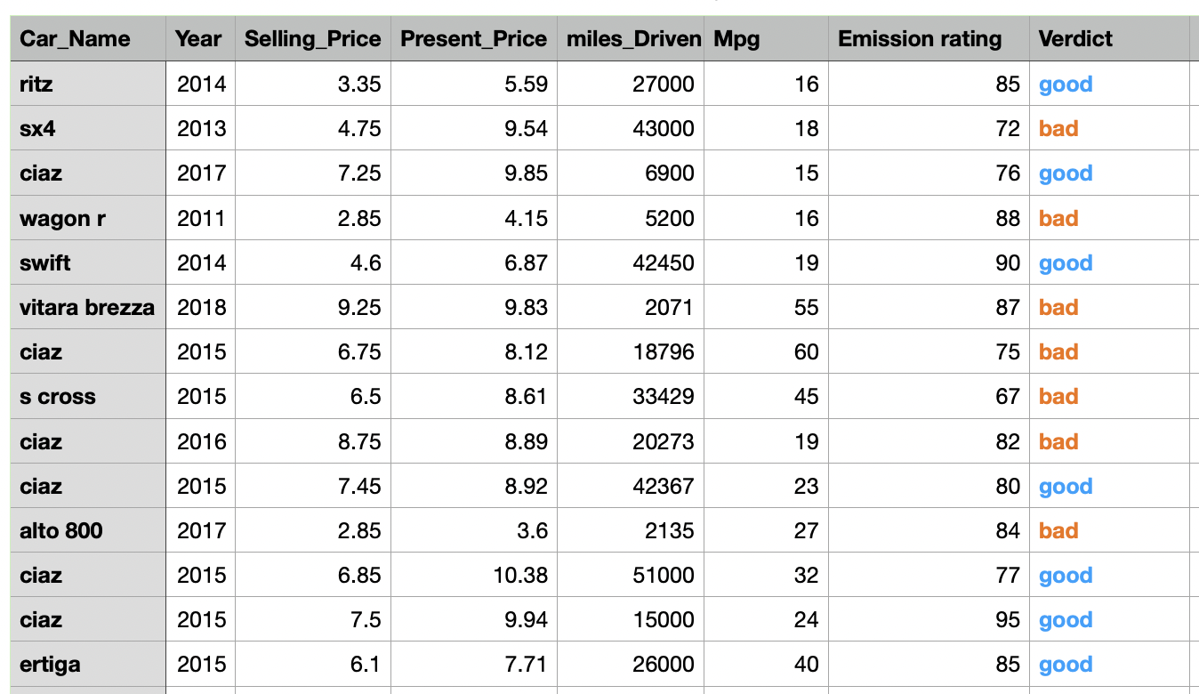
Curse of dimension
Decision boundaries can be visualized up to 3-dimension feature sets
Not visualizable in higher dimensions

Slide 5
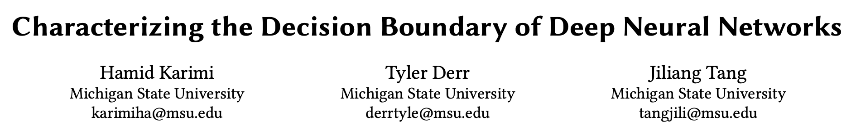
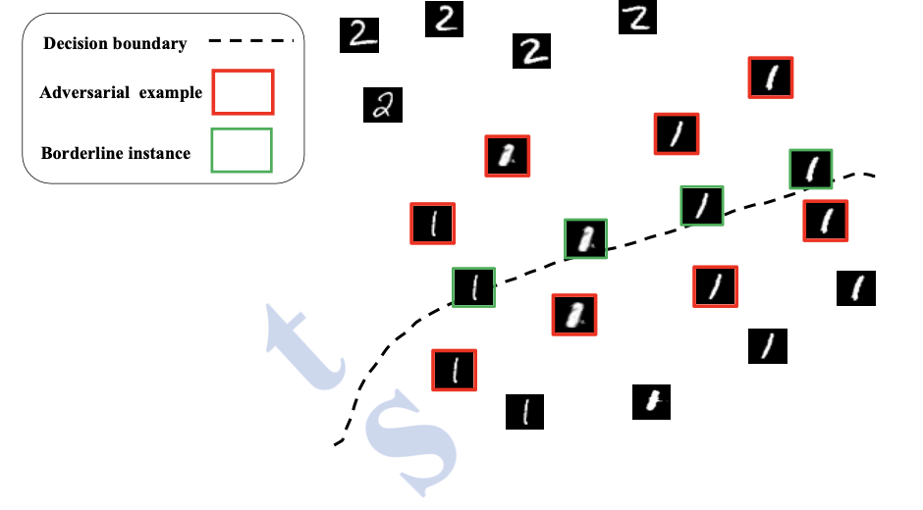
What alternatives we have?
Visualization is not possible at higher dimensions
Image credit: Karimi, H., Derr, T., & Tang, J. (2019). Characterizing the Decision Boundary of Deep Neural Networks. ArXiv, abs/1912.11460.

Slide 6
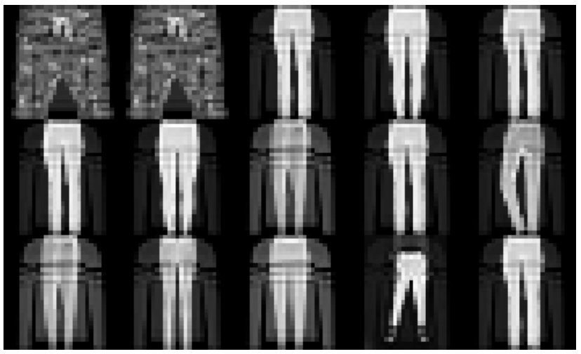
Objectives
They need to be as near as possible to the decision boundary between two classes i.e., their DNN’s classification scores (probabilities) be as close as possible.
(b) Borderline instances need to be similar to the original (real) instances.
Image credit: Karimi, H., Derr, T., & Tang, J. (2019). Characterizing the Decision Boundary of Deep Neural Networks. ArXiv, abs/1912.11460.

Slide 7
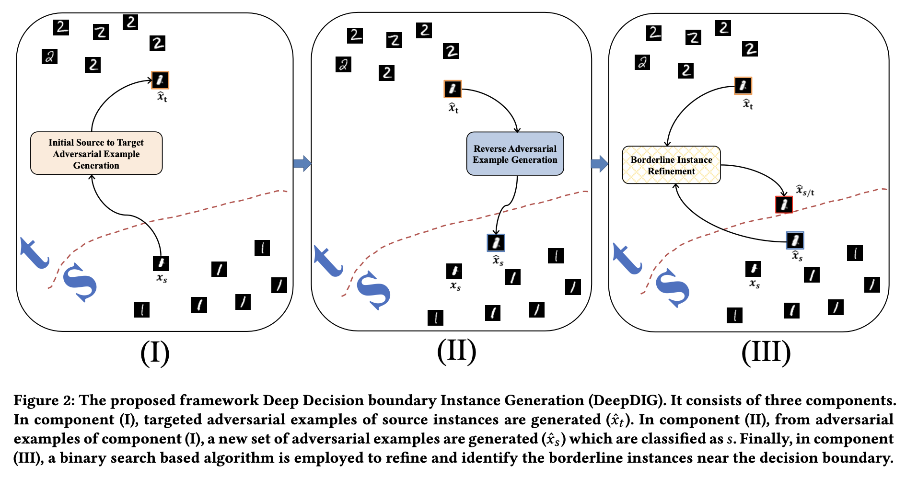
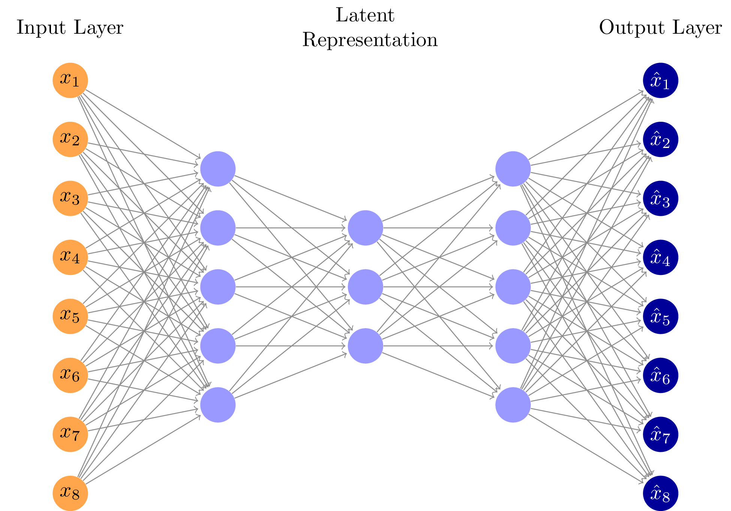
Overview
Steps:
Use an instance from s class to generate an instance which the DNN mis-classifies as t
Use the instance generated in step 1 to produce another instance which the model classifies as an s
Apply bisection method to to identify instances for which model holds equal probability for different class
i.e. f_{s}(instance)=f_{t}(instance) ≈ 0.5
Image credit: Karimi, H., Derr, T., & Tang, J. (2019). Characterizing the Decision Boundary of Deep Neural Networks. ArXiv, abs/1912.11460.

Slide 8
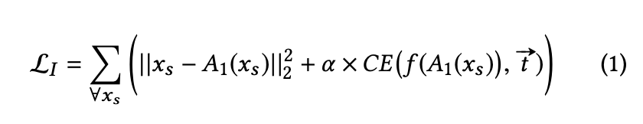
Deep Dive
Steps:
Use an instance from s class to generate an instance which the DNN mis-classifies as t
Image credit: Karimi, H., Derr, T., & Tang, J. (2019). Characterizing the Decision Boundary of Deep Neural Networks. ArXiv, abs/1912.11460.

Slide 9
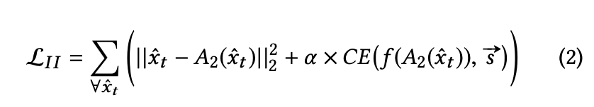
Deep Dive
Steps:
2) Use the instance generated in step 1 to produce another instance which the model classifies as an s
Image credit: Karimi, H., Derr, T., & Tang, J. (2019). Characterizing the Decision Boundary of Deep Neural Networks. ArXiv, abs/1912.11460.

Slide 10
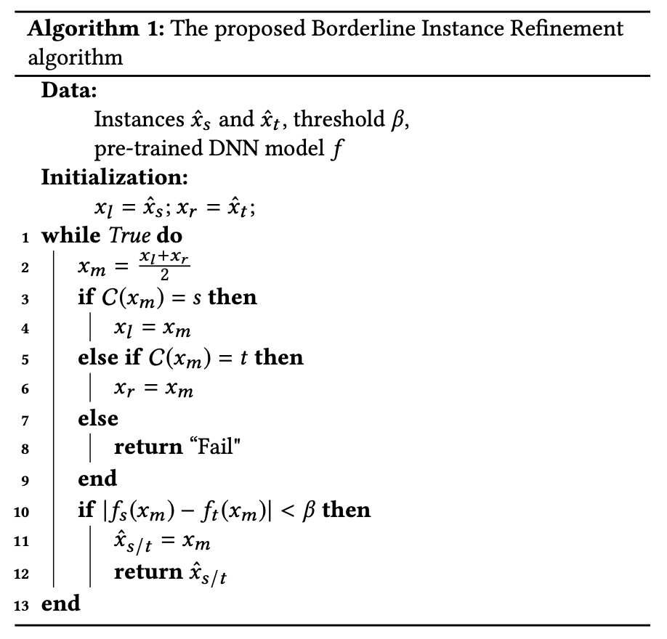
Deep Dive
Steps:
3) Apply bisection method to to identify instances for which model holds equal probability for different class
i.e. f_{s}(instance)=f_{t}(instance) ≈ 0.5
Image credit: Karimi, H., Derr, T., & Tang, J. (2019). Characterizing the Decision Boundary of Deep Neural Networks. ArXiv, abs/1912.11460.

Slide 11
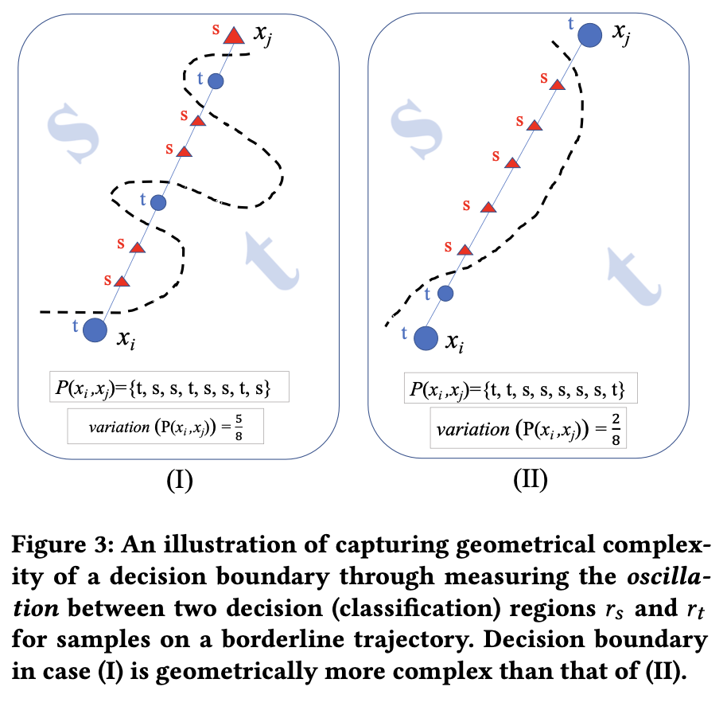
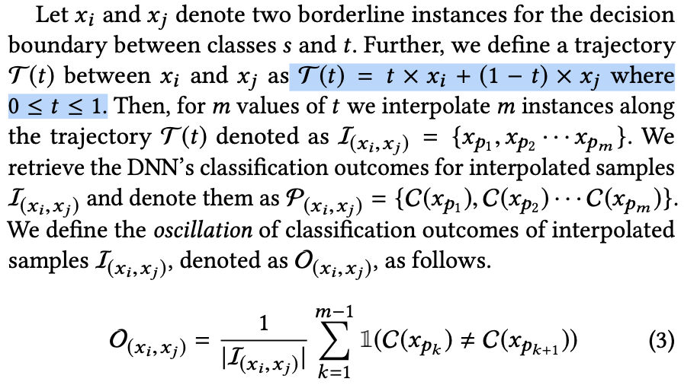
Complexity of Decision boundary
Is the Decision boundary too zigzag? Or smooth?
Image credit: Karimi, H., Derr, T., & Tang, J. (2019). Characterizing the Decision Boundary of Deep Neural Networks. ArXiv, abs/1912.11460.

Slide 12
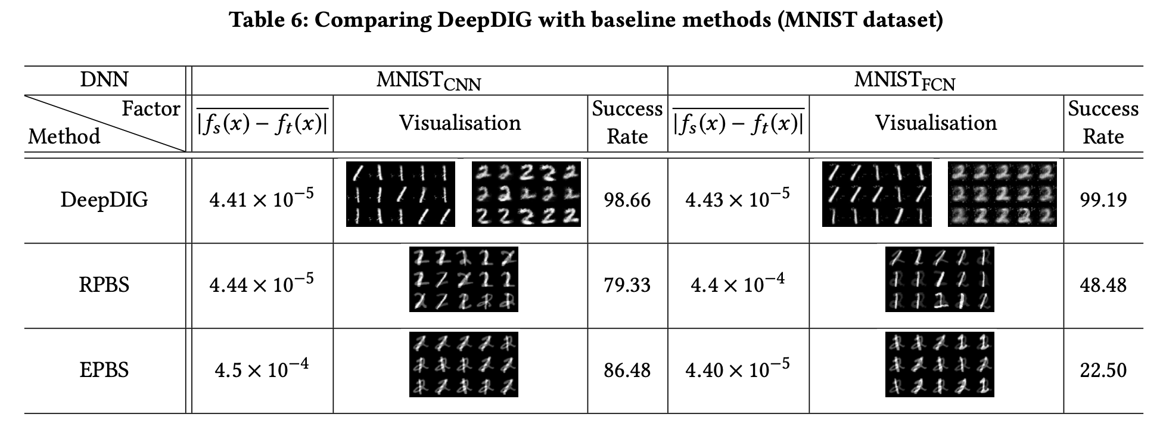
Performance Evaluation

Slide 13
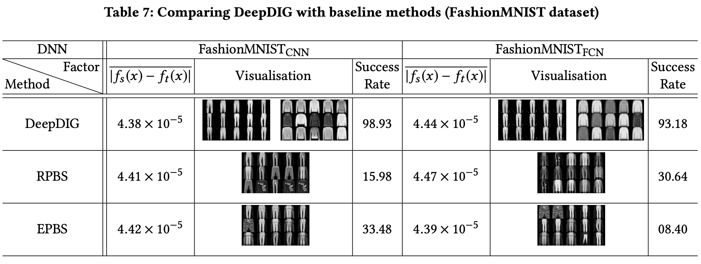
Performance Evaluation

Slide 14
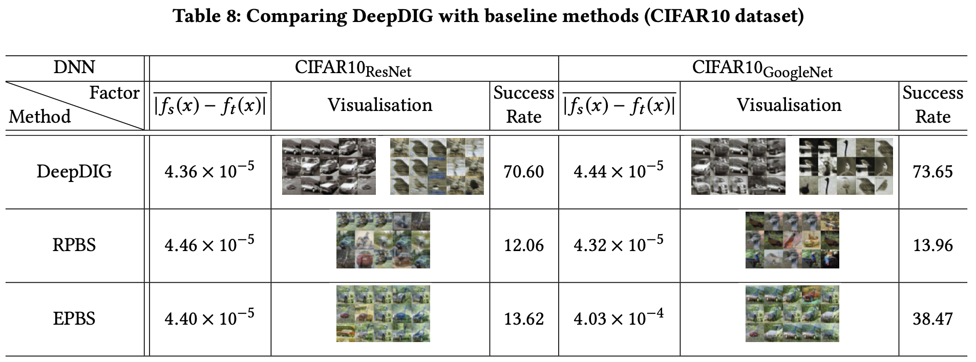
Performance Evaluation

