Slide 1
Explaining Machine Learning Classifiers through Diverse Counterfactual Explanations Microsoft Corporation ACM Conference on Fairness, Accountability, and Transparency (FAT* ’20) Cited 710 times

Slide 2
Counterfactual Explanations

Slide 3

Introducing Counterfactual Explanations
A different type of suggestion to topple the class
A counterfactual explanation is a perturbation of the input to generate a different output y by the same algorithm.
Loan approval-
age 26y
gender F
salary $100k
residency local
credit score 700
loan amount 1 million
loan term 20y
Not approved
X_{T}
age 26y
gender F
salary $150k
residency local
credit score 700
loan amount 1 million
loan term 20y
X_{T}*

Slide 4
Introducing Counterfactual Explanations
University Admission
GPA 3.90
Test score 100
Extra-curricular yes
sports no
Work exp. 1y
LOR score 20
SOP score 15
Not admitted
GPA 3.90
Test score 100
Extra-curricular yes
sports no
Work exp. 1y
LOR score 30
SOP score 20
X_{T}
X_{T}*

Slide 5
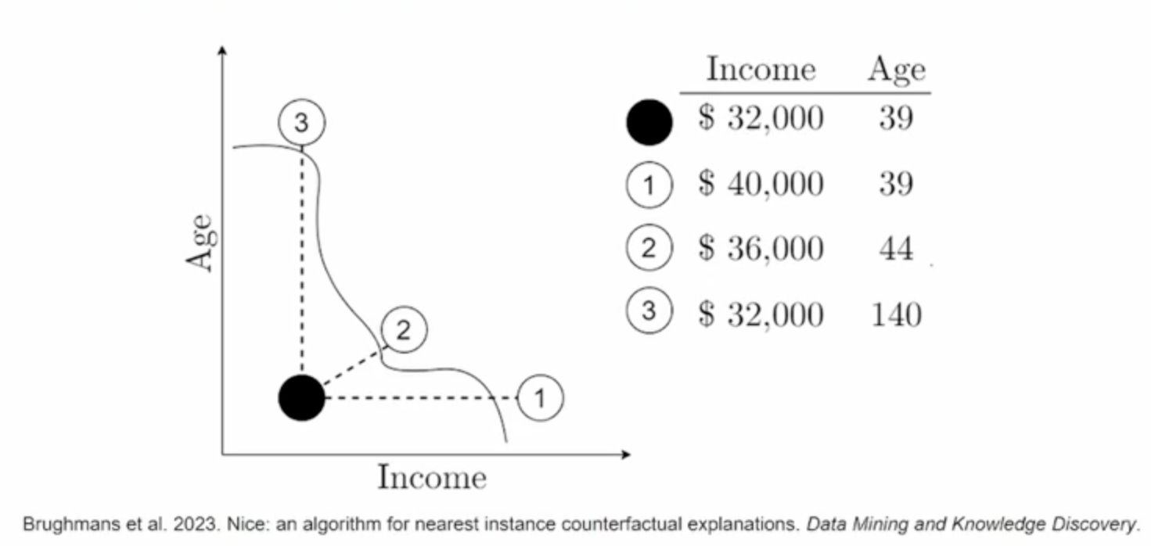
Introducing Counterfactual Explanations

Slide 6
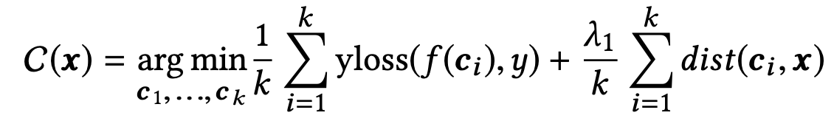

Conditions of counterfactual explanations
Counterfactual Explanations must satisfy several conditions-
Must flip/change the class
Proximity/Must be minimally distant from the test point
Must be realistic i.e. values must be within training data
Sparsity/Must reflect user’s preferences (which features to change or keep unchanged)
The counterfactuals must be diverse

Slide 7
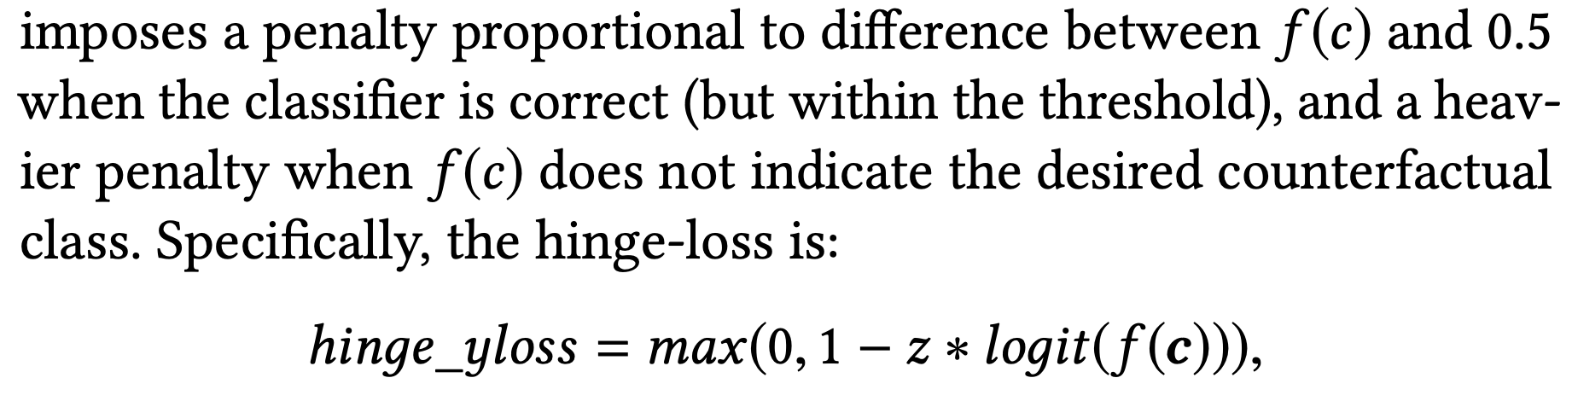
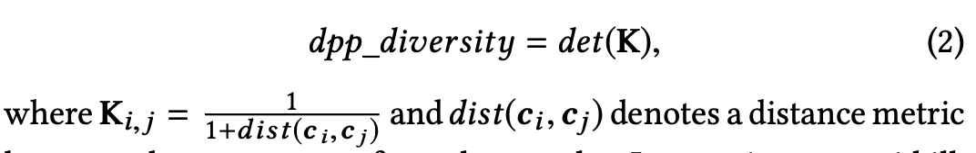
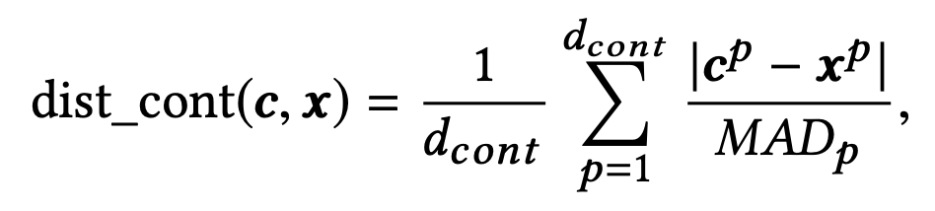
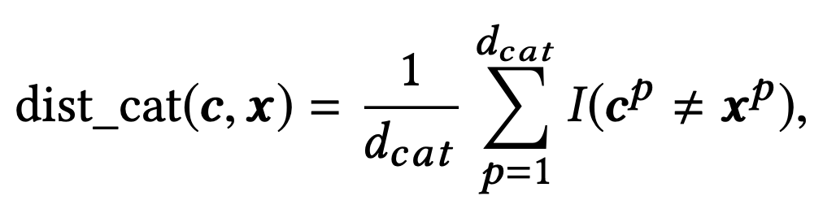
The multi-objective optimization
Sparsity: Only accept the change if it’s below a certain threshold, retain the original value otherwise.
Threshold: $min⁡(MAD, 10th percentile)$
Factual/test sample
f₁ | f₂ | f₃ | f₄ | f₅
Counterfactual
f₁ | f₂ | f₃ | f₄ | f₅

Slide 8
Optimization Datasets
Adult-income dataset
contains demographic, educational, and other information based on 1994 Census database
8 features: hours per week, education level, occupation, work class, race, age, marital status, and sex. The ML model’s task is to classify whether an individual’s income is over $50, 000.
Lending Club
five years (2007-2011) data on loans given by LendingClub
8 features: employment years, annual income, number of open credit accounts, credit history, loan grade as decided by LendingClub, home ownership, purpose, and residency status. Model’s task is to predict prediction of whether an individual will pay back their loan
German-Credit
contains information about individuals who took a loan from a particular bank. 20 features. Model predicts whether the person has a good or bad credit risk based on their attributes
COMPAS
analysis on recidivism decisions in the United States. Decides bail based on predicting which of the bail applicants will recidivate in the next two years given 5 features
Optimized the comprehensive loss function using gradient descent
Objective function is non-convex
Might have multiple local minima
5000 iterations/until loss function converges
Initialize the counterfactual feature values randomly

Slide 9
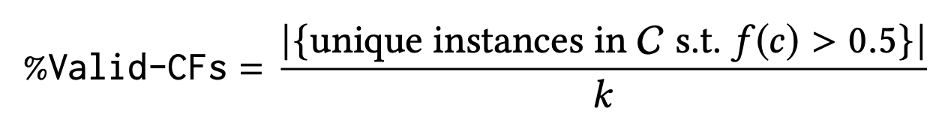
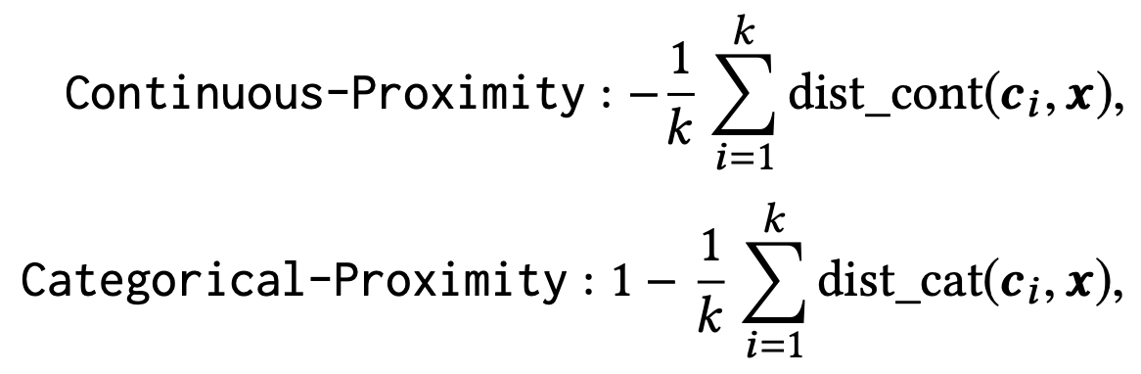
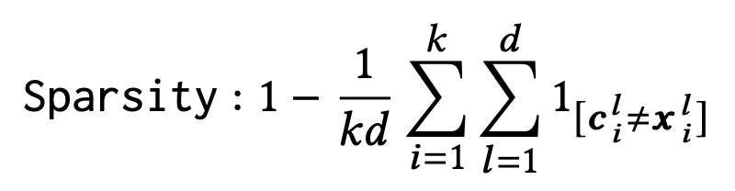
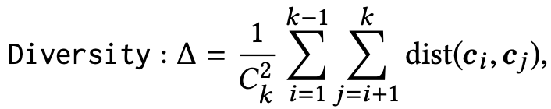
Evaluation
Validity: Validity is simply the fraction of examples returned by a method that are actually counterfactuals.
Proximity: We define distance-based proximity separately for continuous and categorical features.
Sparsity: Captures the number of features that are different. We define sparsity as the number of changes between the original input and a generated counterfactual.
Diversity: Diversity for a set of counterfactual examples is the mean of the distances between each pair of examples.

Slide 10
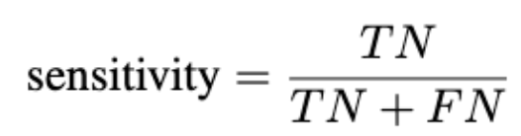
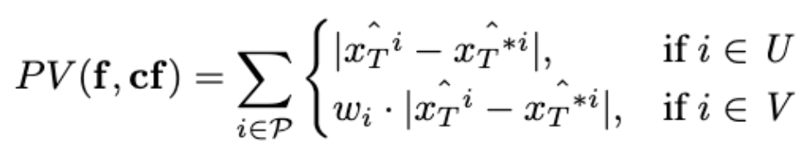
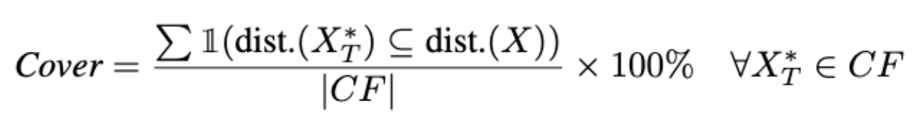
More Evaluation (from literature)
Sensitivity: Feed the CFs to an external simulator and evaluate on the basis of their predicted class. Calculate sensitivity, F1 score, accuracy etc-
Preference Violation Penalty: Assign higher penalty when a feature, that is preferred to remain unchanged, is changed.
Cover: Fraction of the CFs that fall within the distribution of the training data

Slide 11
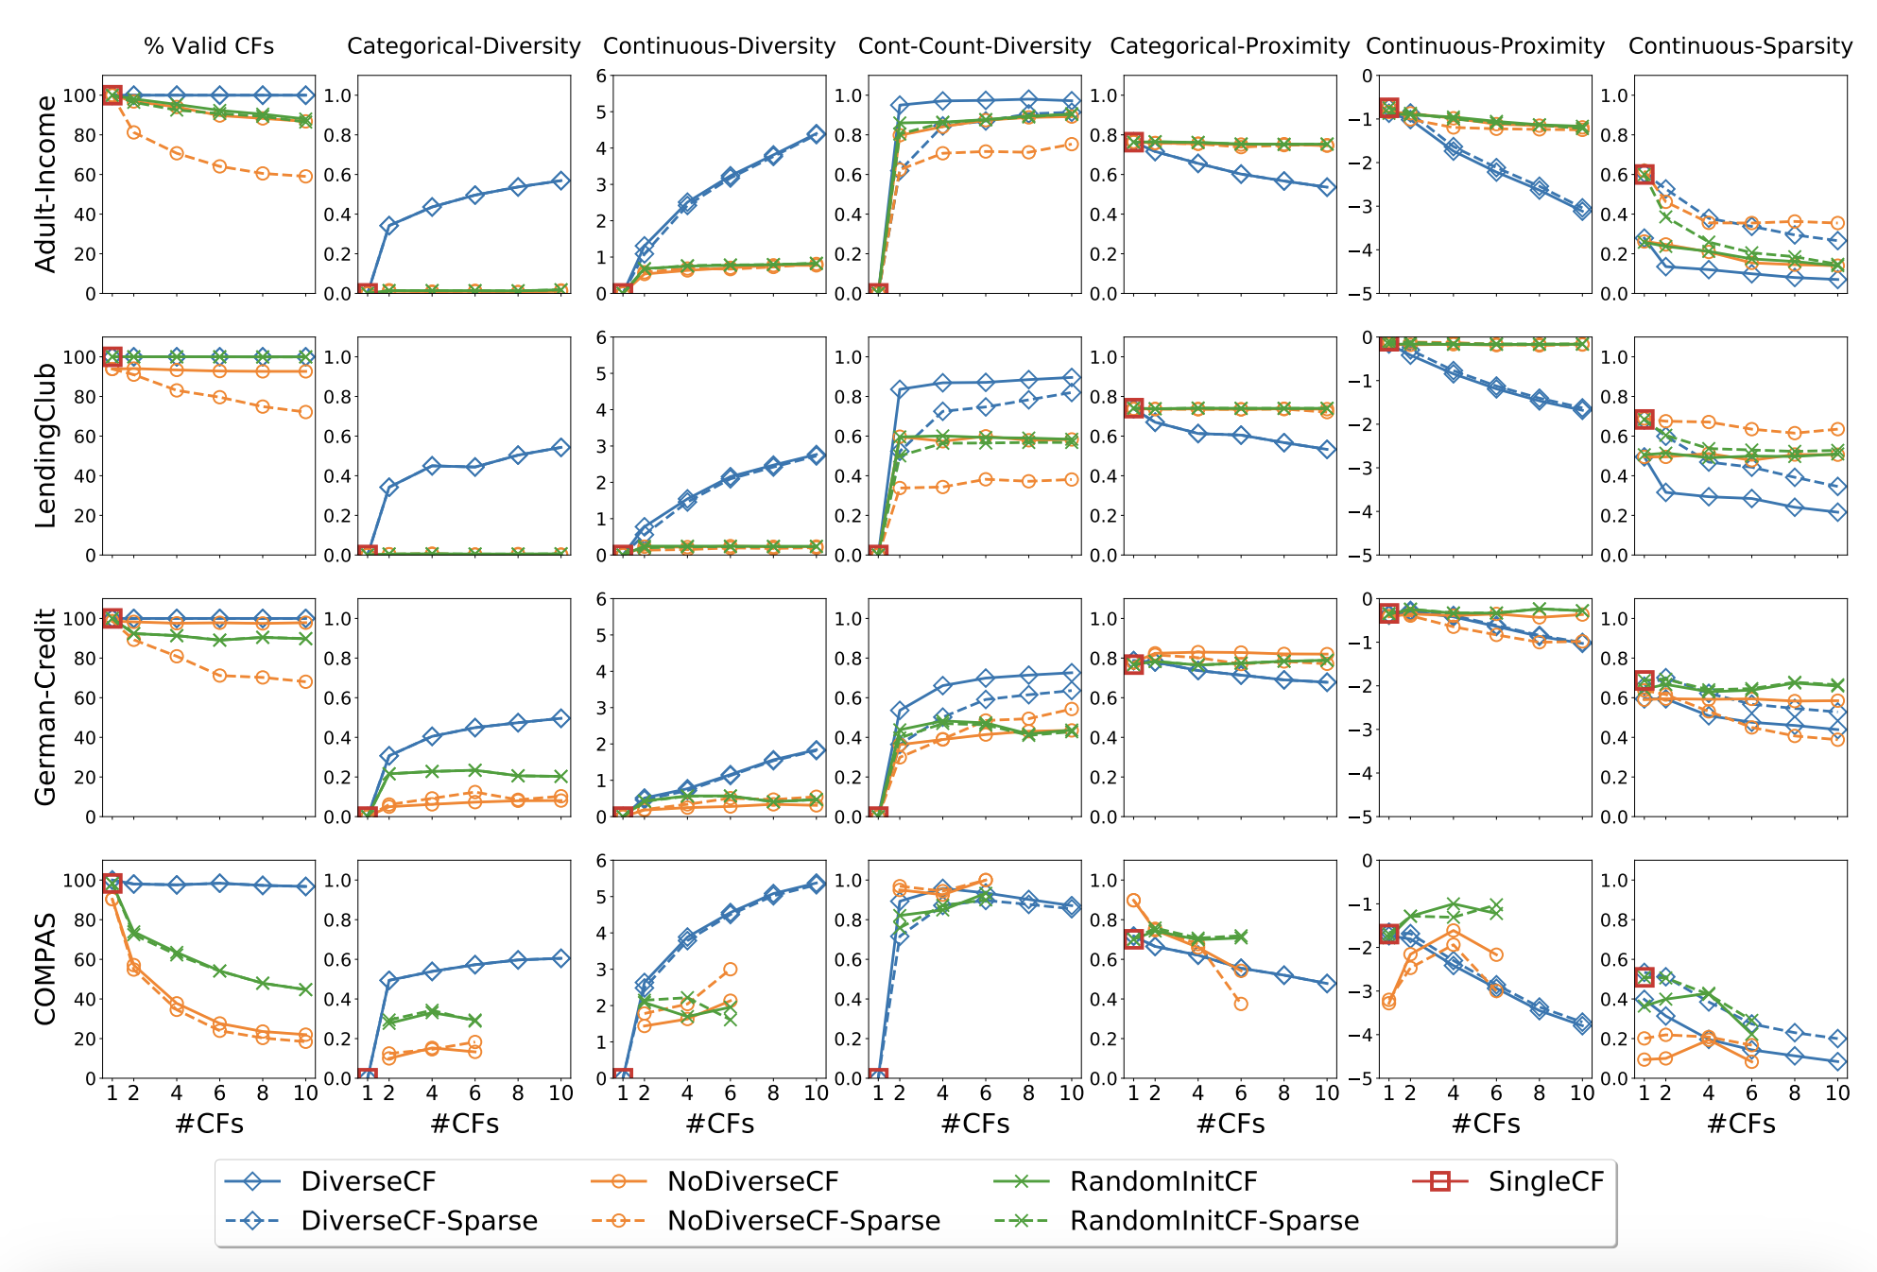
Results

