Slide 1
﻿Augmented Experiment in Material Engineering Using Machine Learning
AAAI-21

Slide 2
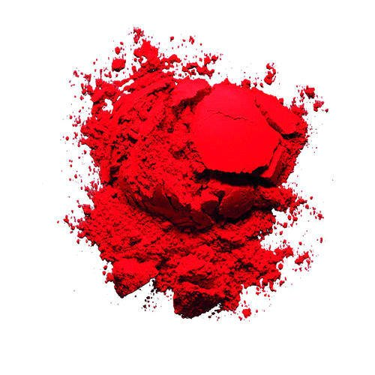
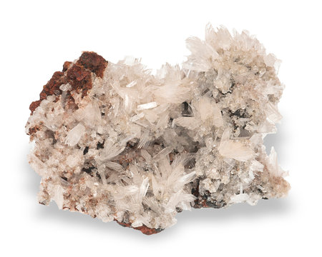
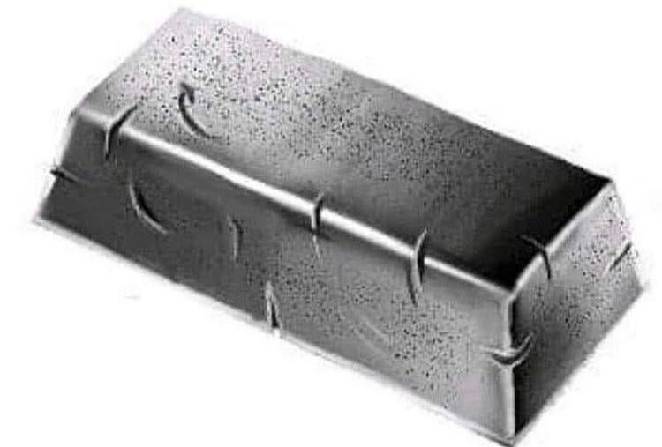
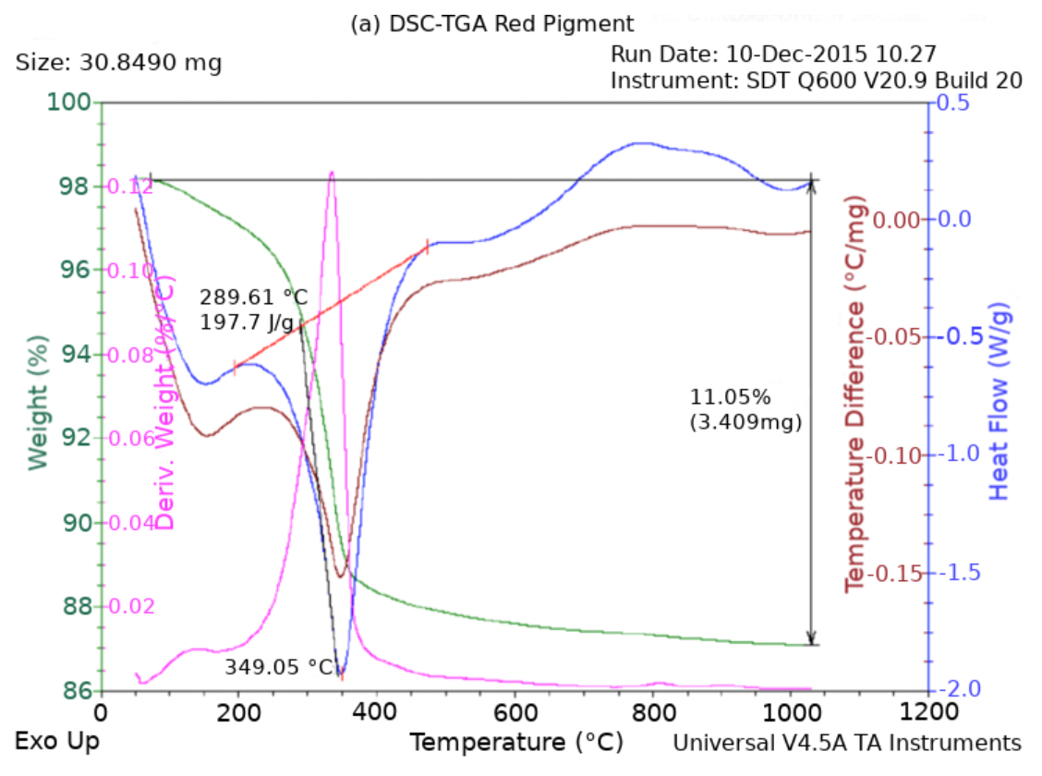
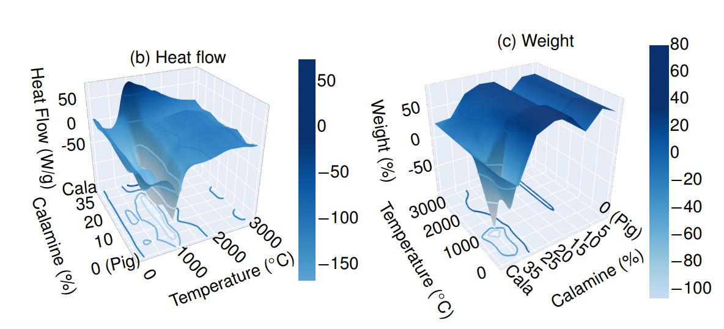
Overview
Properties to follow:
﻿heat flow, absorbed moisture,
sample purge flow, degradation point,
temperature of the mixture,
and mass of the mixture.
Calamine oxide
Red pigment
Iron bar

Slide 3
Objectives
﻿frame an application of material engineering into a setting and reduce the number of real experiments using domain analytical models
﻿novel approach for incorporating domain analytical models via regularization-like terms.

Slide 4
Dataset
Real industrial dataset
Characteristics of individual elements (Red pigment and calamine)
Characteristics of the iron + red pigment + calamine compound
Data segmented by composition of calamine {5, 10, 15, 20, 25, 35}%
Predict temperature and mass
Inside region
outside region
5
10
15
20
25
35

Slide 5
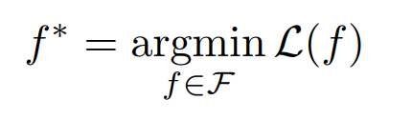

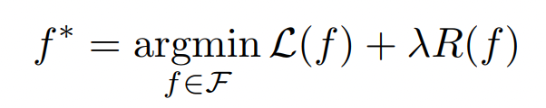
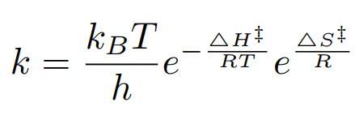
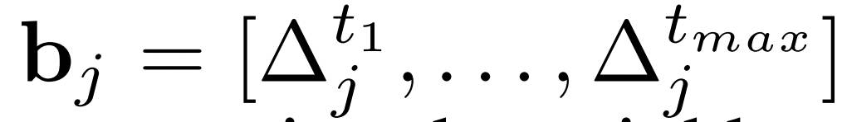
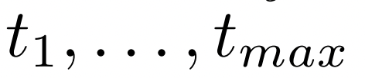
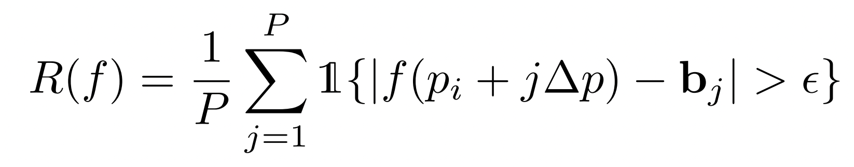
Model
3 Fully connected layers
Regression model
1000 epochs
Adam optimizer with 0.0001 learning rate
Objective function: Minimizing the mean squared error
mass
Temp.
Baseline model
This regularization term is the Main contribution
Defined from kinetic model
Keeps values within the
range
For any given calamine composition, exploit Penalty bounds
Kinetic model
At different temp.

Slide 6
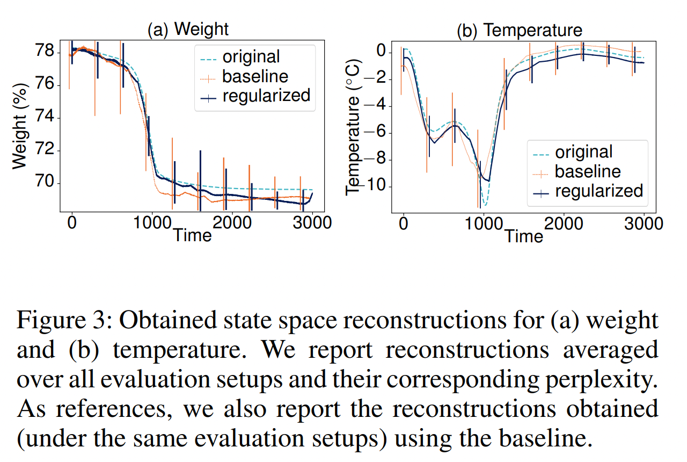
Results

Slide 7
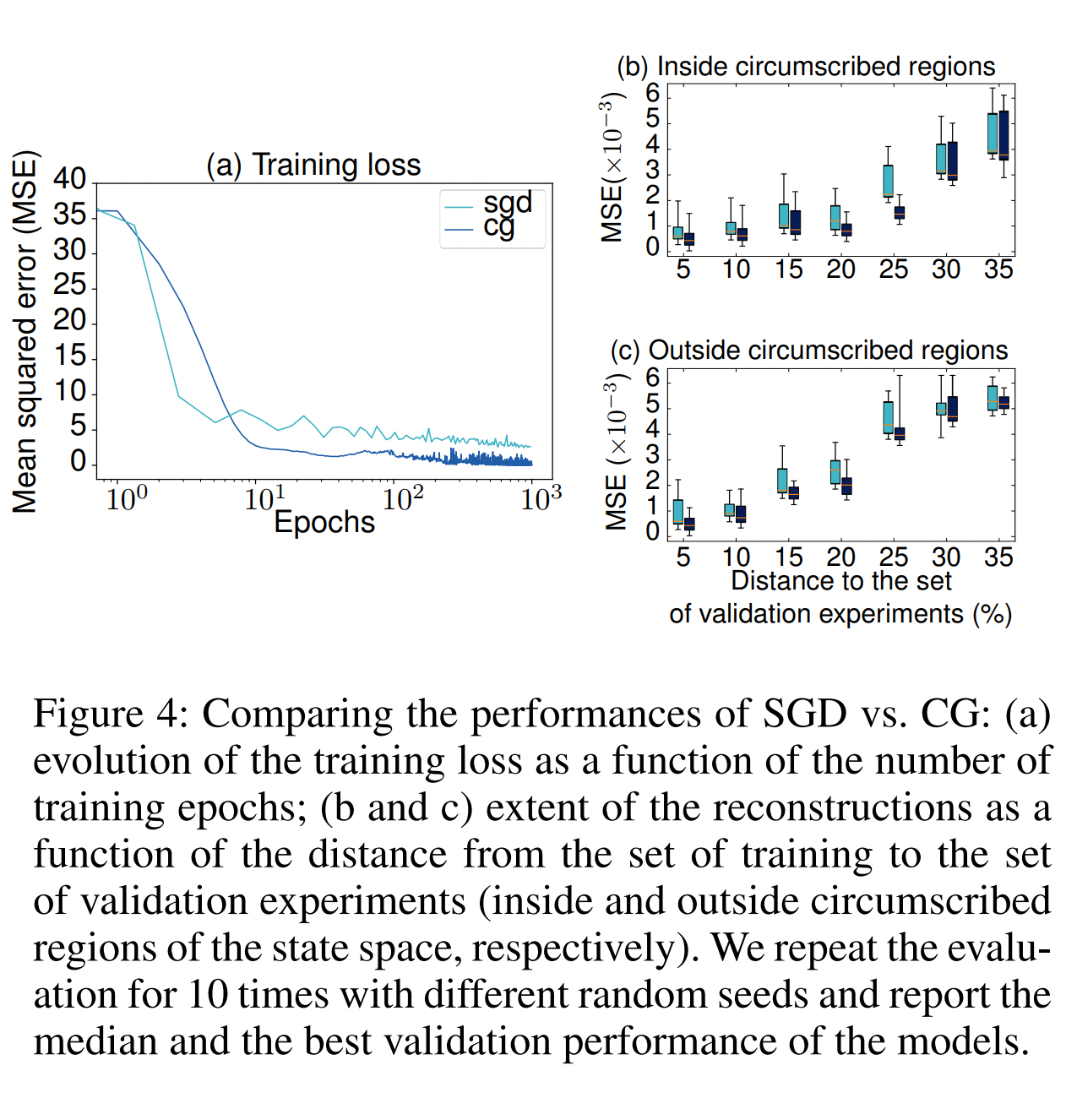
Results

Slide 8
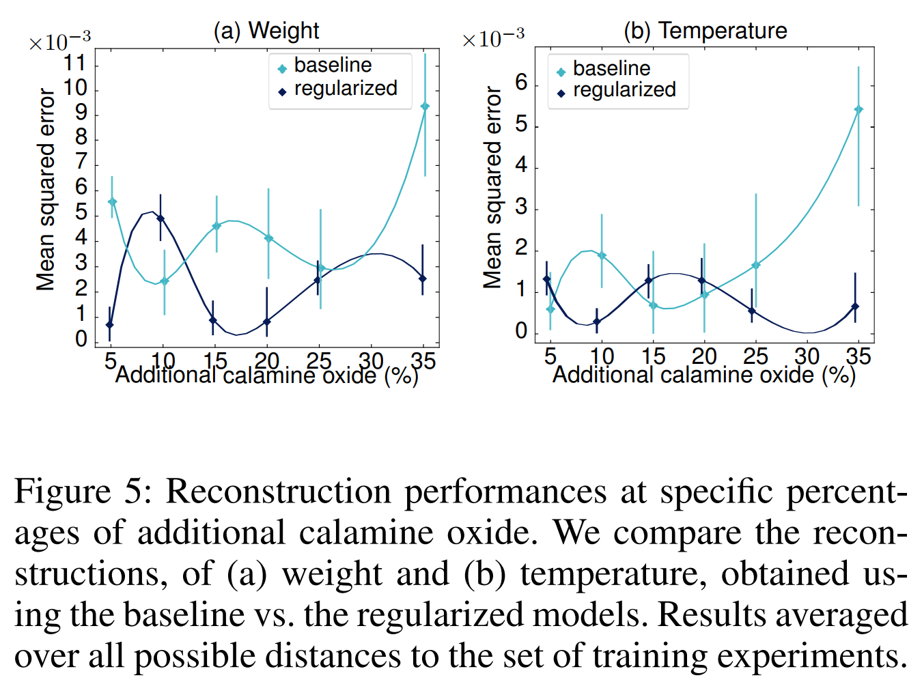
Results

