Slide 1
﻿Entropy-based Logic Explanations of Neural Networks University of Cambridge (UK), Universita di Firenze (Italy), Universita di Siena (Italy), Universite Cote d’Azur (France)
AAAI 22

Slide 2
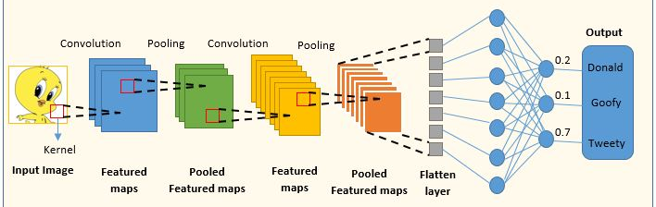
Facts on Explainable AI (XAI)
Lawmakers are edging towards XAI for safety critical domains
US >> Algorithmic Accountability Act (2022) and
EU >> Right to Explanation (2018)
Concept based Neural Network
Do not explain things based on very low-level features/pixels that doesn’t make any sense to the users
Explain things in terms of human understandable features

Slide 3
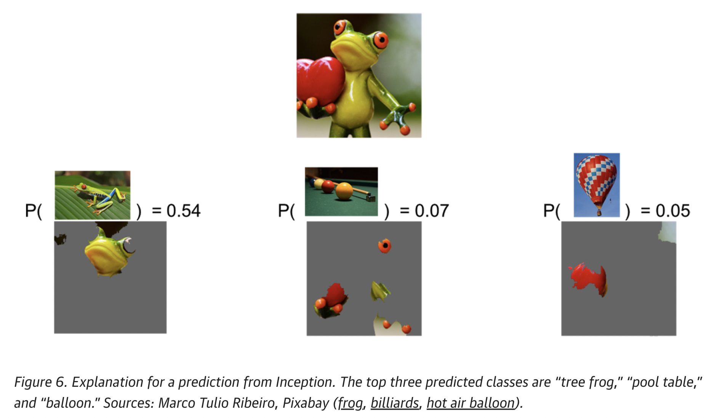
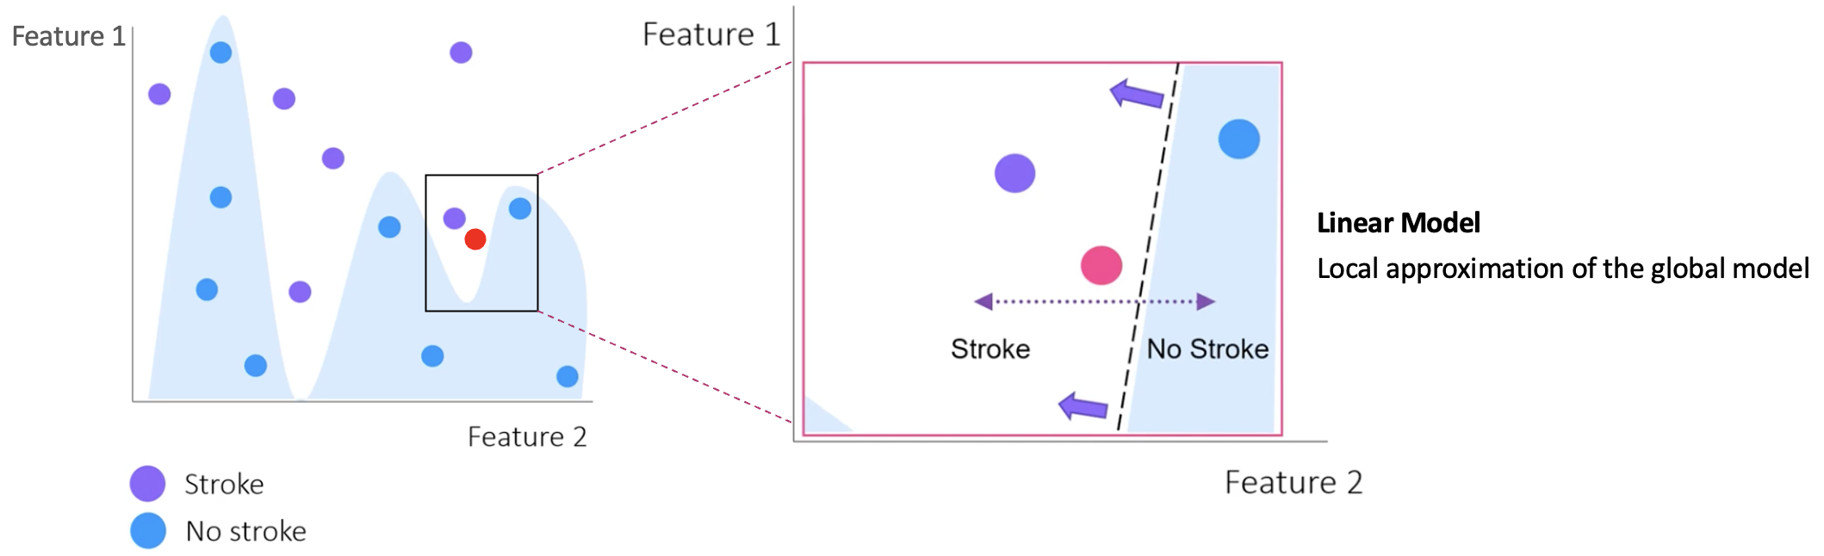
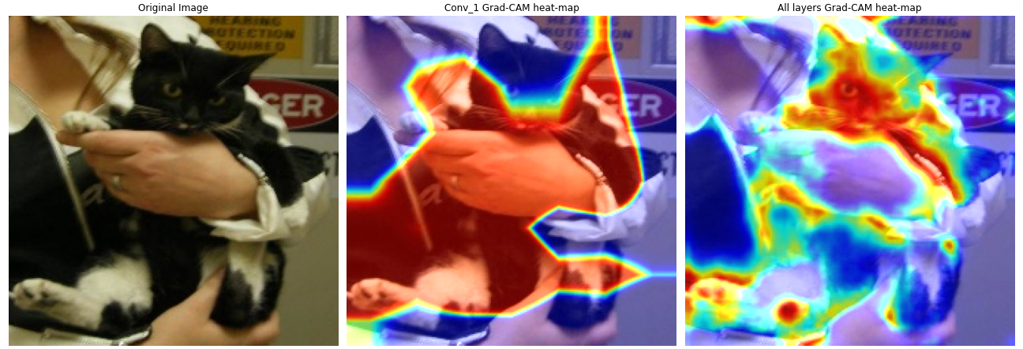
Facts on Explainable AI (XAI)
Two types of explanations
Post-hoc explanation of black-box models
Has nothing to do with the model training
Transfers knowledge to a simpler model – system loss OR tracks back to the gradients
Finds or ranks the most relevant features used by the prediction model to make prediction
Cannot explain how NNs compose those features to make decision
Explanations are given based on input features
LIME
Grad-CAM

Slide 4
Facts on Explainable AI (XAI)
Two types of explanations
Models interpretable by design
End-to-end i.e. One model predicts and explains
Explanation is optimized like model accuracy
Concept based (explanations are based on human understandable features)
Drawback: dimension of explanation could be very large depending on the cardinality of available concepts

Slide 5
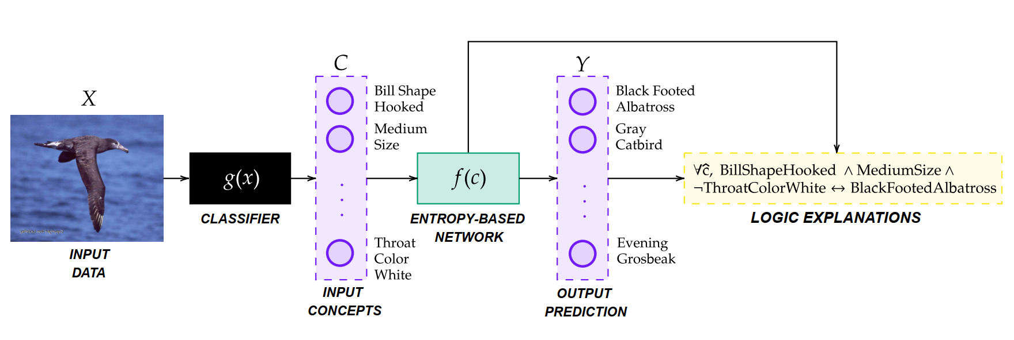
Proposal
Entropy based explanation
Explainable by design – not post-hoc explanation (imposes constraint on classifier architecture and learning process)
A layer in a neural network – a series of operations
Explanations are based on truth tables
Explanations for individual examples
Y_1 happened because x_1 happened, x_2 did not happen, x_3 happened ….
Explanation for a whole target class
Y_1 happens if (x_1 and x_3 happen) or (x_2, x_3 and x_4 happen) etc.
Evaluate the explanations based on 6 metrics
Matches performances of Black box models
Outperforms white box models (DT, LR)

Slide 6
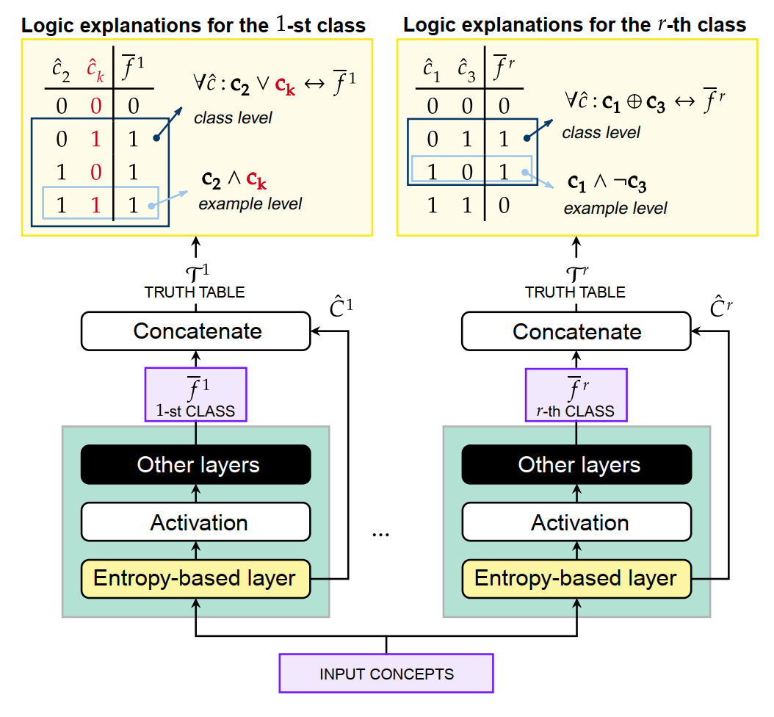
Proposal

Slide 7
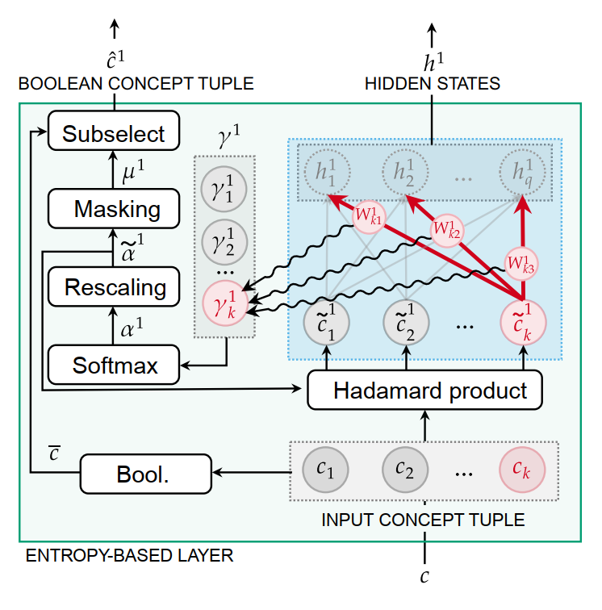

Slide 8

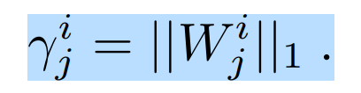
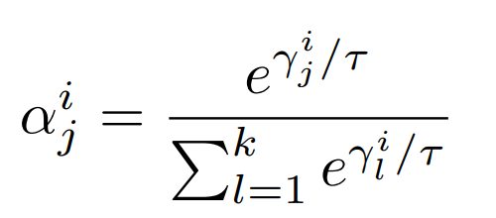
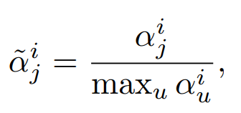


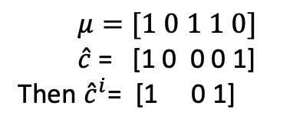
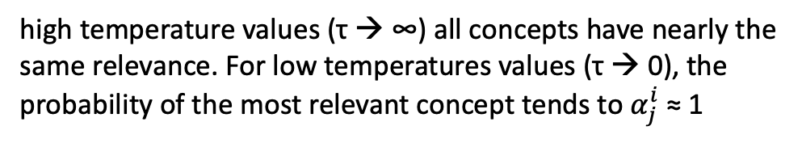
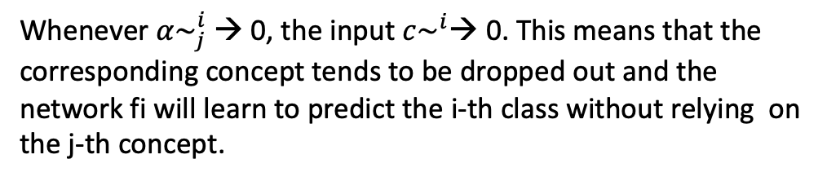
Importance of each concept
﻿The higher $γ_{j}^{i}$, the higher the relevance of the concept j for the network $f_{i}$.
Relative importance of each concept
﻿high temperature values (τ → ∞) all concepts have nearly the same relevance. For low temperatures values (τ → 0), the probability of the most relevant concept tends to $α_{j}^{i}$≈ 1
Normalize the RI
Update the weights
﻿Whenever $α\sim _{j}^{i}$ → 0, the input $c\sim ^{i}$→ 0. This means that the corresponding concept tends to be dropped out and the network fi will learn to predict the i-th class without relying on the j-th concept.
$μ=[1 0 1 1 0]$
$\hat{c}$ = [1 0 0 0 1]
Then ${\hat{c}}^{i}$= [1 0 1]
﻿contains m Boolean features, with m < k

Slide 9
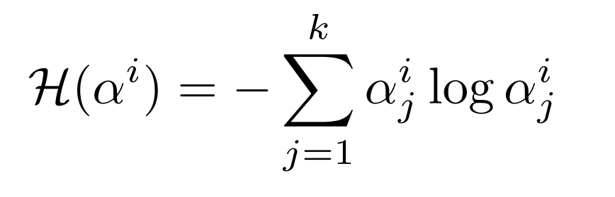
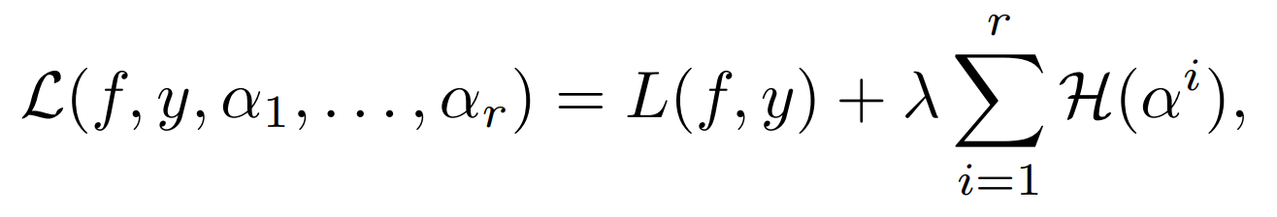
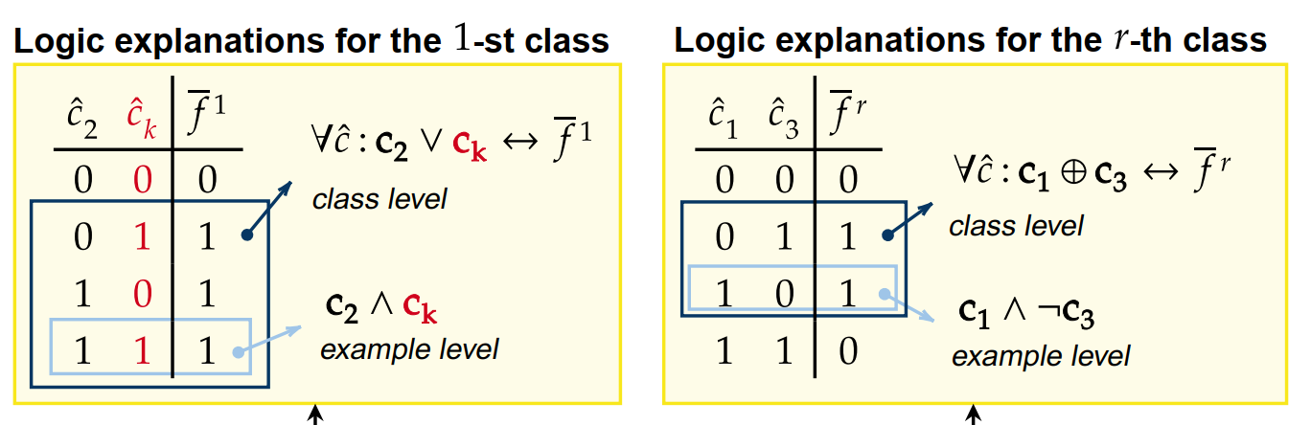
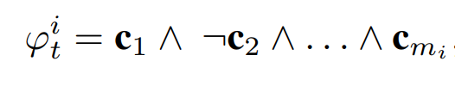

Loss function
﻿minimized when a single $α_{j}^{i}$ is one
optimize
Lowers the number of concepts in the explanation
Accuracy loss of the classifier (entropy based)
Truth table-based explanation

Slide 10
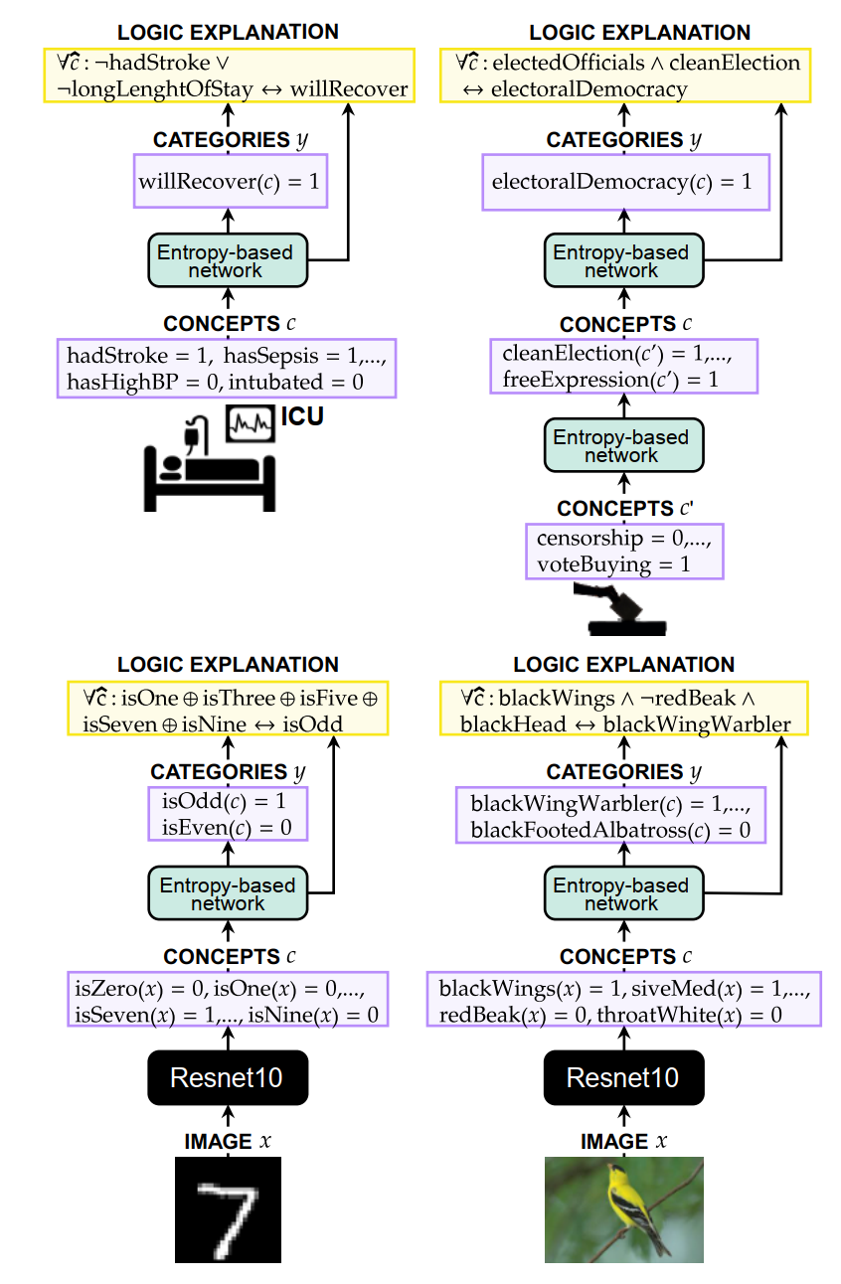
Experiment
Datasets
﻿Will we recover from ICU? (MIMIC-II)
﻿What kind of democracy are we living in? (V-Dem)
﻿What does parity mean? (MNIST Even/Odd)
﻿What kind of bird is that? (CUB)

Slide 11
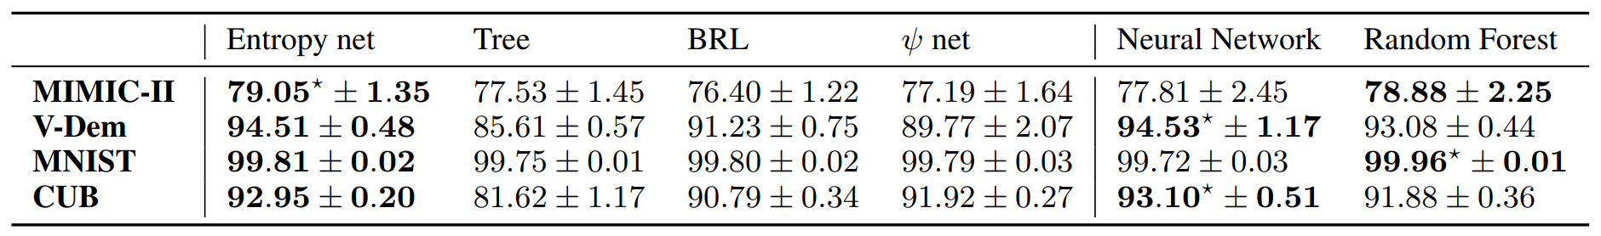
Experiment
Metrics
﻿(i) The MODEL ACCURACY measures how well the explainer identifies the target classes on unseen data
﻿(ii) The EXPLANATION ACCURACY measures how well the extracted logic formulas identifies the target classes
﻿(iii) The COMPLEXITY OF AN EXPLANATION is computed by standardizing the explanations in DNF and then by counting the number of terms of the standardized formula
﻿(iv) The FIDELITY OF AN EXPLANATION measures how well the extracted explanation matches the predictions obtained using the explainer
﻿(v) The RULE EXTRACTION TIME measures the time required to obtain an explanation from scratch
﻿(vi) The CONSISTENCY OF AN EXPLANATION measures the average similarity of the extracted explanations over the 5-fold cross validation runs
MODEL ACCURACY

Slide 12
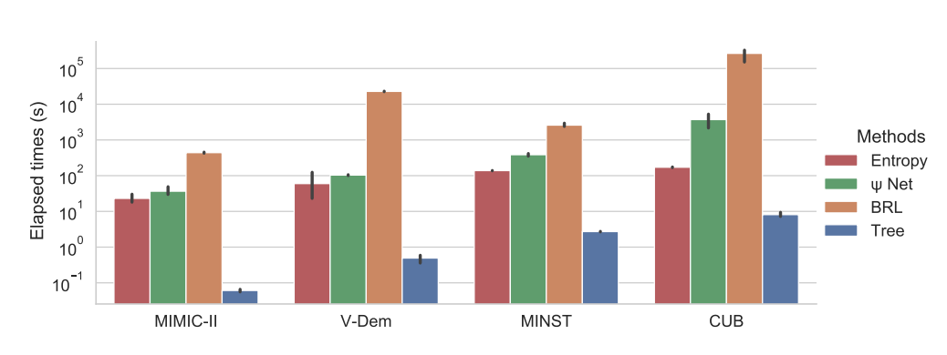
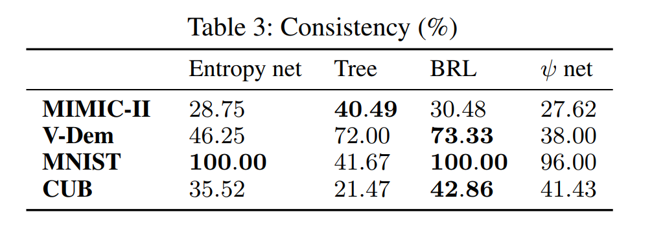
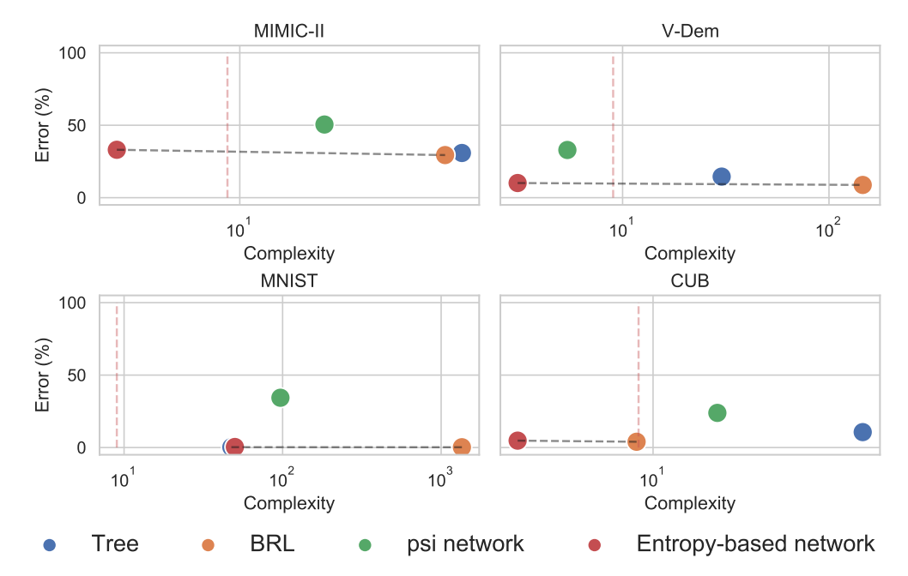
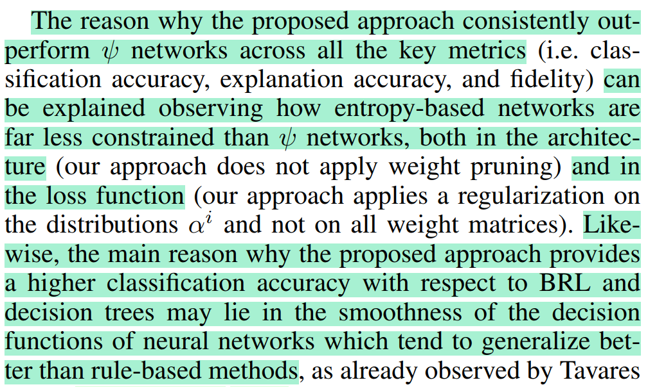
Results
TIME
CONSISTENCY
COMPLEXITY

