Slide 1
﻿CounterNet: End-to-End Training of Prediction Aware Counterfactual Explanations
ACM KDD 2023

Slide 2
Intro to counterfactual explanation
Counterfactual explanation explains a model by offering a hypothetical sample x’ that is very close to an original sample x, but belongs to a different class

Slide 3

Motivation
Most counterfactual explanation (CF) generation techniques are post-hoc
The process of generating CFs is uninformed by the training of the predictive model – leads to misalignment between the prediction and explanations, CF generator does not know the decision boundary
Most CF generation techniques are time intensive – negatively impacts the runtime
Additional algorithms to generate CFs—
Non-parametric
Parametric/generative model
model agnostic
predictive
model

Slide 4
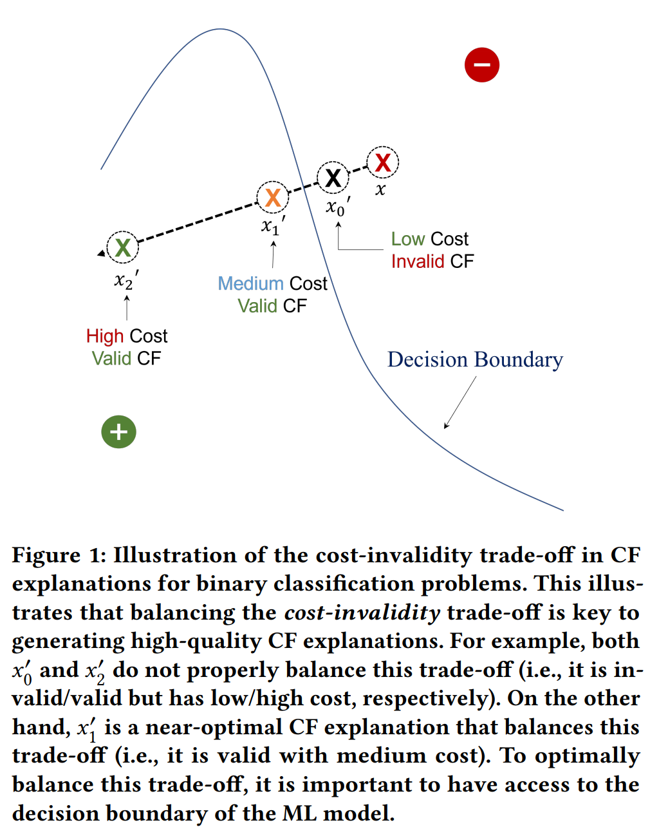
Motivation

Slide 5
Contribution
CounterNet is an end-to-end learning framework – integrates model training and CF generation into a single pipeline, ensures better cost-invalidity tradeoff
A feedback system – creates valid CFs
A block-wise coordinate descent process – improve the convergence
﻿CounterNet generates CF explanations with ∼100% validity and low cost of change (∼9.8% improvement to baselines) at 3x speed
Train together
predictive
model
CF generator

Slide 6
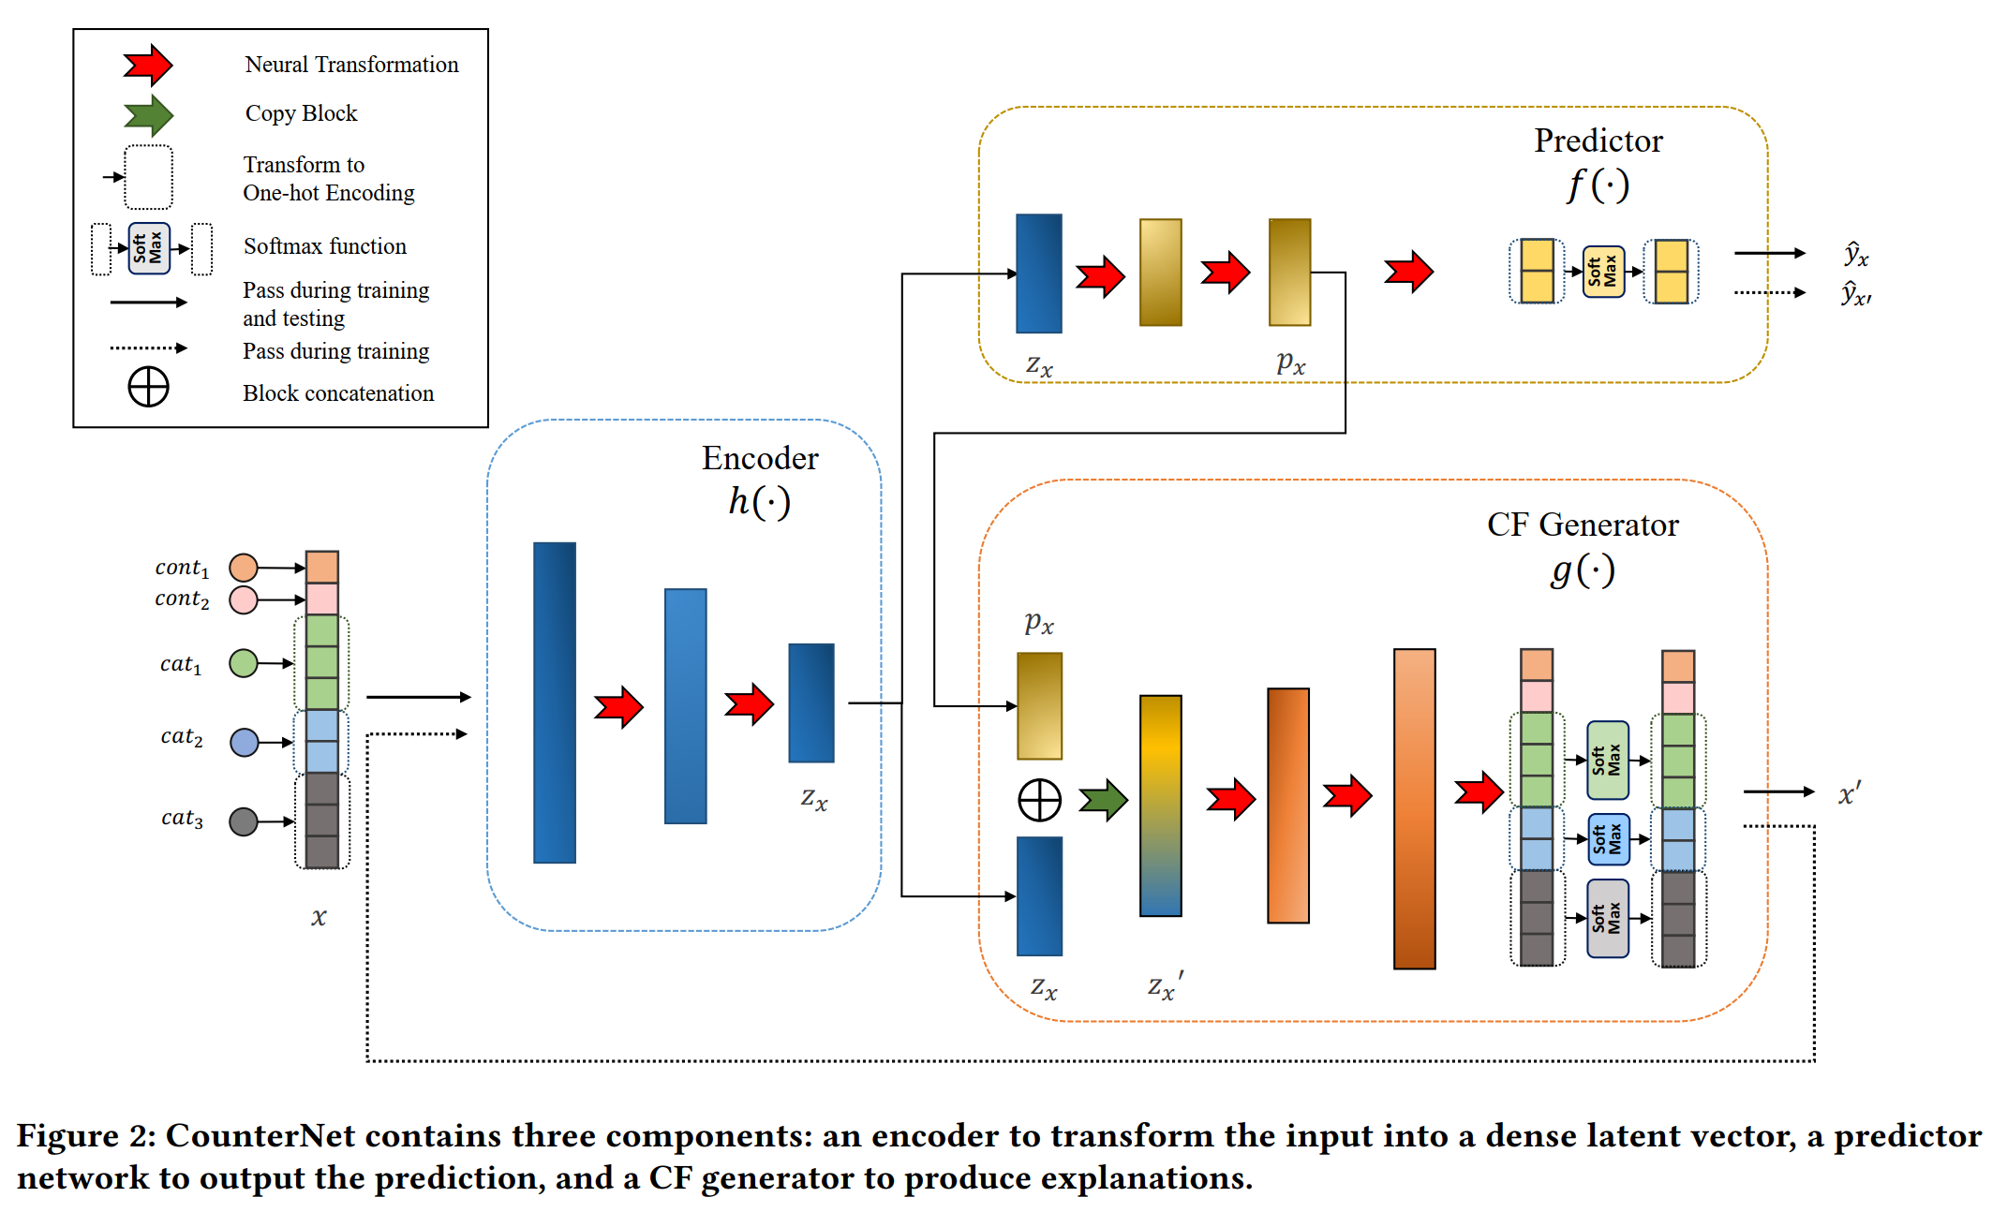
Proposed architecture
Kept during training, removed during testing
One-hot encoded
Categorical features
﻿to ensure input 𝑥 and CF example 𝑥′ are opposite

Slide 7
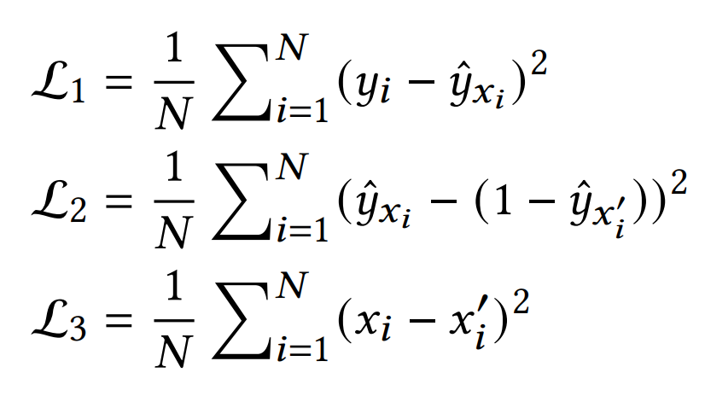
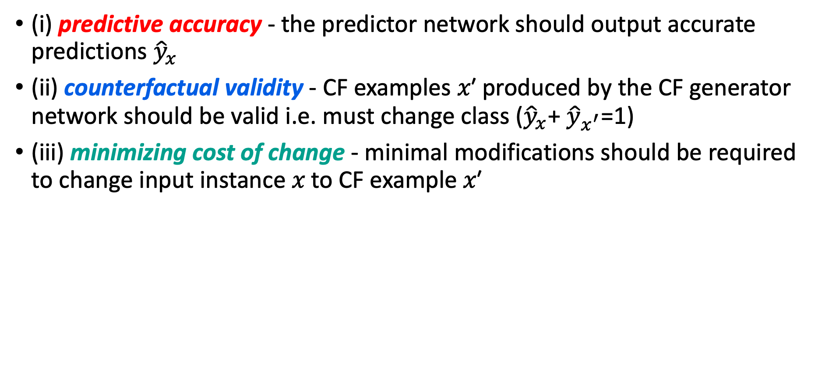
Optimization
﻿(i) predictive accuracy - the predictor network should output ﻿accurate predictions ${\hat{y}}_{x}$
﻿(ii) counterfactual validity - CF examples 𝑥′ produced by the CF generator network should be valid i.e. must change class (${\hat{y}}_{x}$+ ${\hat{y}}_{x^{′}}$=1)
﻿(iii) minimizing cost of change - minimal modifications should be required to change input instance 𝑥 to CF example 𝑥′
﻿MSE loss-based training seems to be less sensitive to randomness in initialization, more robust to noise, and less prone to overfitting on a wide variety of learning tasks (as compared to cross-entropy loss).

Slide 8
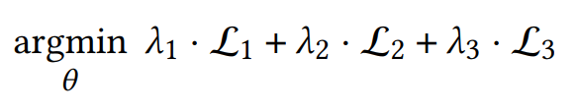
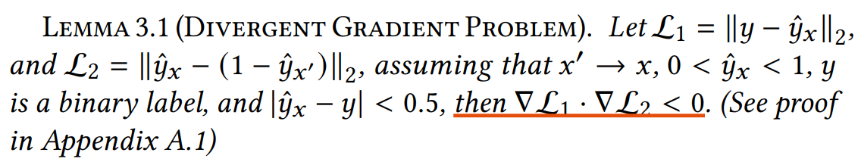
Optimization
﻿conventional way of solving the optimization problem is using gradient descent with backpropagation
Leads to 2 issues
﻿poor convergence in training
﻿proneness to adversarial examples
﻿gradient across all three loss objectives fluctuates drastically, which leads to poor convergence
﻿optimizing ℒ₂ with respect to the predictive weights 𝜃_{𝑓} decreases the robustness of the predictor 𝑓 (·), which leads to an increased vulnerability to adversarial examples

Slide 9


Optimization
﻿conventional way of solving the optimization problem is using gradient descent with backpropagation
Leads to 2 issues
﻿poor convergence in training
﻿proneness to adversarial examples
﻿propose a block-wise coordinate descent procedure
﻿(i) optimizing predictive accuracy (ℒ₁) , (ii)﻿ optimizing the validity and proximity of CF generation (ℒ₂ and ℒ₃)
﻿for each minibatch of 𝑚 data points {𝑥^{(𝑖)},𝑦^{(𝑖)}}^{𝑚}, we apply two gradient updates to the network through backpropagation.

Slide 10
Experiment
Comparison
CounterNet is compared against eight state-of-the-art CF explanation methods
﻿VanillaCF
﻿DiverseCF, ProtoCF, and UncertainCF
﻿VAE-CF, CounteRGAN, C-CHVAE, and VCNet
﻿non-parametric post-hoc method, generates CF examples by optimizing CF validity and proximity
﻿non-parametric methods, optimize for diversity, consistency ﻿and uncertainty
﻿parametric methods, use generative models (i.e., VAE or GAN) to generate CF examples
﻿post-hoc methods require a trained predictive model as input. For fair comparison, only encoder and the predictor have been optimized for L₁ loss (improve accuracy)

Slide 11
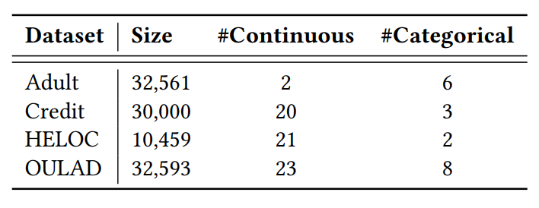
Experiment
Datasets
CounterNet extensively tested using 4 datasets.
﻿Adult
﻿Credit
HELOC
OULAD
﻿predict whether an individual’s income
reaches $50K (Y=1) or not (Y=0) using demographic data
﻿uses historical payments to predict the default of payment (Y=1) or not (Y=0)
﻿predicts if a homeowner qualifies for a line of
credit (Y=1) or not (Y=0)
﻿predicts whether MOOC students drop out
(Y=1) or not (Y=0), based on their online learning logs

Slide 12
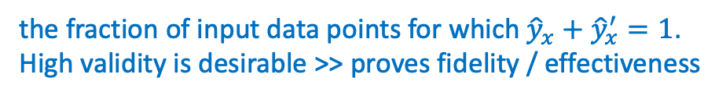
Experiment
Evaluation Metrics
5 evaluation metrics have been used to validate the performance.
﻿﻿Validity
﻿﻿Proximity
Sparsity
Manifold distance
Runtime
the fraction of input data points for which ${\hat{y}}_{x}+$ ${\hat{y}}_{x}^{′}=1$.
High validity is desirable >> proves fidelity / effectiveness
﻿defined as the 𝐿₁ norm distance between 𝑥 and 𝑥′ divided by the number of features. Low score better.
﻿measures the number of feature changes (i.e., 𝐿₀ norm) between 𝑥 and 𝑥′
Cost
﻿𝐿₁ distance to the 𝑘-nearest neighbor of 𝑥′ (𝑘 = 1). Low manifold distance is desirable as closeness to the training data
manifold indicates realistic CF explanations
Time to generate CF examples, not training time

Slide 13
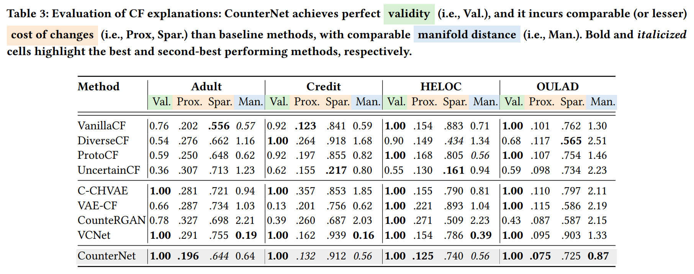
Results
Comparison of validity, proximity, sparsity, manifold distance

Slide 14
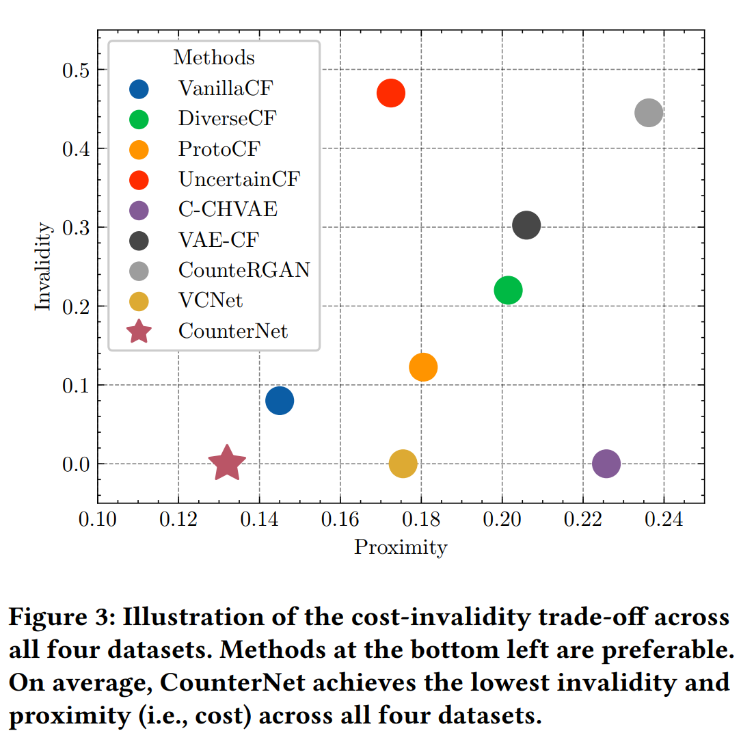
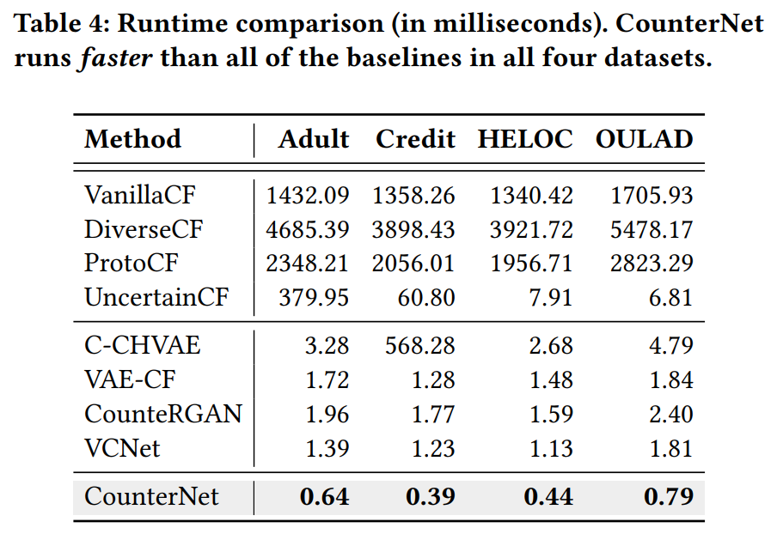
Results
Cost-invalidity tradeoff
Runtime (inference time only) comparison
Average of all 1- % of invalid CFs

Slide 15
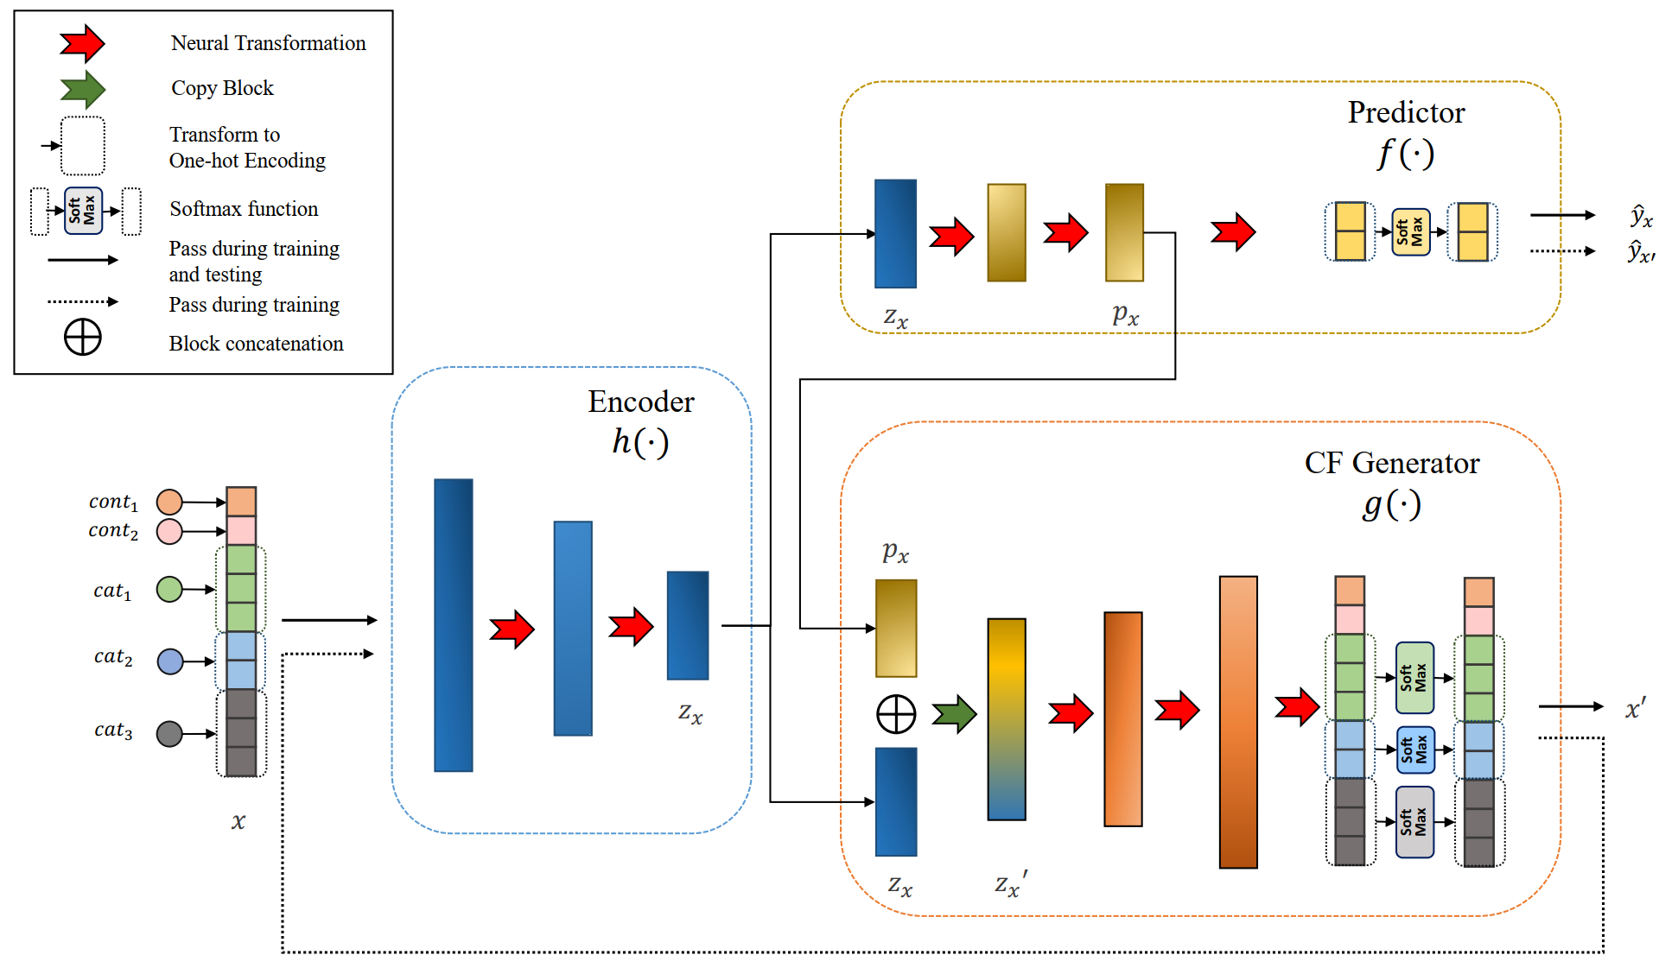
Additional Results
5 ablation studies:
CounterNet-BCE: ﻿replacing the MSE based L₁ and L₂ loss ﻿with binary cross entropy loss
CounterNet-SingleBP: no block wise backpropagation
CounterNet-Separate: ﻿a separate predictor 𝑓 : X → Y and CF generator 𝑔 : X → X′, such that 𝑓 and 𝑔 share no identical components
﻿CounterNet-NoPass-𝑝_{𝑥} : ﻿excluding passing 𝑝_{𝑥}
﻿CounterNet-Posthoc: ﻿ train the predictor on the entire training dataset, and optimize CF generator while the trained predictor is frozen.

Slide 16
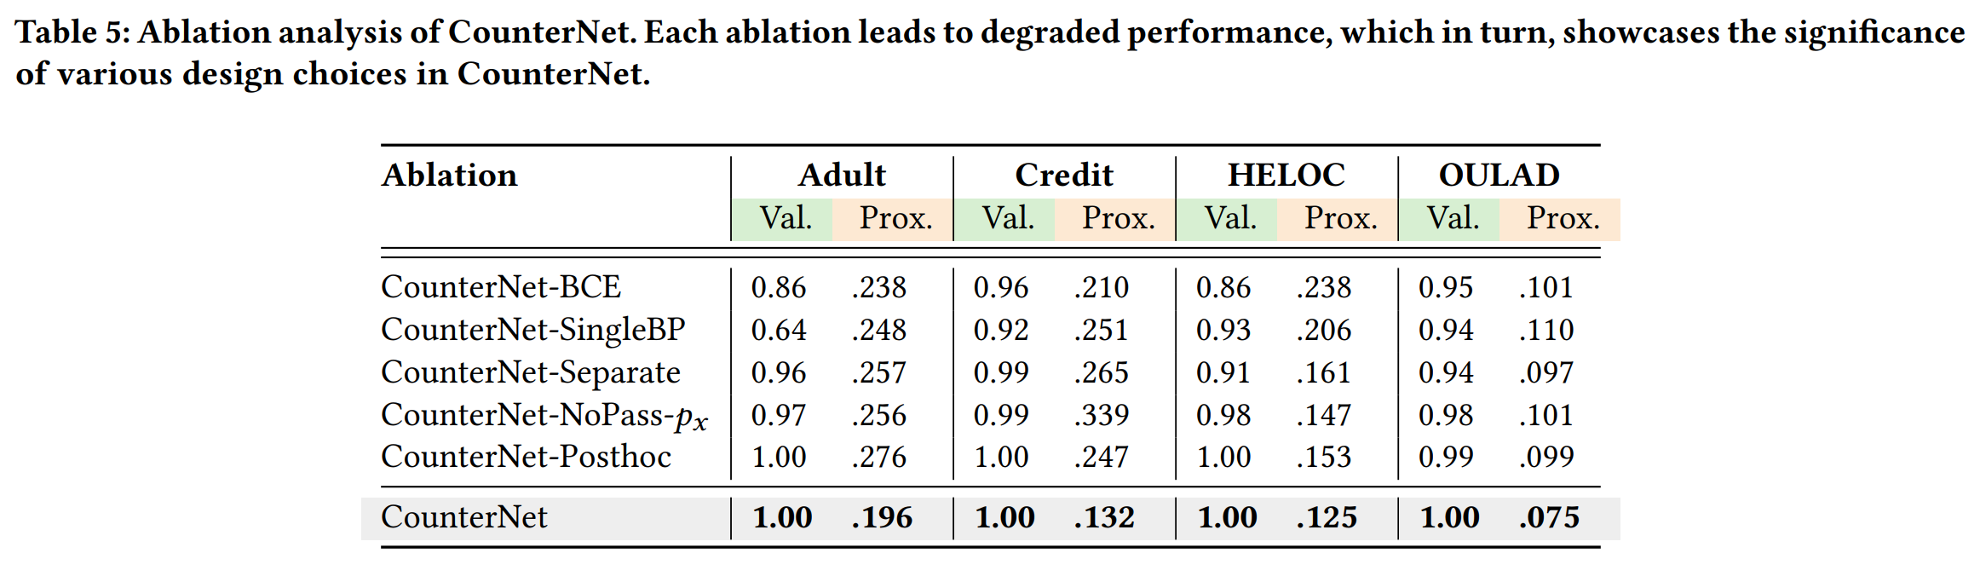
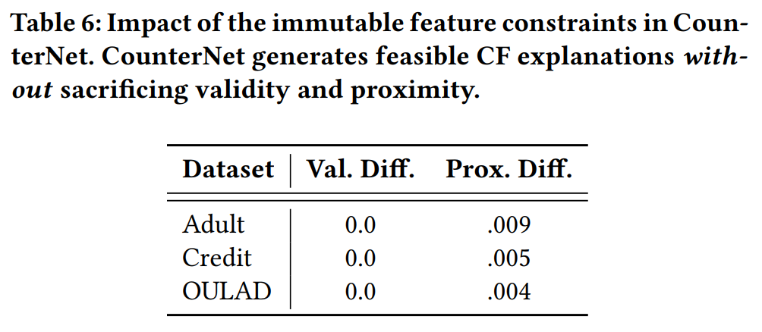
Additional Results

Slide 17
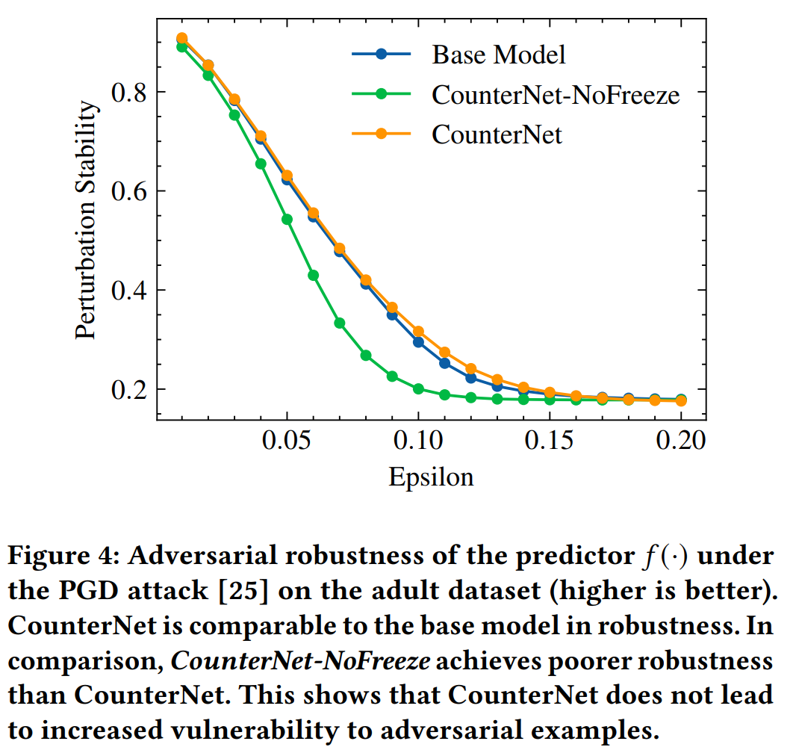
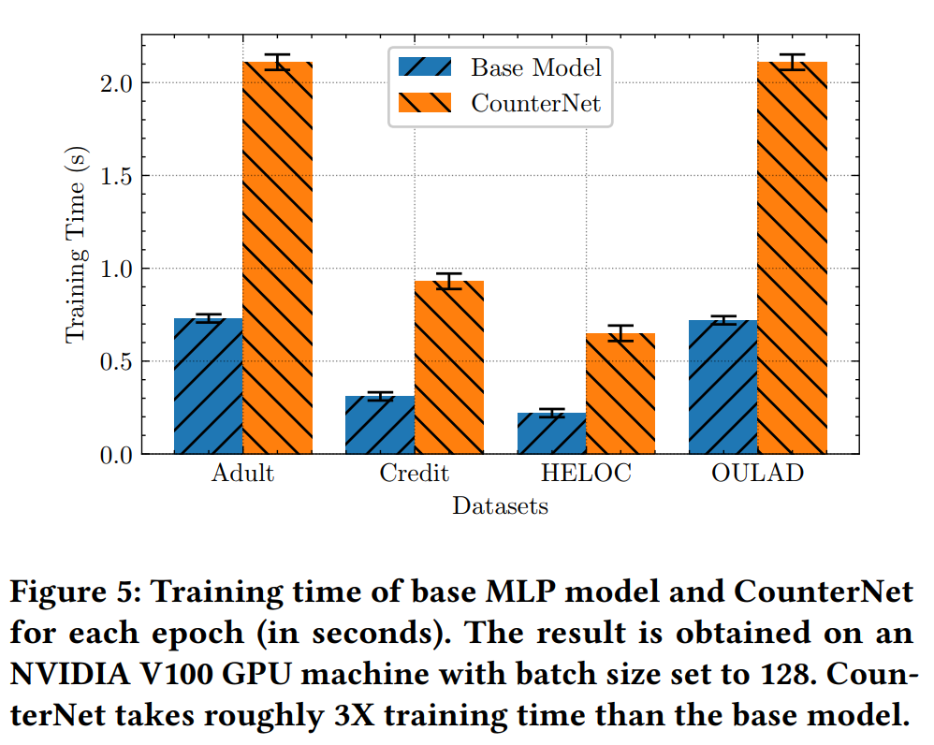
Additional Results
more ablation studies:
﻿CounterNet-NoFreeze: ﻿﻿without freezing the predictor at the second stage of the optimization
Base model: Just a predictor

