Slide 1
An Introduction to Propensity Score Methods for Reducing the Effects of Confounding in Observational Studies
Peter C. Austin
Institute for Clinical Evaluative Sciences
Department of Health Management, Policy and Evaluation,
University of Toronto

Slide 2
Overview
potential outcomes framework
causal treatment effects
Randomized Control Trials (RCTs)
Observational Studies
Propensity score
Methods of applying propensity scores

Slide 3
Potential Outcome Framework and
Average Treatment Effects
Two possible treatments
Active Treatment (T=1) and Control Treatment (T=0)
Pair of potential outcomes
Y_{i} (0) and Y_{i} (1)
Actual Observed Outcome
Y_{i} = T_{i} Y_{i} (1) + (1 - T_{i}) Y_{i} (0)
Treatment Effect for each patient
Y_{i}(1) - Y_{i}(0)
Average Treatment Effect (ATE)
E[Y_{i} (1) – Y_{i} (0)]

Slide 4
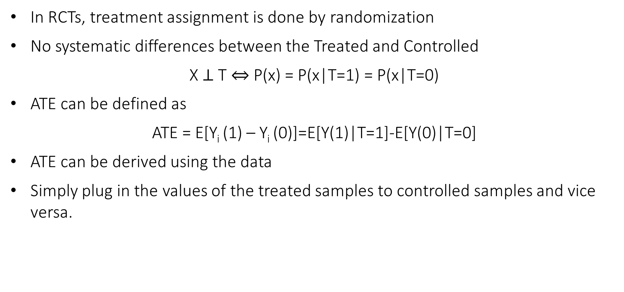
RCTs vs Observational Studies
In RCTs, treatment assignment is done by randomization
No systematic differences between the Treated and Controlled
X $⊥$ T $⇔$ P(x) = P(x|T=1) = P(x|T=0)
ATE can be defined as
ATE = E[Y_{i} (1) – Y_{i} (0)]=E[Y(1)|T=1]-E[Y(0)|T=0]
ATE can be derived using the data
Simply plug in the values of the treated samples to controlled samples and vice versa.

Slide 5
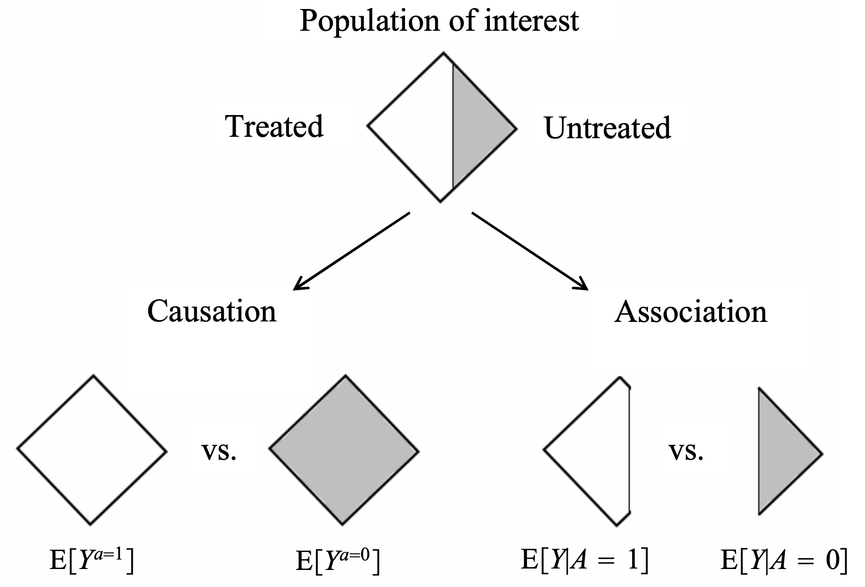
RCTs vs Observational Studies (Cont.)
In observational studies, we do not use randomization to allocate units to treatment and control groups
Systematic differences between the Treated and Controlled
P(x) ≠P(x|T=1) ≠ P(x|T=0)
And also for ATE we have
ATE = E[Y_{i} (1) – Y_{i} (0)] ≠ E[Y(1)|T=1] - E[Y(0)|T=0]
Deriving the ATE from the data is impossible
without making a lot of assumptions

Slide 6
Most Common Assumptions
No unmeasured confounders: treatment assignment (T) is independent of the potential outcomes (Y(0) and Y(1)) conditional on the observed baseline covariates (X).
(Y(1), Y(0)) ⫫ T | X
Common support: every subject has a nonzero probability to receive either treatment
0 < P(T=1|X) < 1

Slide 7
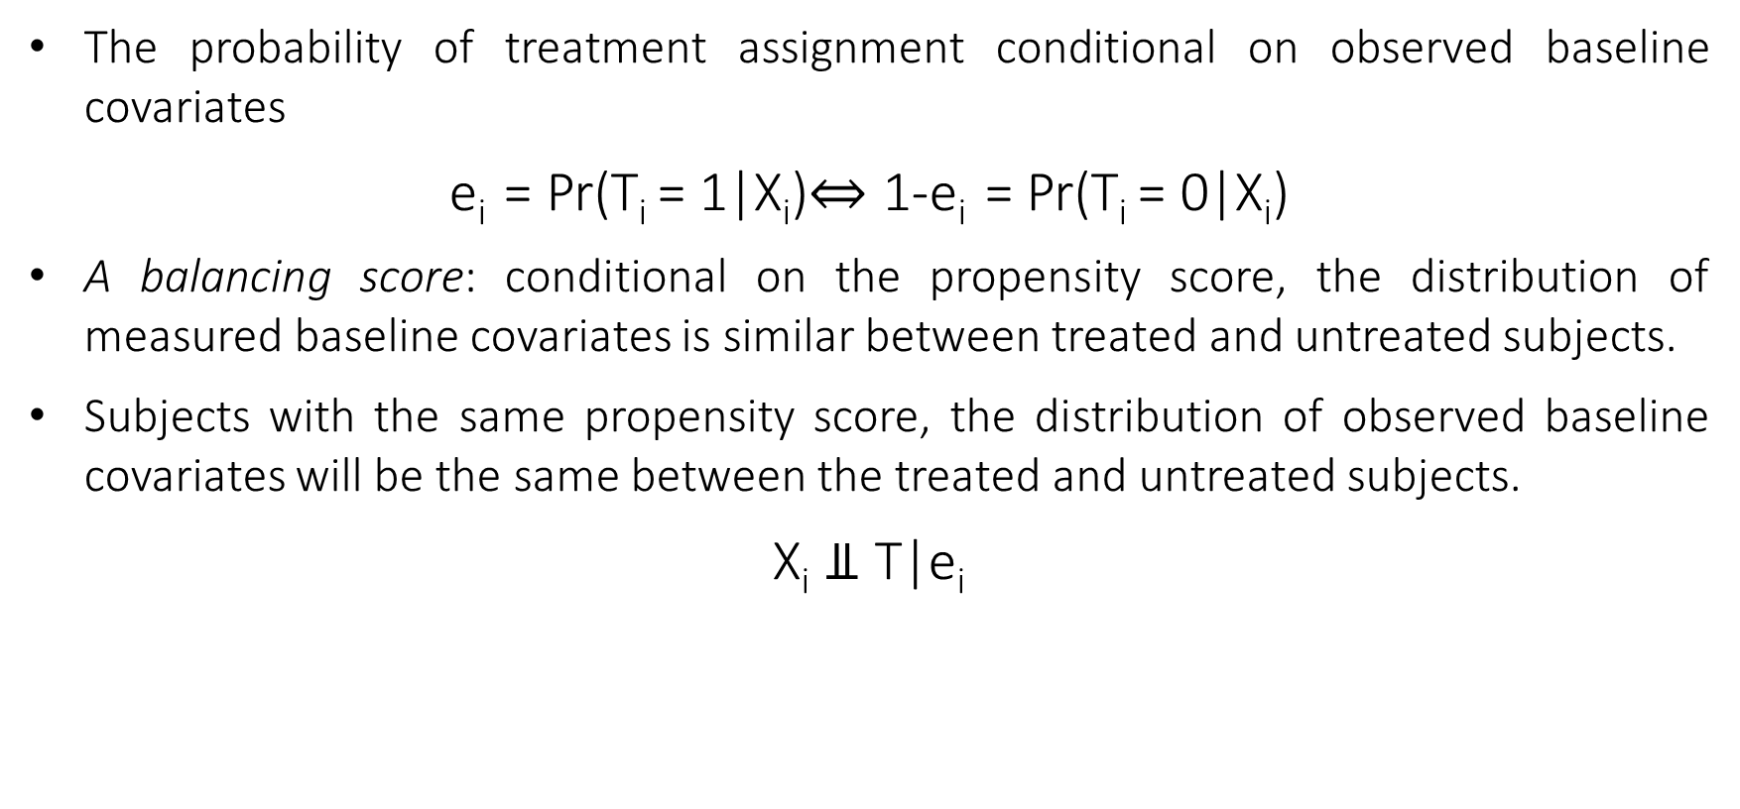
Propensity Score
The probability of treatment assignment conditional on observed baseline covariates
e_{i} = Pr(T_{i} = 1|X_{i})$⇔$ 1-e_{i} = Pr(T_{i} = 0|X_{i})
A balancing score: conditional on the propensity score, the distribution of measured baseline covariates is similar between treated and untreated subjects.
Subjects with the same propensity score, the distribution of observed baseline covariates will be the same between the treated and untreated subjects.
X_{i} ⫫ T|e_{i}

Slide 8
Propensity Score Based Methods
Methods of using propensity score to evaluate the Average Treatment Effect (ATE)
We will discuss three methods:
Propensity Score Matching
Inverse Probability of Treatment Weighting Using the Propensity Score
All of these methods assume that both of the assumptions hold:
(Y(1), Y(0)) ⫫ T | X
0 < P(T=1|X) < 1

Slide 9
Propensity Score Matching
Forming matched sets of treated and untreated subjects who share a similar value of the propensity score.
Most common way: one-to-one or pair matching, in which pairs of treated and untreated subjects are formed, such that matched subjects have similar values of the propensity score.
Once a matched sample has been formed, the treatment effect can be estimated by directly comparing outcomes between treated and untreated subjects in the matched sample
ATE is the difference between the mean outcome for treated subjects and the mean outcome for untreated subjects in the matched sample.

Slide 10
Propensity Score Matching (Cont.)
Matching with/without replacement:
matching without replacement: Each untreated subject is included in at most one matched set.
matching with replacement: A given untreated subject can be included in more than one matched set.
Greedy/Optimal matching:
Greedy matching: the nearest untreated subject is selected for matching to the given treated subject.
Optimal matching: matches are formed so as to minimize the total within-pair difference of the propensity score.

Slide 11
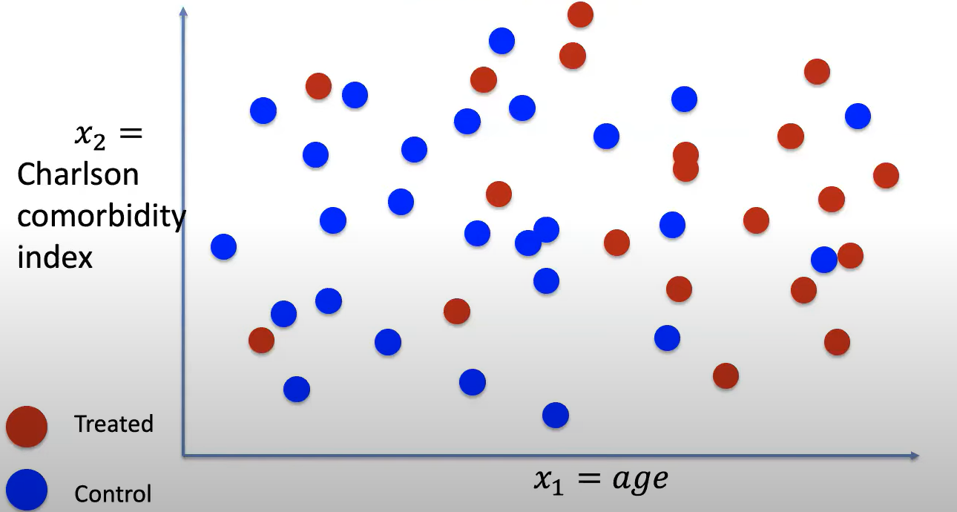
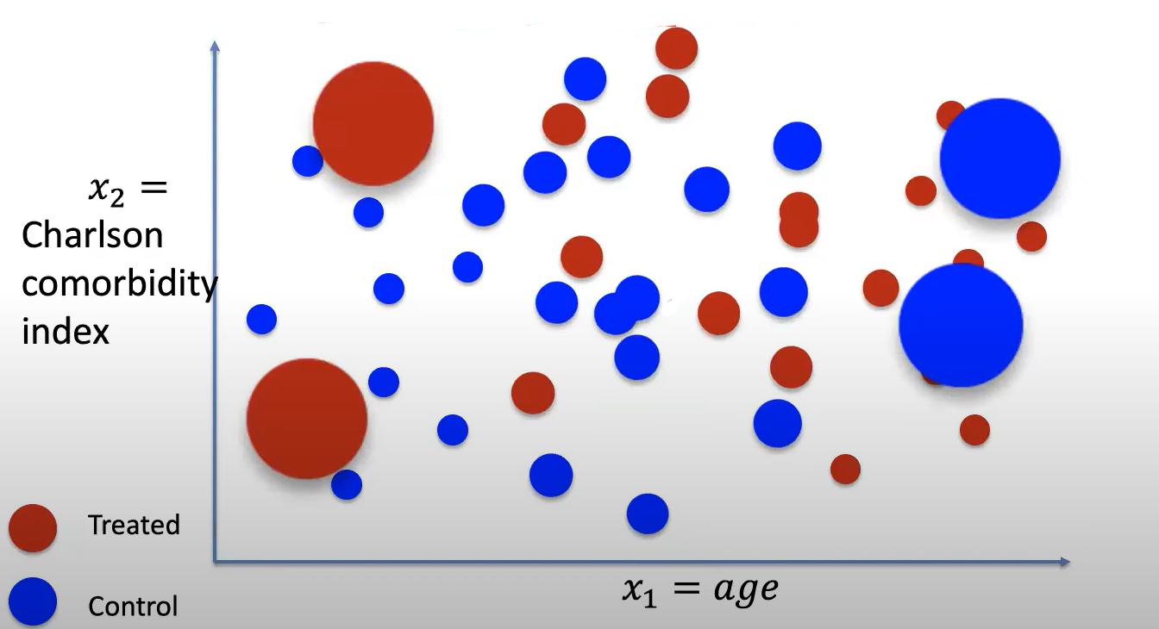
Inverse Probability of Treatment Weighting Using the Propensity Score
Uses weights based on the propensity score to create a synthetic sample in which the distribution of measured baseline covariates is independent of treatment assignment.

Slide 12
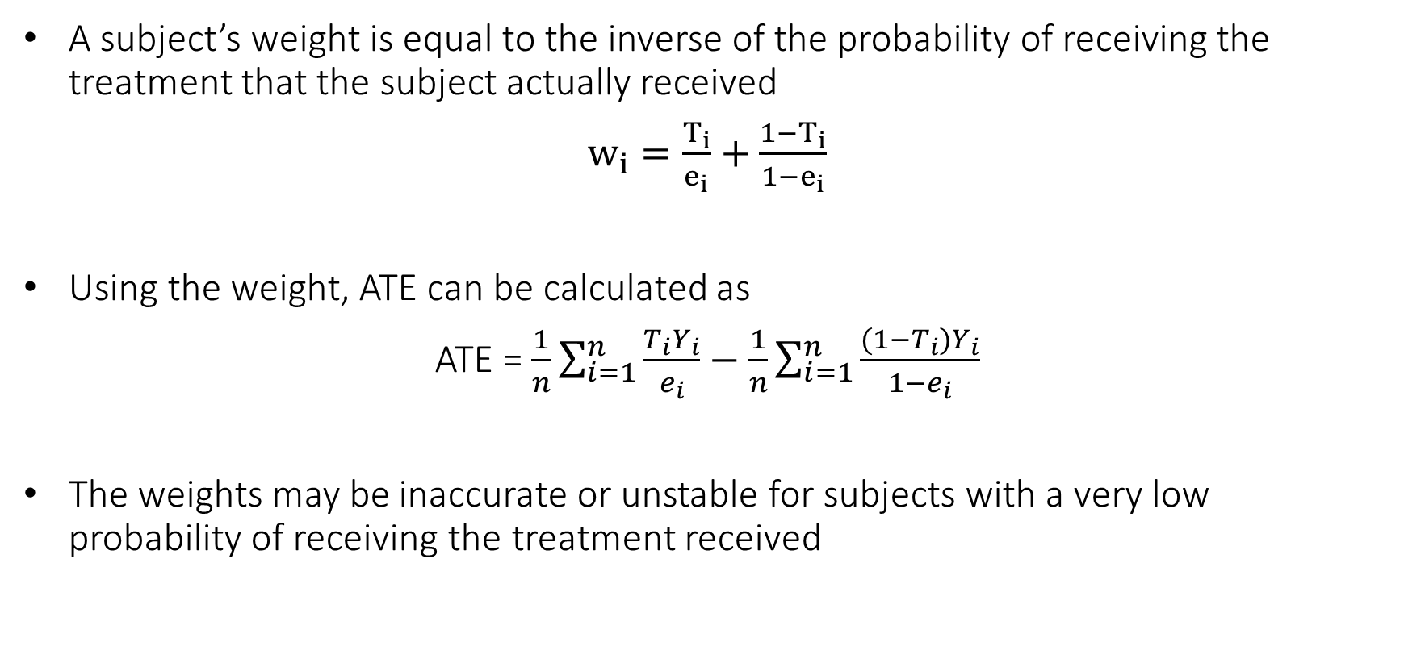
Inverse Probability of Treatment Weighting Using the Propensity Score
A subject’s weight is equal to the inverse of the probability of receiving the treatment that the subject actually received
$w_{i}=\frac{T_{i}}{e_{i}}+\frac{1−T_{i}}{1−e_{i}}$
Using the weight, ATE can be calculated as
ATE = $\frac{1}{n}\sum_{i=1}^{n}{\frac{T_{i}Y_{i}}{e_{i}}}−\frac{1}{n}\sum_{i=1}^{n}{\frac{(1−T_{i})Y_{i}}{{1−e}_{i}}}$
The weights may be inaccurate or unstable for subjects with a very low probability of receiving the treatment received

