Slide 1
Rep-Net: Efficient On-Device Learning via Feature Reprogramming
CVPR 2022

Slide 2
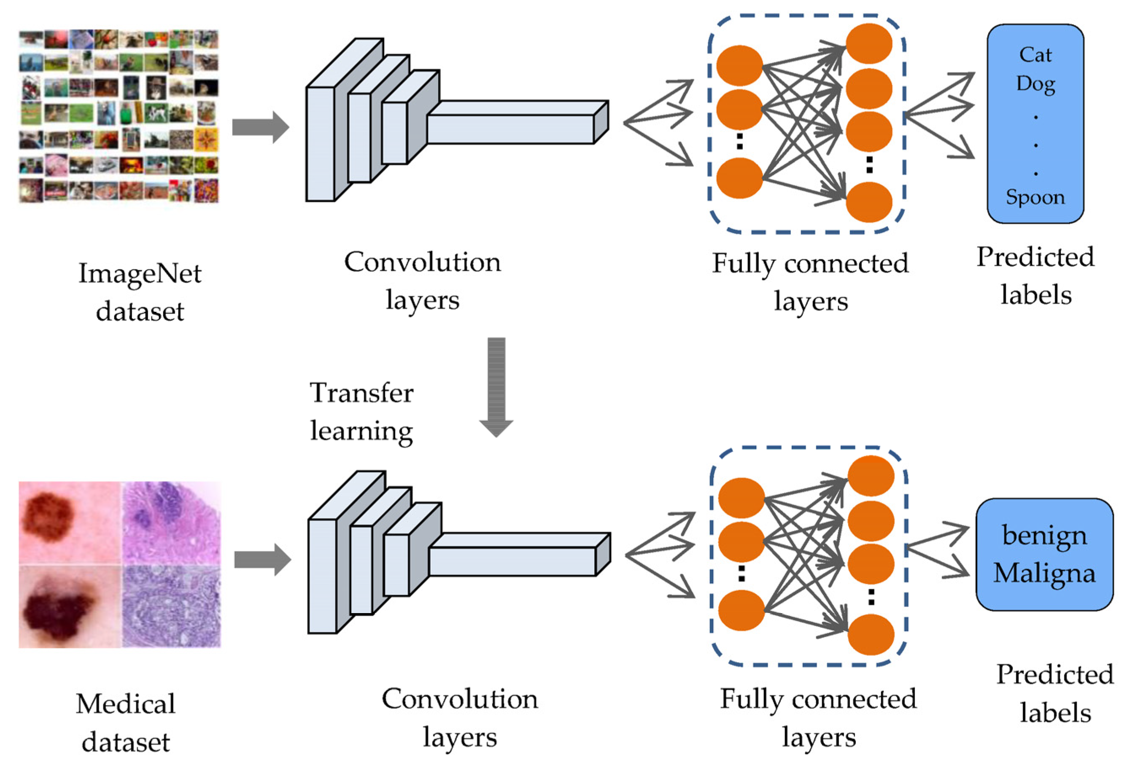
Background
Model implementation on-device –
Train the model on cloud, implement it on device
Communication between cloud and device
Privacy concern
Train model on-device
Training is memory hungry (Arduino Nano 256KB SRAM, 1MB Flash)
High activation storage
High memory overhead
Transfer learning
Limited transfer capacity
Performance declines

Slide 3
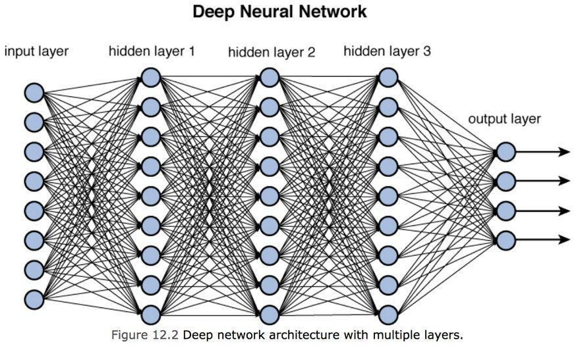

Why can’t we train the model on-device?
Major bottleneck is the High activation storage
Reducing number of parameters doesn’t work for deep models
Set the params
backpropagation

Slide 4
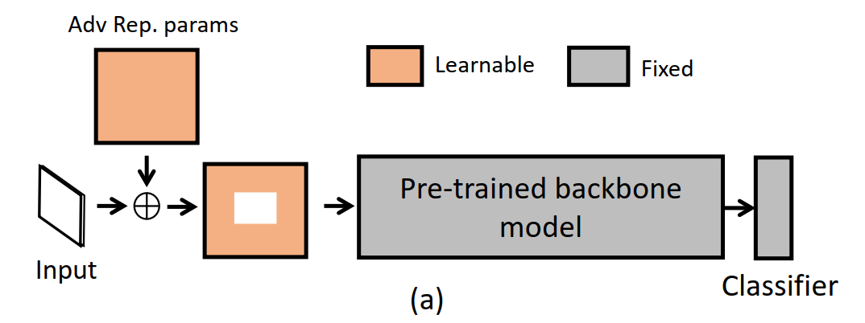
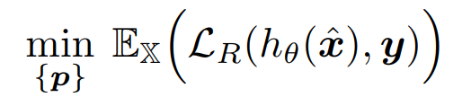
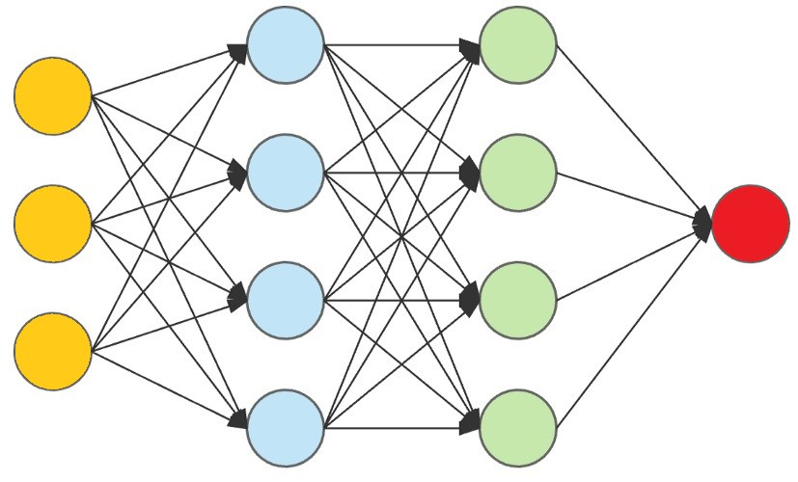

Alternatives?
Adversarial reprogramming
Drawbacks-
Limited learning capacity (sub par performance)
Will add k x k x c additional bias terms
Quite heavy for ImageNet (224x224x3=150k additional trainable parameters)
source
x (size- k x k x c)
target
P (size- k x k x c)
Train a single additive bias
$$x^{′}=x+p$$
Just changes the additive parameters

Slide 5
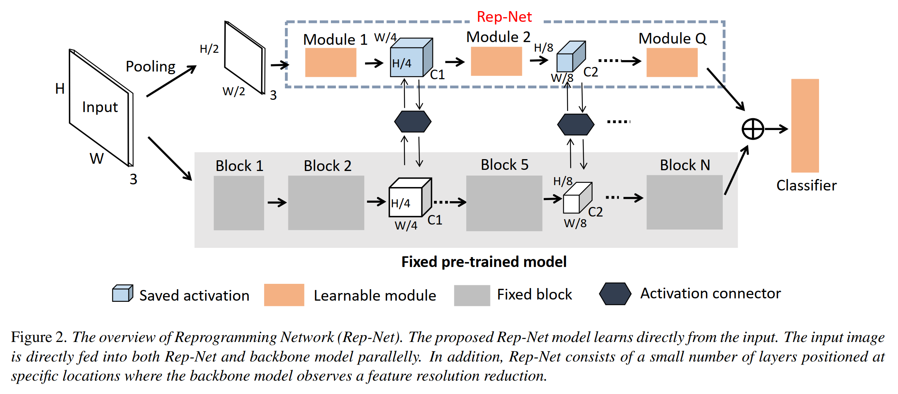
Solution
Lightweight NN model to be trained
﻿lightweight Reprogramming Network (Rep-Net)
interconnector
Backbone model
Shares same output layer

Slide 6
Solution?
﻿lightweight Reprogramming Network (Rep-Net)
Backbone remains frozen during training
Only Rep-Net is trained
Feature inter-exchange helps both models
Sets the positions of interconnectors using literature
Interconnectors designed to reduce activation storage

Slide 7

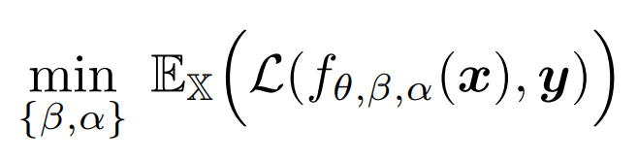
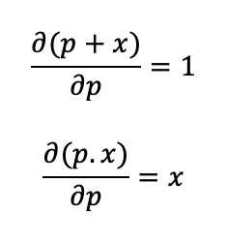
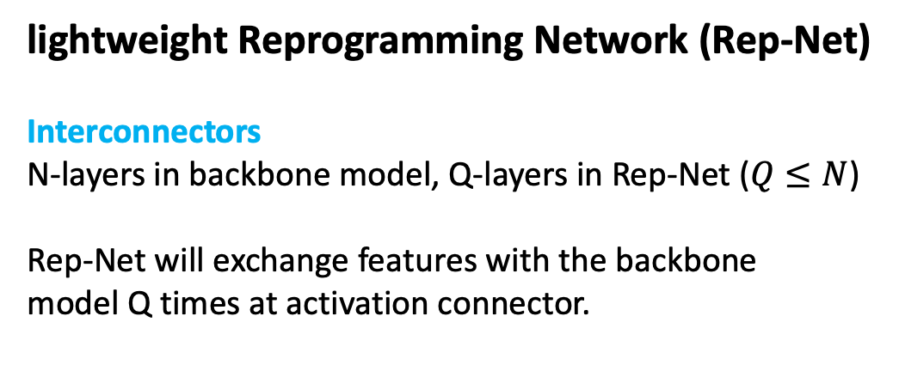
Solution?
﻿lightweight Reprogramming Network (Rep-Net)
Interconnectors
N-layers in backbone model, Q-layers in Rep-Net ($Q≤N$)
﻿Rep-Net will exchange features with the backbone
model Q times at activation connector.
Nothing to be stored
Needs to be stored

Slide 8
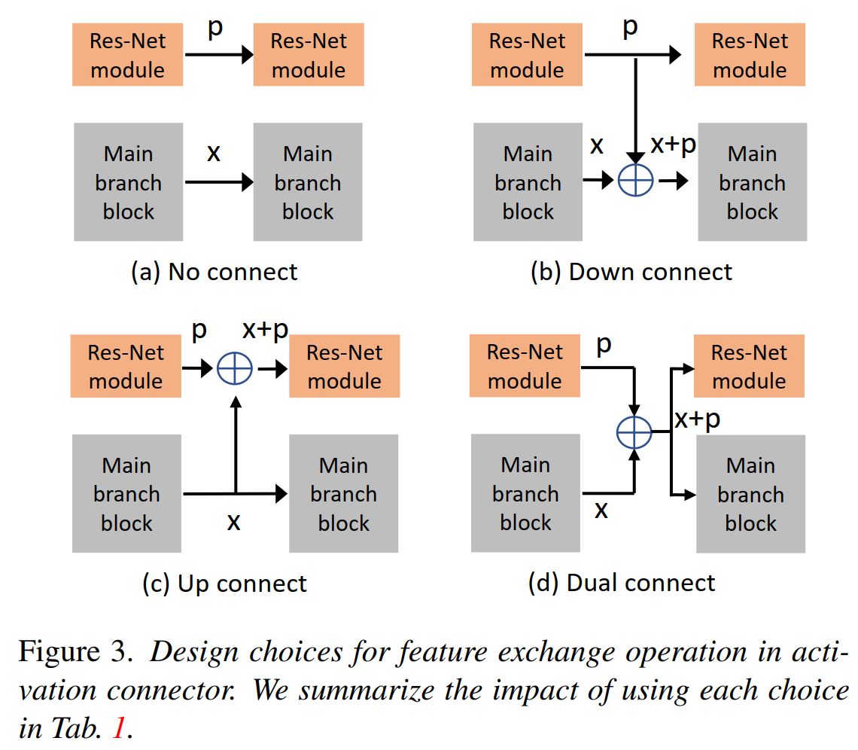
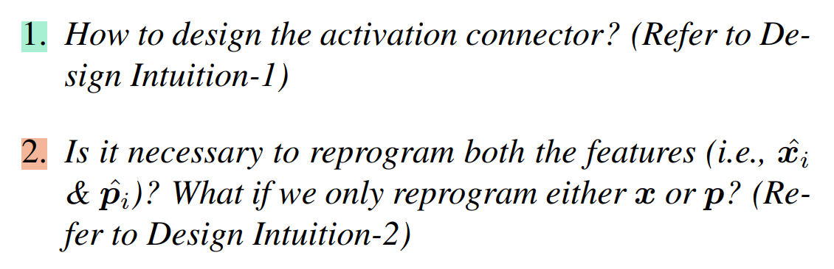
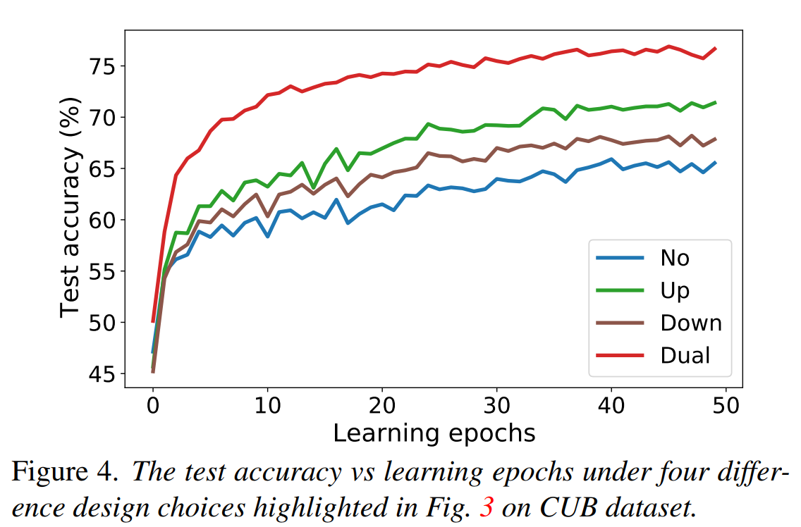
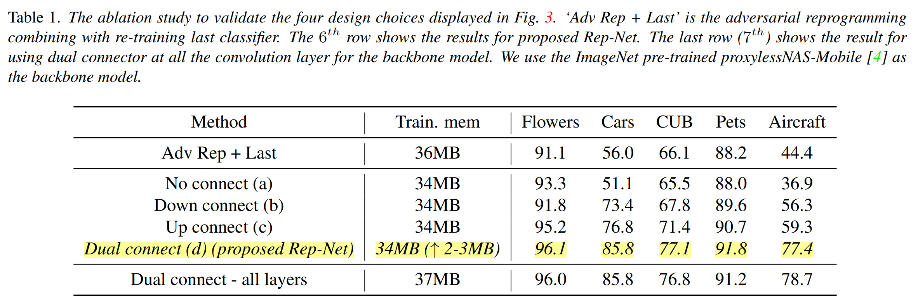
Solution?
﻿lightweight Reprogramming Network (Rep-Net)
Interconnectors

Slide 9
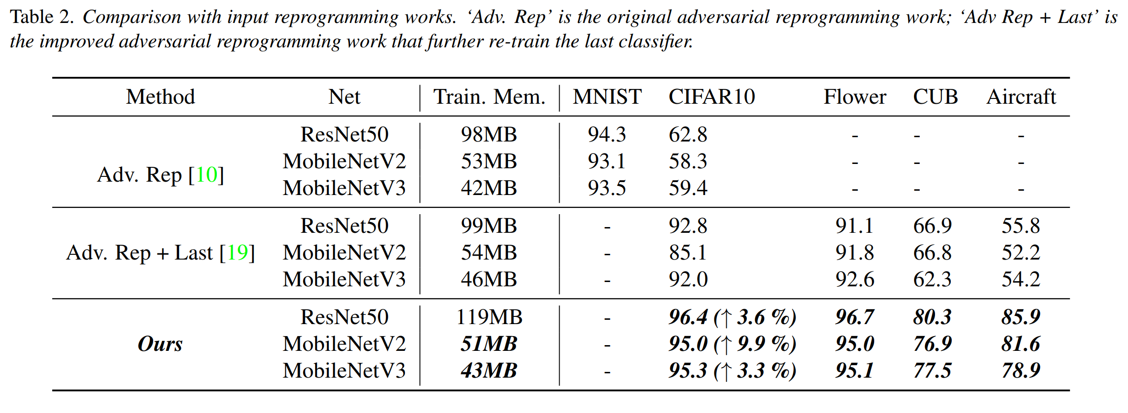
Results

Slide 10
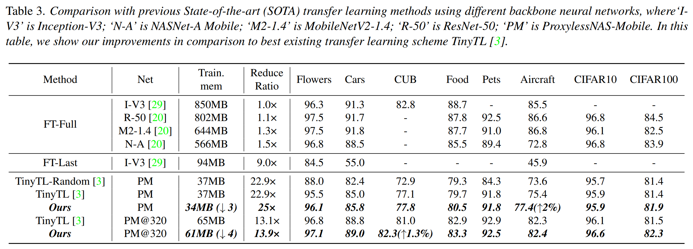
Results

