Slide 1
Contrastive learning based self-supervised time-series analysis
Johannes Pöppelbaum, Gavneet Singh Chadha, Andreas Schwung
South Westphalia University of Applied Sciences

Slide 2
Introduction
Self-supervised learning as a breakthrough in deep learning for unlabeled data.
Paper's focus: Enhancing time-series analysis using the SimCLR contrastive learning approach.
Paper’s Contributions:
SimCLR-TS, a new self-supervised learning based approach for industrial time-series analysis which uses data-augmentation techniques.
Multiple novel data-augmentation techniques for time-series analysis.
Thorough comparison on the effectiveness of both the proposed data augmentation techniques as well as the proposed contrastive learning framework.

Slide 3
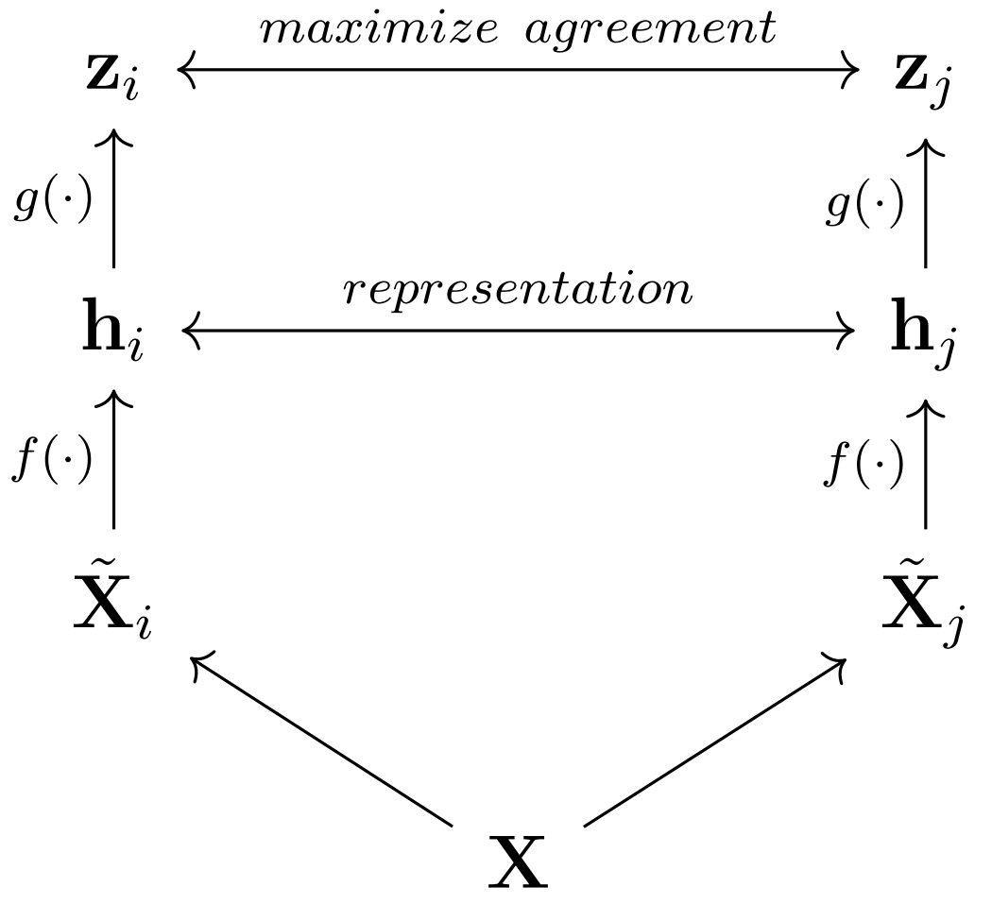
SimCLR
a framework for contrastive learning and intended for the usage in image classification

Slide 4
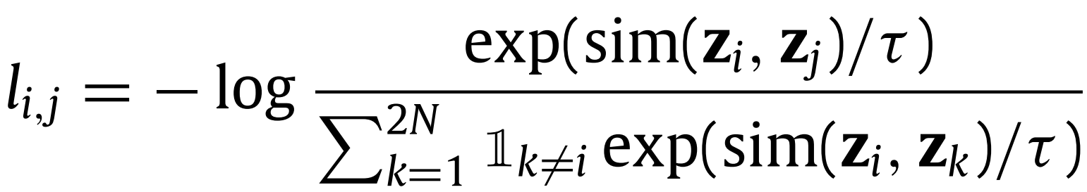
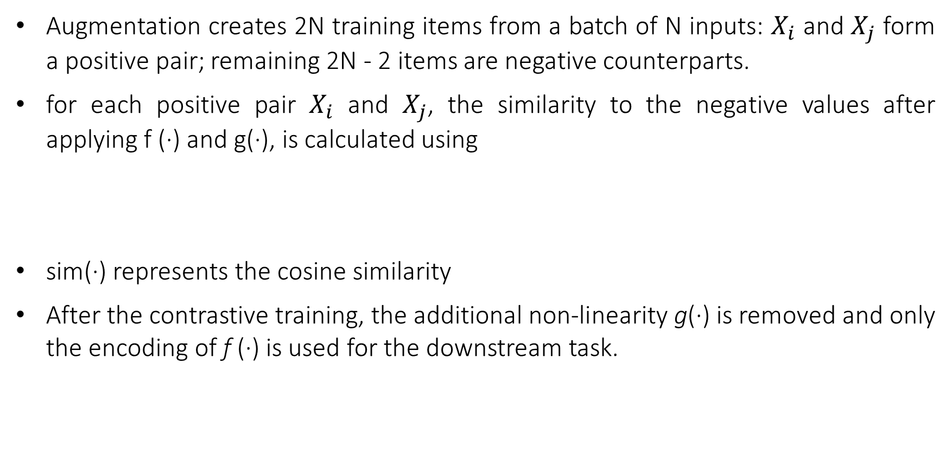
SimCLR
Augmentation creates 2N training items from a batch of N inputs: $X_{i}$ and $X_{j}$ form a positive pair; remaining 2N - 2 items are negative counterparts.
for each positive pair $X_{i}$ and $X_{j}$, the similarity to the negative values after applying f (·) and g(·), is calculated using
sim(·) represents the cosine similarity
After the contrastive training, the additional non-linearity g(·) is removed and only the encoding of f (·) is used for the downstream task.

Slide 5
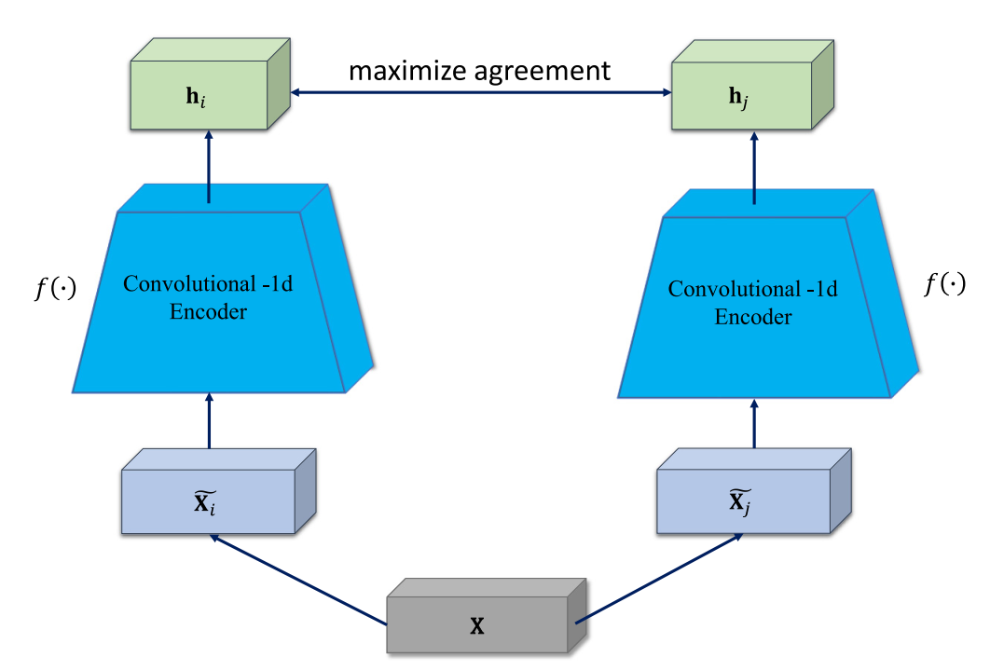
SimCLR-TS

Slide 6
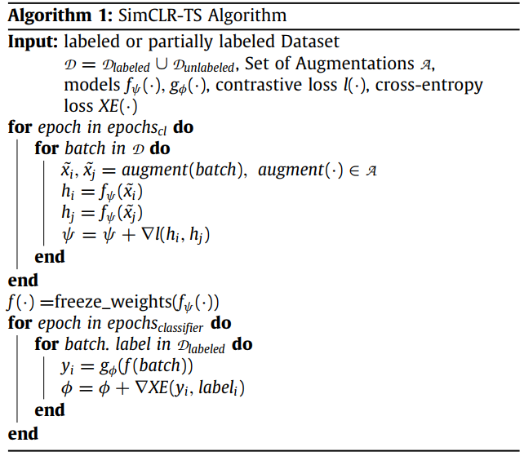
SimCLR-TS

Slide 7
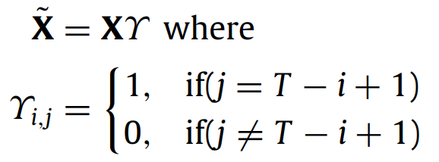
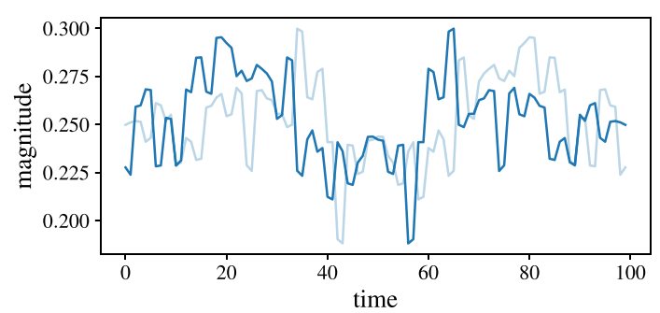
Augmentations – Left to Right Flipping

Slide 8
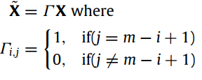
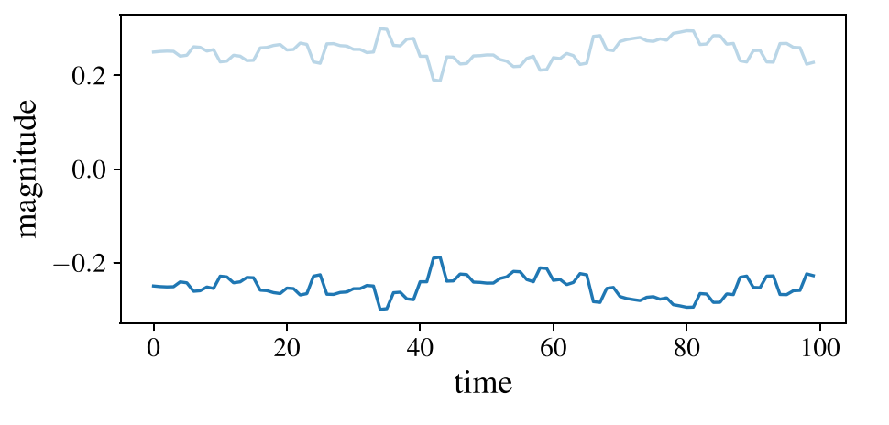
Augmentations – Bidirectional Flipping

Slide 9
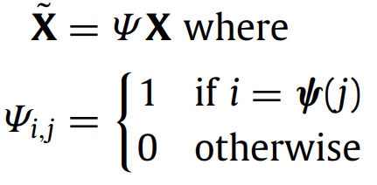
Augmentations – Random Channel Permutation

Slide 10
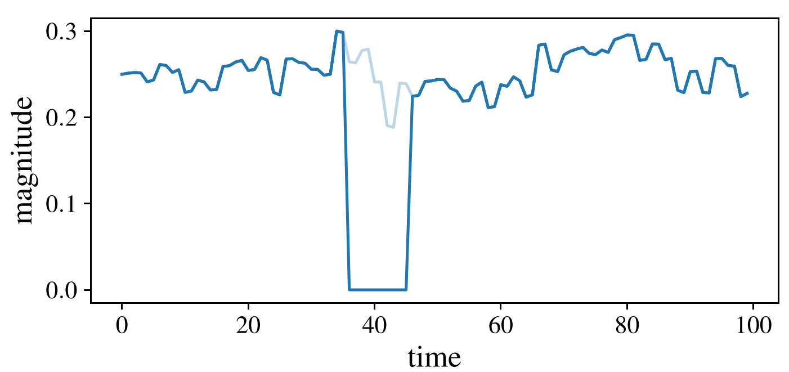
Augmentations – Blockout

Slide 11
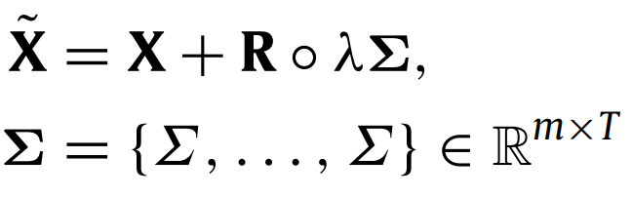
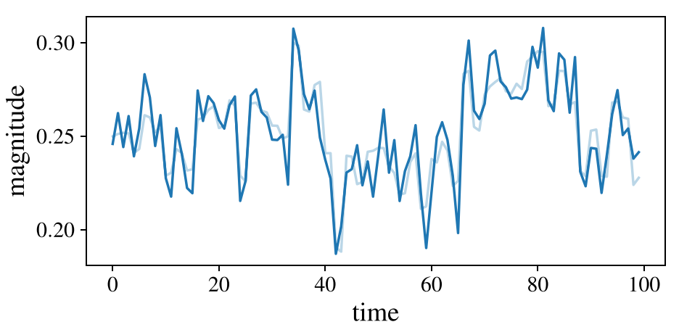
Augmentations – Random Noise

Slide 12
Augmentations – Random Noise

Slide 13
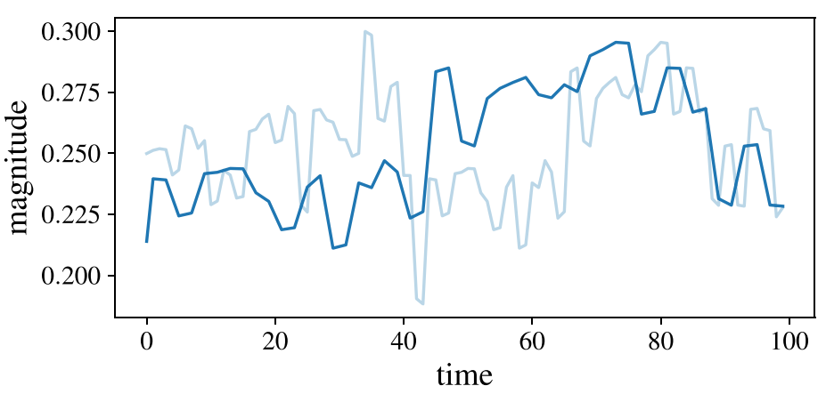
Augmentations – Crop and Resize

Slide 14
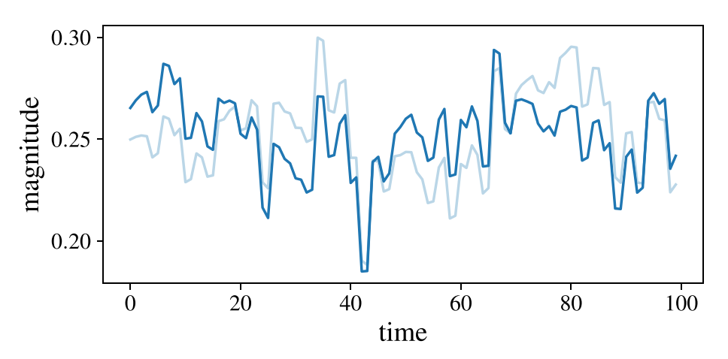
Augmentations – Magnitude Wrapping

Slide 15
Experimental Setup
Dataset is Tennessee Eastman Process (TSP) dataset
There are 22 cases (classes) in the dataset
The network they used for contrastive learning is
Three layers of Conv1D, Leaky ReLU, and Batch-Normalization-1D
A kernel size of 3 in all conv layers
A stride of 2 in the first two conv layers and a stride of 1 in the last conv layer
The number of conv channels doubling with each layer, starting with 64 channels
When using the pre-trained contrastive model for the final supervised evaluation, the standard linear evaluation protocol is used, i.e. a linear layer with inputs according to the flattened output of the contrastive model and 22 classification neurons

Slide 16
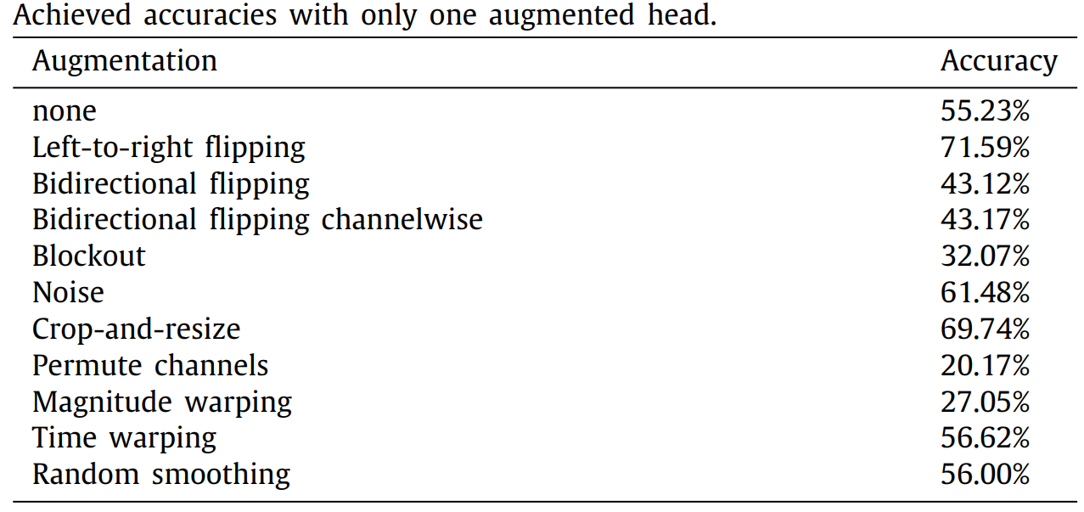
Results

Slide 17
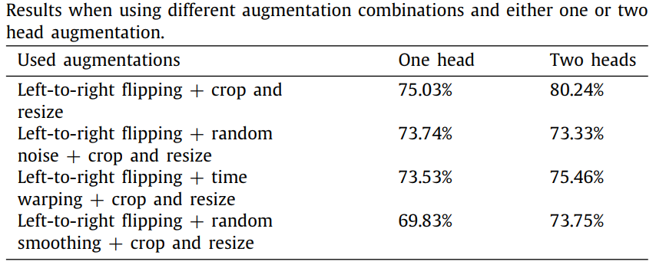
Results

Slide 18
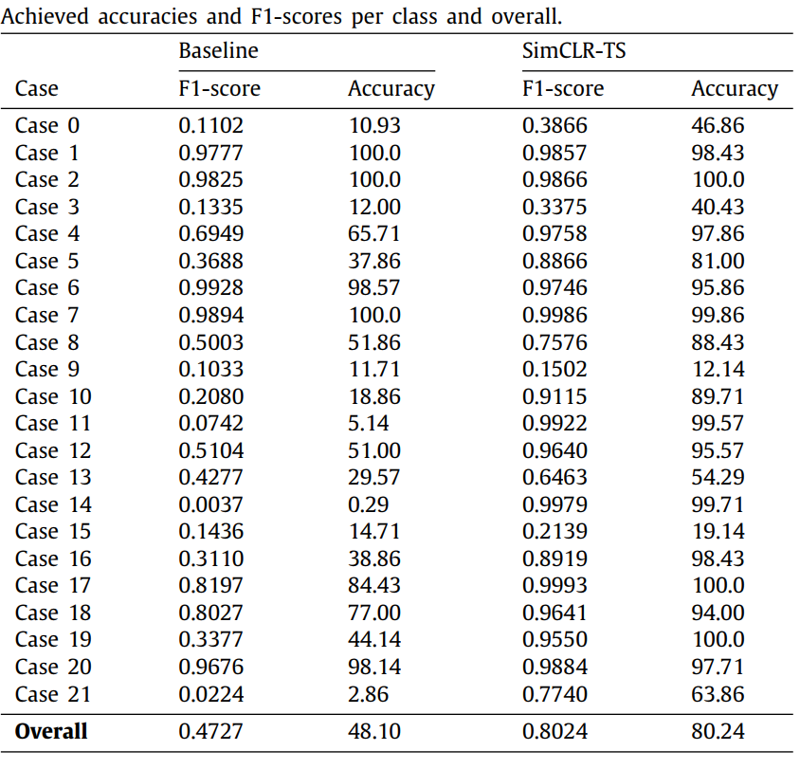
Results

Slide 19
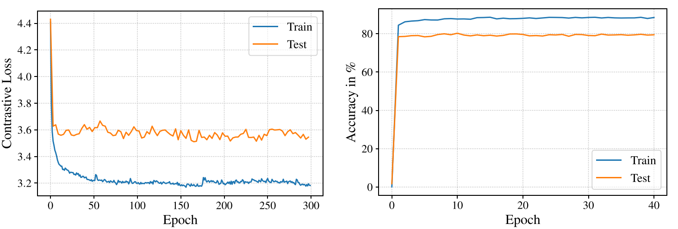
Results

Slide 20
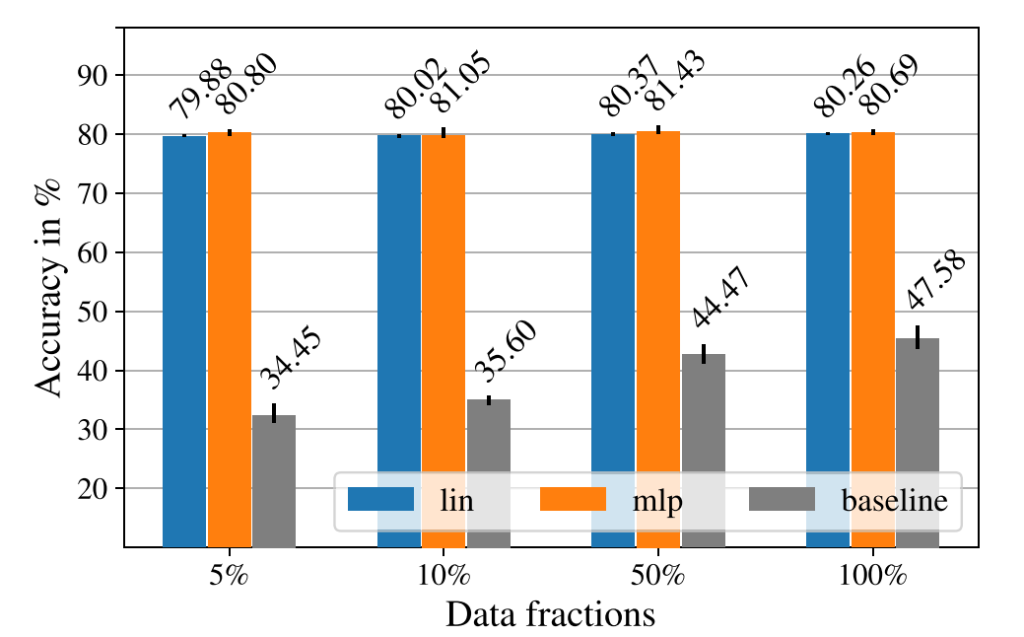
Results

