Slide 1
﻿Feature Importance Explanations for Temporal Black-Box Models (TIME)
AAAI 2022

Slide 2
Overview of Explainability
Existing approaches
Explains feature importance only
More focused on tabular data
Not always model agnostic
Cannot explain temporal features
Only local importance
What TIME does?
Explains which features are important
Explains what segment of a feature sequence is important
Explains if the order of the important sequence segment is important
Local importance + global importance

Slide 3
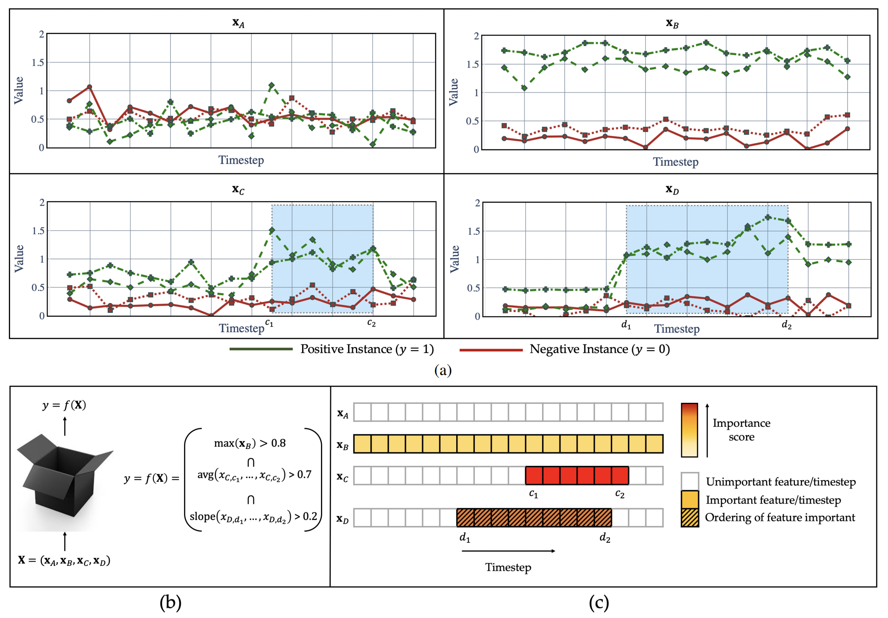

Slide 4
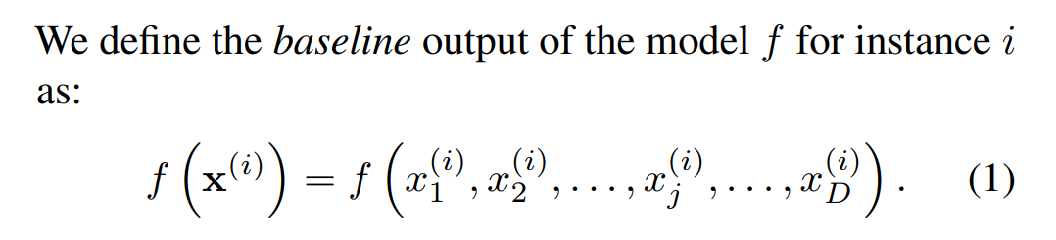
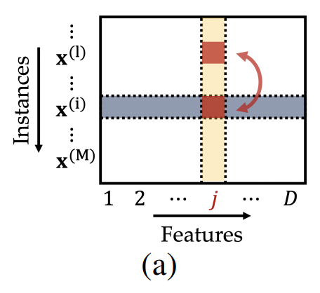
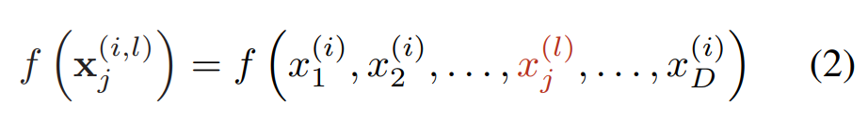
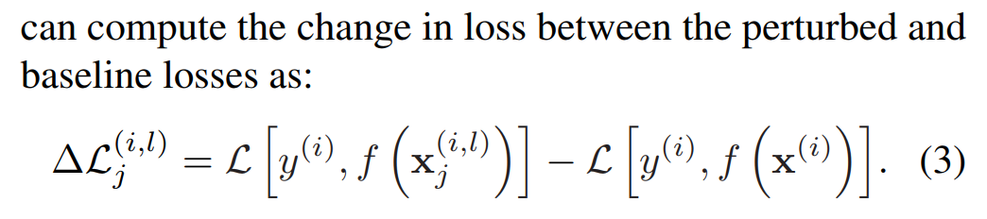

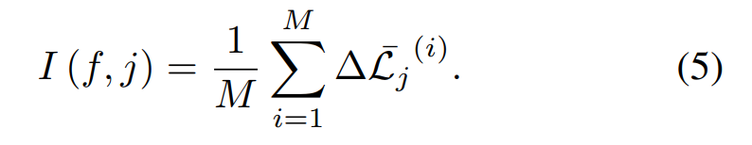
Permutation test
M test samples, each has D features, each feature is of length L
Start with tabular data, not timeseries
﻿We consider a feature to be important if it has a positive association with the target, in the sense that permuting the value of the feature increases the model’s loss on average.

Slide 5
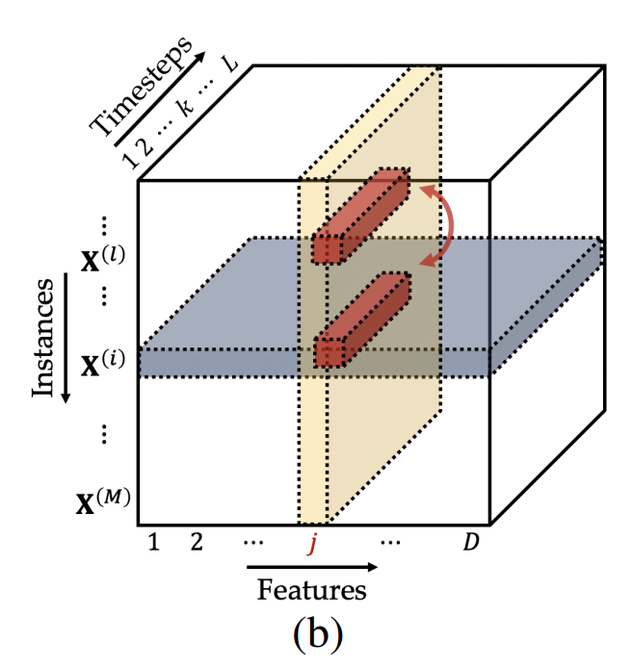
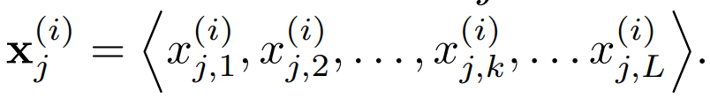
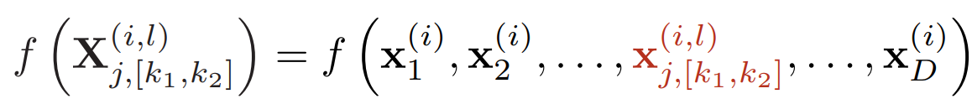
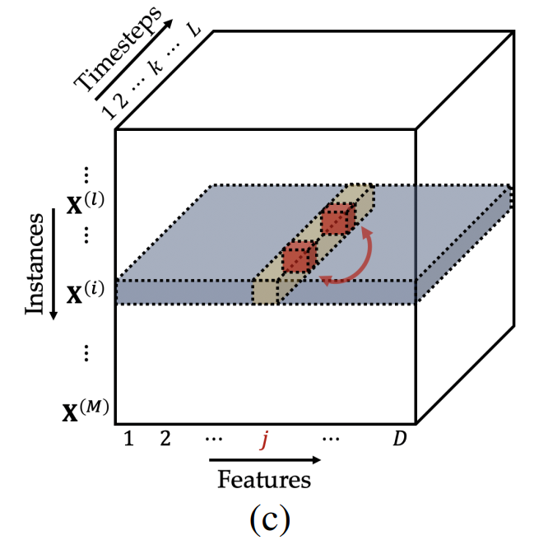
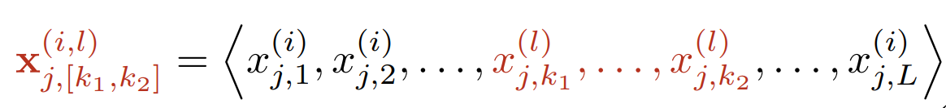
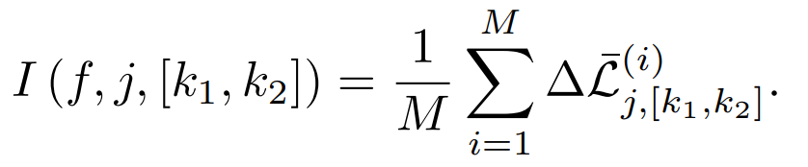
Permutation test for timeseries
M test samples, each has D features, each feature is of
length L
﻿M × D × L tensor

Slide 6



Detecting the window [k₁, k₂]
﻿In order to pin down the most salient timesteps, we want to find the smallest window W* such that
&
1
k₁
k₂
L
W_{p}
W*
W_{s}

Slide 7
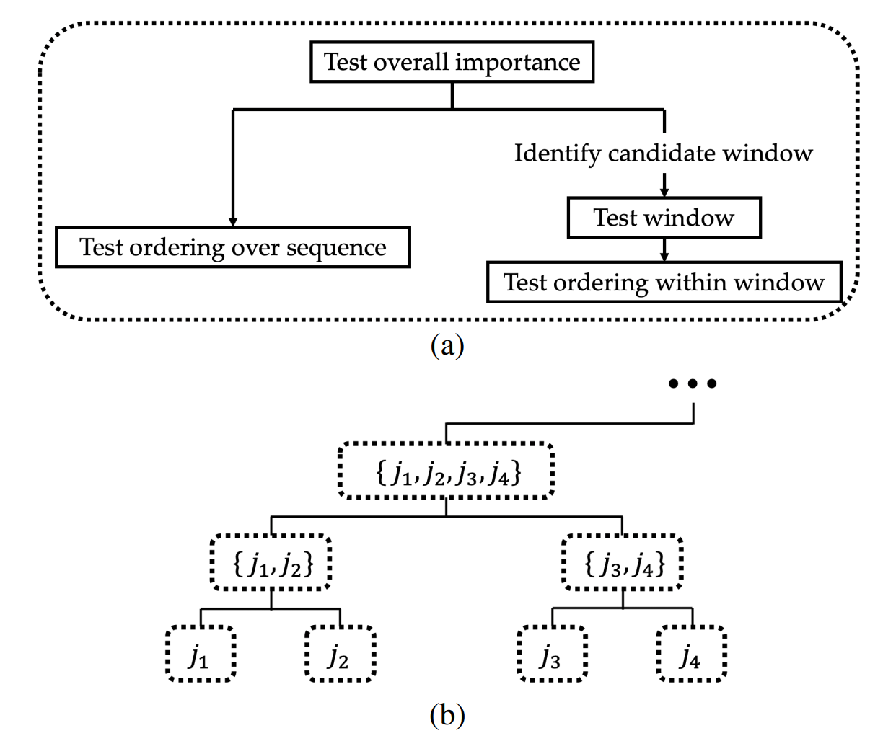
Hierarchy to follow

Slide 8
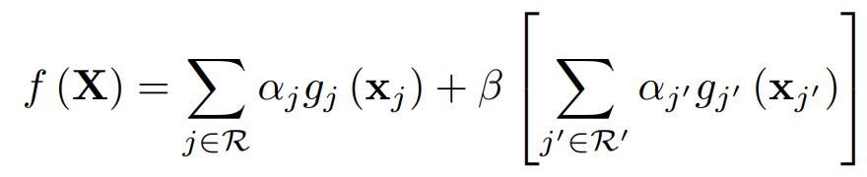
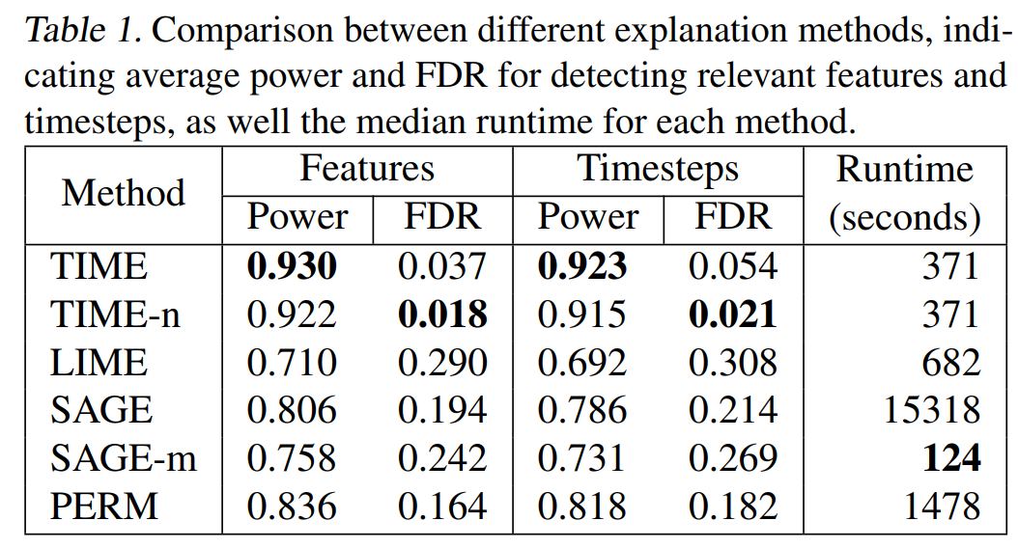
Validation
﻿Generated data sets with 1,000 instances, 10 features and 20 timesteps per feature. 5 features are randomly selected as relevant. We create a synthetic model for each data set, with β tuned to yield a 90% accuracy (for classification models) or an R² value of 0.9 (for regression models).
﻿aggregates the values within the window [k_{1,} k₂] of that feature
1
k₁
k₂
L
W_{p}
W*
W_{s}

Slide 9
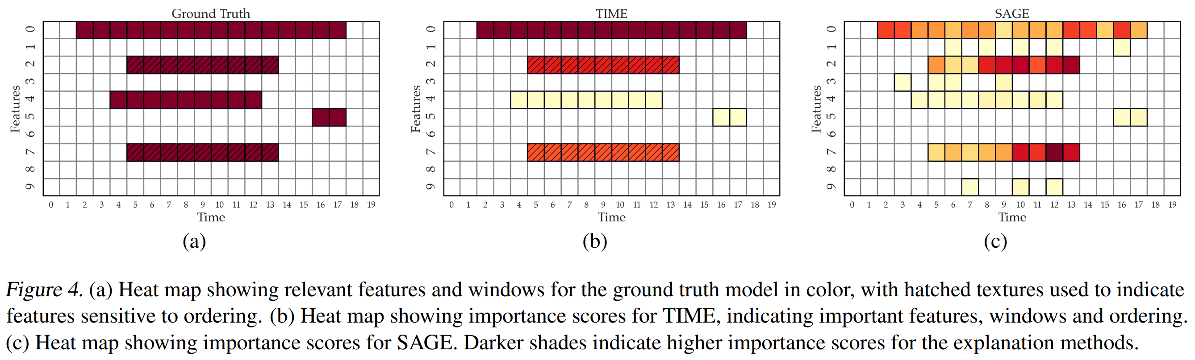
Validation

Slide 10
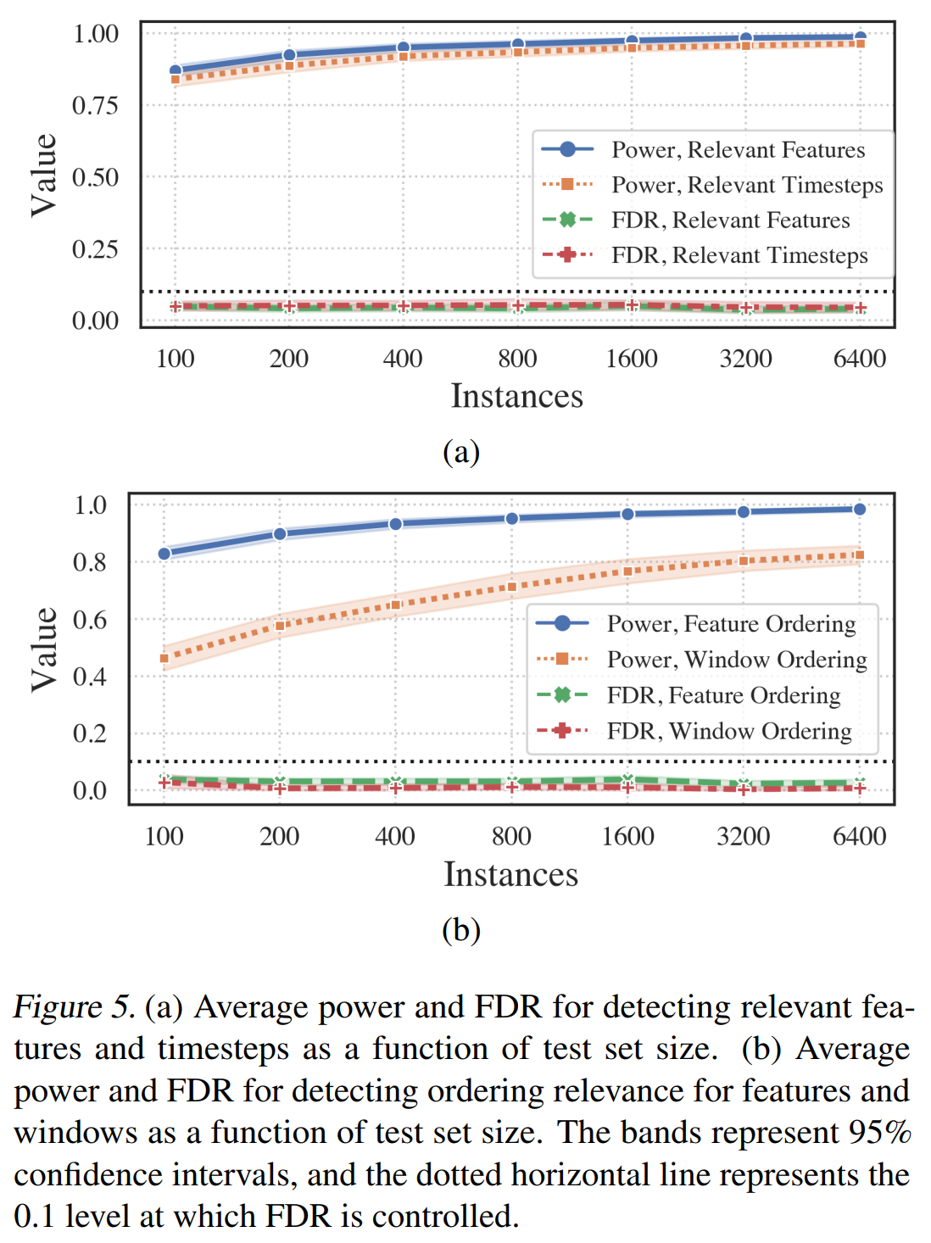
Validation

