Slide 1

TinyOL: TinyML with Online-Learning on
Microcontrollers
Haoyu Ren
Siemens AG
Technical University of Munich

Slide 2
Internet of Things
Microcontrollers
Machine Learning
Carbon footprint for training the network ”GPT-3” is approximately equal to traveling 700,000 kilometers by car!
MCUs are designed to live long with less than 0.1W power consumption.
Tiny Machine Learning (TinyML) tries to fill the gap between MCUs and ML.

Slide 3
TinyML
Privacy
Latency
Energy efficiency

Slide 4
Motivation
TinyML assumes the model is trained in powerful machines or cloud, and it is afterward uploaded to the edge device.
The MCU only needs to perform inference.
TinyML treats the model as a static object.
To learn from new data, the model must be retrained from scratch and re-uploaded to MCUs.

Slide 5
Motivation
It is difficult to access some remote embedded devices.
Machines are different which makes it difficult for a single model to work on all machines.
We cannot store lots of field data on embedded devices.
Transmission to a data center is expensive.
Concept drift can be challenging because of the model’s limited flexibility.

Slide 6
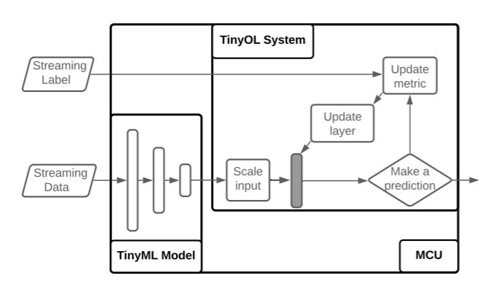
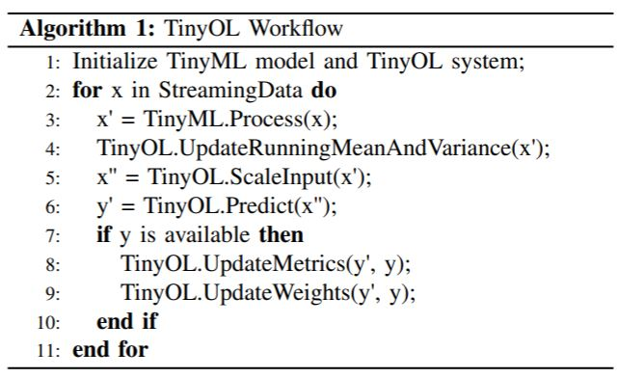
TinyOL System
TinyML with Online-Learning

Slide 7
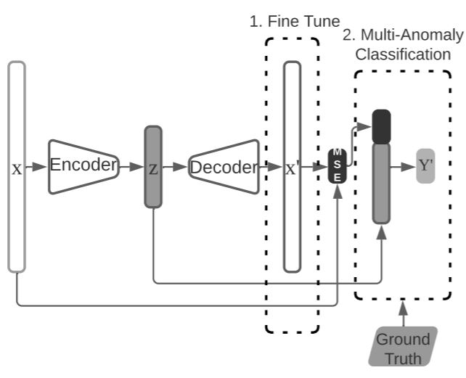
Concept Design
Autoencoder
Encoder pencoder(Z|X)
Decoder pdecoder(X'|Z)
The loss function (MSE)
Notes:
Encoder that learns to map high dimensional data into low dimension.
Decoder that reconstructs the input from the embedding.

Slide 8
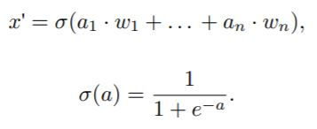
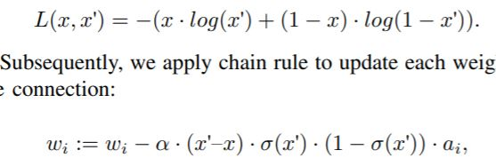
Fine Tune
Field data might not be the same as the training data.
It is essential to democratizing MCUs to post train their NN on the fly!
Only one sample will be processed at a time!
Notes:
Assume activation function of the last layer is sigmoid function, the output of decoder is A, and the weights between the decoder and last layer are W. The forward propagation of one connection in the last layer is written as:
Take cross entropy loss function as an example:
Subsequently, we apply chain rule to update each weight in the connection:

Slide 9
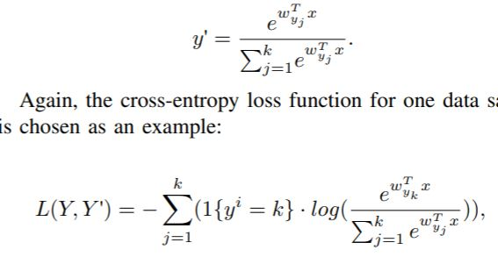
Multi-Anomaly Classification
We enable the classification of different anomaly patterns on the go.
TinyOL maintains a weights vector for each class and will initialize extra neurons when a new class appears.
We choose a softmax regression layer for the task.
Cross-entropy loss function
Notes:
We denote the input feature as X and the corresponding weights in the multi-class layer as W
k is the number of the current anomaly classes

Slide 10
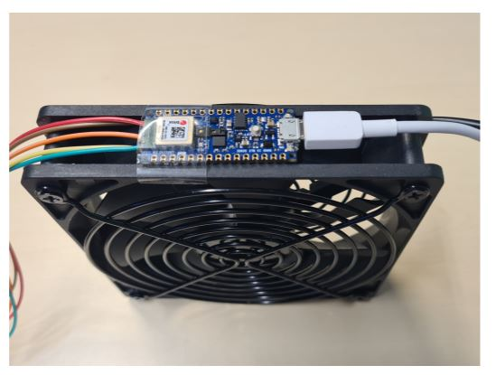
Experimental Design
Arduino Nano 33 BLE board
The board is featured with a Cortex™-M4 CPU running at 64 MHz, 256KB SRAM.
Industrial rotating machine simulation.
Regular operation, the fan is stuck, and the fan is tilted.
Notes:
it comes with several embedded sensors, in which the 3-axis accelerometer sensor is used in the experiment

Slide 11
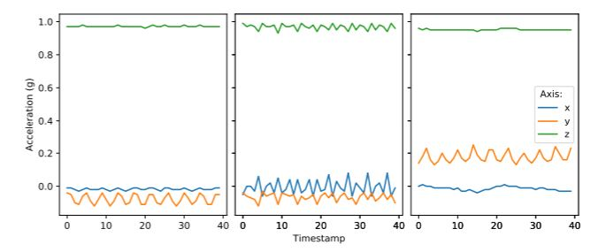
Experimental Design
Left: normal. Middle: stuck. Right: tilted

Slide 12
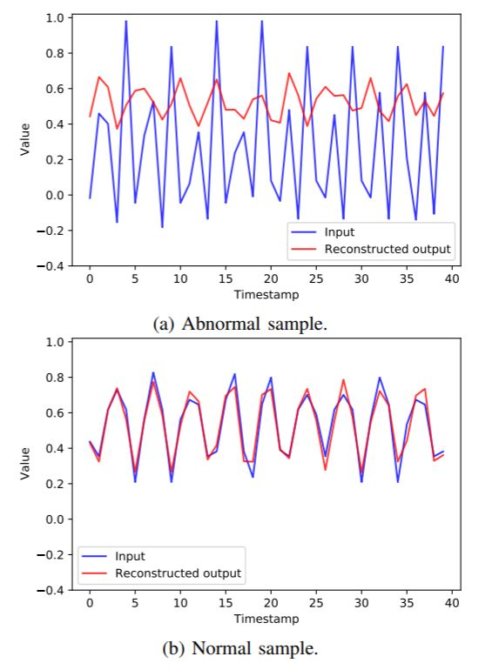
Autoencoder Experiment
They train the autoencoder on normal data samples to minimize the reconstruction error. The hypothesis is that abnormal data samples (in our experiment: tilted and struck) will have a higher reconstruction error.
Notes:
plots input (after PCA) and the autoencoder’s reconstructed output, where the upper figure describes an anomalous example, and the lower plot is for a normal sample.

Slide 13
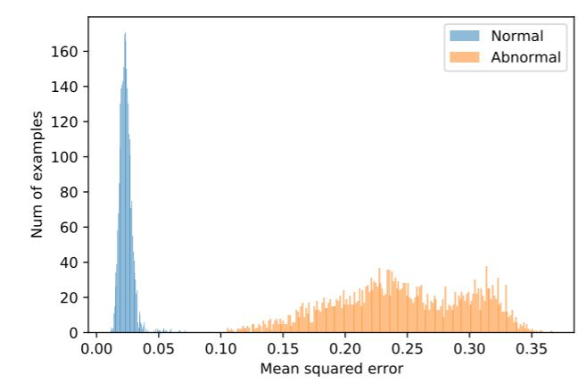
Result of Autoencoder
The distribution of the MSE from 3000 normal and 3000 abnormal samples.

Slide 14
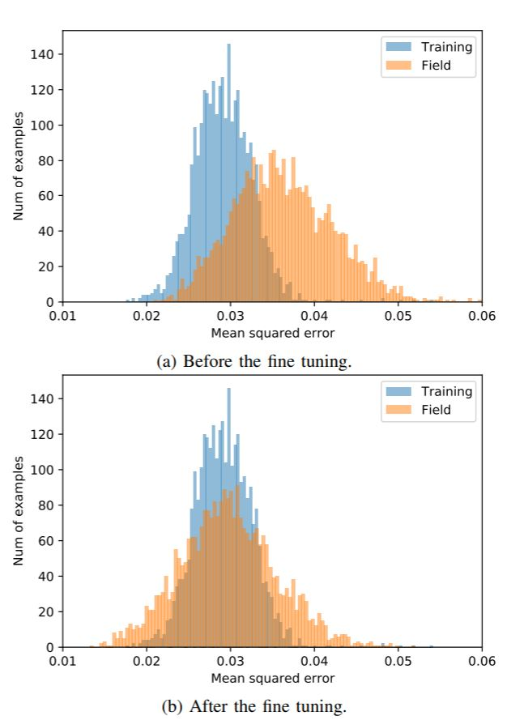
Result of Fine Tune
The distribution of 3000 normal samples’ MSE collected in the field (orange) compared to 3000 normal samples’ MSE collected at training phase (blue).

Slide 15
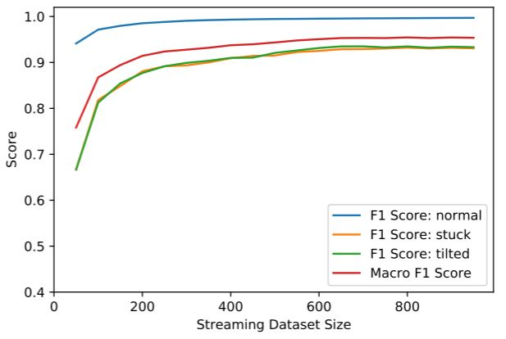
Result of Anomaly Detection
Online learning: the F1-score of each classes and the averaged Macro F1-score.

