Slide 1
U-Net: Convolutional Networks for Biomedical Image Segmentation

Slide 2
Similar Tasks
LeCun et al. developed a CNN but it’s efficiency was highly dependent on the available training set
Krizhevsky et al. developed a NN with 8 layers and millions of parameters and trained with 1 million
These papers mostly focused on classification where the output of an image is a single class
Cannot work on image localization where each pixel is assigned with a class
Ciresan et al. predicted class label for each pixel by dividing the image into many local patches and won EM segmentation challenge at ISBI 2012
But it was too slow and had accuracy issues

Slide 3
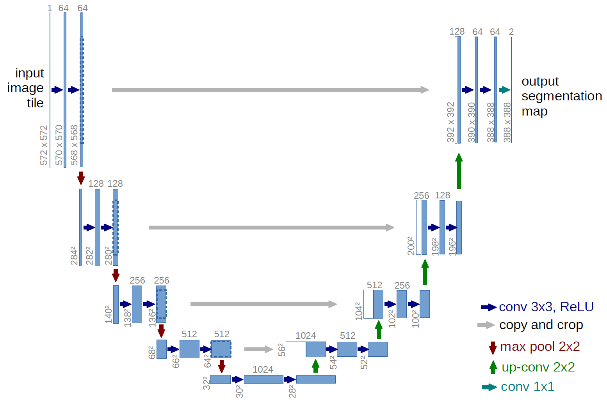
U-Net : fully connected convolutional network
Single channel input
Foreground and background

Slide 4
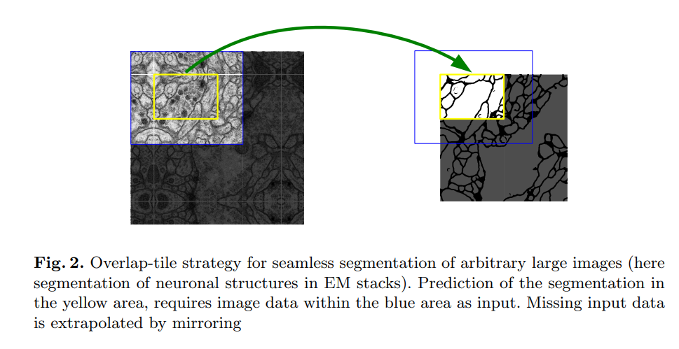
Some facts: No Padding
Extrapolation using mirroring

Slide 5
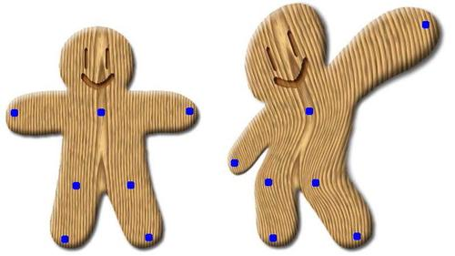
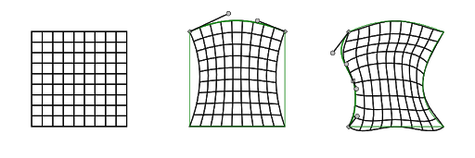
Some facts: Image augmentation by elastic deformation

Slide 6
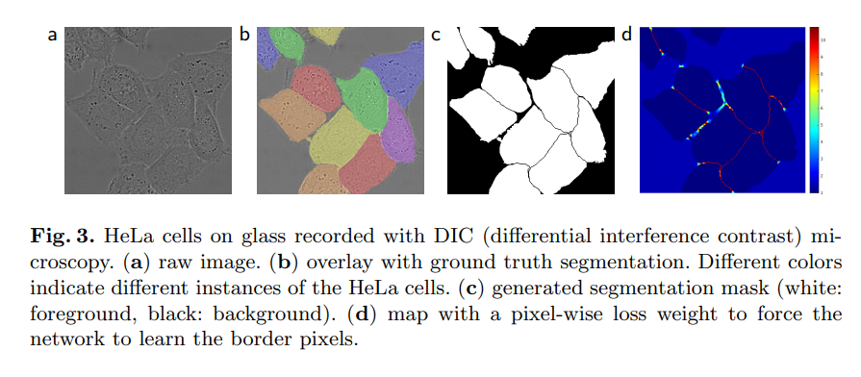
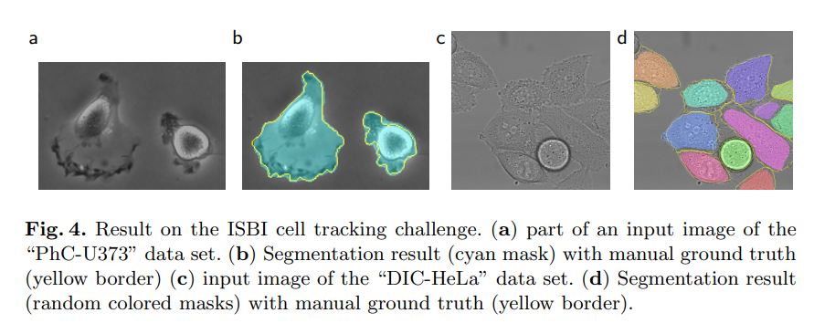
Demonstration

Slide 7
Success of U-Net
Requires very few training images
Yields more precise segmentation
Segmentation of a 512*512 image takes less than a second
Won the ISBI cell tracking challenge 2015 by a large margin
Customized and used in other applications
Cited more than 20,500 times

Slide 8
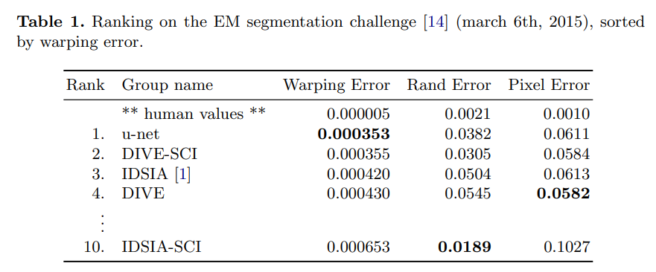
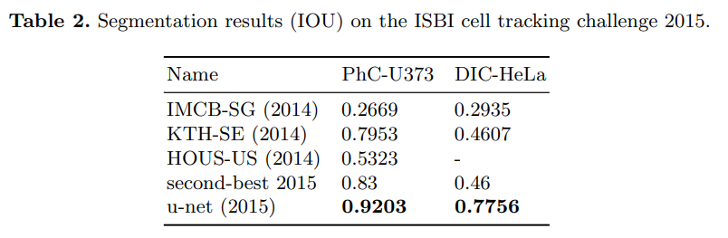
Results

