Slide 1
Any-Width Networks
IEEE CVPR 2020 workshop paper

Slide 2
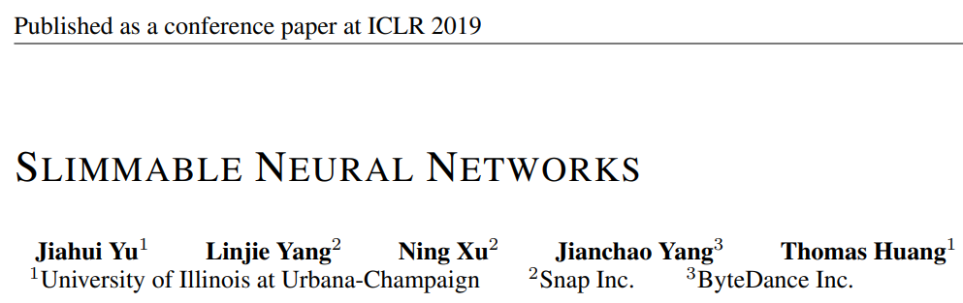
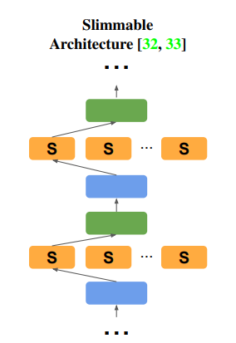
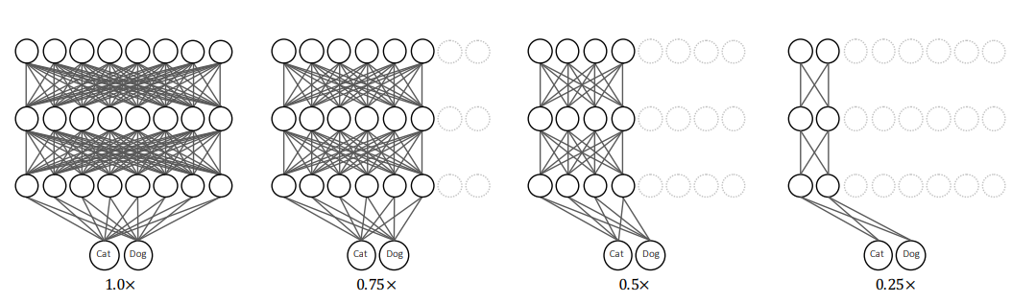

Further development of…
“Instead of training individual networks with different width configurations, we train a shared network with switchable batch normalization.”

Slide 3
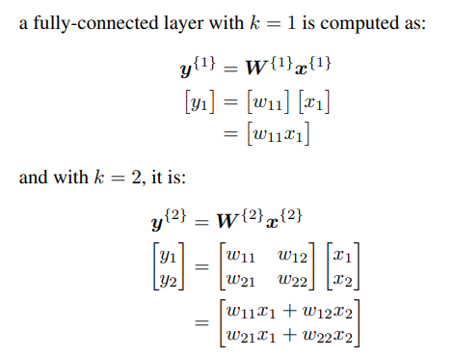

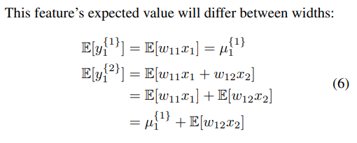
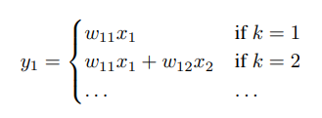
Why Switchable BN?
k = number of features
General batch normalization formula,

Slide 4
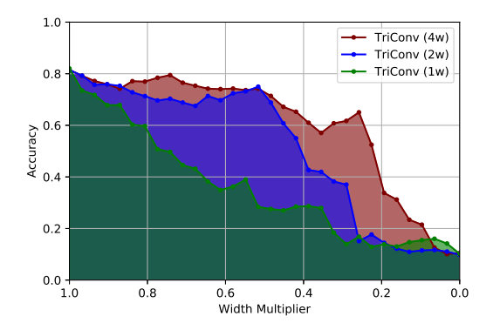
Why Switchable BN not perfect?
1. Increase in model size
“Each additional set of batch normalization parameters in their Slimmable Network can add roughly 1% to the model size. Training the light-weight MobileNetV2 at 20 widths would result in an 18.5% increase in the model size.”
2. Storing the BN module for each width
3. Increased inference time
4. Inconsistent width-accuracy trade-off curve

Slide 5
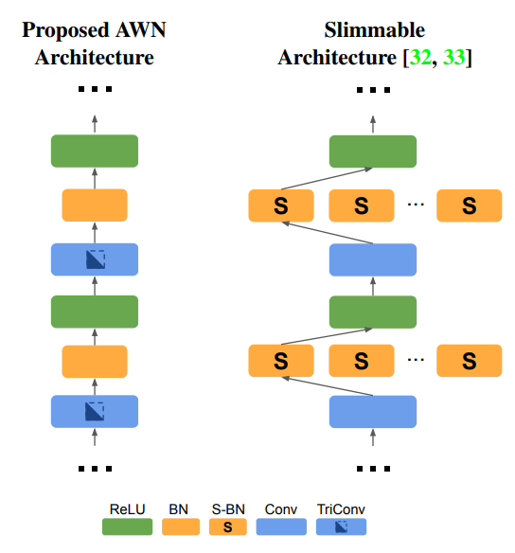

AWN: Main Contribution

Slide 6








Variants of AWN
AWN
1
2
3
4
5
6
7
8
BN
AWN + Random sampling (RS)
1
2
3
4
5
6
7
8
0.25
0.50
0.75
1
BN

Slide 7
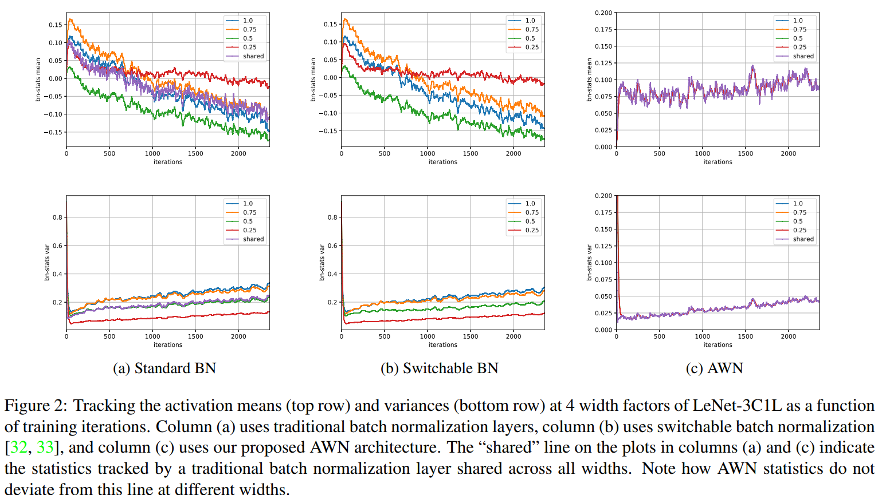
Effect of AWN

Slide 8
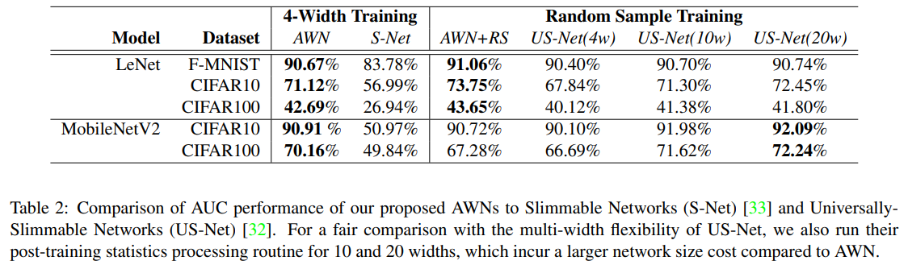
Result comparison

Slide 9
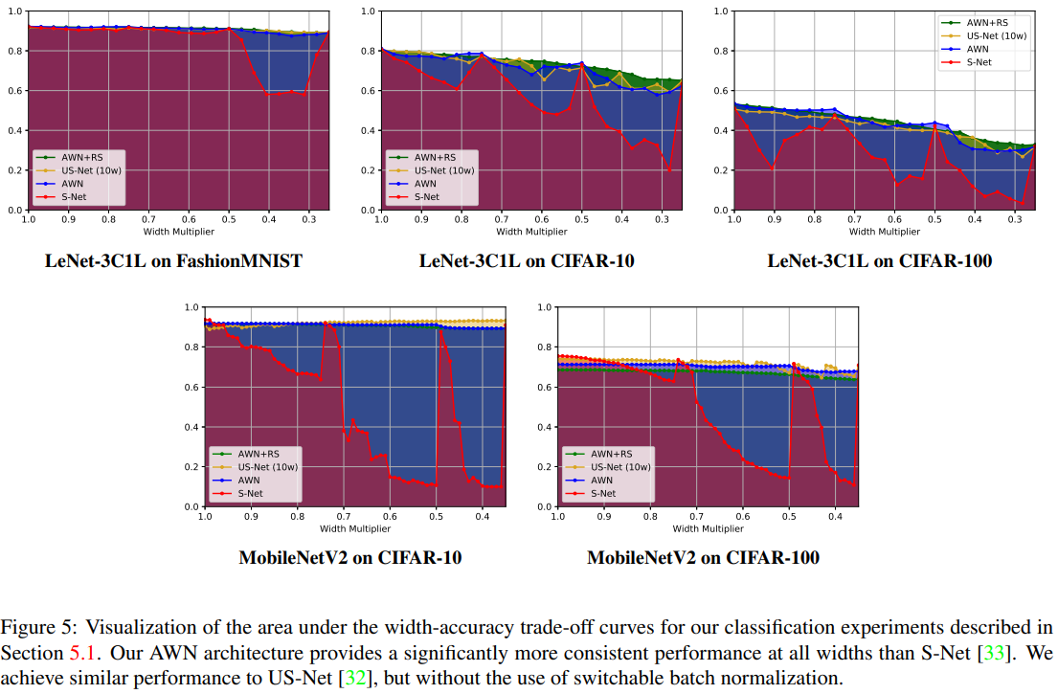
Result comparison

