Slide 1
Friday Evening Discourse at the Royal Institution of Great Britain in London
Michael Faraday and the principles of photography in 1839
J. J. Thomson and the electron in 1897
On February 9, 1877, Francis Galton Presented “Typical Laws of Heredity.”

Slide 2
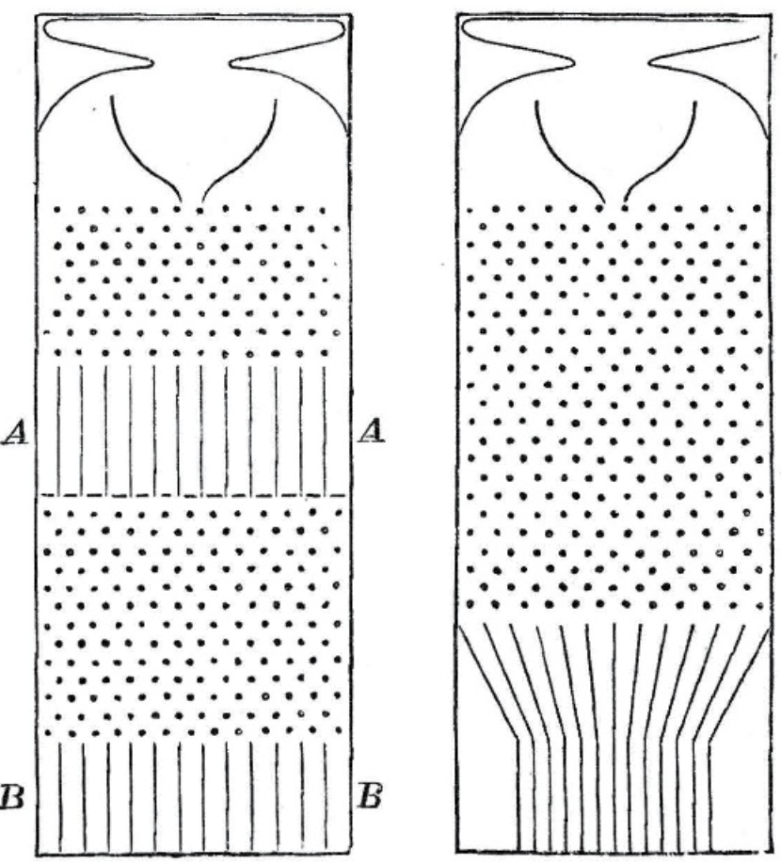

Slide 3
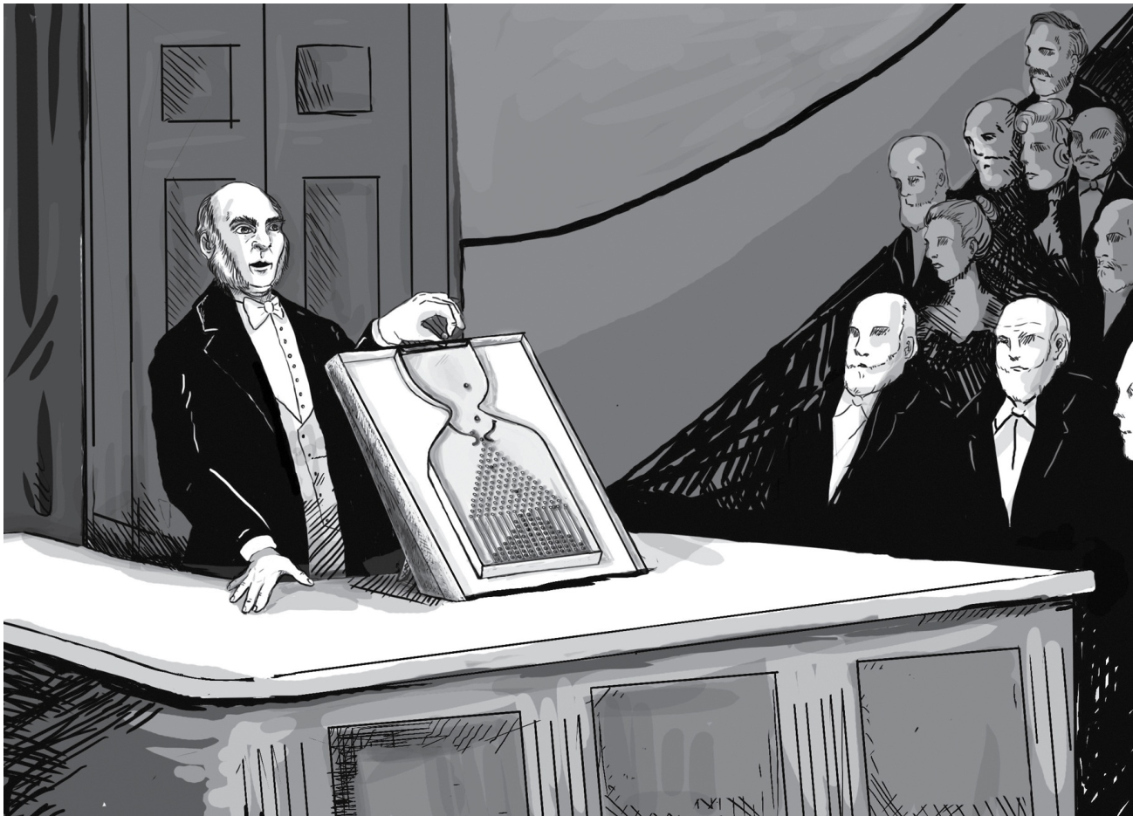
Sir Francis Galton demonstrates his “Galton board” or “quincunx” at the Royal Institution. He saw this pinball-like apparatus as an analogy for the inheritance of genetic traits like stature. The pinballs accumulate in a bell-shaped curve that is similar to the distribution of human heights. The puzzle of why human heights don’t spread out from one generation to the next, as the balls would, led him to the discovery of “regression to the mean.”

Slide 4
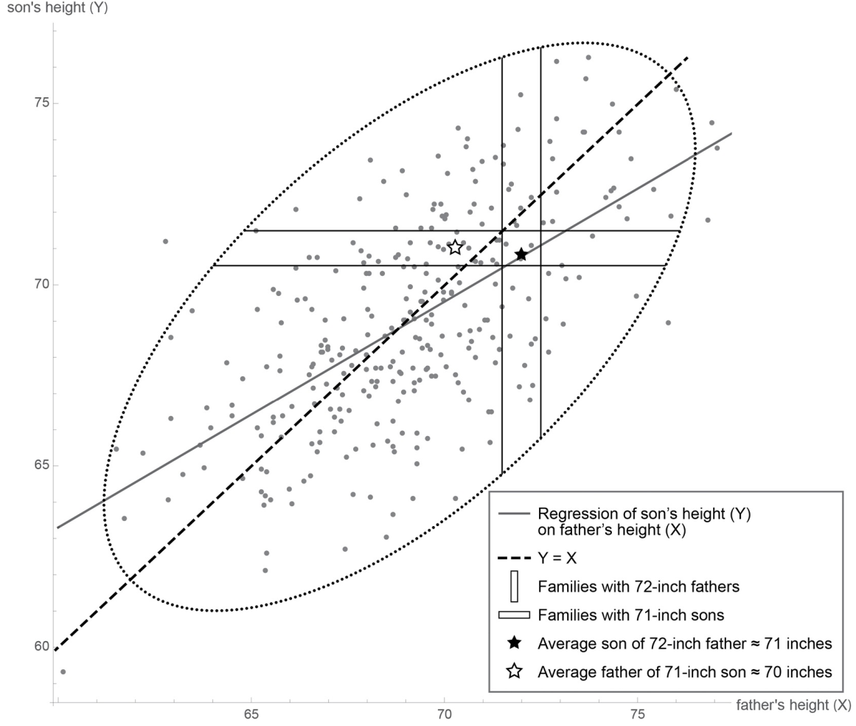

Slide 5
