Slide 1
Counterfactual Diagnosis
Jonathan G. Richens, Ciar´an M. Lee, and Saurabh Johri
Babylon Health, London, United Kingdom
University College London, United Kingdom

Slide 2
Overview
Introduction
Associative diagnosis
Counterfactual diagnosis
Definitions and Methods
Expected disablement
Expected sufficiency
Results
Diagnostic model and datasets
Counterfactual v.s associative rankings
Comparing to doctors

Slide 3
Introduction
In medical diagnosis a doctor aims to explain a patient’s symptoms by determining the diseases causing them
existing diagnostic algorithms are purely associative
Inability to disentangle correlation from causation → sub-optimal or dangerous diagnoses.
Diagnosis is fundamentally a counterfactual inference task.

Slide 4


Associative diagnosis
Model based diagnosis $≡$ using a model $θ$ to estimate the likelihood of a fault component $D$ given evidence $ℰ$
$$P(D|θ,ℰ)$$
Discriminative Models v.s. Generative Models
However, diagnosis is the process of finding causal explanations for a patient’s symptoms

Slide 5
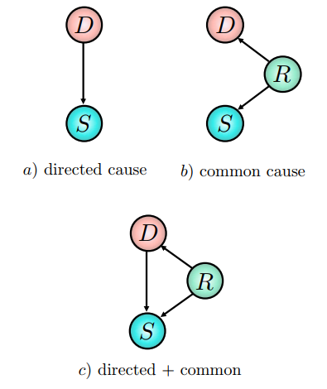
Associative diagnosis
The posterior does not differentiate between these different scenarios and so is insufficient for assigning a diagnosis to a patient’s symptoms in all but the simplest of cases

Slide 6
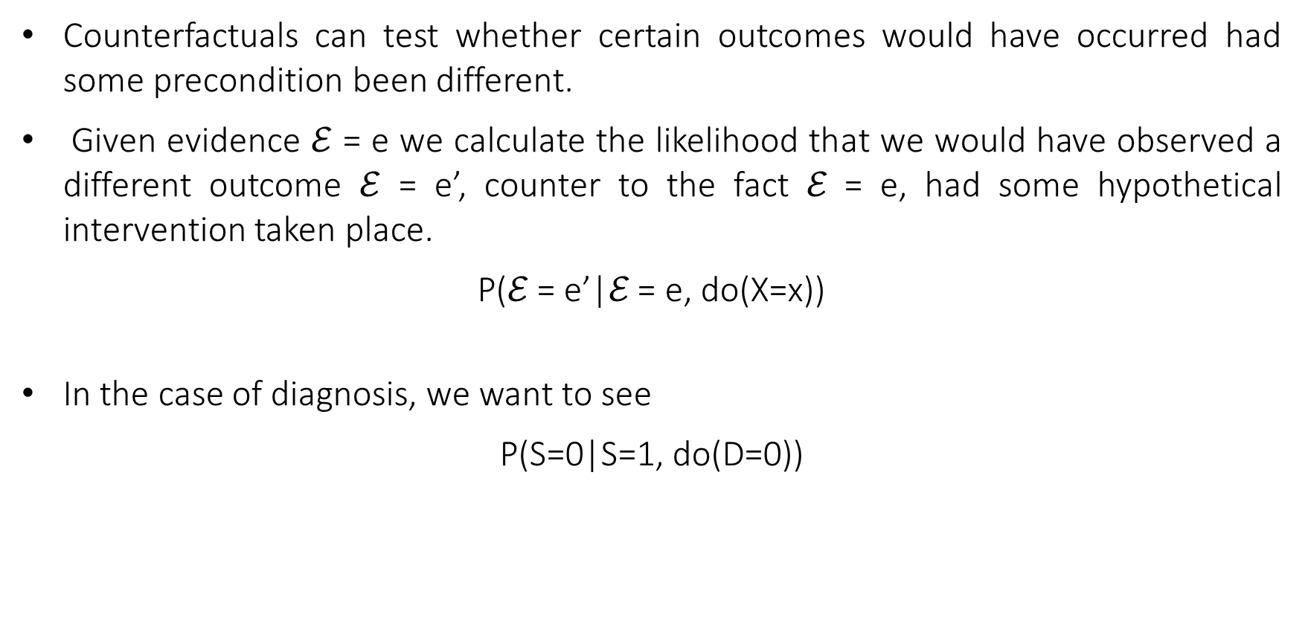
Counterfactual diagnosis
Counterfactuals can test whether certain outcomes would have occurred had some precondition been different.
Given evidence $ℰ$ = e we calculate the likelihood that we would have observed a different outcome $ℰ$ = e’, counter to the fact ℰ = e, had some hypothetical intervention taken place.
P(ℰ = e’|ℰ = e, do(X=x))
In the case of diagnosis, we want to see
P(S=0|S=1, do(D=0))

Slide 7
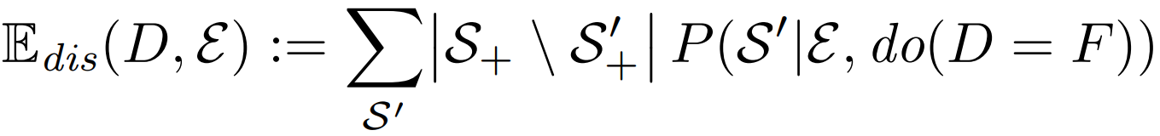
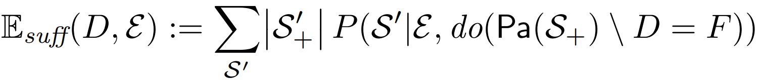
Counterfactual diagnosis
Def1 (Expected disablement) The expected disablement of disease D is the number of present symptoms that we would expect to switch off if we intervened to cure D
Def2 (Expected sufficiency) The expected sufficiency of disease D is the number of positively evidenced symptoms we would expect to persist if we intervene to switch off all other possible causes of the patient’s symptoms,

Slide 8
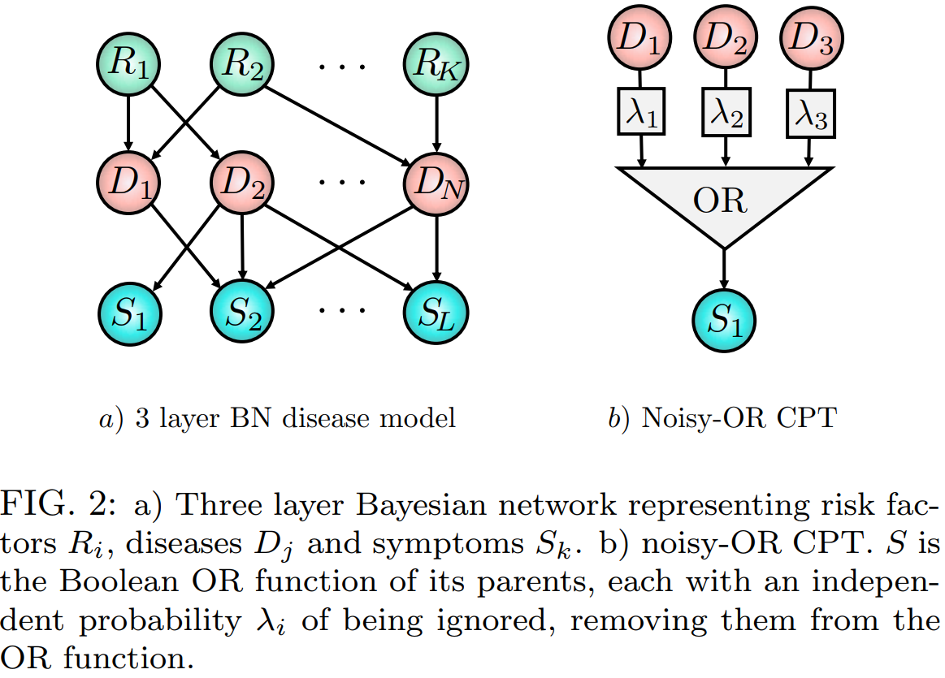
Counterfactual diagnosis

Slide 9
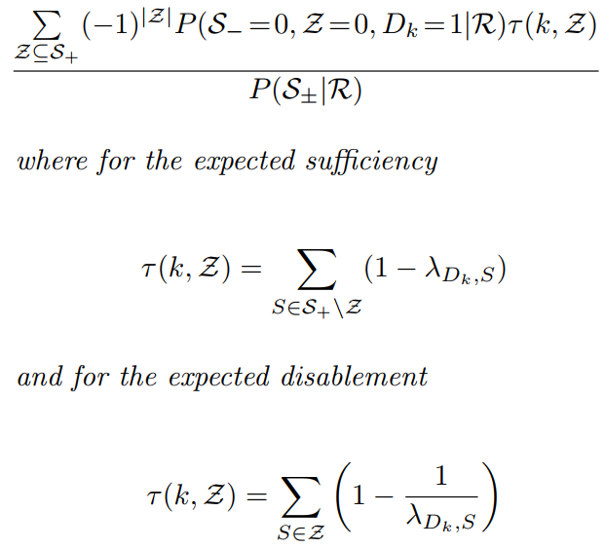

Counterfactual diagnosis
Theorem. For 3-layer noisy-OR BNs, the expected sufficiency and expected disablement of disease $D_{k}$ are given by

Slide 10
Results - Diagnostic model and datasets
A key limitation of this approach is the difficulty in defining the ground truth diagnosis, where diagnostic errors result in mislabeled data.
A test set of 1671 clinical vignettes, generated by a separate panel of doctors qualified at least to the level of general practitioner
In all experiments the counterfactual and associative algorithms use identical disease models to ensure that any difference in diagnostic accuracy is due to the ranking query used. The disease model used is a three layer noisy-OR diagnostic BN .

Slide 11
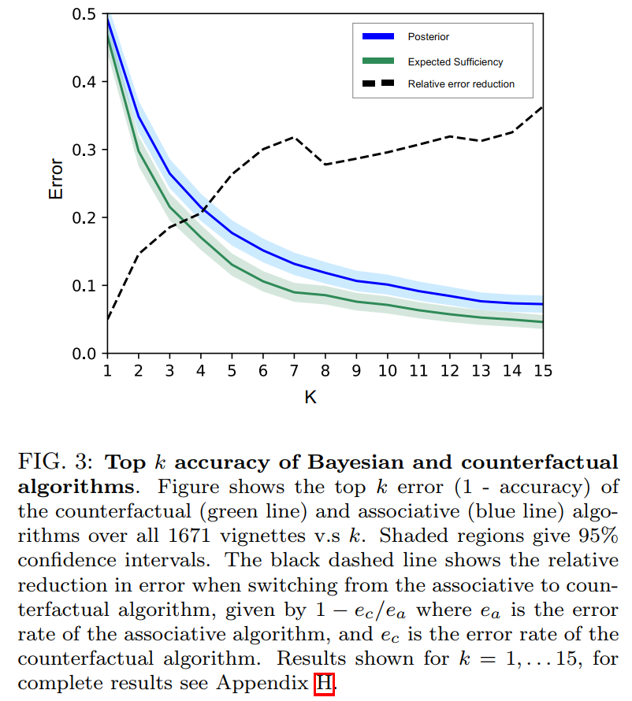
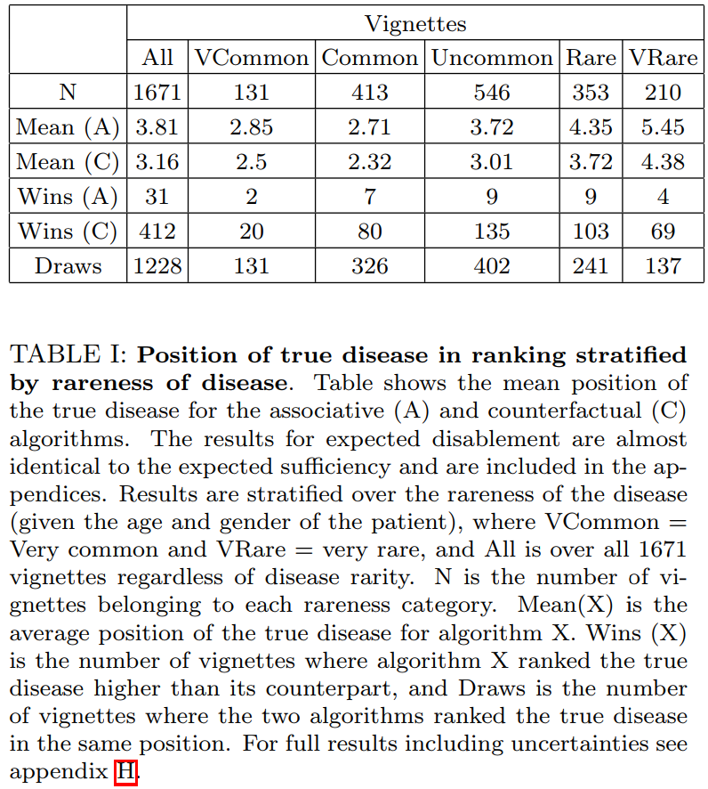
Results – Counterfactual v.s. associative ranking

Slide 12
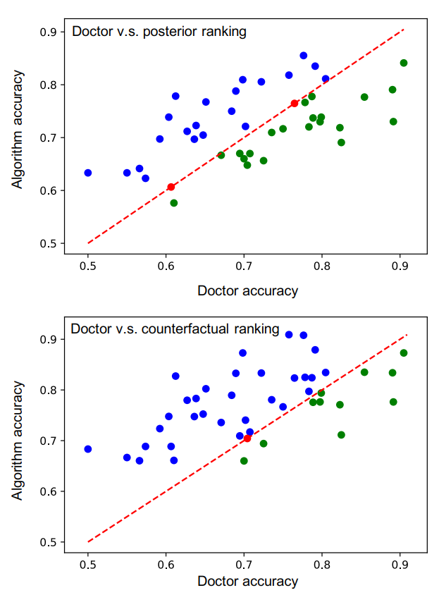
Results – Comparing to Doctors

