Slide 1
Optimizations in Sparce Coding

Slide 2
Unsupervised Learning
Unlabeled data is inexpensive and available in plenty
Can be used to extract meaningful features automatically
Neural Network for Unsupervised Learning
Autoencoder
Noise removal, compressed representation
Sparse coding
Restricted Boltzmann Machine

Slide 3



Sparse Coding
Objective-
For each sample x^{(t)}, we want to find h^{(t)} such that-
h^{(t)} is sparse i.e. h^{(t)} has many zeros
x^{(t)} can be reconstructed from h^{(t)}
More formally
D is the Dictionary Matrix
D is equivalent to the decoder weights of an autoencoder
Constrains on D
Columns of D is of norm 1 or Columns of D equals 1
Cause if D keeps growing, h^{(t)} will become a vector ones
Best performing h^{(t)} is h(x^{(t)})
Sparsity controller
Reconstruction x̂(t)
Reconstruction loss
Sparsity penalty
Code or compressed representation

Slide 4
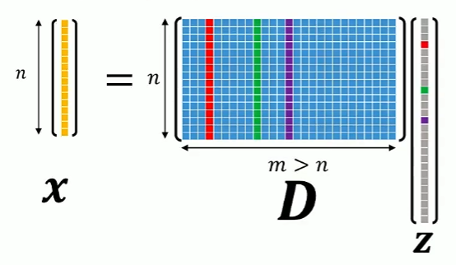
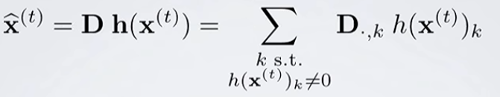
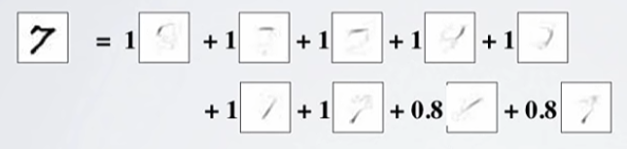


Sparse Coding
Dictionary
We can either use available Dictionaries or learn it

Slide 5

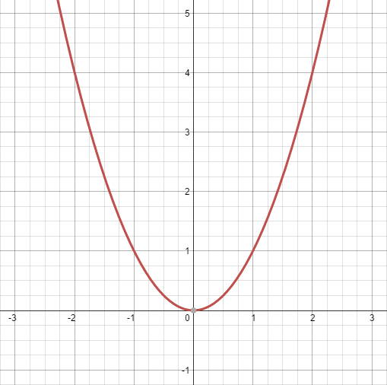
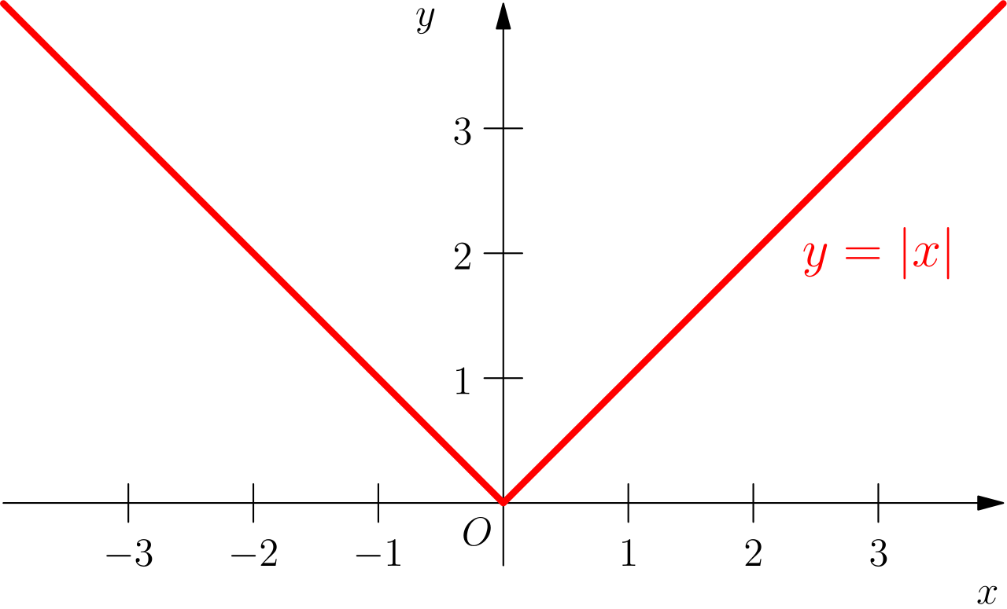

Sparse Coding (determine h(x^{(t)}))
Finding h(x^{(t)})
Given D, how we can find the optimal h(t) i.e. h(x^{(t)})?
Clearly, we want to optimize this term –
Has a unique global optima
Use gradient descent-

Slide 6

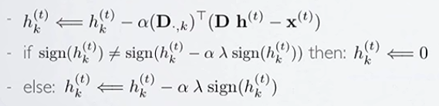
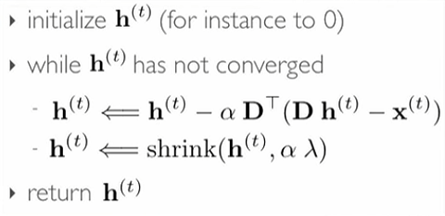
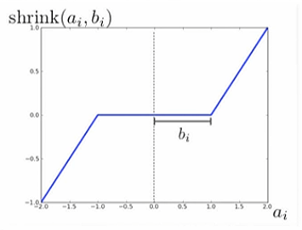
Sparse Coding (determine h(x^{(t)}))
Gradient calculation for a single unit-
Issue- L1 norm is not differentiable at h=0
Won’t get h=0 even it’s the solution
Determine via sign of h_{k}^{(t)}
ISTA Algorithm

Slide 7
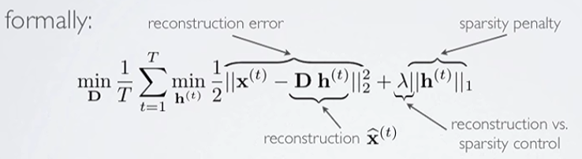

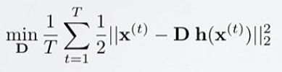
Sparse Coding (Find D)
Initial objective-
if
Working independently
Constrains on D
Columns of D should be of unit norm

Slide 8
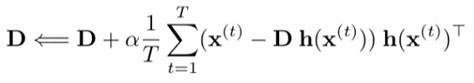
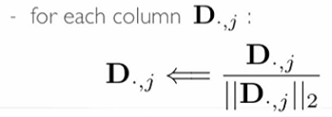
Sparse Coding (Find D)
Dictionary update: Algorithm I
While D doesn’t converge,
Update D
Renormalize the columns of D

Slide 9
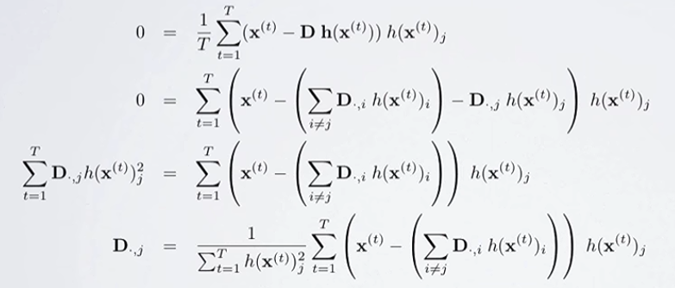
Sparse Coding (Find D)
Dictionary update: Algorithm II – Block Coordinate Descent
Take the derivative and isolate D_{.,j}
We don’t need a learning rate here

Slide 10
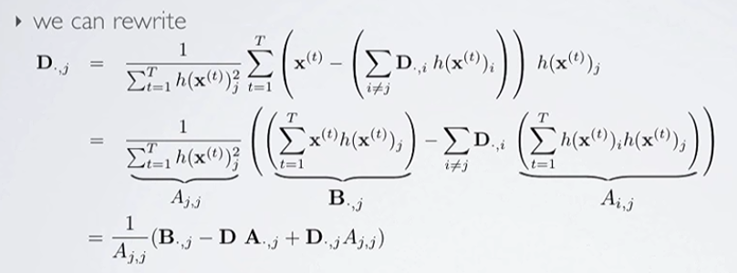

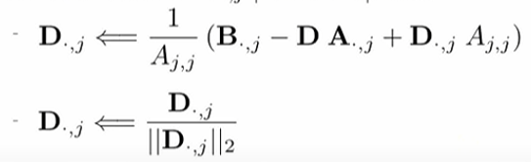
Sparse Coding (Find D)
Dictionary update: Algorithm II
More advantage: We just have to store these two values at the beginning
While D hasn’t converged-
Update each column D_{.,j} and force to unit norm

Slide 11

Sparse Coding (Putting all together)
Alternatively run updates for h^{(t)} and D_{.,j}
While D has not converged-
Find sparse codes h(x^{(t)}) for all the samples x^{(t)} in the training set with ISTA
Update Dictionary D
Calculate A and B matrices
Update using Block Coordinate Descent

Slide 12
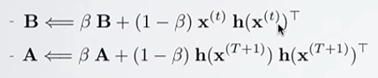
Sparse Coding (Putting all together)
Alternatively run updates for h^{(t)} and D_{.,j}
While D has not converged-
Find sparse codes h(x^{(t)}) for all the samples x^{(t)} in the training set with ISTA
Update Dictionary D
Calculate A and B matrices
Update using Block Coordinate Descent
Problem
Use Running Average
Batch update
Online update
How much priority you will give to previous A and Bs

Slide 13

Sparse Coding (Putting all together)
Initialize D (not a zero matrix)
While D hasn’t converged
For each training sample x(t)
Find h(x(t))
Update dictionary using running average
While D hasn’t converged
For each atom D_{.,j} force unit norm

