Slide 1
Estimating Average Treatment Effects via Orthogonal Regularization
Tobias Hatt , Stefan Feuerriegel
ETH Zurich, Switzerland

Slide 2
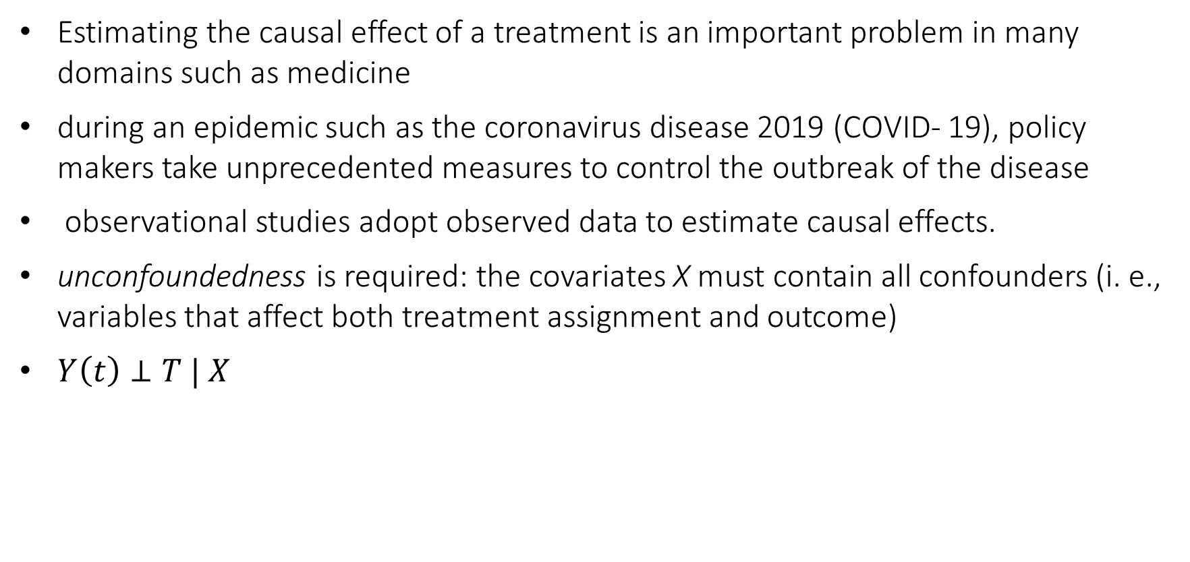
Introduction
Estimating the causal effect of a treatment is an important problem in many domains such as medicine
during an epidemic such as the coronavirus disease 2019 (COVID- 19), policy makers take unprecedented measures to control the outbreak of the disease
observational studies adopt observed data to estimate causal effects.
unconfoundedness is required: the covariates X must contain all confounders (i. e., variables that affect both treatment assignment and outcome)
$Y\left(t\right)⊥T | X$

Slide 3
Introduction (continued)
To estimate the average effect of a treatment from observational data, the outcome of an alternative treatment has to be estimated
But, we do not know what the outcome would have been if another treatment had been applied
methods for estimating the average treatment effect
Regression-based approaches use the treatment assignment as a feature and train regression models to estimate the outcomes
Weighting-based approaches re-weight the data such that the re-weighted distribution resembles the distribution of interest
Doubly-robust approaches seek to combine the first two approaches

Slide 4
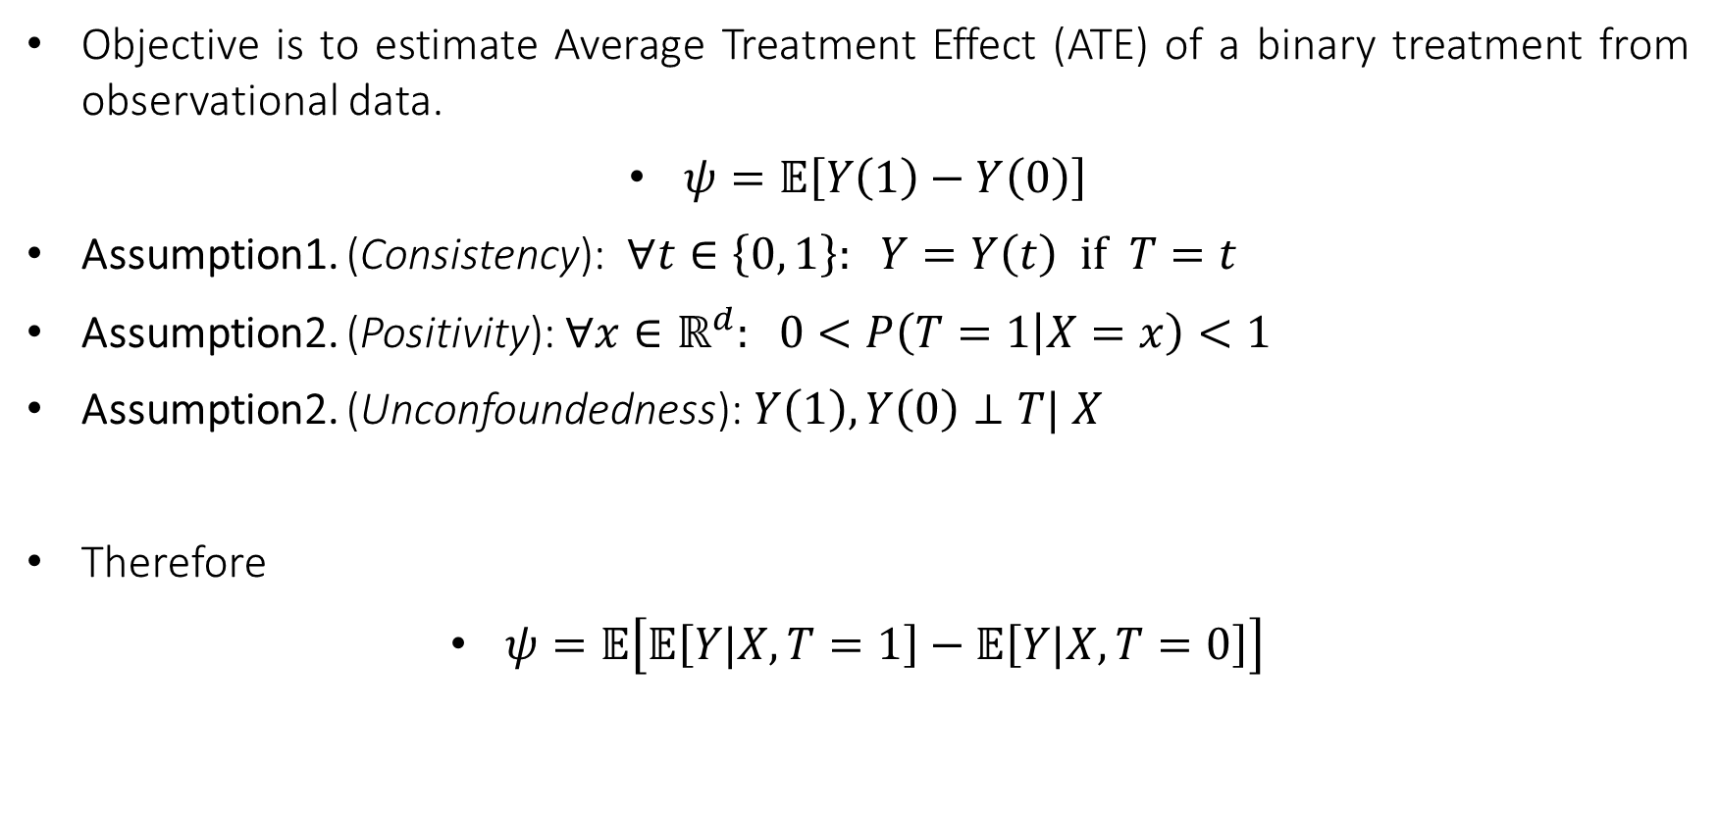
Problem Setup
Objective is to estimate Average Treatment Effect (ATE) of a binary treatment from observational data.
$ψ=𝔼\left[Y\left(1\right)−Y\left(0\right)\right]$
Assumption1. (Consistency): $∀t∈\left\{0, 1\right\}: Y=Y\left(t\right) if T=t$
Assumption2. (Positivity): $∀x∈ℝ^{d}: 0<P\left(T=1 | X=x\right)<1$
Assumption2. (Unconfoundedness): $Y\left(1\right), Y\left(0\right)⊥T| X$
Therefore
$ψ=𝔼\left[𝔼\left[Y|X, T=1\right]−𝔼\left[Y|X, T=0\right]\right]$

Slide 5
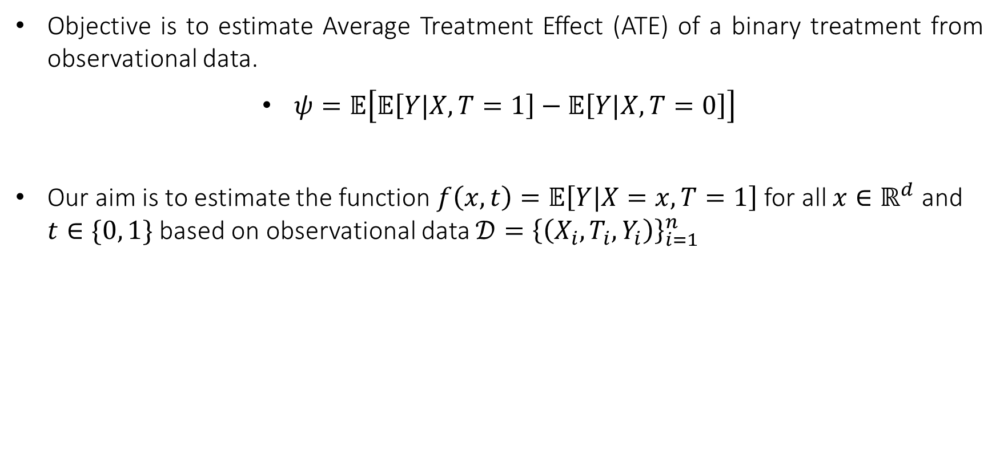
Problem Setup (continued)
Objective is to estimate Average Treatment Effect (ATE) of a binary treatment from observational data.
$ψ=𝔼\left[𝔼\left[Y|X, T=1\right]−𝔼\left[Y|X, T=0\right]\right]$
Our aim is to estimate the function $f\left(x, t\right)=𝔼\left[Y|X=x, T=1\right]$ for all $x∈ℝ^{d}$ and $t∈\{0, 1\}$ based on observational data $𝒟={\left\{\left(X_{i},T_{i},Y_{i}\right)\right\}}_{i=1}^{n}$

Slide 6
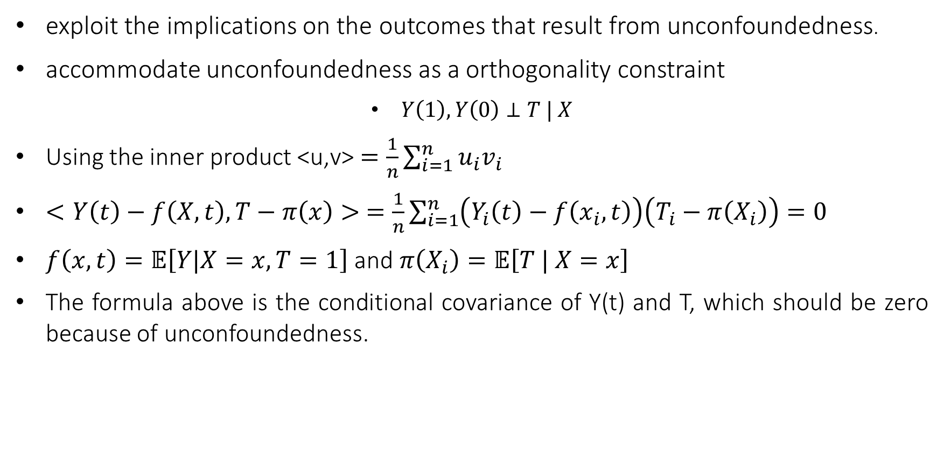
Orthogonal Regularization for Estimating Average Treatment Effects
exploit the implications on the outcomes that result from unconfoundedness.
accommodate unconfoundedness as a orthogonality constraint
$Y\left(1\right), Y\left(0\right)⊥T | X$
Using the inner product <u,v> $=\frac{1}{n}\sum_{i=1}^{n}{u_{i}v_{i}}$
$<Y\left(t\right)−f\left(X,t\right),T−π\left(x\right)> =\frac{1}{n}\sum_{i=1}^{n}{\left(Y_{i}\left(t\right)−f\left(x_{i},t\right)\right)\left(T_{i}−π\left(X_{i}\right)\right)}=0$
$f\left(x, t\right)=𝔼\left[Y|X=x, T=1\right]$ and $π\left(X_{i}\right)=𝔼\left[T | X=x\right]$
The formula above is the conditional covariance of Y(t) and T, which should be zero because of unconfoundedness.

Slide 7
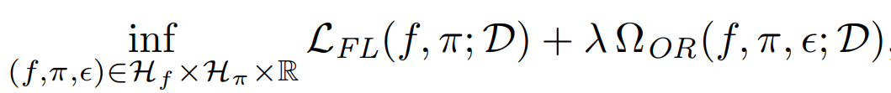
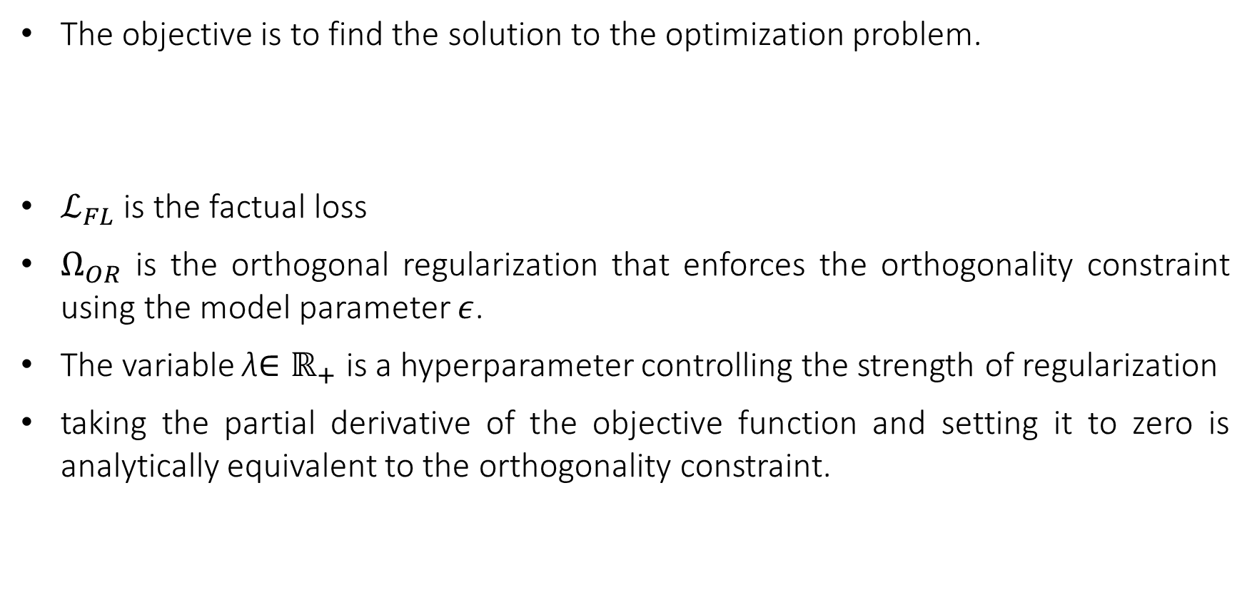
Proposed Regularization Framework
The objective is to find the solution to the optimization problem.
$ℒ_{FL}$ is the factual loss
$Ω_{OR}$ is the orthogonal regularization that enforces the orthogonality constraint using the model parameter $ε$.
The variable λ$∈ℝ_{+}$ is a hyperparameter controlling the strength of regularization
taking the partial derivative of the objective function and setting it to zero is analytically equivalent to the orthogonality constraint.

Slide 8
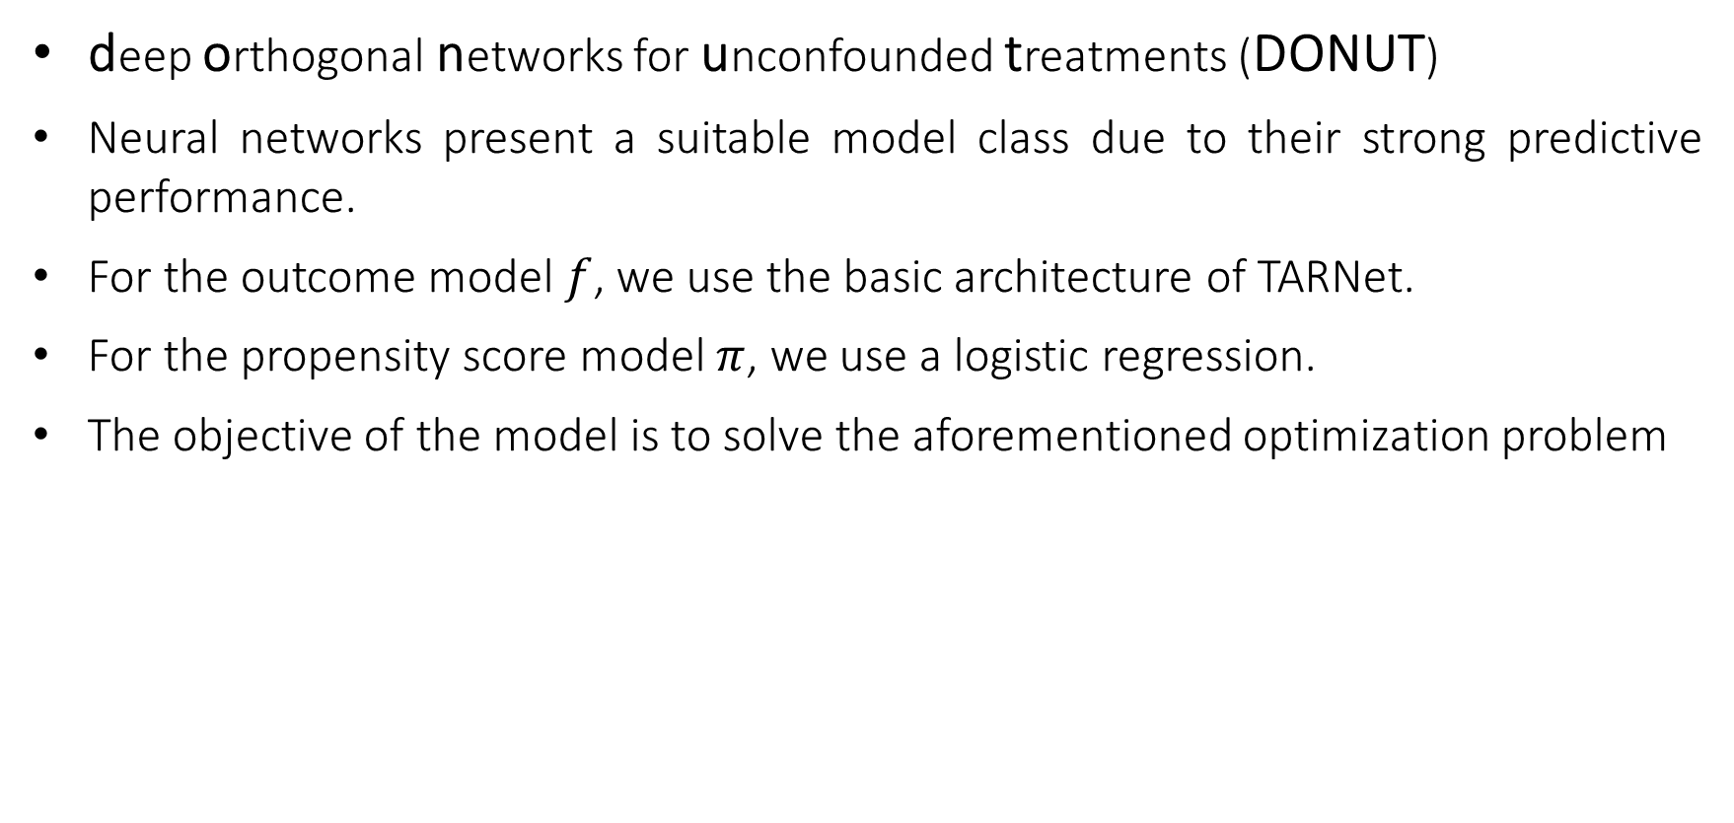
Deep Orthogonal Networks for Unconfounded
Treatments
deep orthogonal networks for unconfounded treatments (DONUT)
Neural networks present a suitable model class due to their strong predictive performance.
For the outcome model $f$, we use the basic architecture of TARNet.
For the propensity score model $π$, we use a logistic regression.
The objective of the model is to solve the aforementioned optimization problem

Slide 9
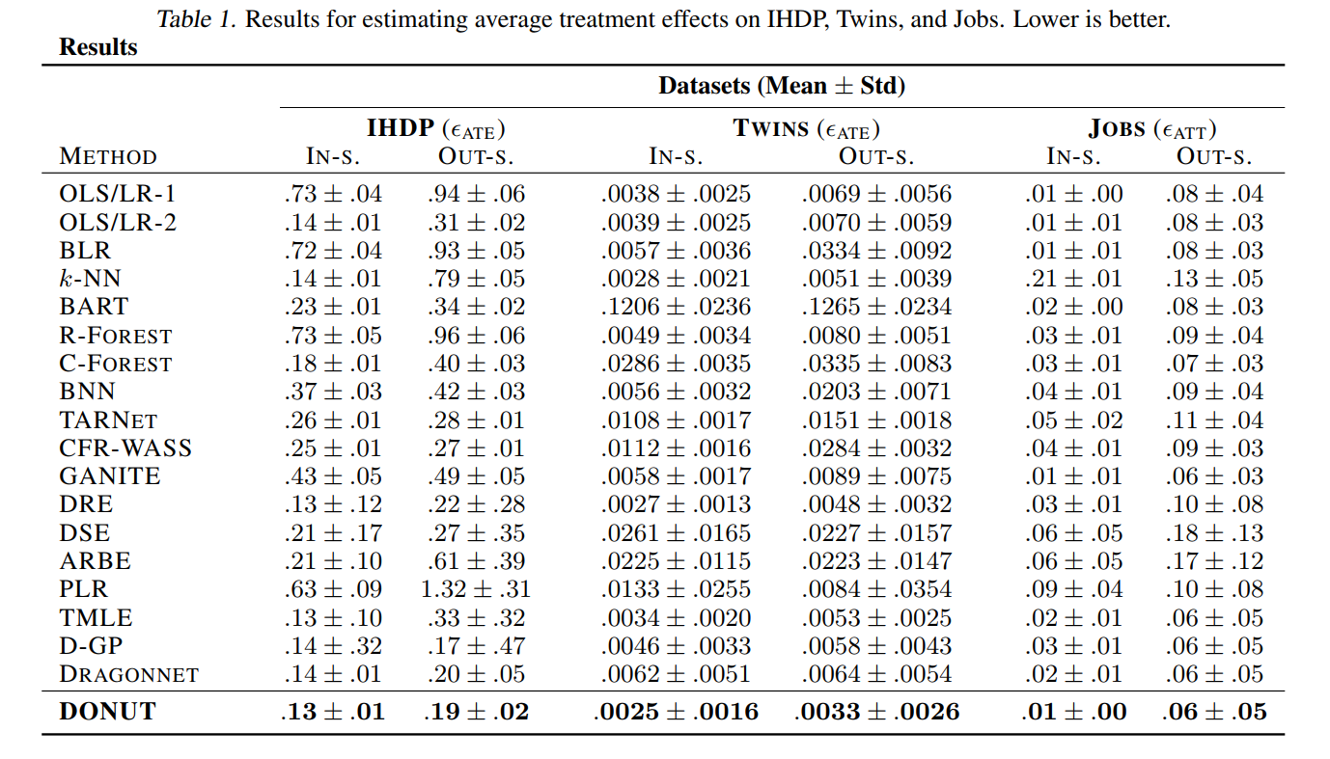
Results

Slide 10
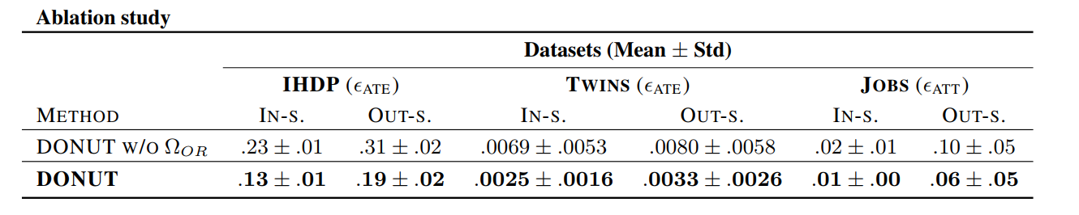
Results (Ablation Study)

