Slide 1
Attention is All You Need
google
Neural Information Processing Systems (NIPS 2017)

Slide 2

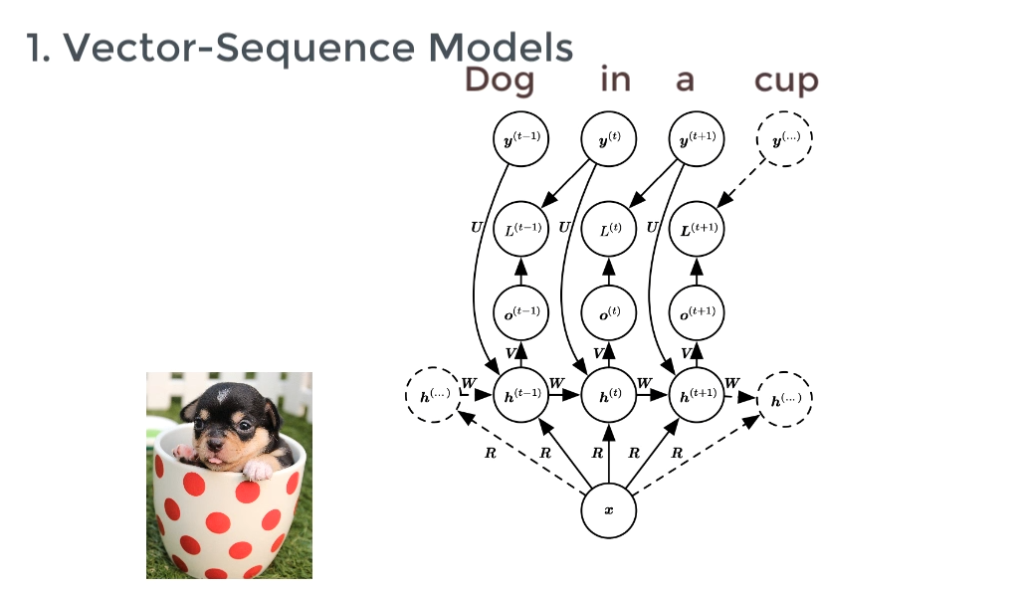
A look back to RNN/LSTM

Slide 3
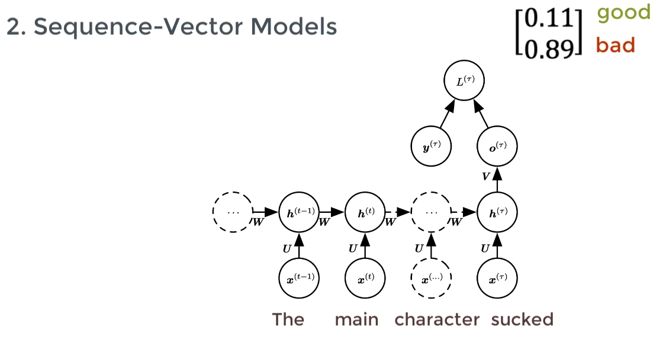
A look back to RNN/LSTM

Slide 4
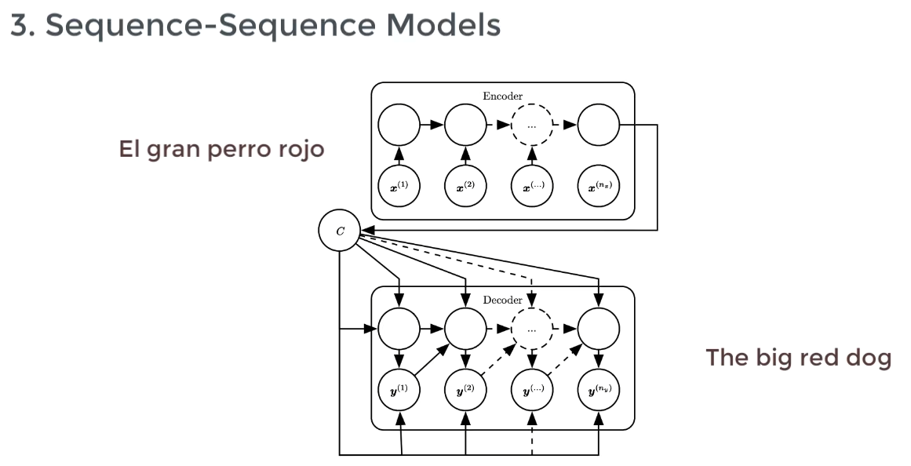
A look back to RNN/LSTM

Slide 5
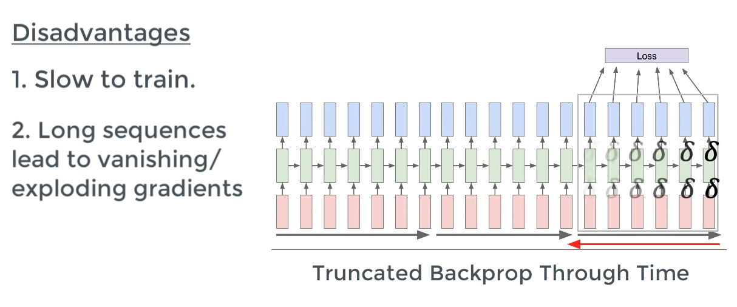
A look back to RNN/LSTM

Slide 6
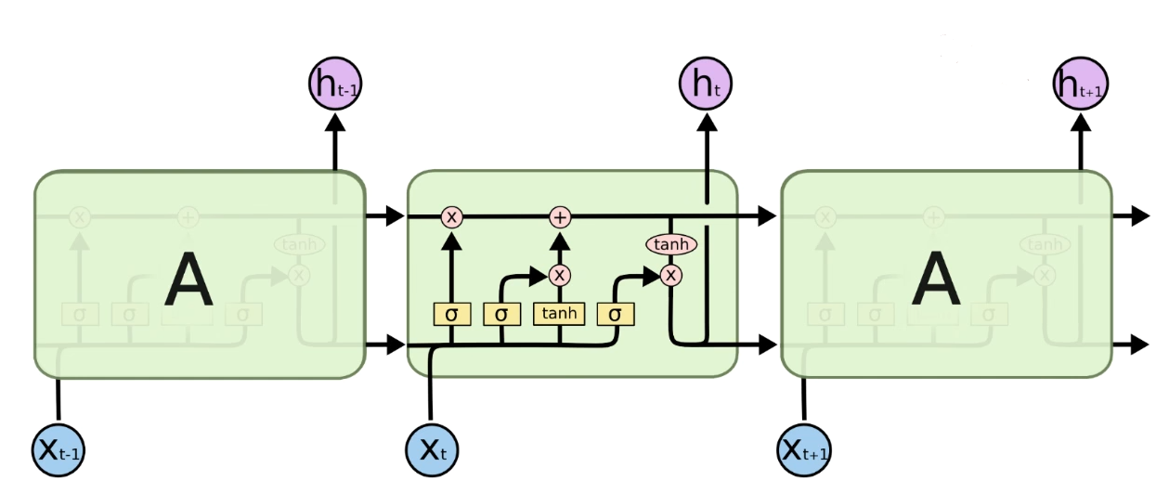
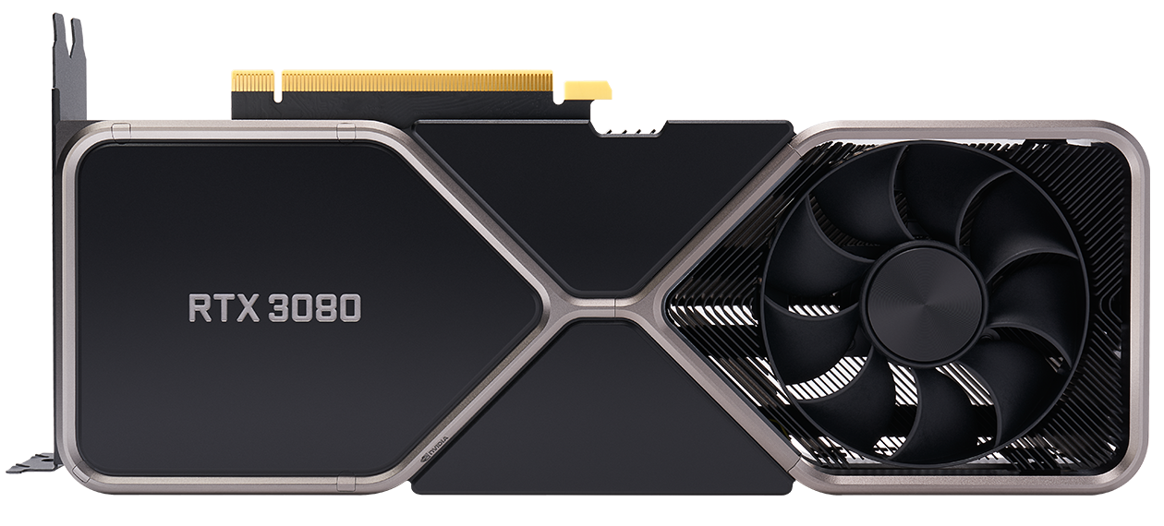

A look back to RNN/LSTM
dependencies

Slide 7
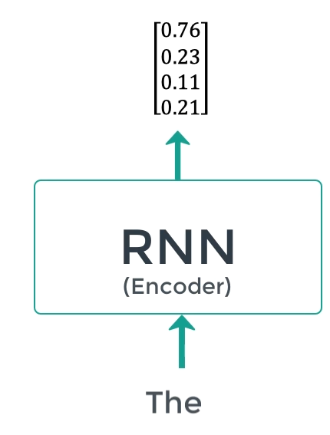
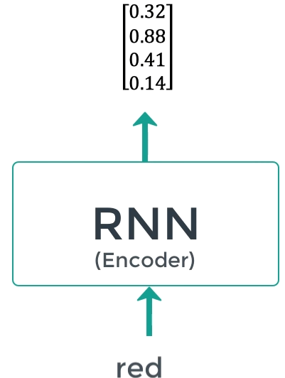
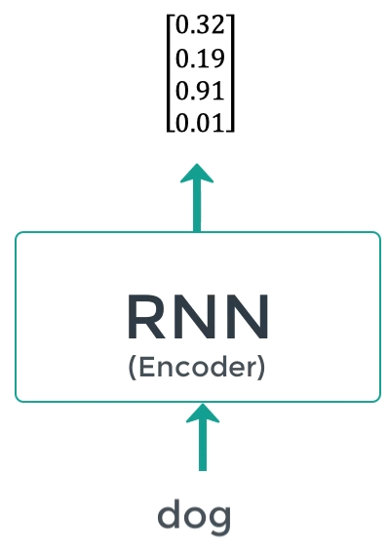
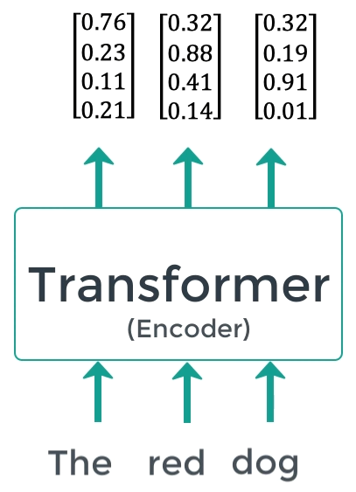
Attention Model/Transformer
Idea is to do ‘parallelization’
VS

Slide 8
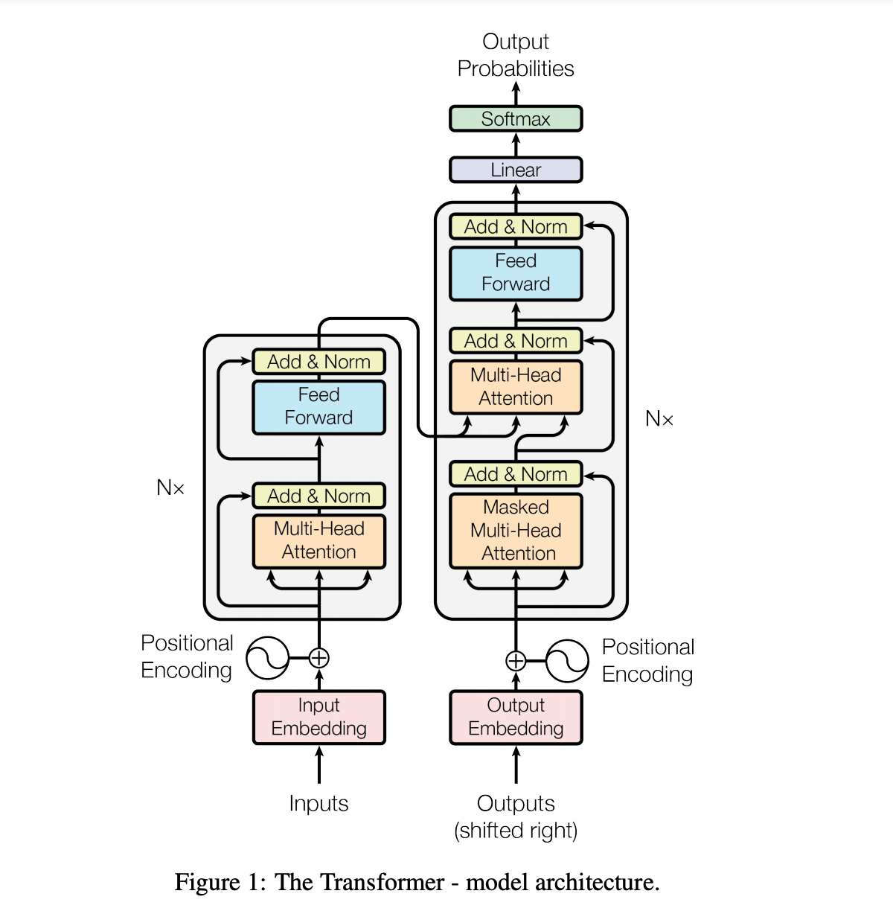
Attention Model/Transformer

Slide 9
Attention Model/Transformer
Input embedding

Slide 10
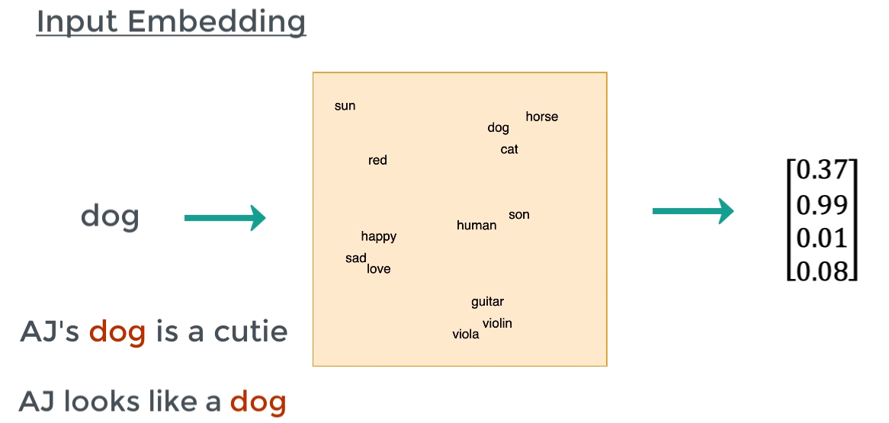
Attention Model/Transformer

Slide 11
Attention Model/Transformer
Position encoding

Slide 12
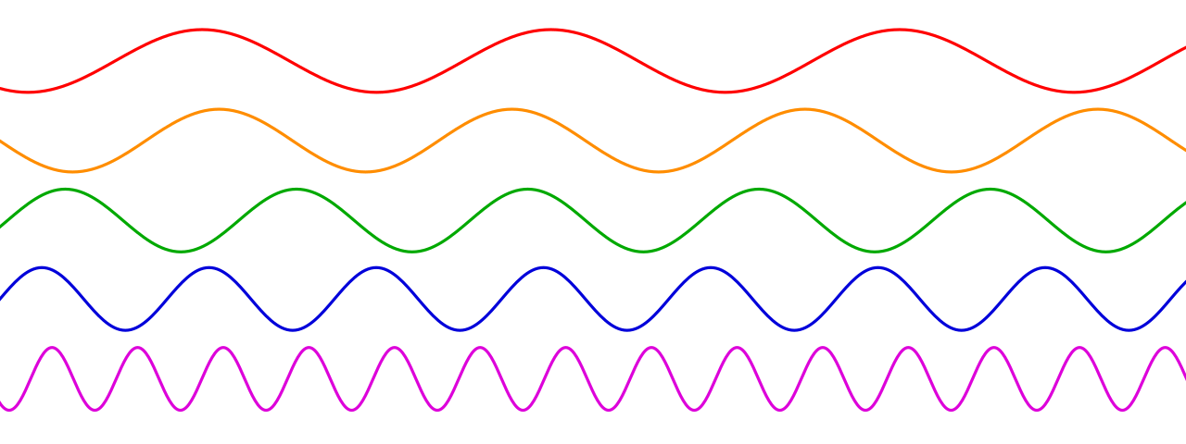
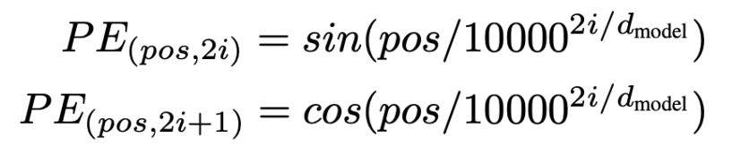
Attention Model/Transformer

Slide 13
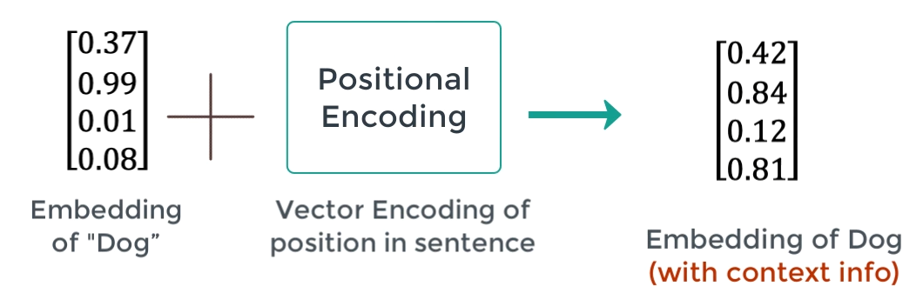
Attention Model/Transformer

Slide 14
Attention Model/Transformer
Attention between the outputs of encoder and masked attention
Self Attention
Masked self Attention

Slide 15
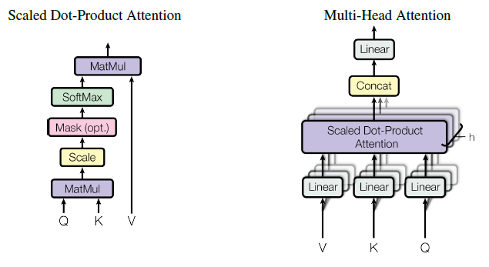
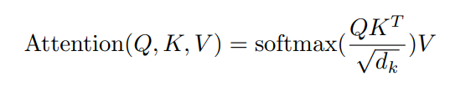
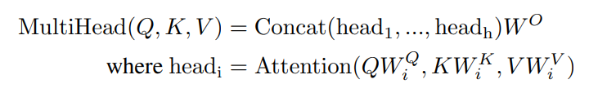
Attention Model/Transformer

Slide 16
Attention Model/Transformer
K1
(height)
<Q,K>
V
K2
(age)
0.1
0.9
0.2
0.1
171
23
130
1
Q
(age)
K3
(weight)
K4
(hair)

Slide 17
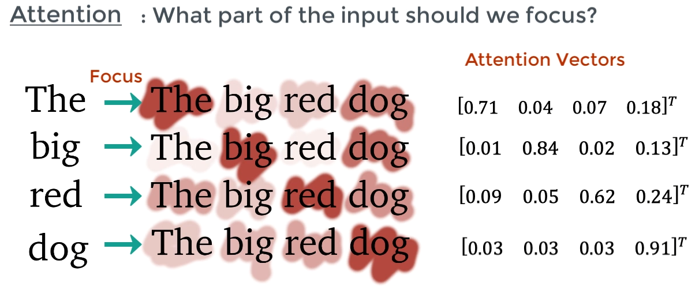
Attention Model/Transformer

Slide 18
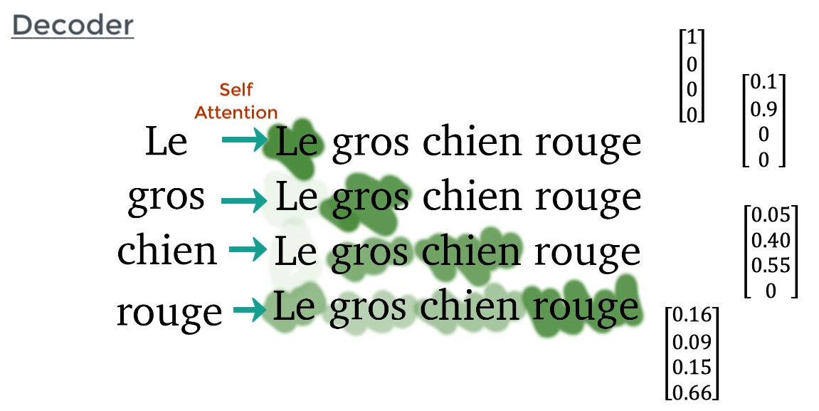
Attention Model/Transformer

Slide 19
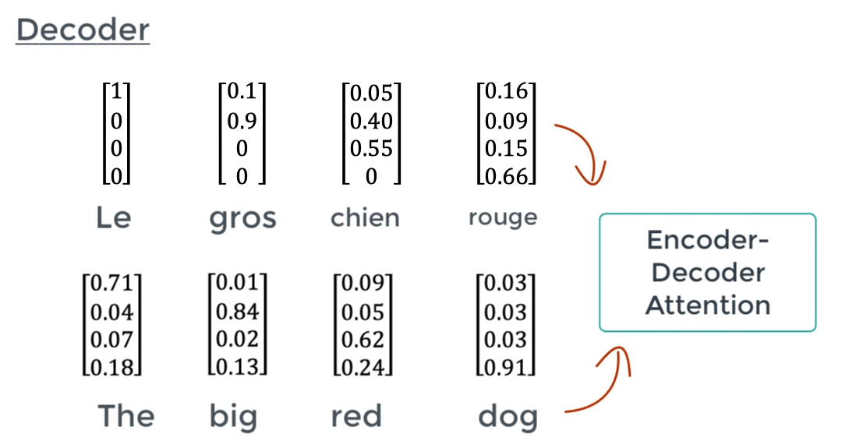
Attention Model/Transformer
English to French mapping takes place

Slide 20
Attention Model/Transformer
Prediction
Increases the dimension to number of French words
FFN
#neurons = #french words
FFN + Norm.
FFN + Norm.

Slide 21
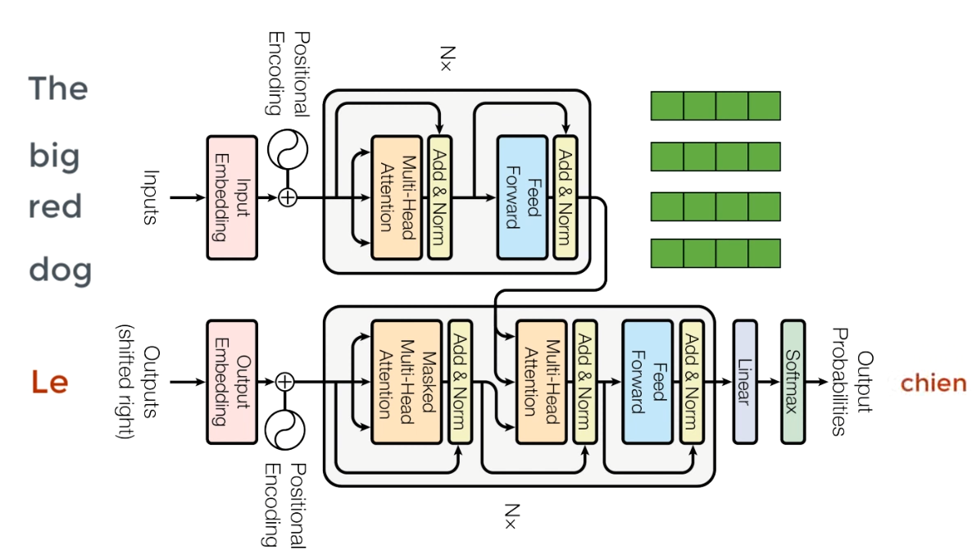
Attention Model/Transformer

Slide 22
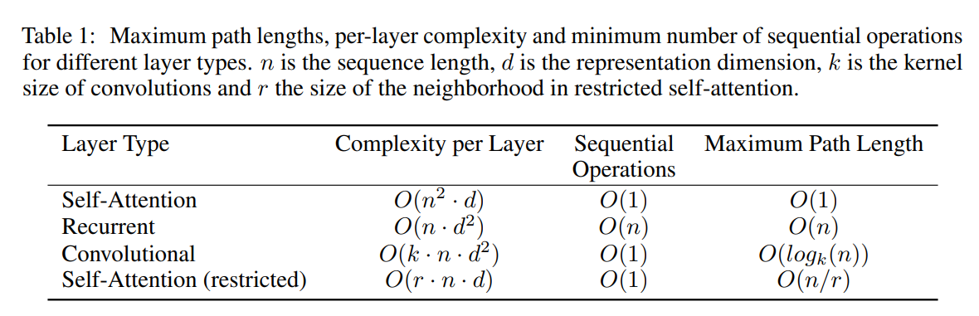
Training
WMT 2014 English-French dataset
36M sentences
32000 word-piece vocabulary
8 NVIDIA P100 GPUs
12 hours

