Slide 1
Recent Techniques in semi-supervised learning
[1] Improved Techniques for Training GANs
[2] SimPLE: Similar Pseudo Label Exploitation for Semi-Supervised Classification

Slide 2
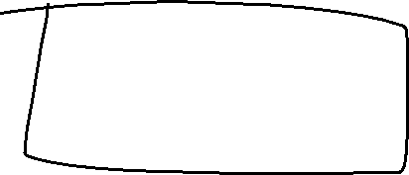


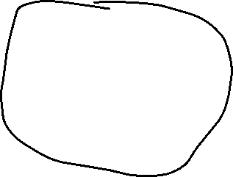


Semi-supervised learning
Semi-supervised learning
Labeled data
Unlabeled data
All Labeled data

Slide 3
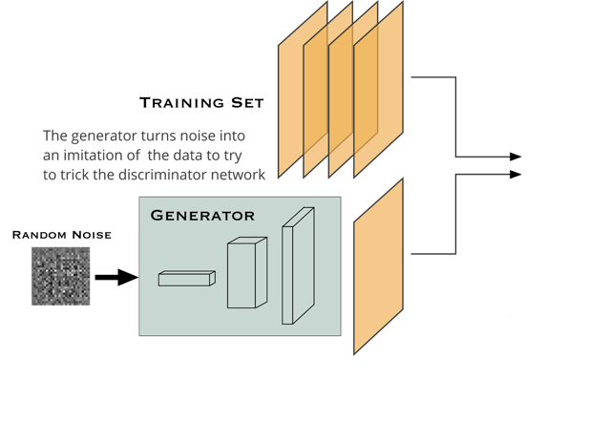
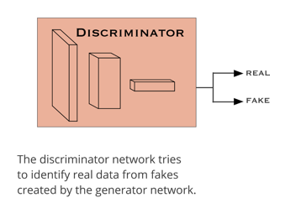



GAN in practice
Optimize between generator and discriminator
Discriminator not too demanding
Generator not too imperfect
After optimization, get rid of the discriminator to generate synthetic data

Slide 4
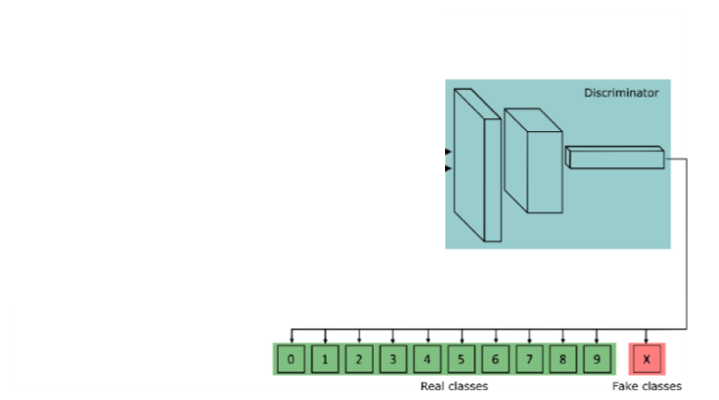
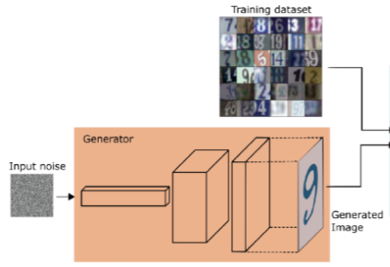
GAN in semi-supervised learning
Optimize between generator and discriminator
Discriminator has k+1 classes
Generator synthesizes data from random noise
After optimization, get rid of the generator to classify data

Slide 5
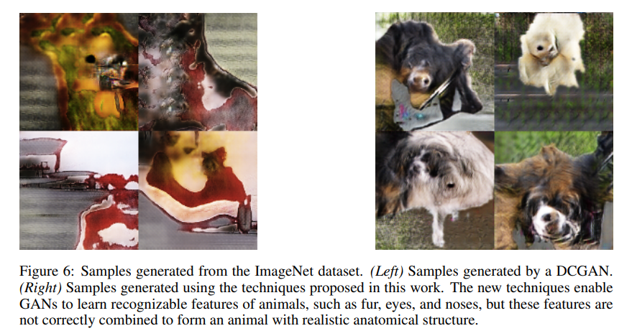
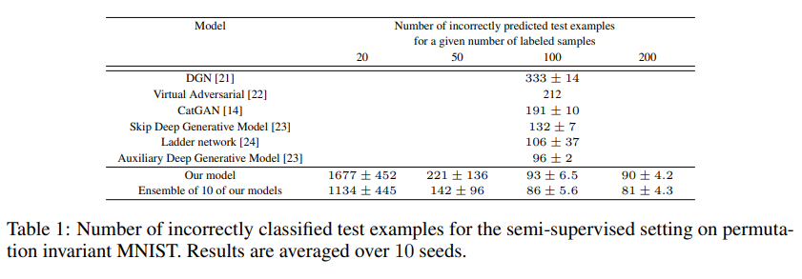

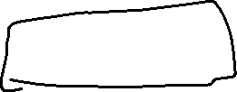






Achievement/drawback

Slide 6
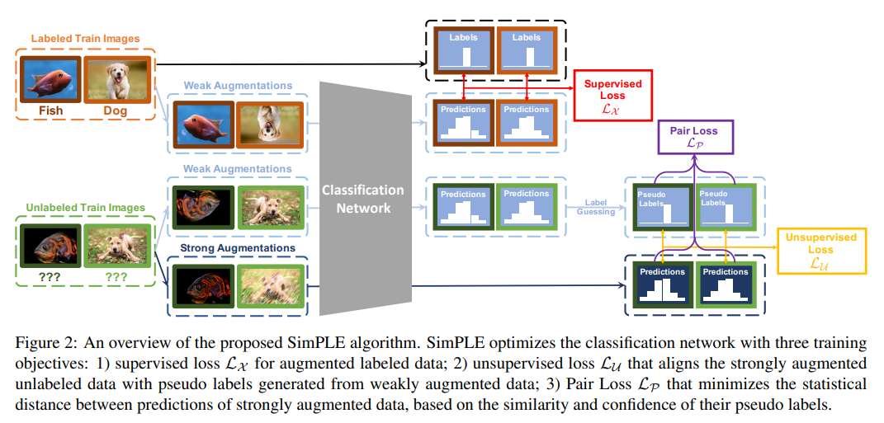









SimPLE

Slide 7
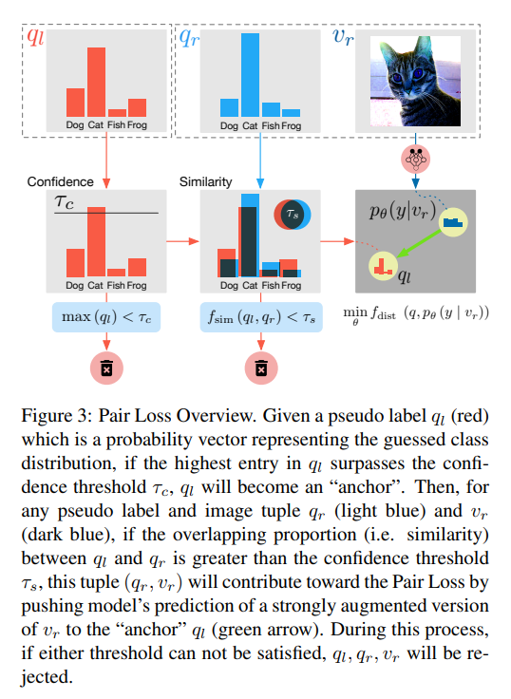


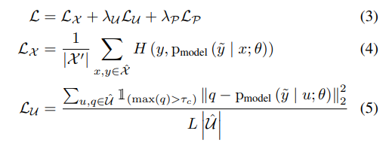

SimPLE: loss functions
calculates the cross-entropy of weakly augmented labeled samples;
represents the L2 distance between strongly augmented samples and their pseudo labels;
Total loss

Slide 8
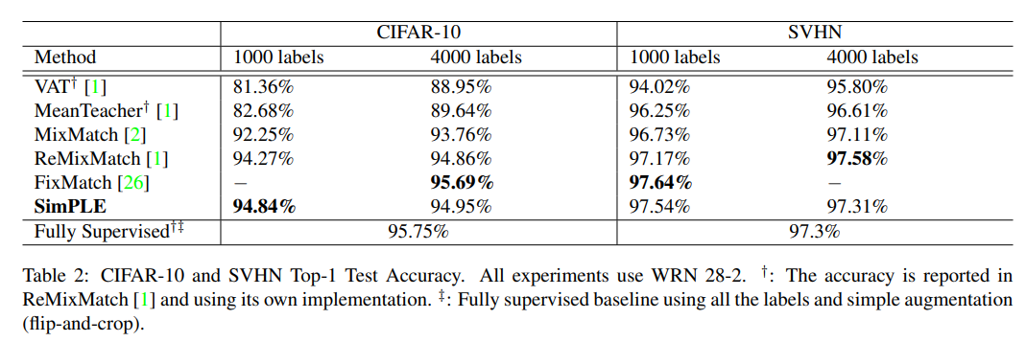
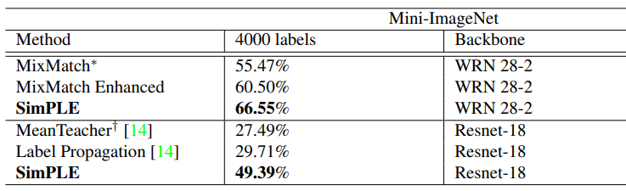
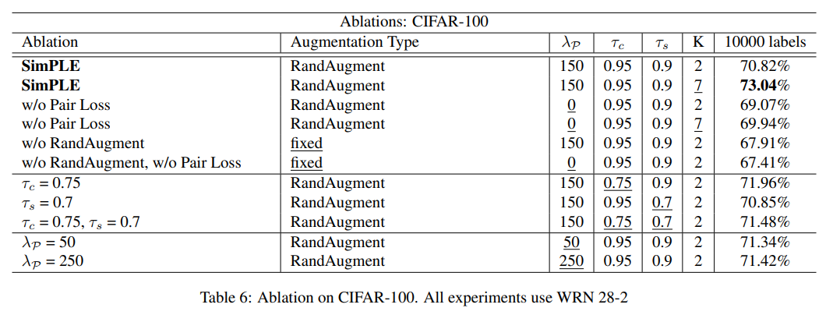

SimPLE: Results

