Slide 1
SNR: Sub-Network Routing for Flexible Parameter Sharing in Multi-Task Learning
AAAI 2019

Slide 2
MTL
Increased Performance
Compact architecture
Reduced computation cost
Good for low latency usage

Slide 3
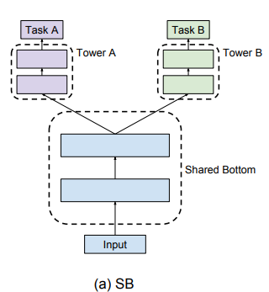
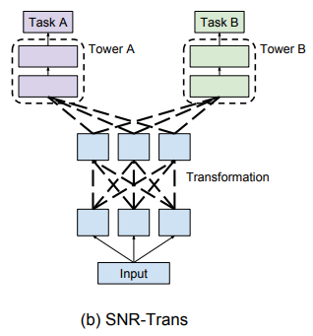
MTL
2 different schemes
Hard parameter sharing
Soft parameter sharing

Slide 4



Neural Architecture Search (NAS)
Zoph and Lee 2016
Outer loop:
{
RNN based controller generates different NN models
inner loop:
{
train the model with RL
rewarded by accuracy
}
}

Slide 5


Approach
SNR-Trans
v1
v2
z13=z23=0 yields
u1
u2
u3
SNR-Aver
task1
task2
z11=z22=1
Others = 0 yields

Slide 6
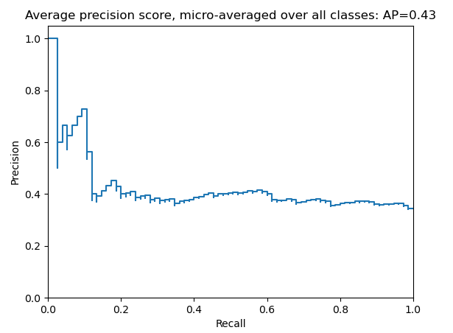




Dataset
YouTube8M
6.1M YouTube video IDs
Input features: precomputed visual and audio features from corresponding videos
24 categories
To ensure balanced dataset, top 16 categories are selected as different tasks
mAP@10
Avg. of 10 networks
Evaluation Metric

Slide 7
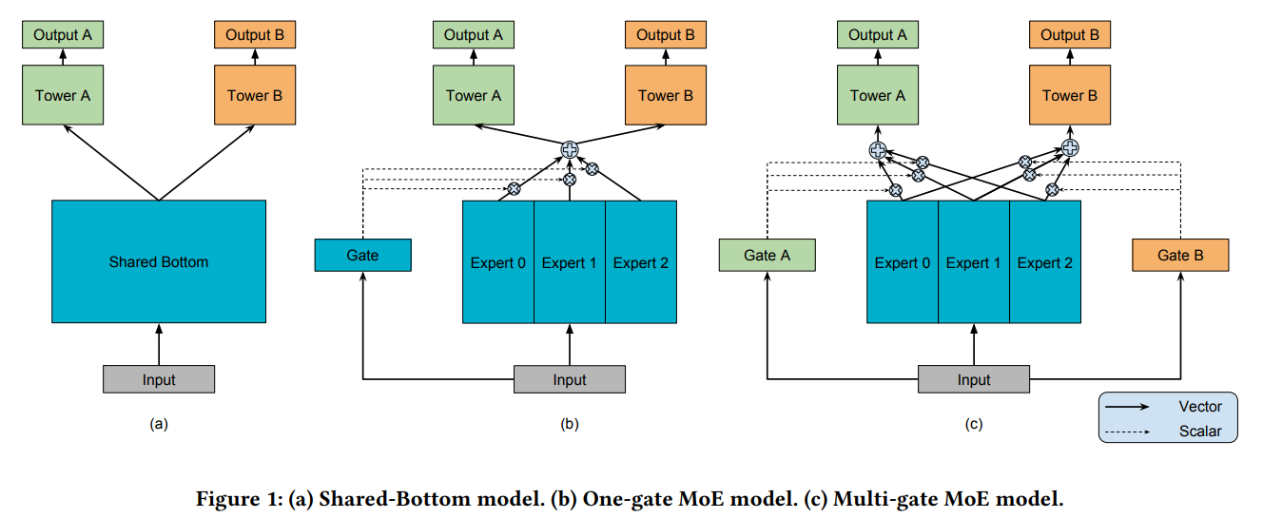
Comparable work (OMoE, MMoE)

Slide 8
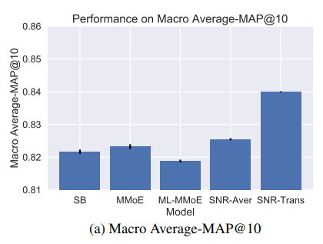
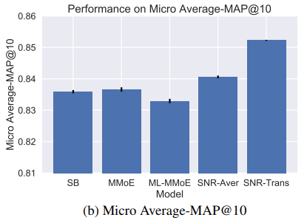
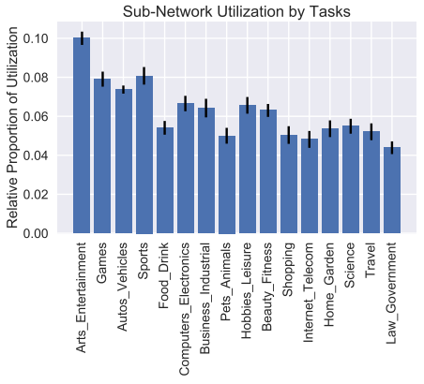
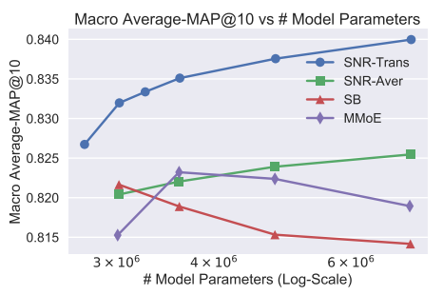
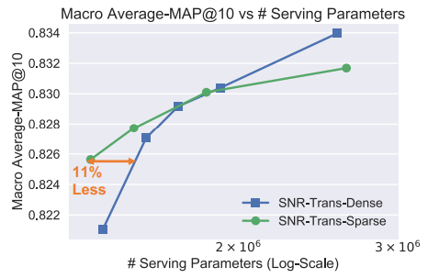
Results

