Slide 1
Fourier Transform Short Time Fourier Transform Wavelet Transform
Presenter: Nooshin Taheri
Date: 1/2/2024

Slide 2
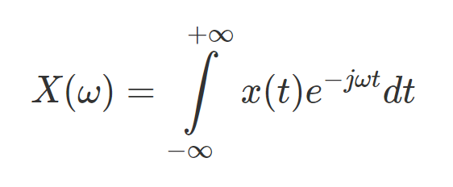
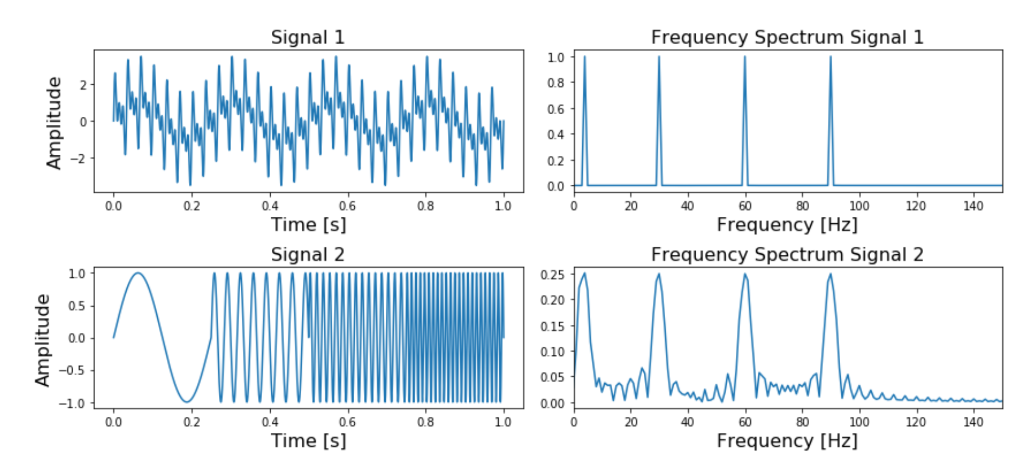
Fourier Transform:
Transform a signal from its time-domain to its frequency domain
The peaks in the frequency spectrum indicate the most occurring frequencies in the signal
It works well when the frequency spectrum is stationary
Most of the signals we see in real life are non-stationary in nature

Slide 3
Short-Time Fourier Transform (STFT):
Transform a signal from its time-domain to time-frequency domain.
Split the original signal into several parts of equal length (with or without overlap)
Apply FT for each part
Limitations of STFT:
Fixed Time and Frequency Resolution: a fixed window size remains the same throughout the entire signal.
Limited Time-Frequency Resolution Tradeoff:
Smaller window size: Provides more information about the frequency's location in the signal.(improve time resolution)
Larger window size: Offers more insight into the frequency value but sacrifices precision in timing.(improve frequency resolution)
This limitation is referred to as the uncertainty principle, or Heisenberg inequality.
Δt * Δf ≥ 1/4π

Slide 4
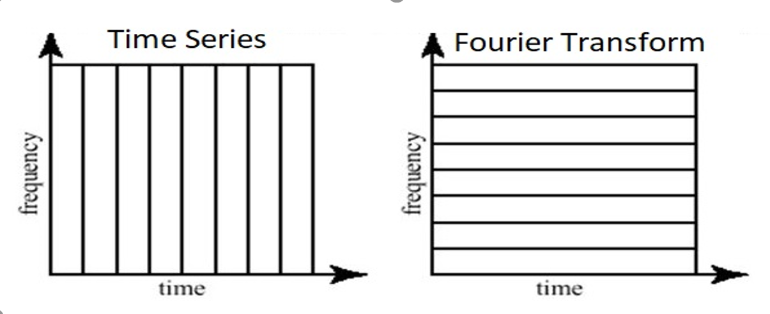
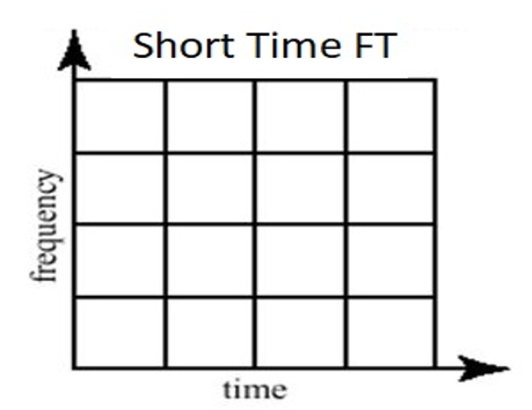
Time and frequency resolution in different transformations:
high time resolution
zero frequency resolution
high frequency resolution
zero time resolution
medium sized resolution in both the frequency and time domain.

Slide 5
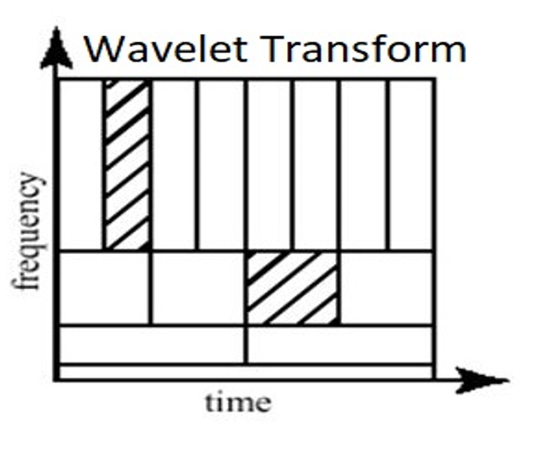
Wavelet Transform:
The wavelet transform results in analyzing a signal into different frequencies at different resolutions, known as multiresolution analysis.
for small frequency values a high resolution in the frequency domain, low resolution in the time- domain,
for large frequency values a low resolution in the frequency domain, high resolution in the time domain.

Slide 6
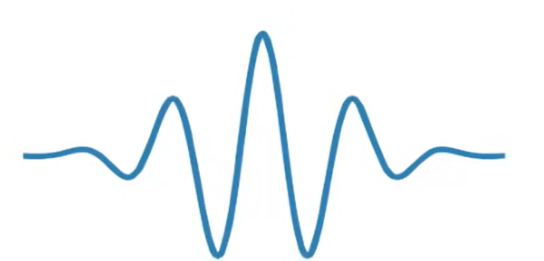
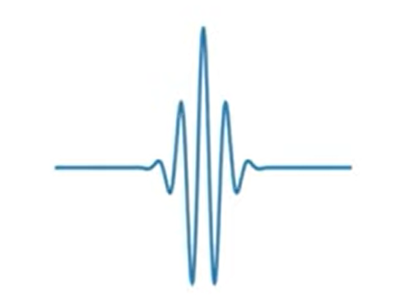

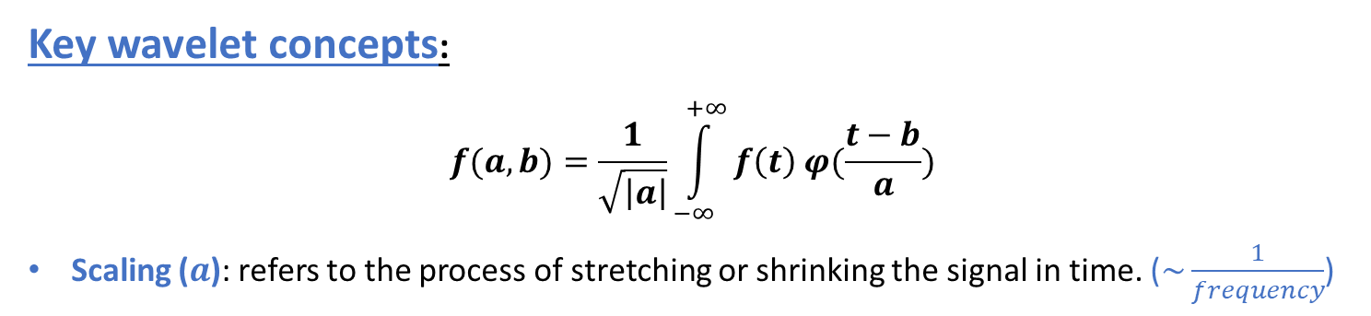
Key wavelet concepts:
$$f(a,b)=\frac{1}{\sqrt{\left|a\right|}}\int_{−∞}^{+∞}{f\left(t\right) φ(\frac{t−b}{a})}$$
Scaling ($a$): refers to the process of stretching or shrinking the signal in time. ($\sim \frac{1}{frequency}$)
Stretched wavelet is better at resolving low frequency components of the signal with low time resolution
(Large values of a)
Shrunken wavelet is better at resolving high frequency components of the signal with high time resolution
(Small values of a)
Shifting (translation): shows where the wavelet is positioned in time.
$$∅\left(t−b\right)$$

Slide 7
How does wavelet transform work:
The Wavelet Transform uses a series of functions called wavelets, each with a different scale.
We start with the beginning of our signal and slowly move the wavelet towards the end of the signal. This procedure is also known as a convolution.
After we have done this for the original (mother) wavelet, we can scale it such that it becomes larger and repeat the process.

Slide 8
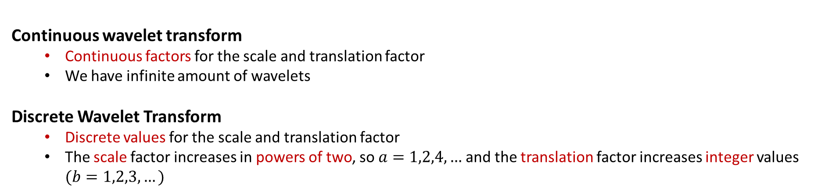
Continuous Wavelet Transform vs Discrete Wavelet Transform
These transforms differ based on how the wavelets are scaled and shifted.
Continuous wavelet transform
Continuous factors for the scale and translation factor
We have infinite amount of wavelets
Discrete Wavelet Transform
Discrete values for the scale and translation factor
The scale factor increases in powers of two, so $a=1,2,4,…$and the translation factor increases integer values $(b=1,2,3,…)$

Slide 9
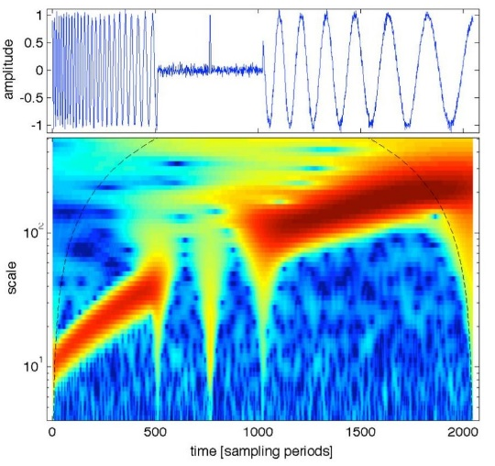
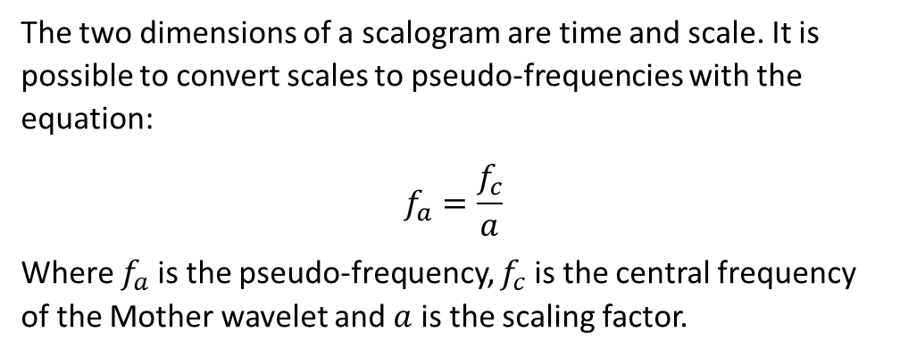
Scalogram:
The 2D representation of a signal's continuous Wavelet transform output is termed a 'scalogram’.
It presents the energy of signal at specific scale and time-location.
The two dimensions of a scalogram are time and scale. It is possible to convert scales to pseudo-frequencies with the equation:
$$f_{a}=\frac{f_{c}}{a}$$
Where $f_{a}$is the pseudo-frequency, $f_{c}$is the central frequency of the Mother wavelet and $a$ is the scaling factor.

Slide 10
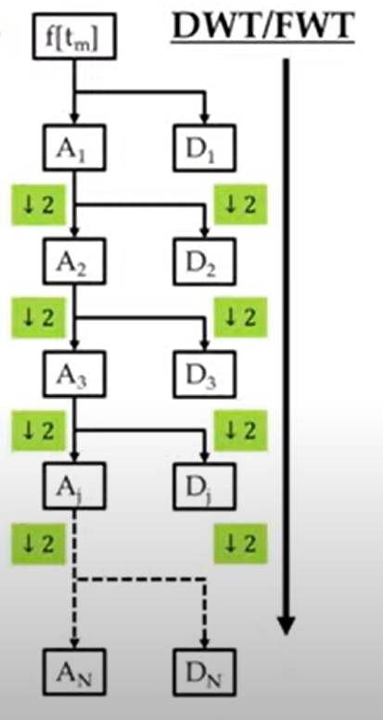
Multilevel Decomposition:
In practice, the DWT is always implemented as a filter-bank
The number of coefficients halve each time
The signal is passed into low pass and high pass filters
The high pass portions are the detail coefficients
The low pass portions
(Approximation coefficients) are iteratively filtered by the same process
goes on until we have reached the level of refinement we need or until we run out of samples.
We end up with sets of approximation and detailed coefficients

Slide 11
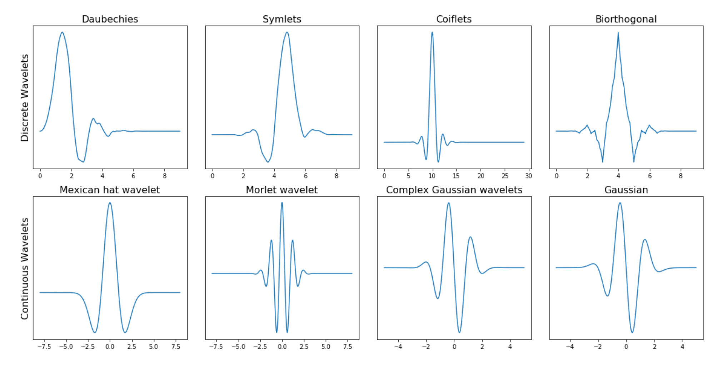
Different types of wavelet families:
Two properties of wavelets:
1) finite energy
2) zero mean

