Slide 1
WHICH TASKS SHOULD BE LEARNED TOGETHER IN MULTI-TASK LEARNING?
ICLR 2020

Slide 2
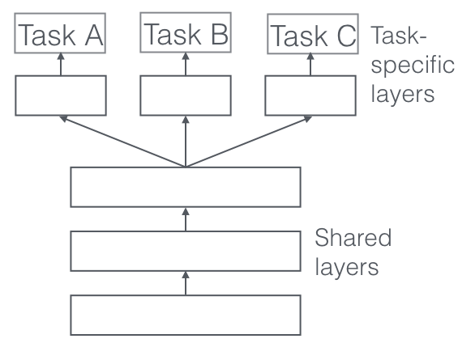
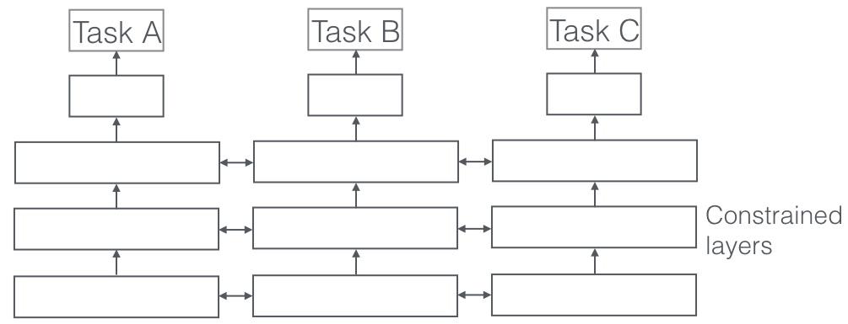
Multi-task Learning
Solve multiple related tasks with one single model (less training time/less inference time)
Model focuses on all tasks
Knowledge of one task can be inductively shared to perform other tasks
Probability of overfitting is very low
Hard Parameter Sharing
Soft Parameter Sharing

Slide 3



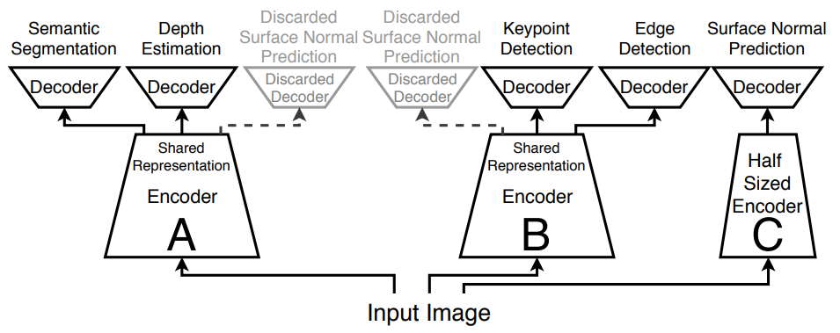
Objectives
Set of tasks τ = (t1,t2,…..,tk)
Maximum allowable inference time b
The overall performance for a solution S is
We want to find the solution with the lowest overall loss and a cost that is under our budget

Slide 4


Candidate Networks
Set of tasks τ = (t1,t2,…..,tk)
Number of tasks = |τ|
Evaluate the performance of tasks, where-
|τ|C1 refers to number of single task models
|τ|C2 refers to number of models that solve task pairs
|τ|C3 refers to number of models that solve any 3 tasks
And so on..
To evaluate the size of the networks, additional |τ| networks with half computational cost were also trained
So, a total of networks were evaluated
If there are 5 tasks, 36 number of networks were evaluated

Slide 5
Early Stopping Approximation (ESA)
Stop training after utilizing 20% of the training data
Pearson-Correlation between ESA-validation-loss and Complete-validation-loss is 0.49
So, the task relationship trends stabilize early
Reduces the time burden 20x
Takes fewer than 150 GPU hours [1 GPU hr. = 1 GPU * 1 Day]
Has some prediction accuracy penalty
Higher Order Approximation (HOA)
Predicts higher orders from lower ordered network
Performance of A-B, B-C and C-A networks tell us about the performance of A-B-C network
Saves 50% training time
Also comes with prediction quality penalty
For example, if you have networks, a&b with losses 0.1&0.2, b&c with 0.3&0.4, and a&c with 0.5&0.6, the per-task loss estimate for a network with a&b&c would be a = (0.1 + 0.6)/2 = 0.35, b = (0.2 + 0.3)/2 = 0.25 and c = (0.4 + 0.6)/2 = 0.5.

Slide 6
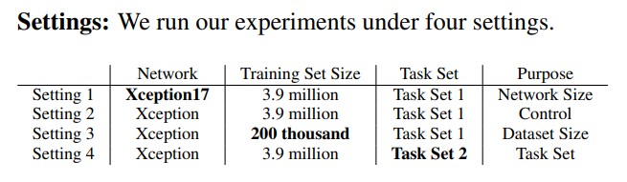
Taskonomy dataset
5 tasks: Semantic Segmentation, Depth Estimation, Surface Normal Prediction, Keypoint Detection, and Edge Detection
1 semantic task, 2 3D tasks and 2 2D tasks
The data was obtained from 3D scans of about 600 buildings
4M examples-
3.9M training, 0.05M validation, 0.05M test
Model selection
Modified Xception Network – Encoder Decoder
Inference time unit = 1 SNT (Standard Network Time)

Slide 7
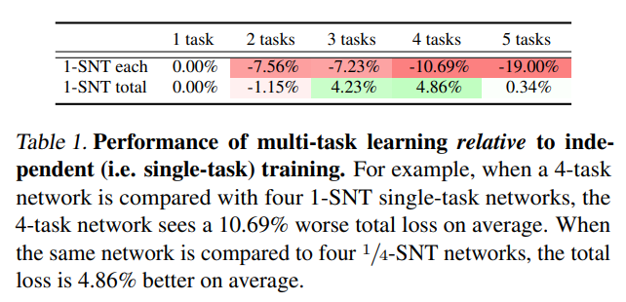
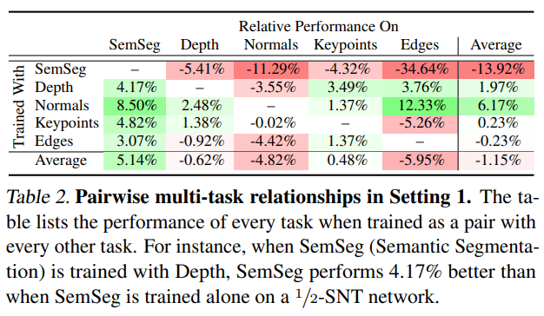
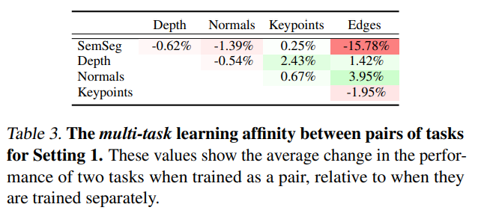
Results

Slide 8
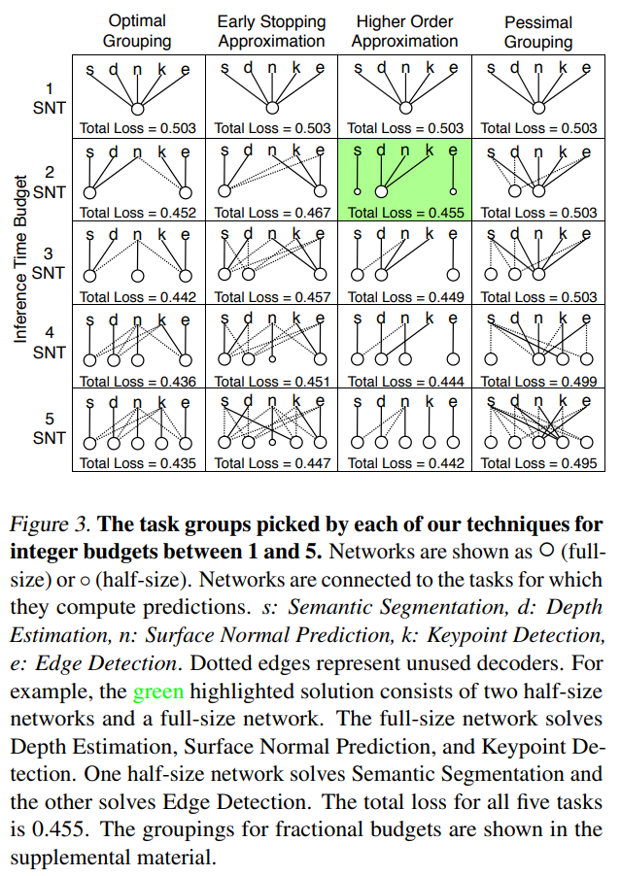
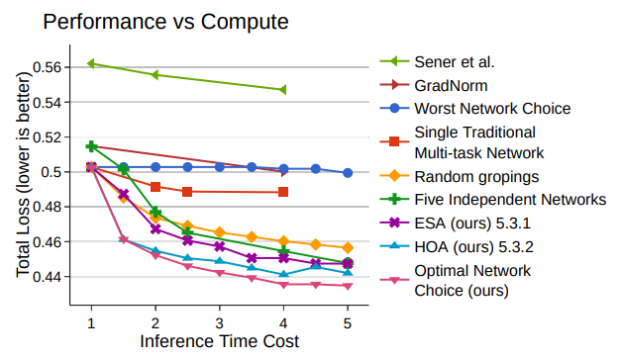
Results

