Slide 1
DeepFood: Food Image Analysis and Dietary Assessment via Deep Model IEEE’S SPECIAL SECTION ON DATA-ENABLED INTELLIGENCE FOR DIGITAL HEALTH
LANDU JIANG, BOJIA QIU, XUE LIU, CHENXI HUANG, and KUNHUI LIN
School of Informatics, Xiamen University, School of Computer Science, McGill University

Slide 2
Introduction
Obesity and dietary habits as major health challenges globally.
What and how people eat is always the major problem that results in weight gain.
Medical cost for people who have obesity was $1,429 higher than those of normal weight.
An accurate estimation of dietary caloric intake will be very important for well-being. Besides, the rapid development of Internet of Things (IoT) and the explosion of data enhances the social media user experience.

Slide 3
Overview of DeepFood
A deep learning-based system for recognizing (localizing and classifying) food items from images
Uses Faster R-CNN for object detection
Provides detailed nutritional analysis
Generates dietary reports with calorie and macronutrient breakdown
Specifically, they propose a three-step algorithm.
Regional Proposal Network
Classify each region
generate a dietary assessment report

Slide 4
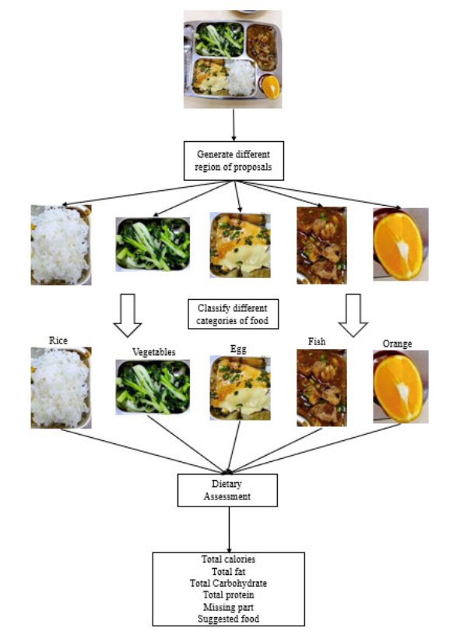
Contributions
They explore a deep model based approach (using faster RCNN) for food recognition and dietary assessment.
They generate/revise a new food related dataset, named FOOD20-with-bbx, based on the existing dataset FOOD101 dataset.
They use UEC-FOOD100 [38] and UEC-FOOD256 [32] datasets with bounding box information for detection evaluation.

Slide 5
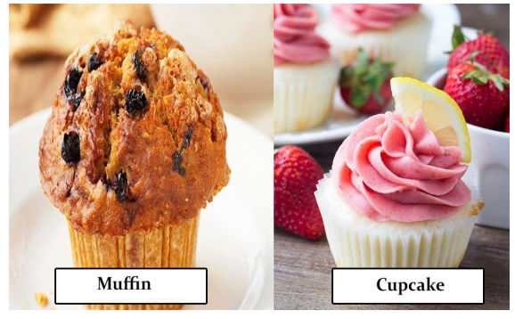
Datasets
UEC-FOOD100: 12,740 images, 100 categories
UEC-FOOD256: 31,395 images, 256 categories
FOOD20-with-bbx: Subset of FOOD101 with manually labeled bounding boxes
The problem of High intra-class and low inter-class variance in food images
Data augmentation techniques included horizontal flipping, rotation (90°, 180°, 270°)

Slide 6
Key Methodologies
Faster R-CNN:
Region Proposal Network for generating RoIs
Bounding box regression for accurate localization
Highly efficient for detecting multiple food items in complex scenarios
Classification Model:
VGG-16 for feature extraction and classification
Transfer learning employed to adapt the model to food datasets
Evaluation Metrics:
Mean Average Precision (mAP) for detection: Measures precision and recall across various thresholds
Intersection over Union (IoU) for bounding box accuracy: Evaluates the overlap between predicted and ground truth boxes

Slide 7
Key Methodologies
Faster R-CNN:
Region Proposal Network for generating RoIs
Bounding box regression for accurate localization
Highly efficient for detecting multiple food items in complex scenarios
Classification Model:
VGG-16 for feature extraction and classification
Transfer learning employed to adapt the model to food datasets
Evaluation Metrics:
Mean Average Precision (mAP) for detection: Measures precision and recall across various thresholds
Intersection over Union (IoU) for bounding box accuracy: Evaluates the overlap between predicted and ground truth boxes

Slide 8
Key Results and Performance
Faster R-CNN:
Region Proposal Network for generating RoIs
Bounding box regression for accurate localization
Highly efficient for detecting multiple food items in complex scenarios
Classification Model:
VGG-16 for feature extraction and classification
Transfer learning employed to adapt the model to food datasets
Evaluation Metrics:
Mean Average Precision (mAP) for detection: Measures precision and recall across various thresholds
Intersection over Union (IoU) for bounding box accuracy: Evaluates the overlap between predicted and ground truth boxes

Slide 9
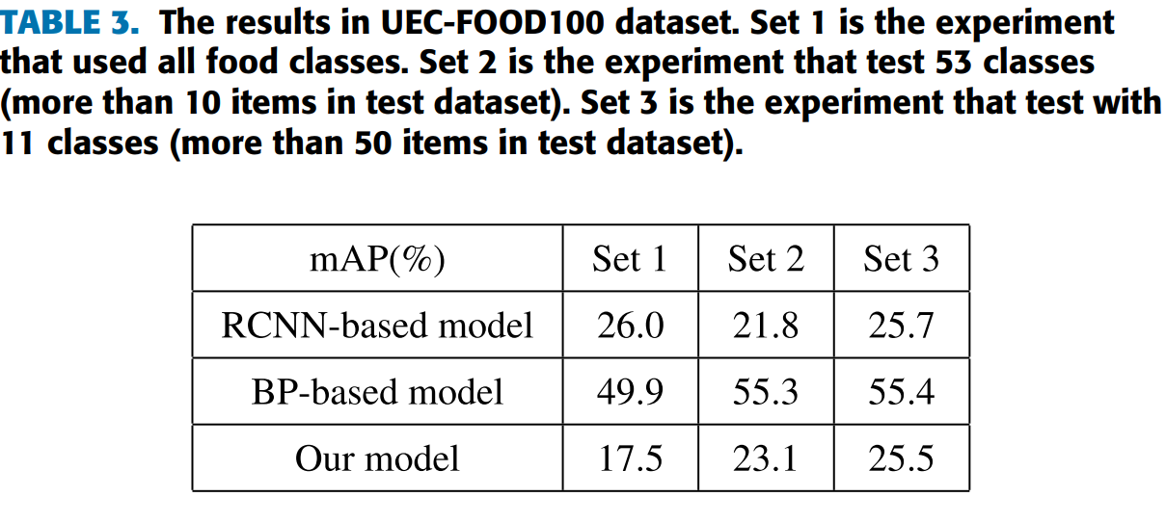
Key Results and Performance

Slide 10
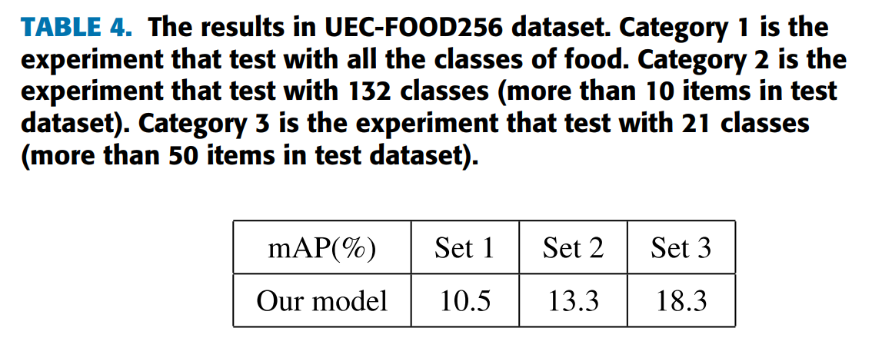
Key Results and Performance

Slide 11
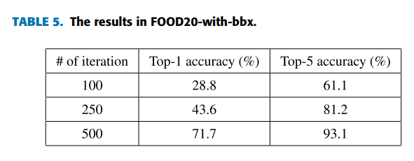
Key Results and Performance

Slide 12
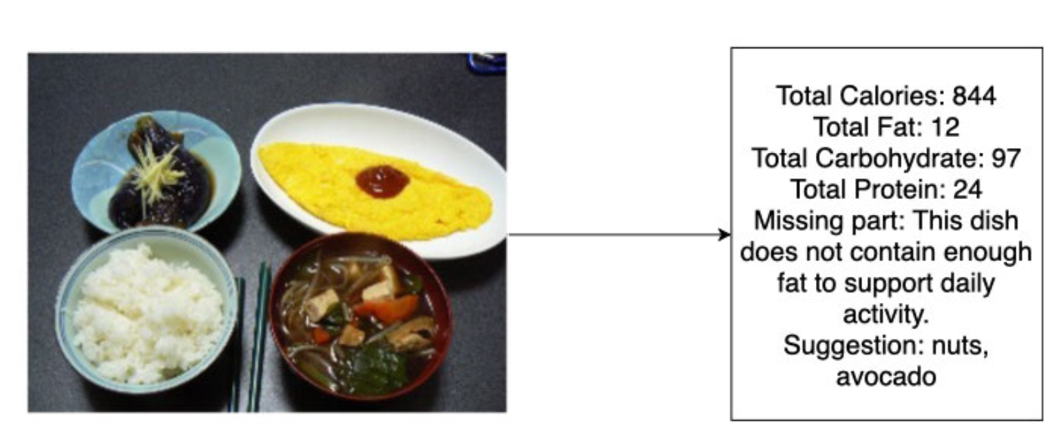
Dietary Assesement
They built a reference table of nutrition facts tables based on the data from USDA (the USDA National Nutrient Database) including all the food items in the datasets
for each food items detected in the image, they assume basic weight is 400 grams per item, which is a normal size for a single serve.

