Slide 1
Loss landscapes and optimization in over-parameterized non-linear systems and neural networks
Chaoyue Liu, Libin Zhu, and Mikhail Belkin
Department of Computer Science and Engineering, The Ohio State University
Department of Computer Science and Engineering, University of California, San Diego
Halicio˘glu Data Science Institute, University of California, San Diego

Slide 2
Introduction
The success of large deep learning models is largely due to the effectiveness of gradient-based optimization methods.
Success here only means low training-error.
But why does GD/SGD algorithms work well, even in non-convex settings?
Convexity is not the right framework for analysis of over-parameterized systems, even locally
An alternative framework is needed to analyze loss landscapes and optimization behavior of non-linear over-parameterized systems.

Slide 3
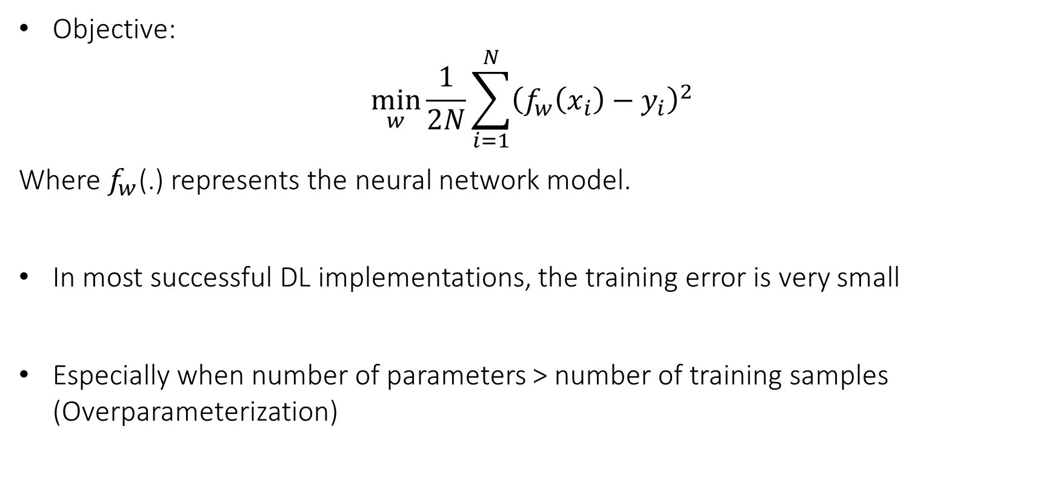
Reminder
Objective:
$$\min_{w}{\frac{1}{2N}\sum_{i=1}^{N}{{\left(f_{w}\left(x_{i}\right)−y_{i}\right)}^{2}}}$$
Where $f_{w}$(.) represents the neural network model.
In most successful DL implementations, the training error is very small
Especially when number of parameters > number of training samples (Overparameterization)

Slide 4
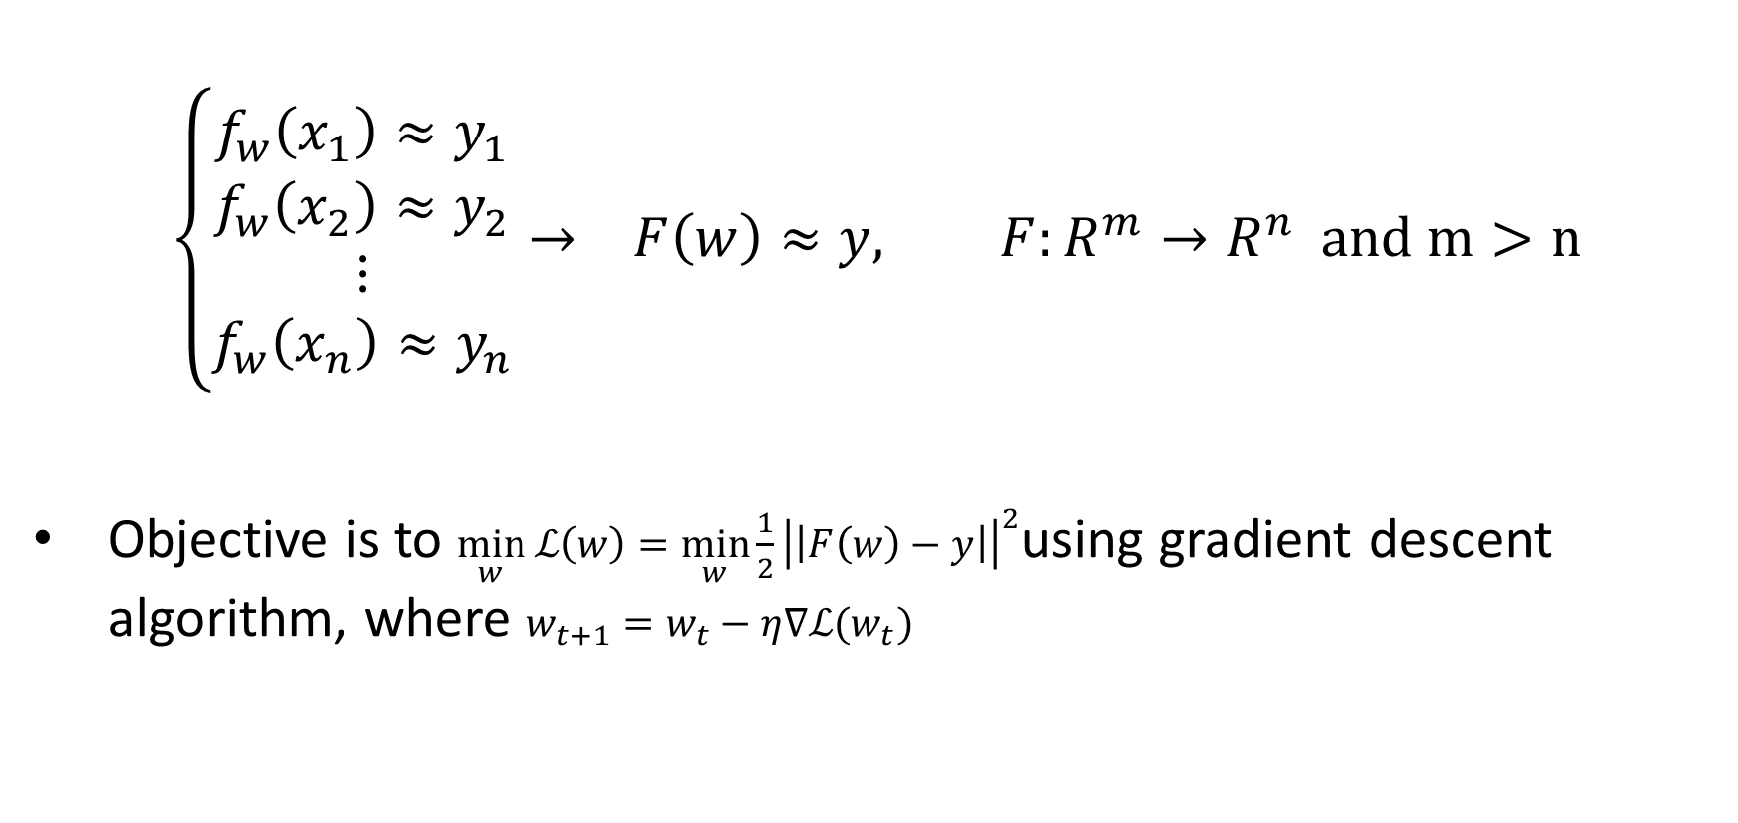
Interpolation
$$\left\{\begin{aligned}f_{w}\left(x_{1}\right)≈y_{1} \\ f_{w}\left(x_{2}\right)≈y_{2} \\ ⋮ \\ f_{w}\left(x_{n}\right)≈y_{n}\end{aligned}\right.→ F\left(w\right)≈y, F:R^{m}→R^{n} and m>n$$
Objective is to $\min_{w} ℒ\left(w\right)=\min_{w}\frac{1}{2}{\left|\left|F\left(w\right)−y\right|\right|}^{2}$using gradient descent algorithm, where $w_{t+1}=w_{t}−η∇ℒ(w_{t})$

Slide 5
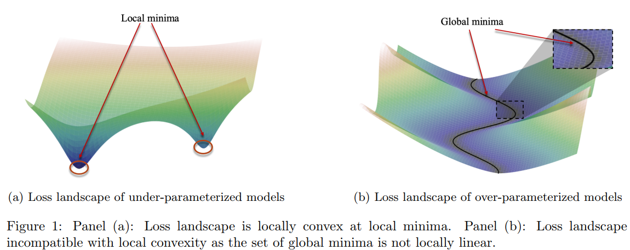
Back to the Paper
The goal of this paper is to provide a modern view of the optimization landscapes.
There is a key difference between under-parameterized and over-parameterized landscapes.

Slide 6
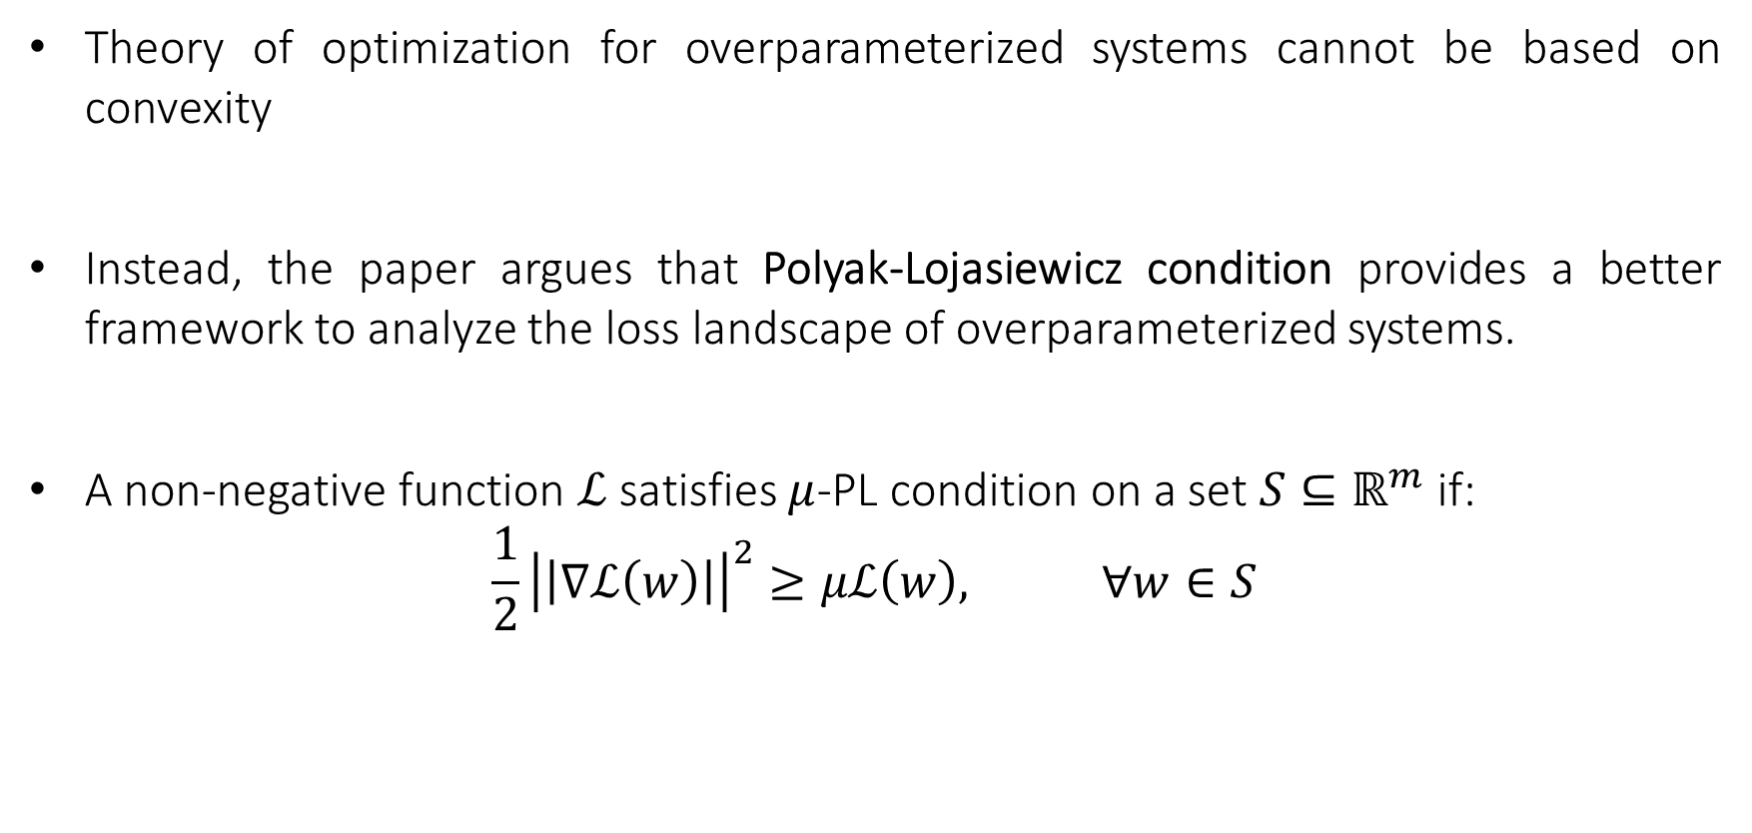
PL Condition
Theory of optimization for overparameterized systems cannot be based on convexity
Instead, the paper argues that Polyak-Lojasiewicz condition provides a better framework to analyze the loss landscape of overparameterized systems.
A non-negative function $ℒ$ satisfies $μ$-PL condition on a set $S⊆ℝ^{m}$ if:
$$\frac{1}{2}{\left|\left|∇ℒ\left(w\right)\right|\right|}^{2}≥μℒ\left(w\right), ∀w∈S$$

Slide 7
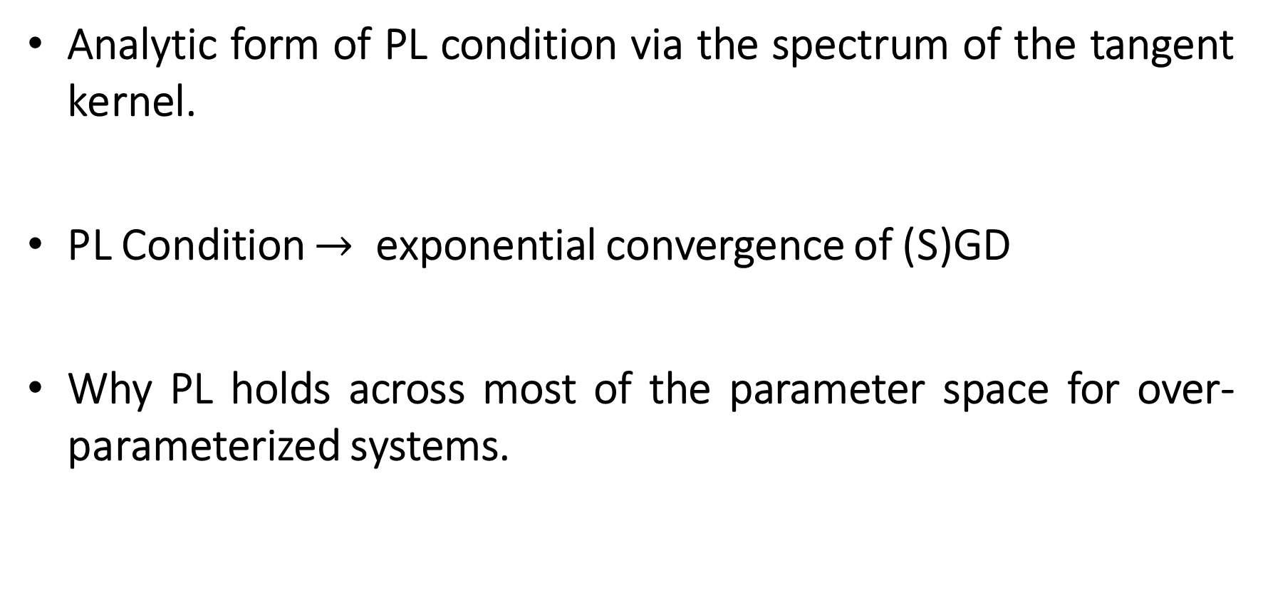
PL Condition
Analytic form of PL condition via the spectrum of the tangent kernel.
PL Condition $→$ exponential convergence of (S)GD
Why PL holds across most of the parameter space for over-parameterized systems.

Slide 8
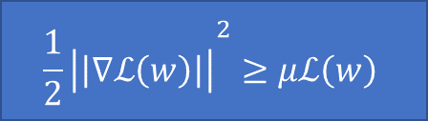

Tangent Kernel
Remember the mapping $F\left(w\right)=y, F:ℝ^{m}→ℝ^{n}$
Tangent kernel is defined as $K\left(w\right)=∇F\left(w\right)∇F{\left(w\right)}^{T}$
Lemma: if $λ_{min}\left(K\left(w\right)\right)≥μ$for $∀w∈S →$ the loss function satisfies PL condition with constant $μ$ over the set S.
Proof:
$${\frac{1}{2}\left|\left|∇ℒ\left(w\right)\right|\right|}^{2}≥μℒ\left(w\right)$$

Slide 9
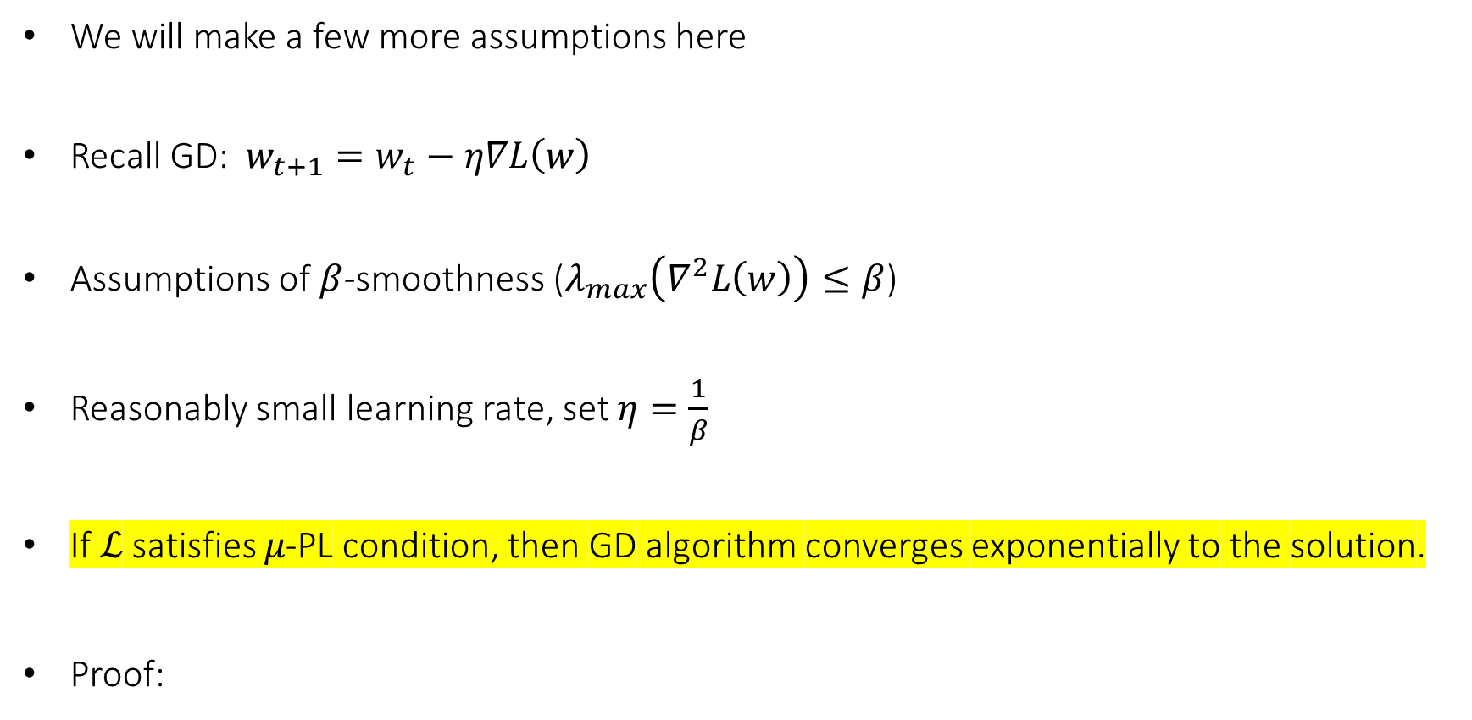
Exponential Convergence of GD
We will make a few more assumptions here
Recall GD: $w_{t+1}=w_{t}−η∇L\left(w\right)$
Assumptions of $β$-smoothness ($λ_{max}\left(∇^{2}L\left(w\right)\right)≤β$)
Reasonably small learning rate, set $η=\frac{1}{β}$
If ℒ satisfies 𝜇-PL condition, then GD algorithm converges exponentially to the solution.
Proof:
$${\frac{1}{2}\left|\left|∇ℒ\left(w\right)\right|\right|}^{2}≥μℒ\left(w\right)$$

Slide 10

Proof:
$L\left(w_{t+1}\right)=L\left(w_{t}\right)+{\left(w_{t+1}−w_{t}\right)}^{T}∇L\left(w\right)+\frac{1}{2}{\left(w_{t+1}−w_{t}\right)}^{T}∇^{2}L\left(w\right)\left(w_{t+1}−w_{t}\right)$ $=L\left(w_{t}\right)−η∇L{\left(w\right)}^{T}∇L\left(w\right)+\frac{η^{2}}{2}∇L{\left(w\right)}^{T}∇^{2}L\left(w\right)∇L\left(w\right)$ $≤L\left(w_{t}\right)−η∇L{\left(w\right)}^{T}∇L\left(w\right)+\frac{η^{2}}{2}λ_{max}∇L{\left(w\right)}^{T}∇L\left(w\right)$
$$=L\left(w_{t}\right)−η{\left|\left|∇L\left(w\right)\right|\right|}^{2}(1−\frac{ηλ_{max}}{2})$$ $$≤L\left(w_{t}\right)−η{\left|\left|∇L\left(w\right)\right|\right|}^{2}\left(1−\frac{ηβ}{2}\right)$$ $$=L\left(w_{t}\right)−\frac{η}{2}{\left|\left|∇L\left(w\right)\right|\right|}^{2}$$

Slide 11

Proof:
$$L\left(w_{t+1}\right)≤L\left(w_{t}\right)−\frac{η}{2}{\left|\left|∇L\left(w\right)\right|\right|}^{2}$$
Recall: ${\frac{1}{2}\left|\left|∇L\left(w\right)\right|\right|}^{2}≥μL\left(w\right)$
$$L\left(w_{t+1}\right)≤\left(1−ημ\right)L\left(w_{t}\right)$$
Which means that
$L\left(w_{t}\right)≤{\left(1−ημ\right)}^{t}L\left(w_{t}\right)$

Slide 12

Overparameterized systems and PL condition
Remember $λ_{min}\left(K\left(w\right)\right)≥μ→$ PL condition is satisfied
Where $K\left(w\right)=∇F\left(w\right)∇F{\left(w\right)}^{T}$
In overparameterized systems, where m>n, $λ_{min}\left(K\left(w\right)\right)$ is lower-bounded by a constant.
Proof:
$${\frac{1}{2}\left|\left|∇ℒ\left(w\right)\right|\right|}^{2}≥μℒ\left(w\right)$$

Slide 13
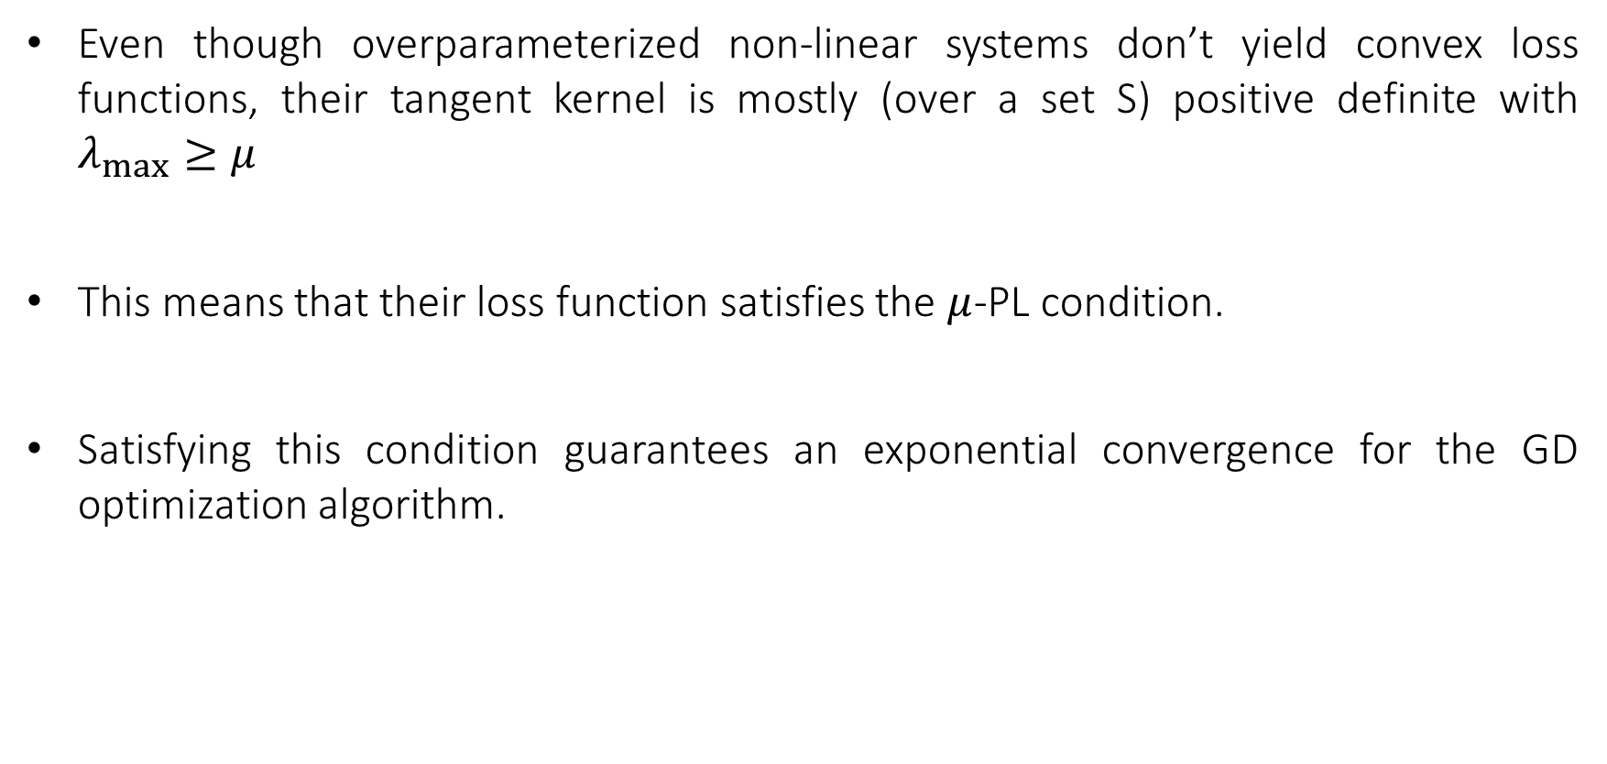
Conclusion
Even though overparameterized non-linear systems don’t yield convex loss functions, their tangent kernel is mostly (over a set S) positive definite with $λ_{max}≥μ$
This means that their loss function satisfies the $μ$-PL condition.
Satisfying this condition guarantees an exponential convergence for the GD optimization algorithm.

