Slide 1
The importance of interpreting
machine learning models for blood
glucose prediction in diabetes:
an analysis using SHAP
Impact Factor: 3.8
Citations: 81
Year: 2023

Slide 2
The goal of this paper is to argue that accuracy is not enough when using ML in sensitive applications like insulin decision-making. Instead, interpretable models should be preferred, and tools like SHAP are crucial for detecting hidden flaws and making safer model choices.
🧠 Core Problem Addressed
While ML and deep learning models (like LSTM) can achieve high accuracy in predicting blood glucose levels, they are often black-boxes, meaning:
❓ We don’t know how they arrive at their predictions
⚠️ This lack of interpretability is risky in healthcare:
You can’t tell if the model is using the right reasoning
You may miss biases in the data
You can’t be sure the model is safe to trust, especially for decision-making like insulin dosage

Slide 3
🧠 Physiological Logic vs. Model Confusion
✅ What a good model should learn:
Insulin lowers blood glucose (BG) Carbohydrates (CHO) raise blood glucose
⚠️ The problem:
Insulin and CHO are usually given together (e.g., at meals) Their doses are often proportional
➡️ This causes collinearity in the data ➡️ Models struggle to separate their individual effects
❌ Common mistake:
The model misinterprets insulin as raising BG (because it's always paired with CHO)

Slide 4
🧠 Key Insight: BG modeling suffers from collinearity
due to strong collinearity between insulin and carbohydrate intake in T1D data, glucose prediction models often learn misleading patterns—making interpretability tools like SHAP essential to ensure models are not only accurate but also physiologically correct and safe to use. There are several tools exist to explain black-box ML models, only a few of them deal with the interpretability of the models
🧪 Contribution
Ad hoc case study They designed a custom, focused case study to demonstrate the crucial importance of model interpretability when developing prediction models for decision-making in Type 1 Diabetes (T1D) management.
Use of SHAP They propose SHAP (SHapley Additive exPlanations), a model-agnostic interpretability method based on game theory, as a powerful tool to analyze and explain model behavior
Notes:
For example, the model might incorrectly learn that insulin raises glucose (because it sees insulin + food → glucose goes up), when in reality insulin lowers it.

Slide 5
🧠 Model Design
They developed two LSTM-based architectures for blood glucose (BG) prediction: 1. np-LSTM (non-physiological) – Input features are directly fed into the LSTM – No mechanism to enforce physiological understanding 2. p-LSTM (physiological) – Includes a preprocessing layer before the LSTM – Helps the model learn the true physiological effect of insulin and carbohydrates (CHO) on BG
Both models were trained on 6 weeks of CGM, insulin, and CHO data – From Subject 588 in the OhioT1DM dataset – Prediction horizons: 30 and 60 minutes ahead

Slide 6
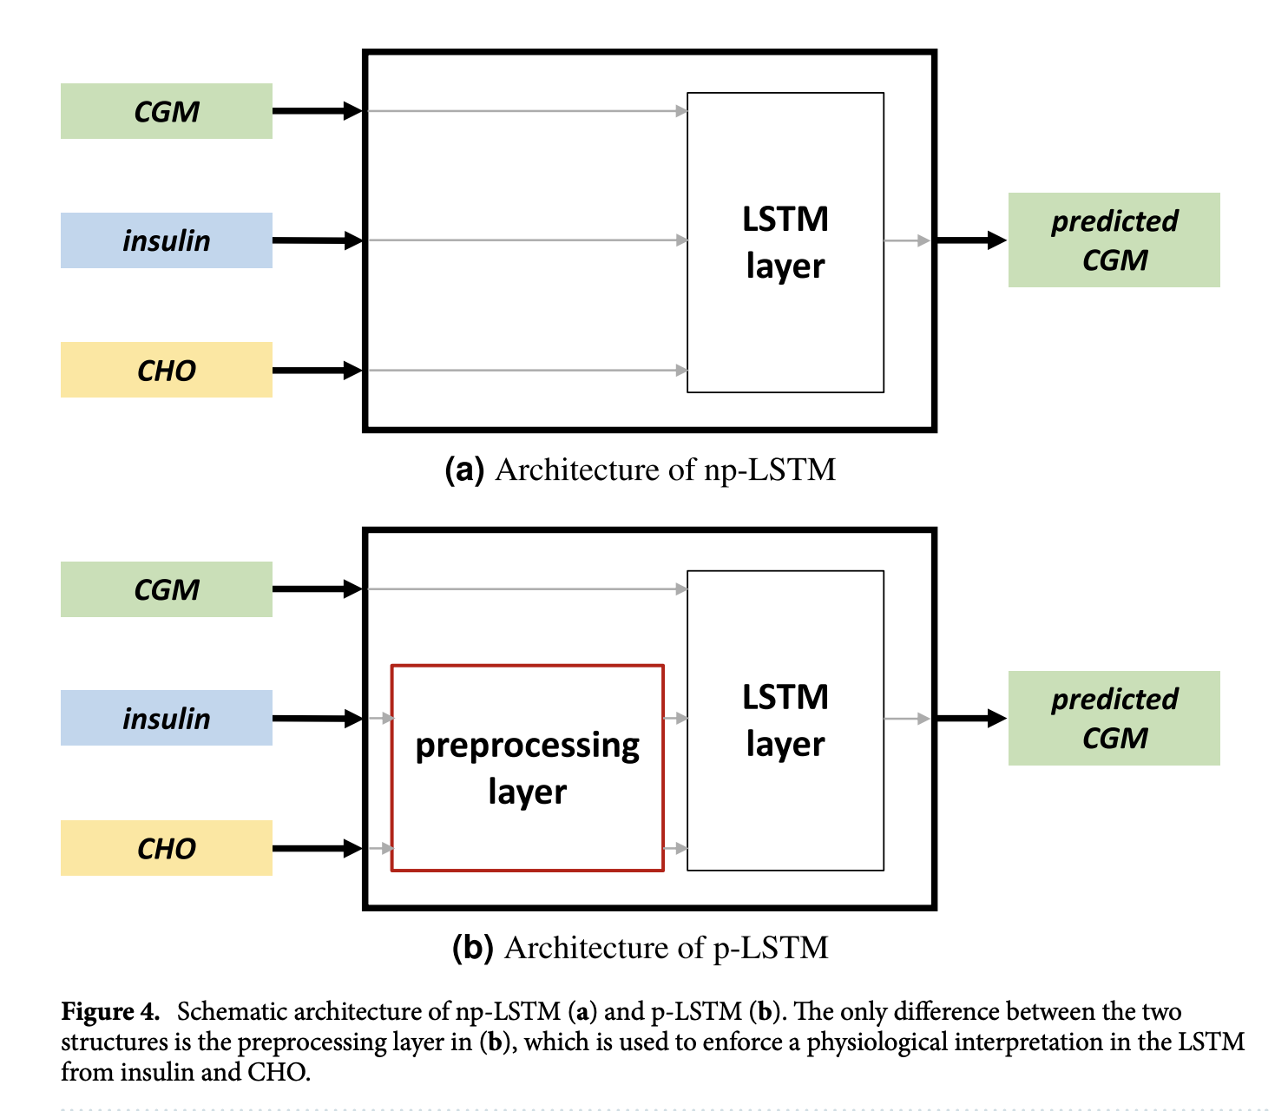

Slide 7
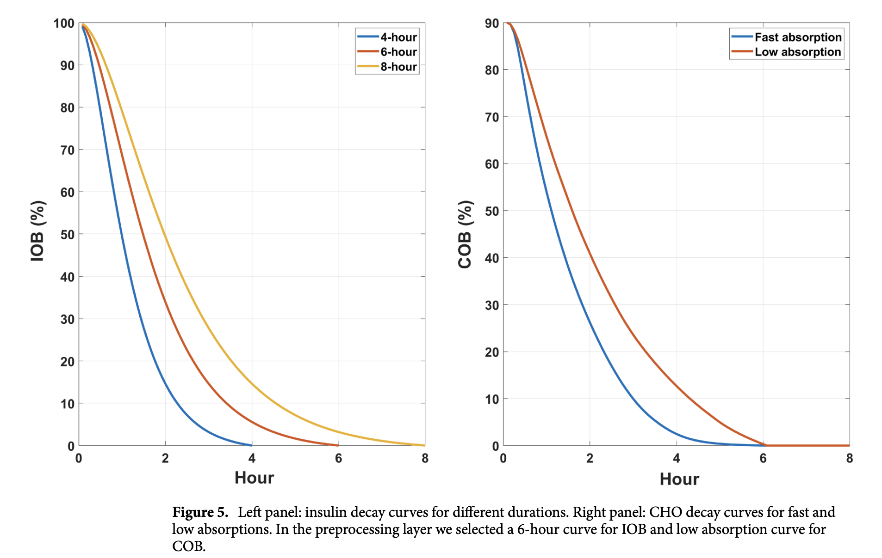
What does the preprocessing layer really do?
Raw insulin → becomes IOB (Insulin On Board)
Raw CHO → becomes COB (Carbs On Board)
Each colored line in shows a different assumption about how long insulin or carbs stay active in the body
This layer applies fixed physiological decay curves to simulate how insulin and carbs behave over time, not instantly.
Notes:
Left Plot: IOB – Insulin Decay Curve
Shows how insulin's effect fades after it’s injected. And how much of the injected insulin is still active
The red 6-hour line is used in the model. That means the model assumes insulin's effect fades over 6 hours.
The preprocessing layer spreads the insulin effect across time, matching this decay.
➕ Why this helps:
The model can now understand that insulin given earlier is still working hours later.
Without this, the model might wrongly assume insulin only works instantly (which is false).
🍞 Right Plot: COB – Carbohydrate Absorption Curve
This shows how much of the meal is still being digested and entering the blood.
With slow absorption (red line), carbs enter the bloodstream gradually.Again, they chose the red curve (slow digestion) to feed into the model.
➕ Why this helps:
The model can correctly learn that carbs raise glucose, and that this effect builds up over ~2–4 hours.

Slide 8
✅ Model Evaluation Pipeline
Step 1: Accuracy Testing
Models were applied to the last 10 days of data from Subject 588 (OhioT1DM dataset)
📉 Result: Both models achieved similar prediction accuracy
Step 2: SHAP Interpretation
Used SHAP to interpret how the models arrived at their predictions
Assessed whether the models learned the correct physiological effects of: Insulin,Carbs
Step 3: Decision Support System (DSS) Simulation
Integrated both models into a simple DSS
DSS used model outputs to suggest corrective insulin boluses
Re-simulated real patient data to evaluate:
🧠 Whether suggestions were clinically appropriate
🛡️ Whether the model was safe for use in decision-making

Slide 9
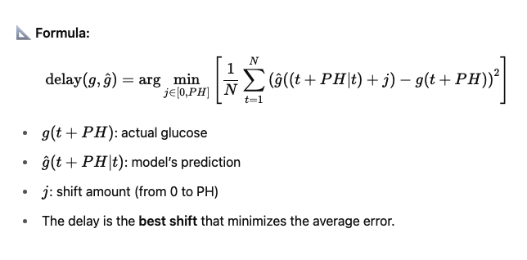
Sometimes the model predicts the correct shape of the glucose curve — but it's shifted in time (i.e., happens too late)
The delay function measures how many minutes later the model's prediction aligns with the actual glucose value
How early can we detecte event
They shift the prediction until it lines up best with reality.
The number of minutes we have to shift = the delay

Slide 10
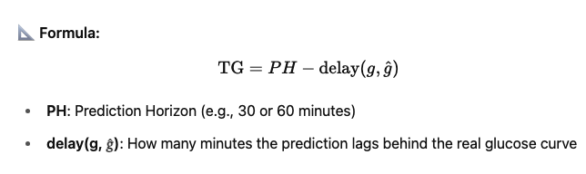
⏱️ Time Gain (TG)
Time Gain measures how early a model predicts a glucose change compared to when it actually happens
Maximize TG → the model is faster and more useful in real-life decision-making

Slide 11
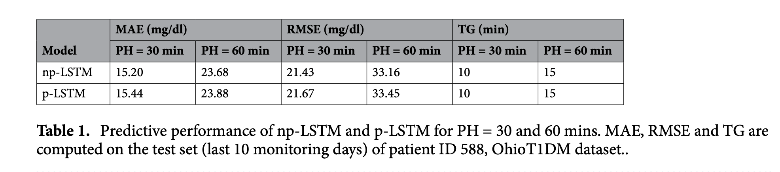
The preprocessing layer in p-LSTM improves interpretability without hurting timing, as both models still detect glucose changes early and similarly

Slide 12
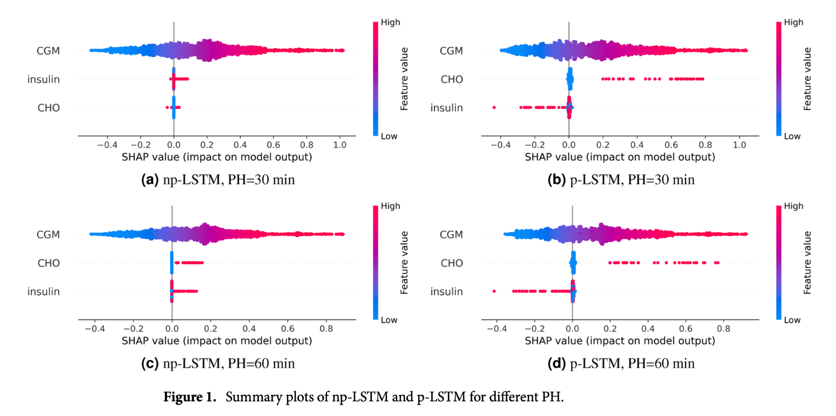
Notes:
p-LSTM learned correct physiological behavior:
CHO ↑ BG, Insulin ↓ BG
np-LSTM learned misleading relationships due to collinearity in raw input data.

Slide 13
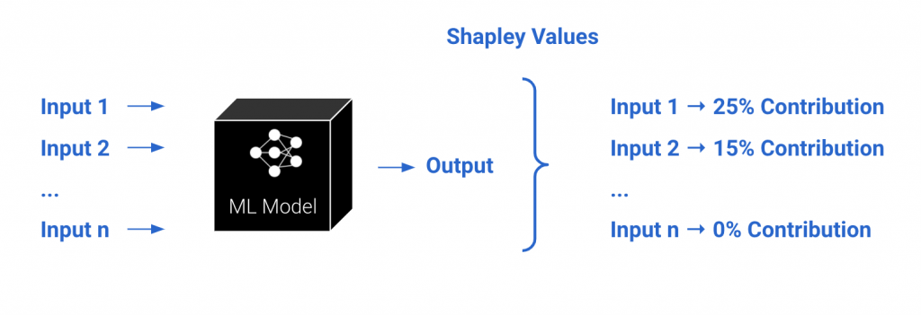
SHAP game theory
SHAP (SHapley Additive exPlanations) is a powerful method to explain how each feature contributes to a machine learning model’s prediction — based on the principles of Shapley values from cooperative game theory
A team of 3 people wins $9,000 in a Kaggle competition: Shovito, Reza, and Asif. We want to fairly divide the prize based on how much each person contributed to the win.

Slide 14
✅ Order 1: S → A → R
Start = 0 S joins → {S} = 2000 → S = 2000 A joins → {S,A} = 5000 → A adds 3000 R joins → {S,A,R} = 9000 → R adds 4000
✅ Order 2: S → R → A
Start = 0 S joins → {S} = 2000 → S = 2000 R joins → {S,R} = 6000 → R adds 4000 A joins → {S,R,A} = 9000 → A adds 3000
✅ Order 3: A → S → R
Start = 0 A joins → {A} = 2500 → A = 2500 S joins → {A,S} = 5000 → S adds 2500 R joins → {A,S,R} = 9000 → R adds 4000
✅ Order 4: A → R → S
Start = 0 A joins → {A} = 2500 → A = 2500 R joins → {A,R} = 7000 → R adds 4500 S joins → {A,R,S} = 9000 → S adds 2000
✅ Order 5: R → S → A
Start = 0 R joins → {R} = 3000 → R = 3000 S joins → {R,S} = 6000 → S adds 3000 A joins → full = 9000 → A adds 3000
✅ Order 6: R → A → S
Start = 0 R joins → {R} = 3000 → R = 3000 A joins → {R,A} = 7000 → A adds 4000 S joins → full = 9000 → S adds 2000
Team members | Value ($)
{} | 0
{S} | 2000
{A} | 2500
{R} | 3000
{S, A} | 5000
{S, R} | 6000
{A, R} | 7000
{S, A, R} | 9000
For each order, we compute each person's marginal contribution — that is, how much value they add when they join.
Notes:
In Shapley, we care about all possible orderings = permutations

Slide 15
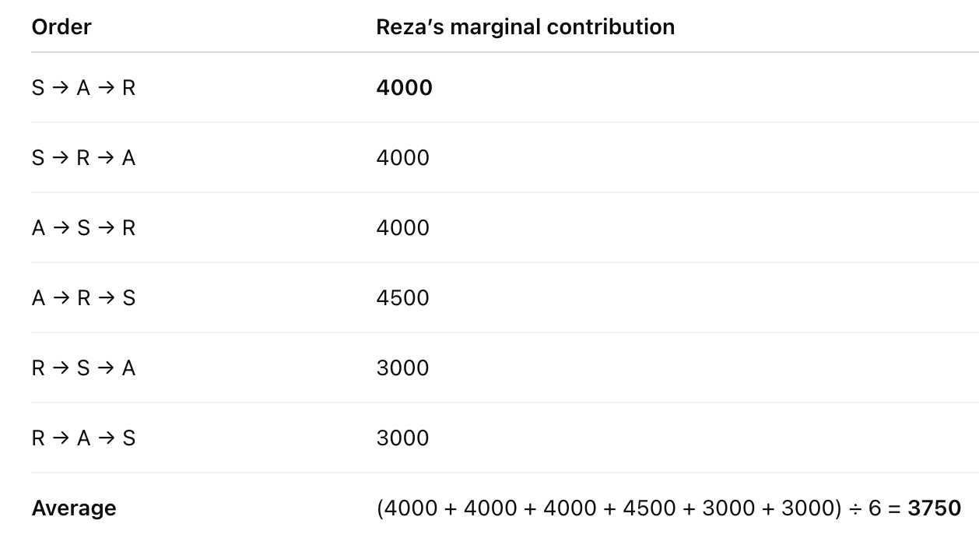
The Shapley value is the average of Reza’s marginal contributions across all possible orders.

Slide 16
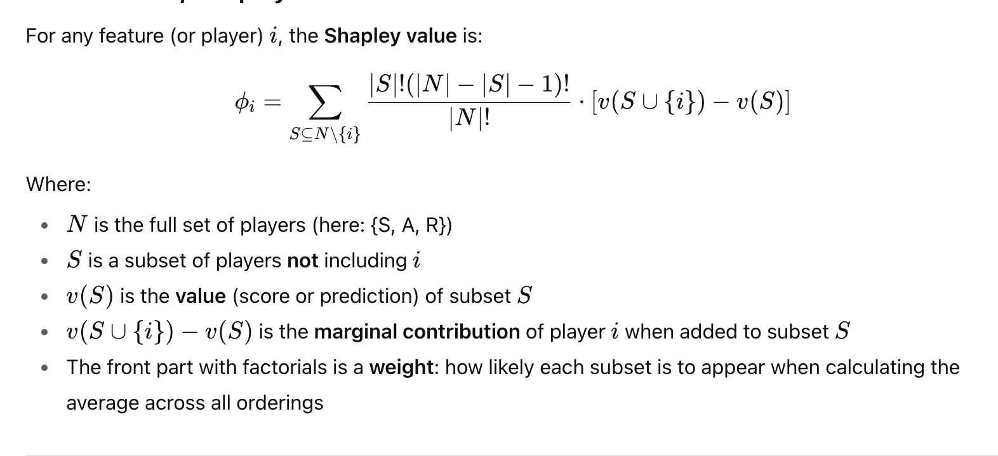

Slide 17
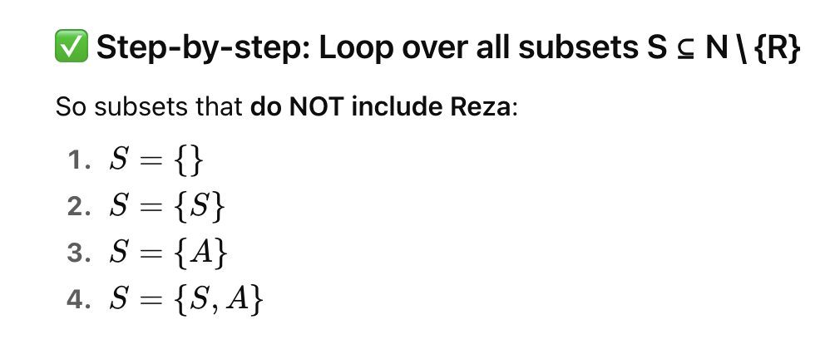
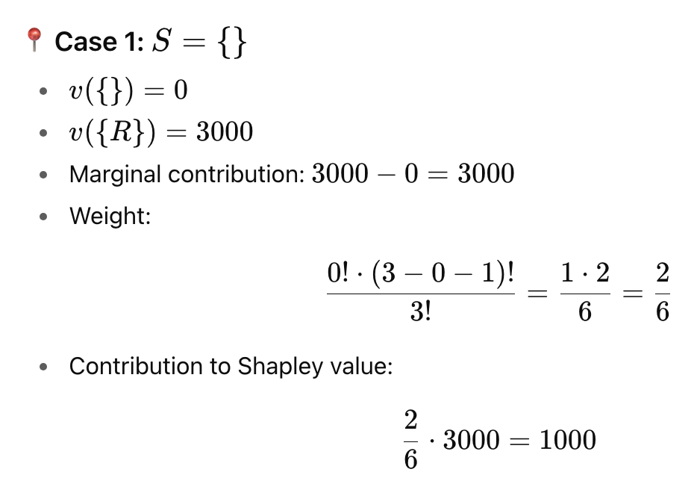
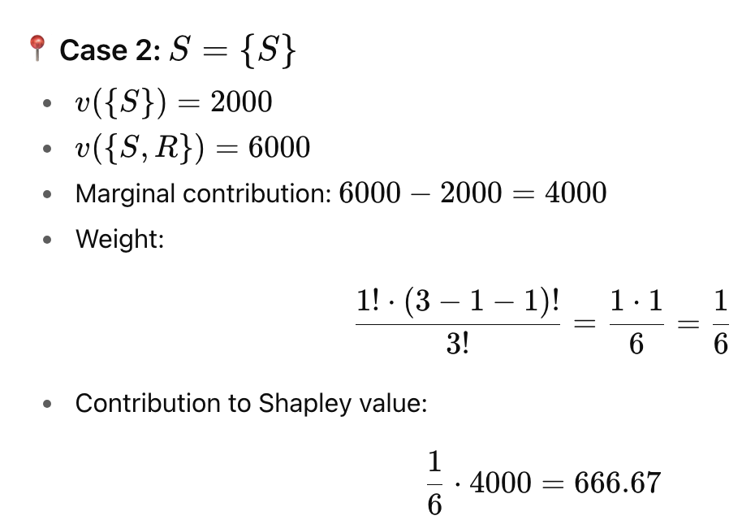

Slide 18
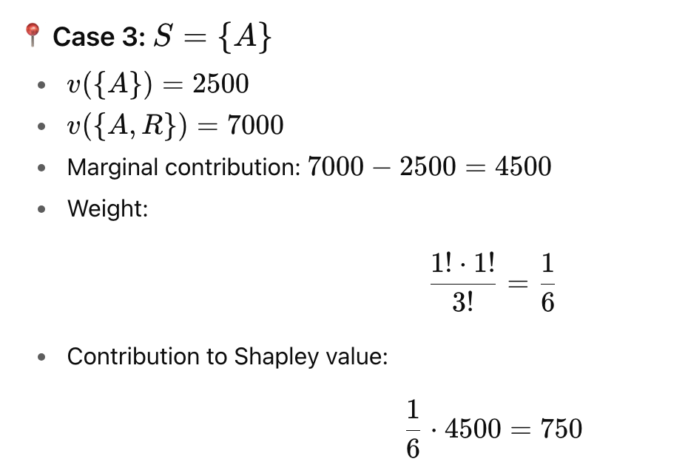
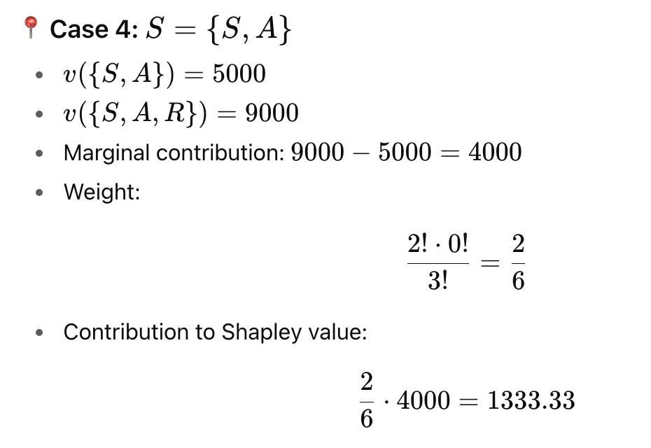
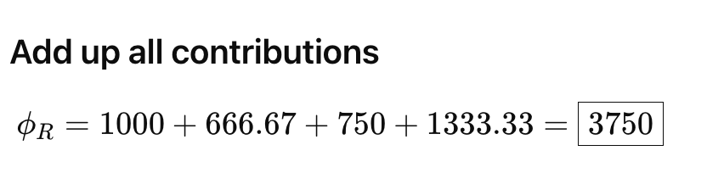

Slide 19
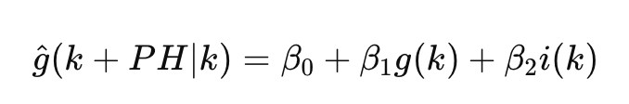
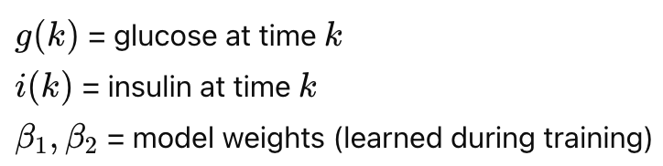
This game theoretical concept can be translated into the context of glucose prediction by understanding the parallelism between players/features and outcome of a game/model prediction.

Slide 20
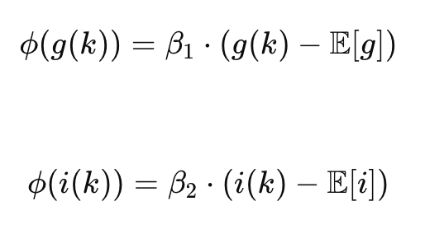
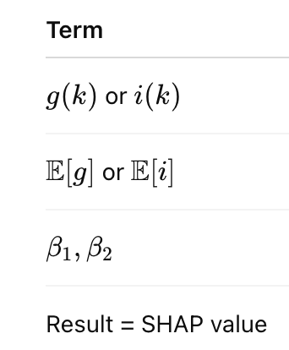
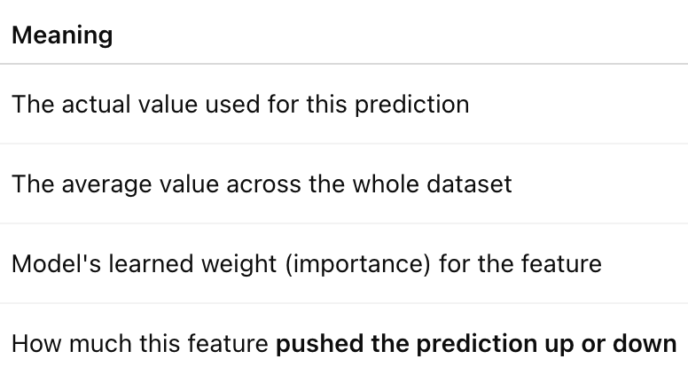
How much did each feature (glucose, insulin) contribute to this specific prediction?
SHAP value for glucose:
SHAP value for insulin:

Slide 21
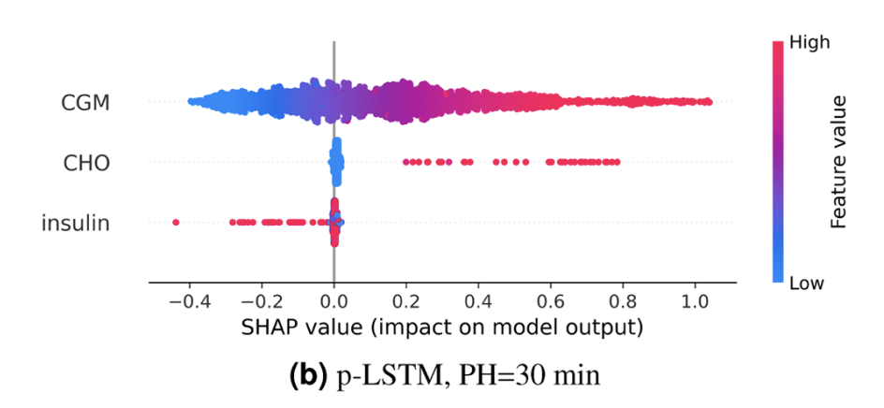

Slide 22
X-axis = SHAP value
This tells you how much that feature pushed the prediction up or down:
➕ Right of zero → increased predicted glucose
➖ Left of zero → decreased predicted glucose
✳️ Closer to 0 → little or no influence
Each dot shows the contribution of one feature for one prediction instance.
Each dot’s position along the x-axis is its SHAP value.
Each dot = one prediction instance
It shows how much one specific feature (like CGM or insulin) contributed to that prediction
The contribution = the SHAP value for that feature in that instance
In the CGM row, a dot = the SHAP value of CGM for one prediction

Slide 23
▶ CGM row:
Most red dots (high CGM values) are on the right
➕ That means: high CGM values increase the predicted glucose
🔵 Blue dots are on the left → low CGM values decrease predictions ✅ This is expected and correct.
▶ CHO row:
High CHO (🔴) also pushes predictions rightward
Low CHO (🔵) stays around 0 ✅ So: carbs raise the predicted glucose — physiologically correct
▶ Insulin row:
High insulin values (🔴) are mostly on the left ➖ This means: insulin lowers predicted glucose ✅ This is the correct behavior.

Slide 24
🧠 What each dot tells you:
“In this specific prediction, how much did this feature change the output compared to the average prediction?”
So for each prediction, SHAP computes one SHAP value per feature → that’s why you see many dots per row.
🧠 Example:
Let’s say your model predicts glucose 30 minutes later:
Base (average) prediction = 120 mg/dL
For one instance, the model predicts 121.0
So the total contribution from all features must add up to +1.0
In that case:
CGM may contribute +0.8
CHO may contribute +0.5
Insulin may subtract –0.3

Slide 25
🧠 Key Question:
If two models have similar prediction performance, ➡️ Should we prefer the one that makes physiologically meaningful predictions?
✅ Yes — especially in decision-making and control systems.
🩺 How We Tested This:
Developed a simple algorithm to suggest Corrective Insulin Boluses (CIBs)
Integrated it into a Decision Support System (DSS)
The DSS uses predictions from each LSTM model (p-LSTM and np-LSTM)
It tests different insulin doses and selects the one that brings predicted BG closest to the target level
Notes:
A Corrective Insulin Bolus is an extra dose of insulin given to bring high blood glucose (BG) back to a safe range

Slide 26
They used a simulator to test if their system could safely suggest insulin after meals, and if that would have helped keep blood sugar in a healthy range — without giving too much insulin.
Used ReplayBG, a simulator, to test the DSS safely (no real patients)
Simulated 5 post-meal periods, each 8 hours long
🎯 Goal:
Test if the DSS's insulin suggestions would improve blood sugar control
📊 Evaluation Metrics:
TIR (70–180 mg/dL) → ✅ increase
TAR (>180) → ❌ decrease
TBR (<70) → ❌ avoid
# of boluses → keep low (avoid over-treating)

Slide 27
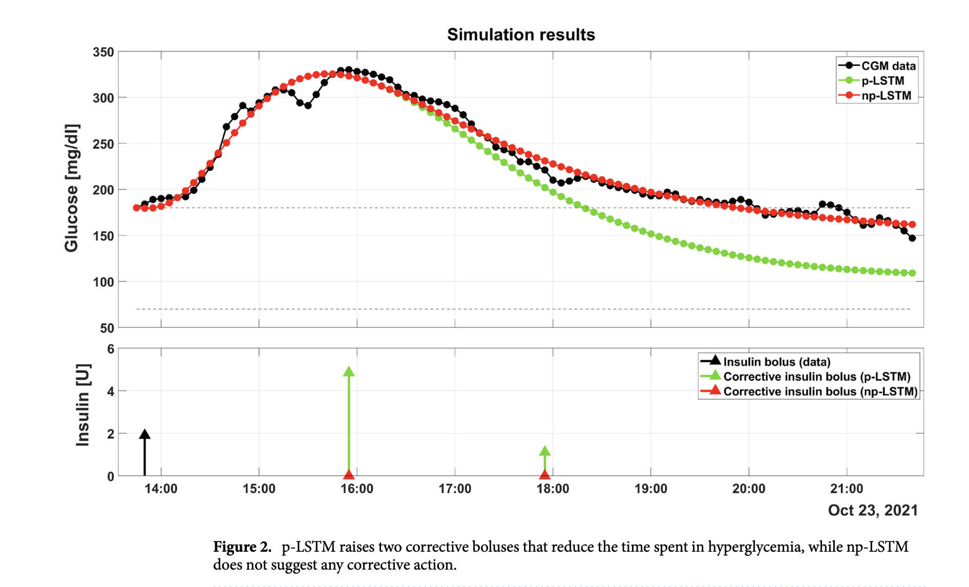
Using ReplayBG, they simulate:
“If the patient had taken that corrective insulin dose, what would the glucose curve have looked like?
np-LSTM made no corrective suggestions → BG stayed high (red = overlaps CGM)
p-LSTM suggested 2 corrective boluses → BG was brought back into the normal range
Notes:
Top panel: Blood glucose (BG) over time after a meal
Black line: Actual CGM data Green line: Predicted BG with p-LSTM-based DSS Red line: Predicted BG with np-LSTM-based DSS
Bottom panel: ⚫ Black arrow: Mealtime insulin given by the patient 🟢 Green arrows: Corrective insulin boluses (CIBs) suggested by p-LSTM DSS 🔴 Red arrows: CIBs suggested by np-LSTM DSS (none shown → np-LSTM made no suggestions)
np-LSTM made no corrective suggestions → BG stayed high (red = overlaps CGM)
p-LSTM suggested 2 corrective boluses → BG was brought back into the normal range

Slide 28
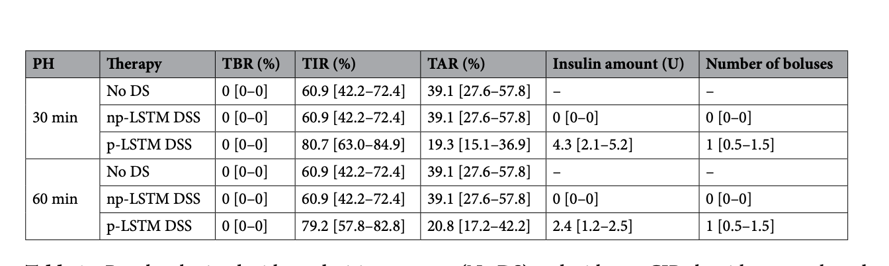
The p-LSTM DSS improved blood glucose control by increasing Time in Range and reducing hyperglycemia, while using safe and minimal insulin — something np-LSTM could not achieve.

Slide 29
Thank you
Questions?

