Slide 1
Balancing Continual Learning and Fine-tuning for Human Activity Recognition AAAI 2024
Chi Ian Tang, Lorena Qendro, Dimitris Spathis, Fahim Kawsar, Akhil Mathur, Cecilia Mascolo
Nokia Bell Labs, UK
University of Cambridge, UK

Slide 2
Self-supervised Continual Learning for HAR
Wearable-based Human Activity Recognition (HAR) is a key task in human-centric machine learning .
Due to the dynamic nature of human behaviours, continual learning promises HAR systems that are tailored to users’ needs.
difficulty in collecting labelled data with wearable sensors.
CaSSLe, a continual self-supervised learning model, and Kaizen, a continual semi-supervised learning model for HAR

Slide 3
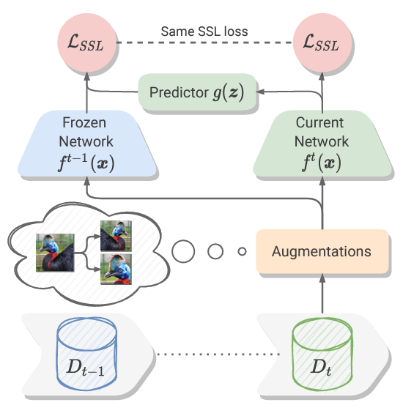

CaSSLe (Fini et al. 2022)
key idea is to train the current model to predict past representations with a prediction head, thus encouraging it to remember past knowledge.
$ℒ=ℒ_{SSL}\left(z^{A}, z^{B}\right)+ℒ_{SSL}\left({g(z}^{A}), {\overline{z}}^{A}\right)$

Slide 4
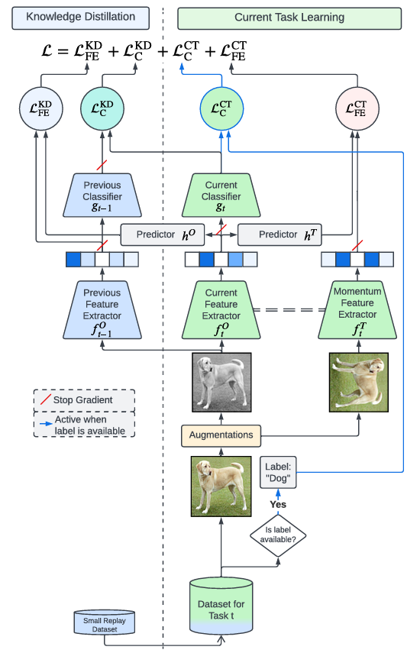
Kaizen (Tang et al. 2024)
key idea is to leverage labeled data and use the classifier in the architecture.

Slide 5
Kaizen (Tang et al. 2024)
key idea is to leverage labeled data and use the classifier in the architecture.

Slide 6
Dataset
The two models were initially proposed for image data
This paper modifies them for accelerometer data to predict HAR
WISDM2019 (WISDM Smartphone and Smartwatch Activity and Biometrics Dataset)
51 subjects, who performed 18 different activities for 3 minutes each.
Participant’s pocket, while the smartwatch is worn at the dominant hand.
Walking, Jogging, Stairs, Sitting, etc.
The 18 classes of activities are randomly and evenly split into 6 tasks of 3 classes each with no overlap

Slide 7
Evaluation Metrics
Final Accuracy (FA): The average accuracy of the model on all tasks after it has been trained on the last task.
Continual Accuracy (CA): The average accuracy of the model across all tasks and at all stages during the continual learning process.
Forgetting (F): The average drop in performance on earlier tasks after the model has been trained on subsequent tasks.
Forward Transfer (FT): The improvement in learning new tasks due to knowledge gained from previous tasks.

Slide 8
Evaluation Metrics
Final Accuracy (FA): The average accuracy of the model on all tasks after it has been trained on the last task.
Continual Accuracy (CA): The average accuracy of the model across all tasks and at all stages during the continual learning process.
Forgetting (F): The average drop in performance on earlier tasks after the model has been trained on subsequent tasks.
Forward Transfer (FT): The improvement in learning new tasks due to knowledge gained from previous tasks.

Slide 9
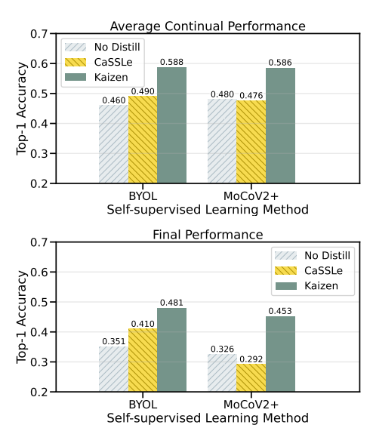
Results

Slide 10
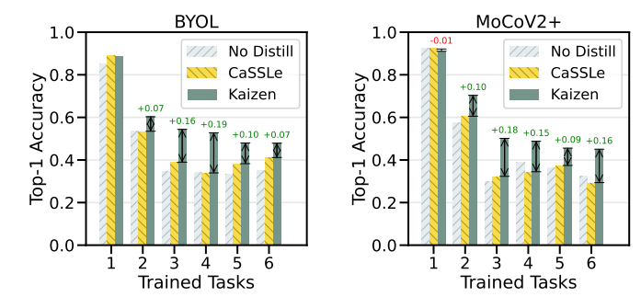
Results

Slide 11
Results

Slide 12
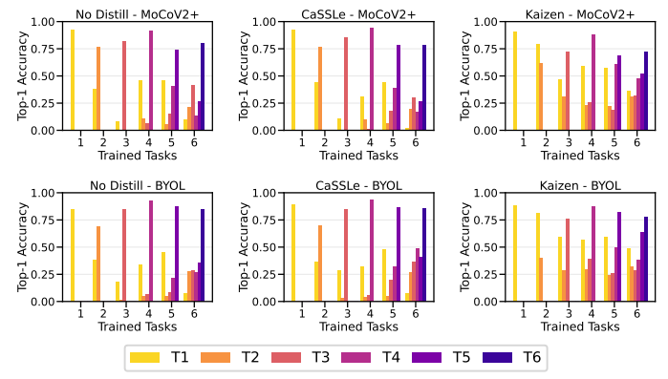
Results

