Slide 1
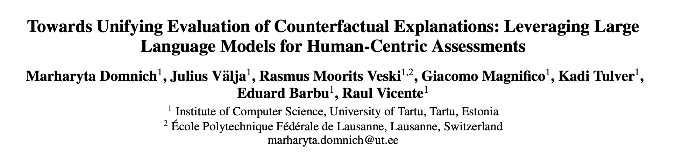

Slide 2
Motivation
Evaluating counterfactual explanations is a decade long problem
Best method: User study
Not always possible
Least: Simulation based
Validity – what a simulator thinks?
Proximity – how much change?
Sparsity – how many features to change?
Plausibility – within the data manifold?
Coverage – can convert all factuals to counterfactuals?

Slide 3
Objective
Can the evaluation process of counterfactual explanations be effectively automated using LLMs?

Slide 4
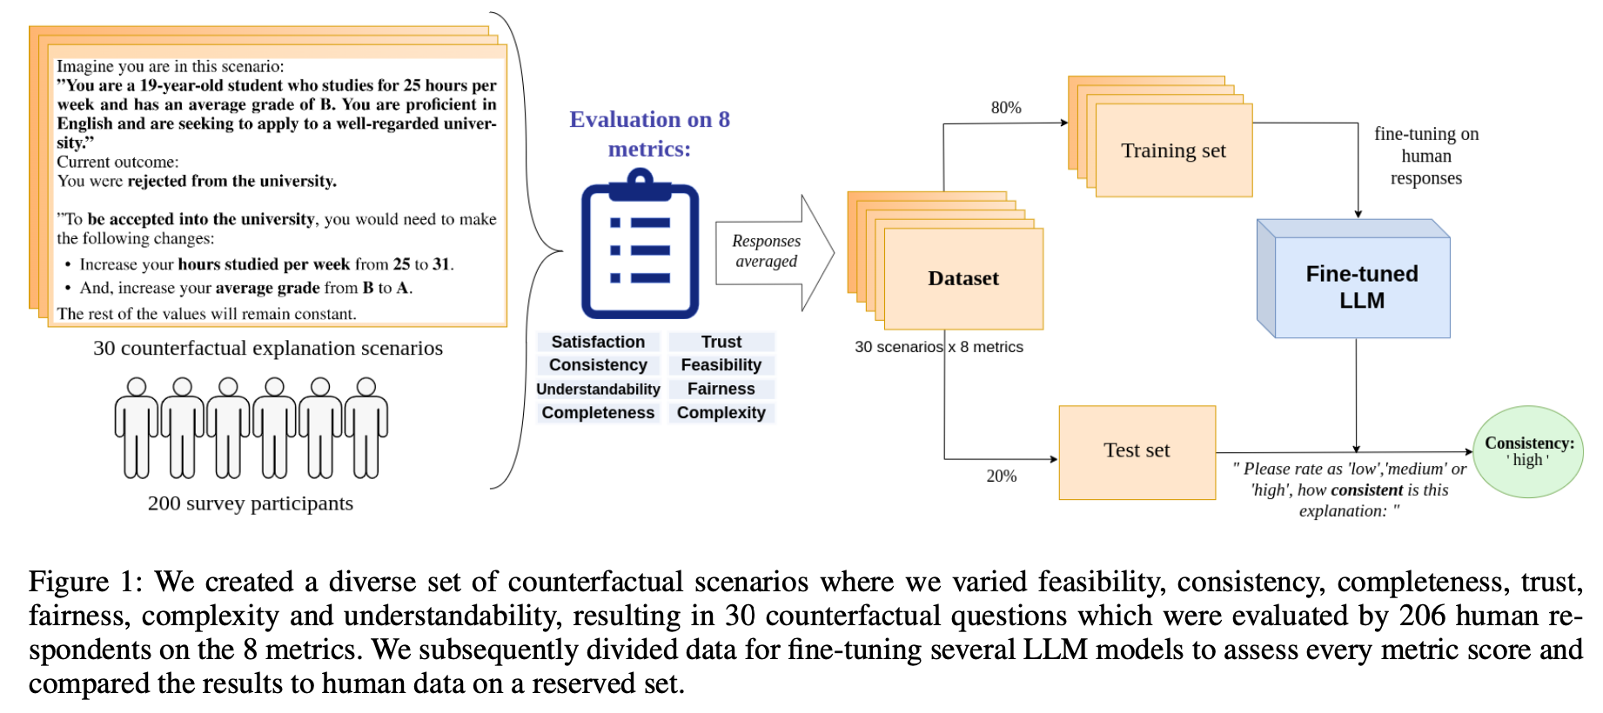
Plan

Slide 5
Questionnaire
Coherence if the suggestions are consistent/they go with usual norm of life
Complexity people prefer simple explanations (Another version of sparsity)
Trust the belief that following the explanation will lead to the desired outcome
Feasibility refers to whether the proposed changes are perceived as achievable and realistic
Understandability how effectively an explanation conveys the model’s decision process to the user and how easily it is grasped
Completeness changing all the underlying features that can influence the target variable?
Fairness biased towards any particular group?

Slide 6
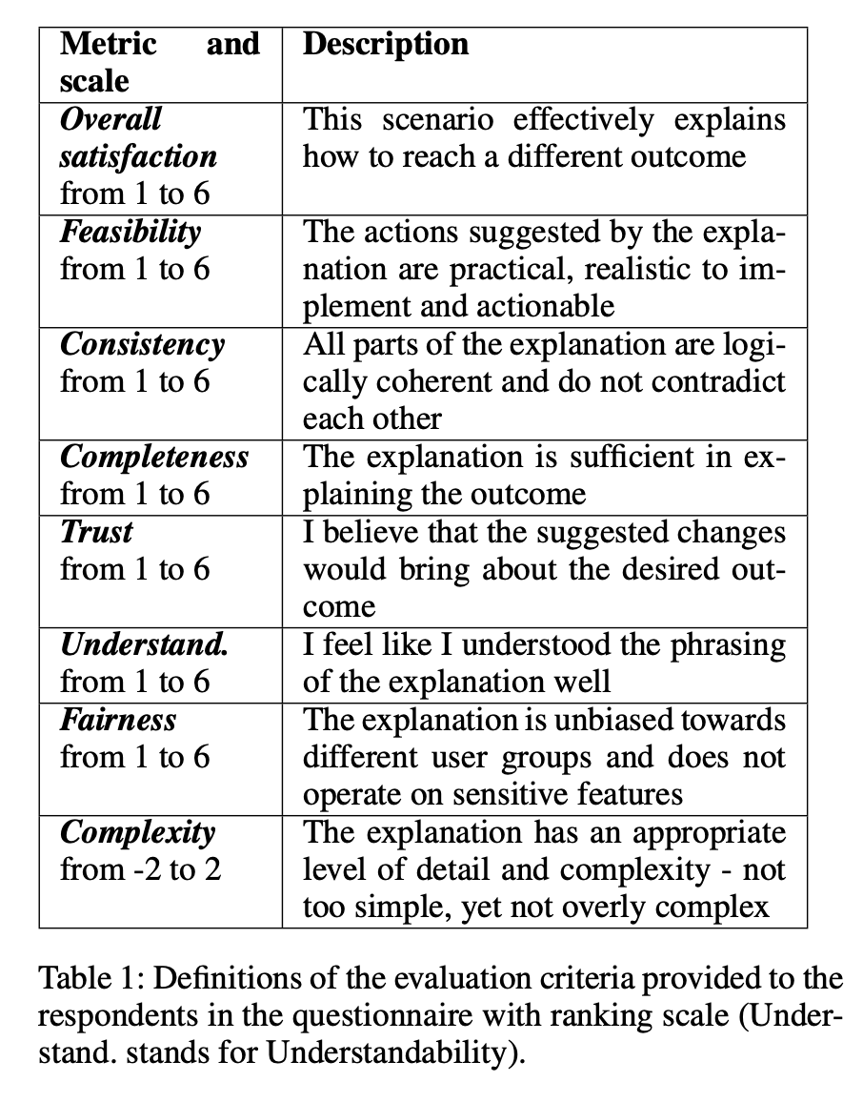
Questionnaire
Was linearly scaled to 1 to 6

Slide 7
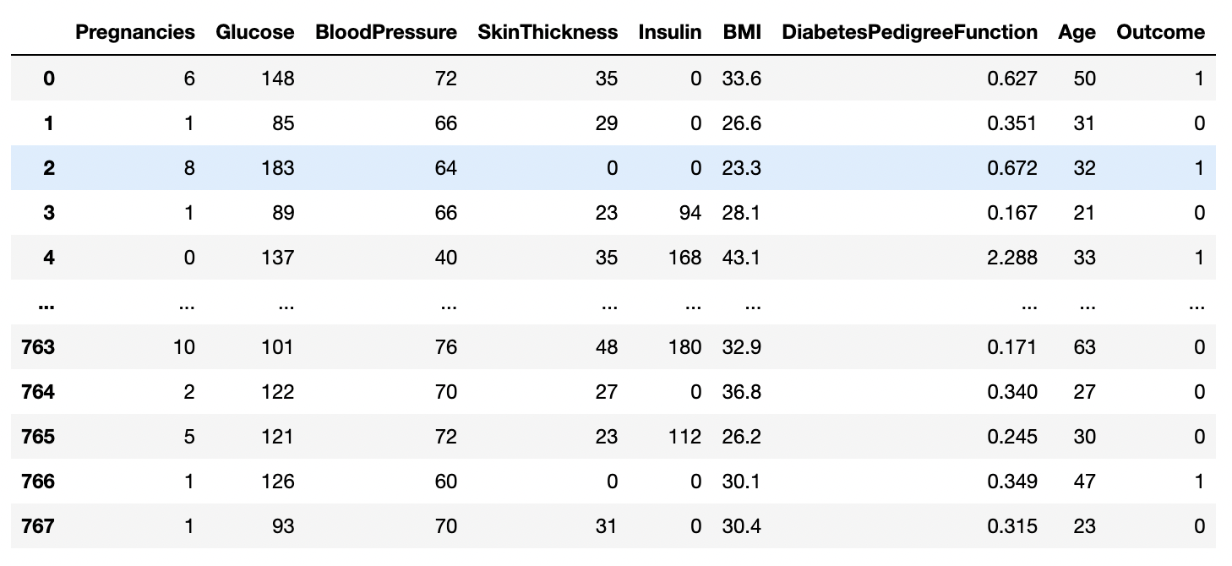
Datasets
Adult
PimaDM
Age | workclass | FNLWGT | Education | Education num | Marital status | occupation | Relationship | Race | Gender | Capital gain | Capital loss | Hours/week | Native country | Income

Slide 8
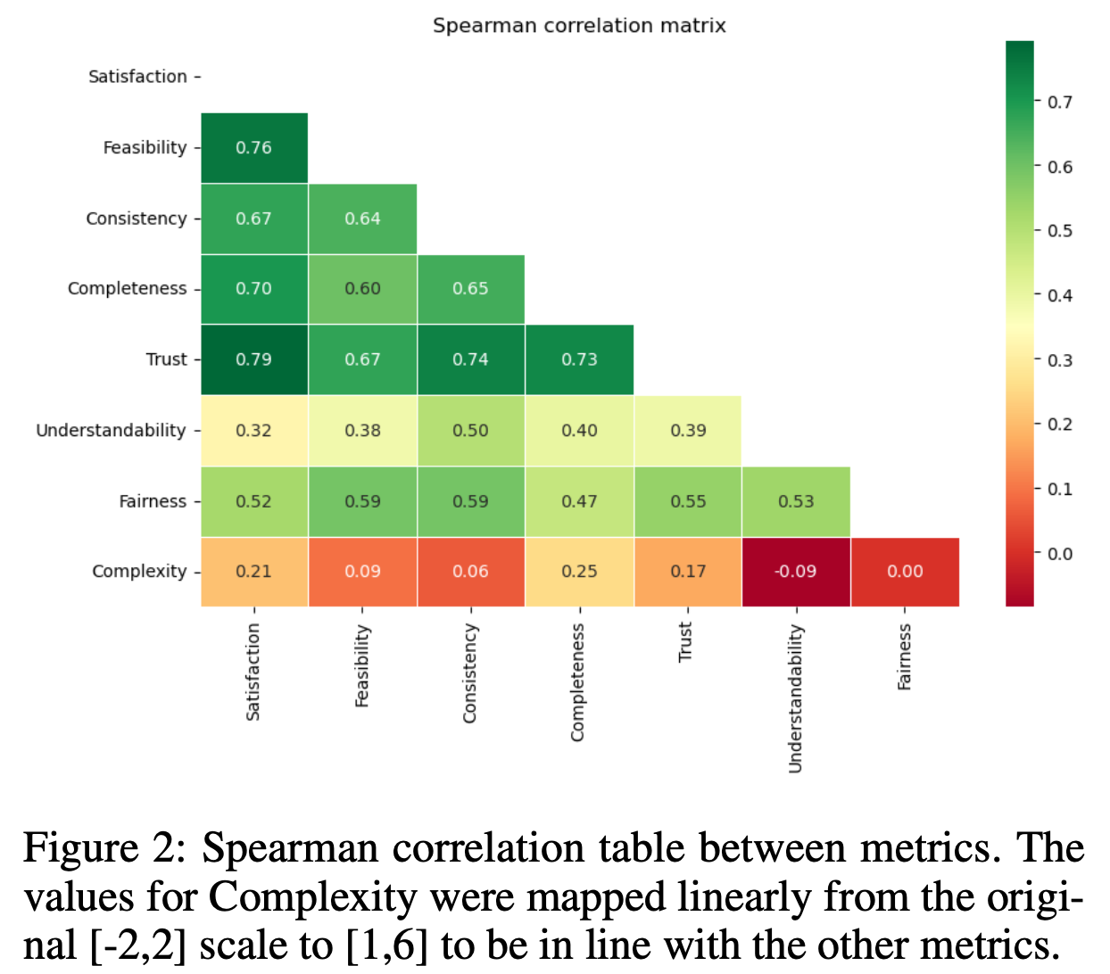
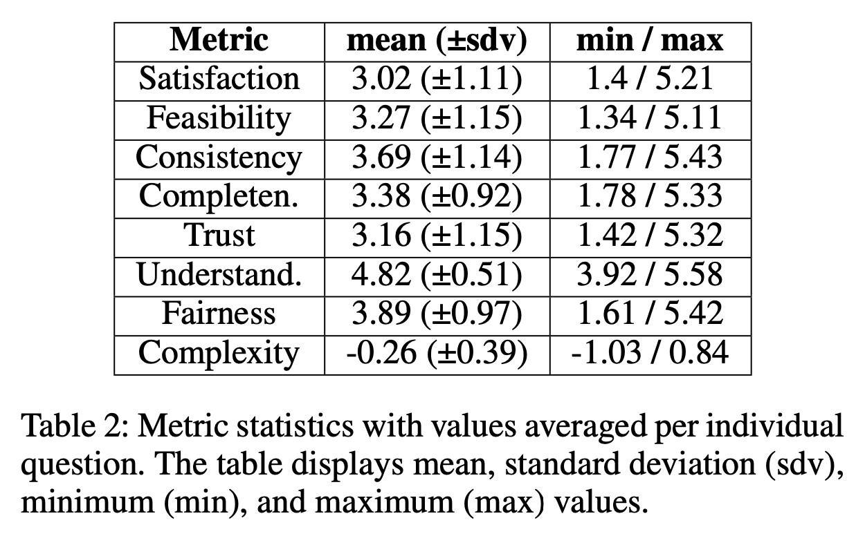
Questionnaire Results
Scores are categorized to ”low,” ”medium,” and ”high”

Slide 9
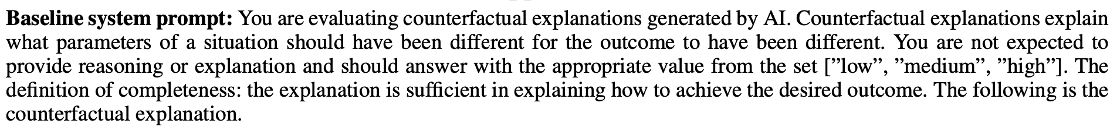
Prompt engineering
A baseline prompt which contains an introduction to counterfactual explanations, the expected output format, and the definition of the metric being evaluated

Slide 10
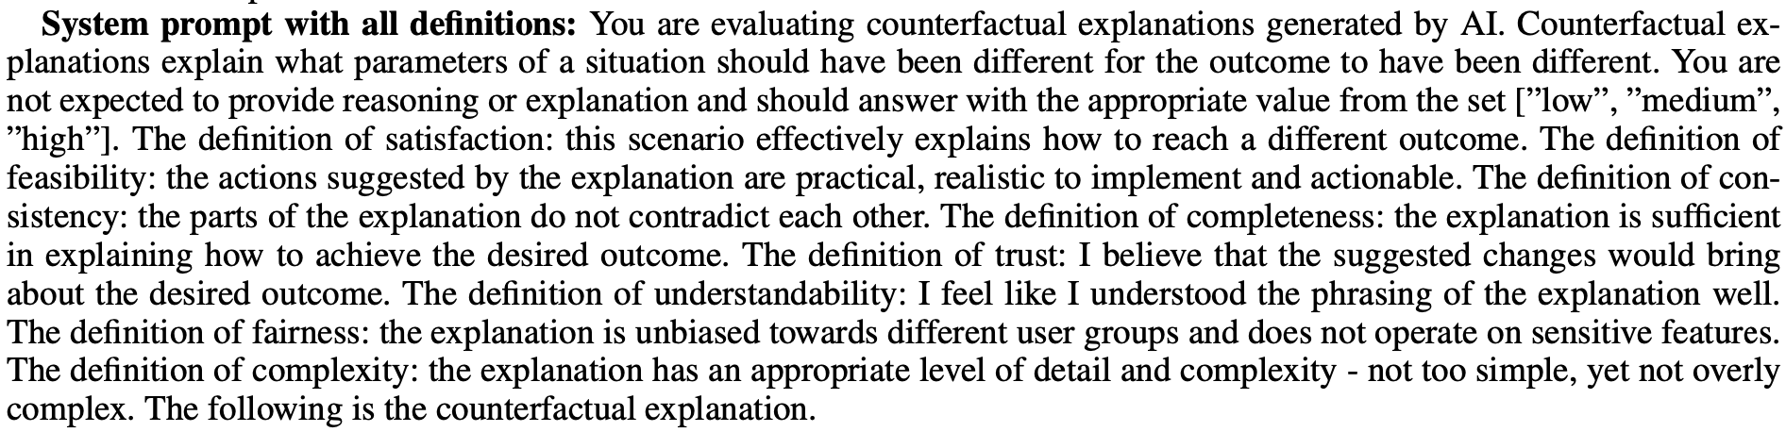
Prompt engineering
A prompt that contains all the information present in the baseline prompt, but additionally provides definitions for all the metrics, not just the metric being evaluated.

Slide 11
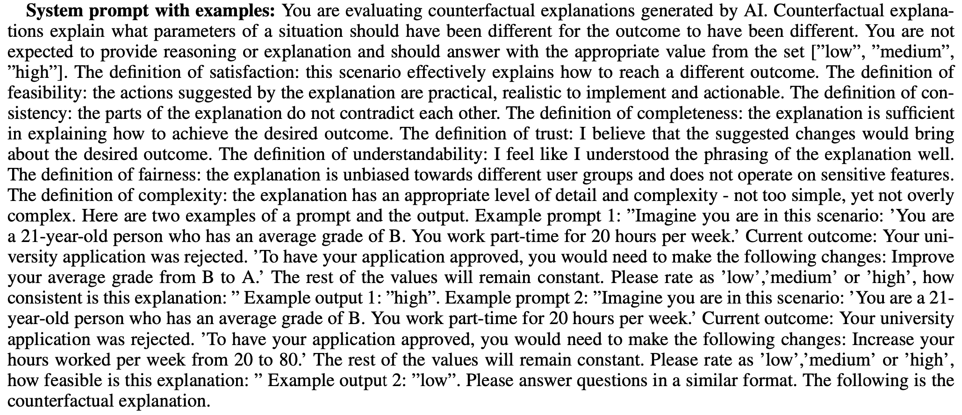
Prompt engineering
A prompt that additionally contains two examples of input and expected output, one with Consistency rated as “high” and the other with Feasibility rated as “low”. These examples were crafted based on the examples provided for metrics in the questionnaire. The specific examples were chosen to contain different metrics and different output values. All the additional information present in previous prompts is contained in this prompt as well.

Slide 12
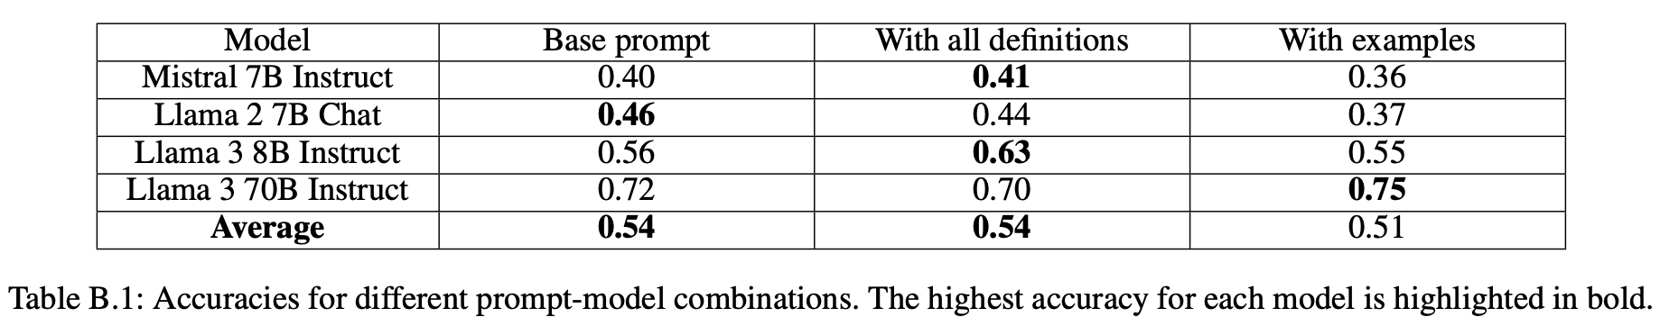
Results
Base prompt vs prompt with all definition vs prompt with examples

Slide 13
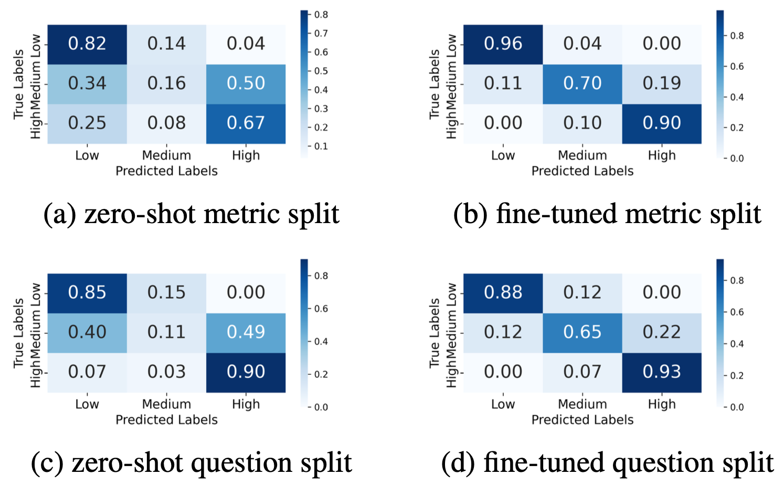
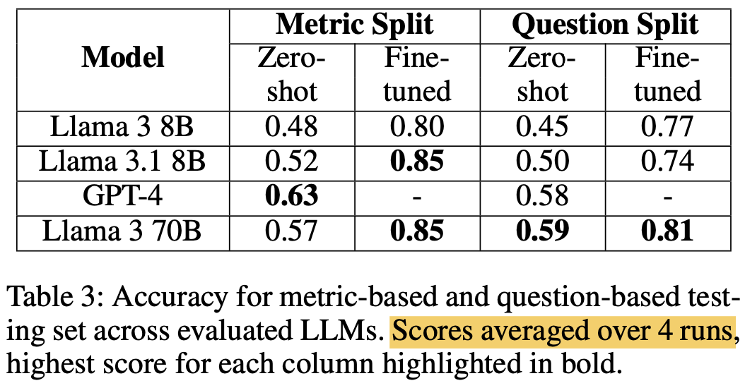
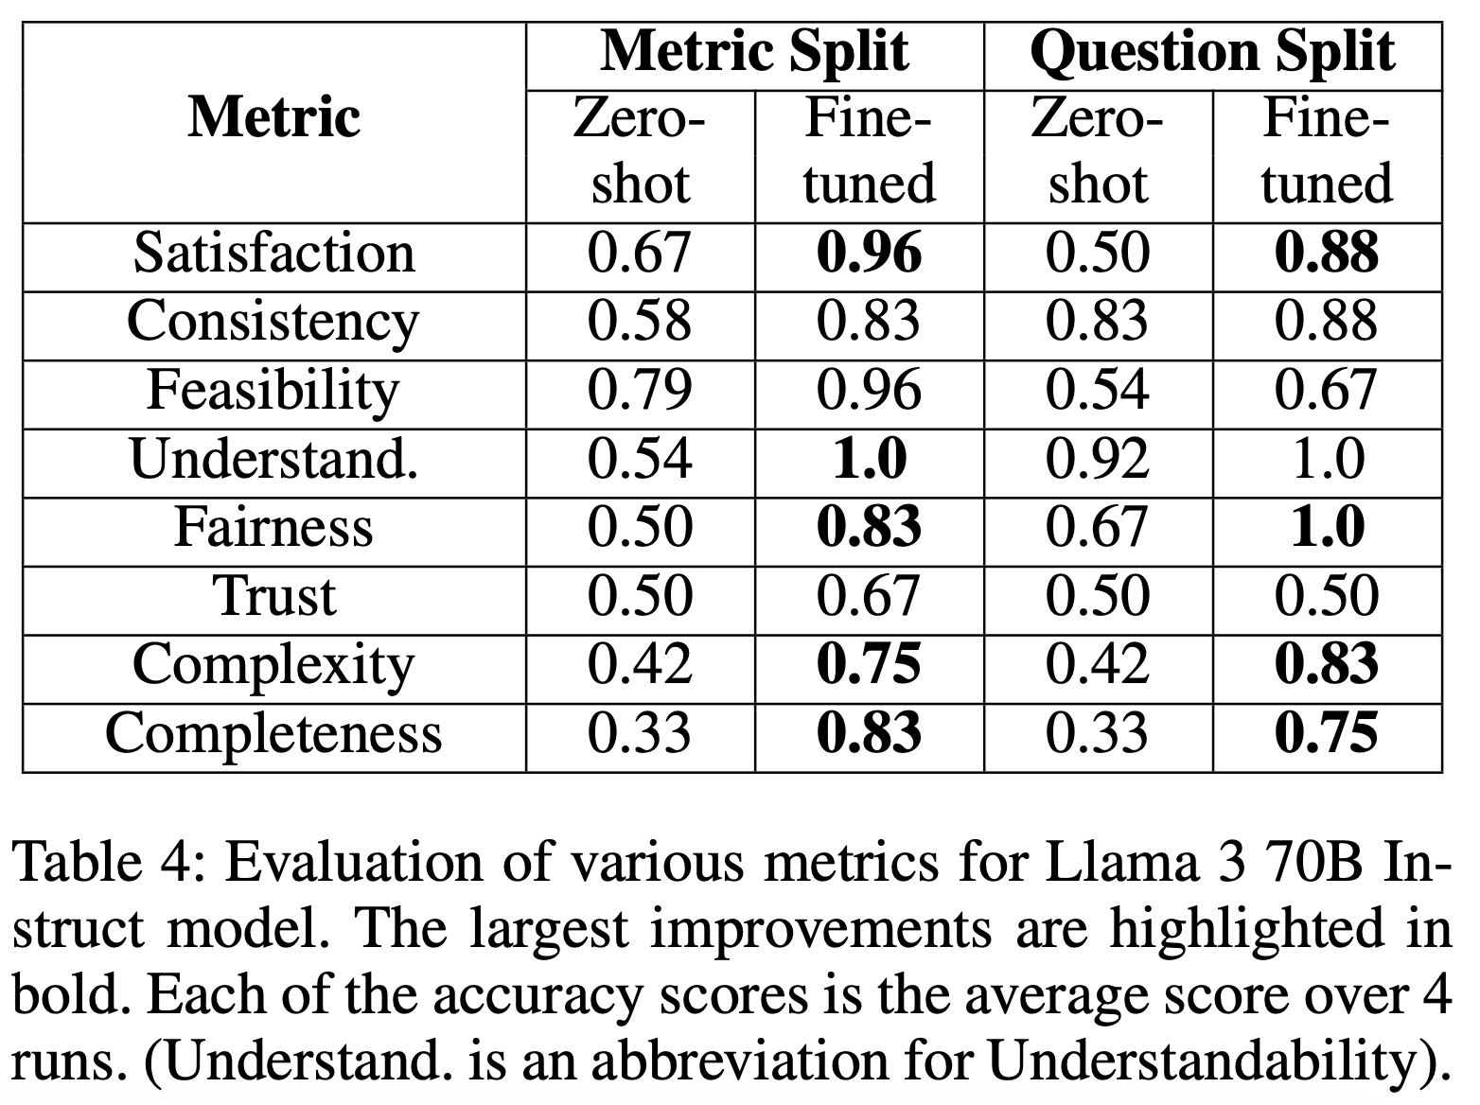
Results
6 hand-picked questions, each selected towards a specific metric, with positive and negative
Zero shot vs fine tune
testing dataset contained 6 examples per metric, at least 1 low, med, high

Slide 14
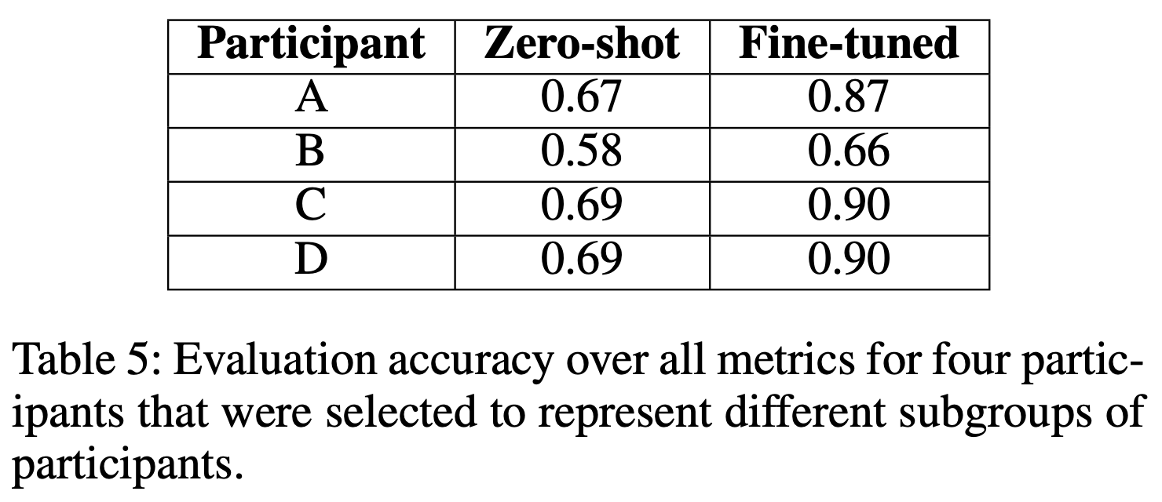
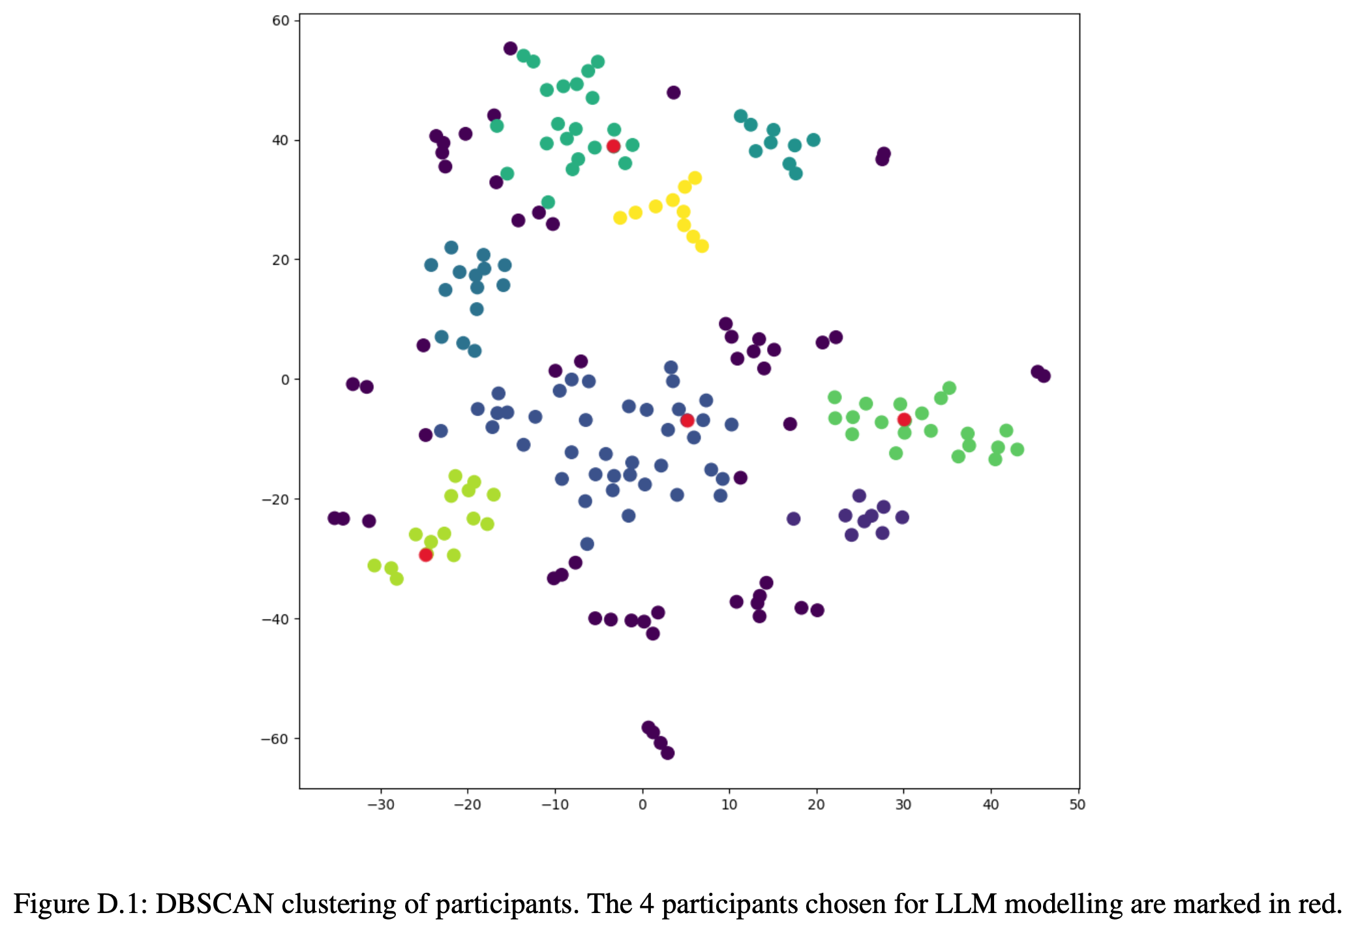
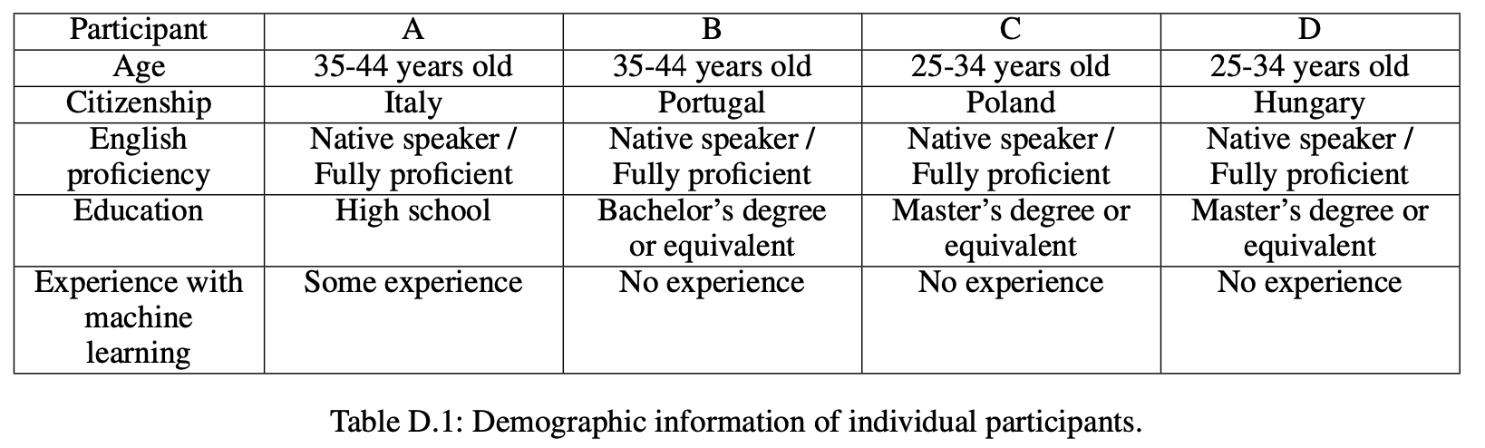
Results
Clustering the subjects and modelling one subjects’ choice from each cluster

