Slide 1
ConvBoost: Boosting ConvNets for Sensor-based Activity Recognition
Shuai Shao, Yu Guan, Bing Zhai, Paolo Missier, Thomas Ploetz
Presenter: Shovito Barua Soumma
Date: December 3, 2024
IMWUT 2023, [7 Citations as today]
Code Base: https://github.com/sshao2013/ConvBoost

Slide 2
Introduction
Method
Raw (framewise) vs Feature engineering (sample wise)
ConvNet: performs better for repetitive/periodical activities
Walking, running, cycling
Drawback: Overfitting due to imbalanced dataset
Solution:
SSL to use unlabeled data
(-) if original labeling is poor then the model will struggle
(-) it can not generate high quality training data
Ensemble learning : epoch wise LSTMs
on addition to that: epoch wise diversity (window length/size, batch size)

Slide 3
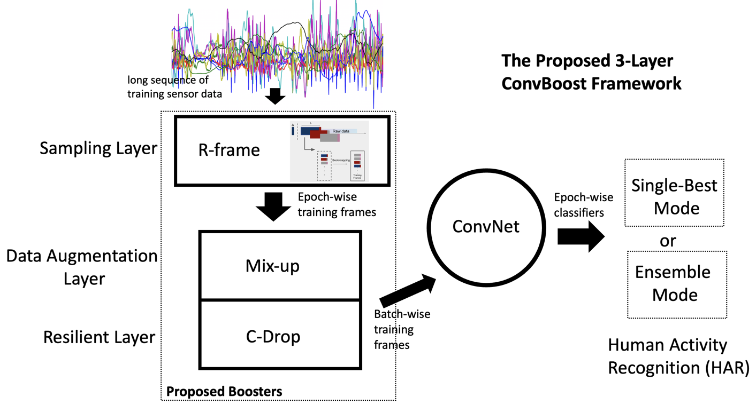
ConvBoost
High quality, dynamic training data
Diversity
Reducing the overfitting issue
Works even for an imbalanced dataset
introduces three novel layers—Sampling Layer, Data Augmentation Layer, and Resilient Layer—that each produce additional, unique training frames per epoch.
3 boosters : Random (R) Frame, Mix-up, and C-Drop

Slide 4
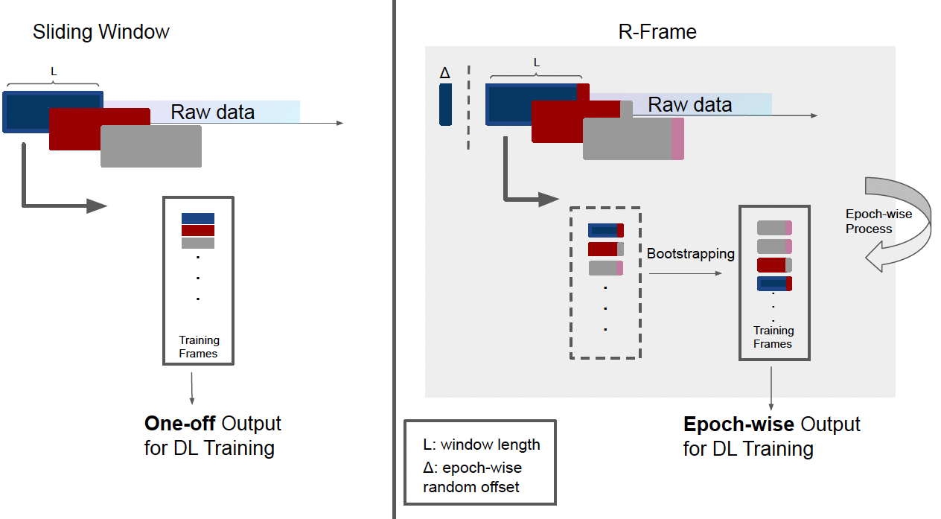
Framework: R-frame booster in Sampling Layer
Why do we need it?
Traditional sliding window and shuffling before each epoch are data hungry and suffered from overfitting in limited labeled samples
Overall training frames are constant all the time
Notes:
For many HAR systems, sliding window is a standard procedure, which converts long signal sequences into short, individual frames for classification. For ConvNet-based HAR, these frames are normally shuffled before
each training epoch. However, DL-based approaches are notoriously data-hungry, and they often suffer from overfitting in scenarios where there is only limited amounts of labeled sample data available for model training,
which is a common problem in HAR. Although the per-epoch shuffling operation may reduce the overfitting effect to some extent, it is limited, since the overall training frames–constructed by the one-off sliding window–is
a fixed set, which is problematic especially when training large ConvNets.

Slide 5
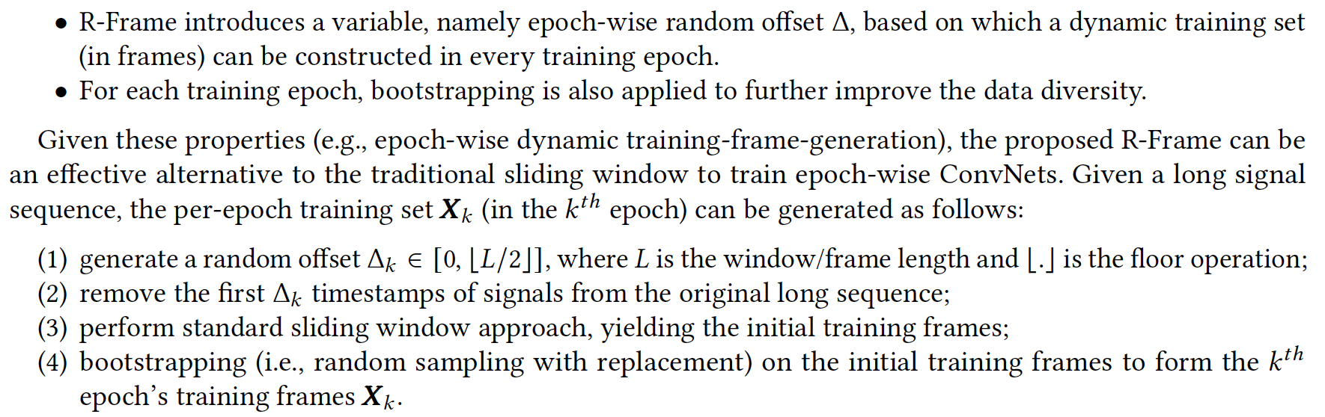

Framework: R-frame booster in Sampling Layer
generate per-epoch dynamic frame sets
Offset varies each epoch => introducing different epoch wise frames/dynamic
Notes:
For many HAR systems, sliding window is a standard procedure, which converts long signal sequences into short, individual frames for classification. For ConvNet-based HAR, these frames are normally shuffled before
each training epoch. However, DL-based approaches are notoriously data-hungry, and they often suffer from overfitting in scenarios where there is only limited amounts of labeled sample data available for model training,
which is a common problem in HAR. Although the per-epoch shuffling operation may reduce the overfitting effect to some extent, it is limited, since the overall training frames–constructed by the one-off sliding window–is
a fixed set, which is problematic especially when training large ConvNets.

Slide 6

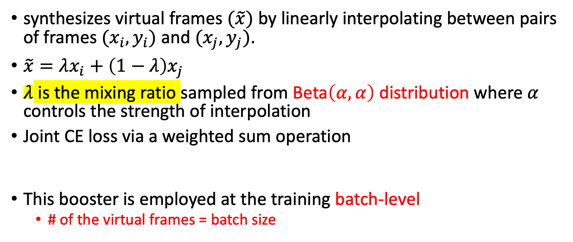
(2) Mix-up Booster in Data Augmentation Layer
synthesizes virtual frames $(\tilde{x})$ by linearly interpolating between pairs of frames $(x_{i},y_{i})$ and $(x_{j},y_{j})$.
$\tilde{x}=λx_{i}+\left(1−λ\right)x_{j}$
$λ$ is the mixing ratio sampled from Beta$\left(α,α\right)$ distribution where $α$ controls the strength of interpolation
Joint CE loss via a weighted sum operation
This booster is employed at the training batch-level
# of the virtual frames = batch size
Smooths the decision boundary
Notes:
the closer λ\lambdaλ is to 0.5, the more evenly mixed the two frames will be.
where we want to combine the predictions from multiple sources or labels into a single loss value. Specifically, it is used to measure the dissimilarity between predicted probabilities and the true labels when the true labels themselves are a combination or mixture of two classes (or more).

Slide 7
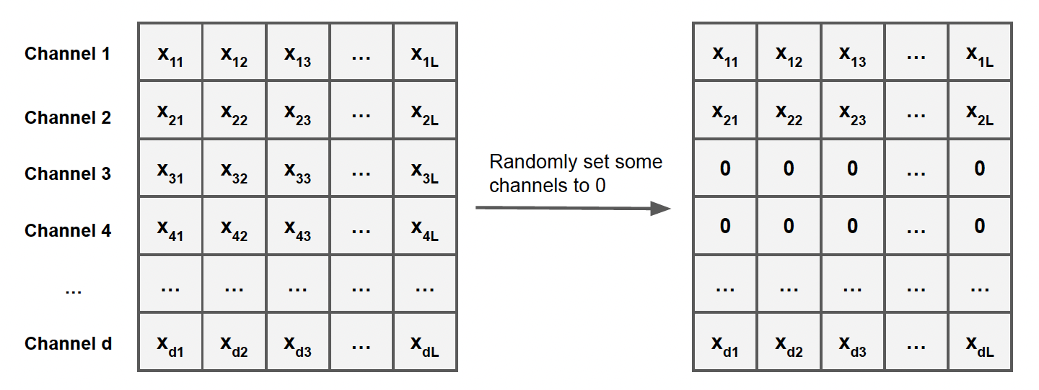
Channel Dropout booster in resilient layer
Simulate the problematic sensors (missing values/garbage values)
Resilient in respect to noise

Slide 8
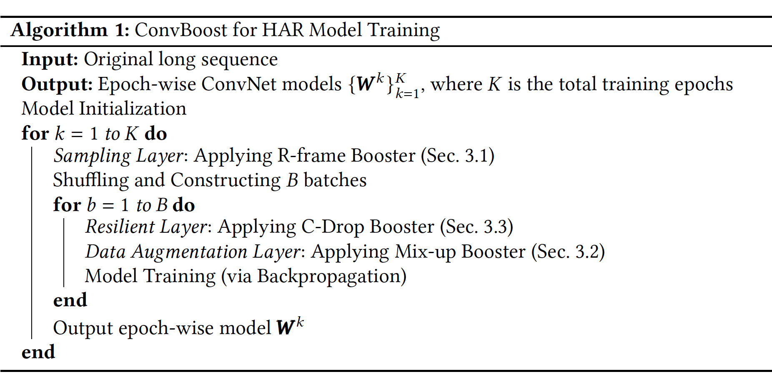
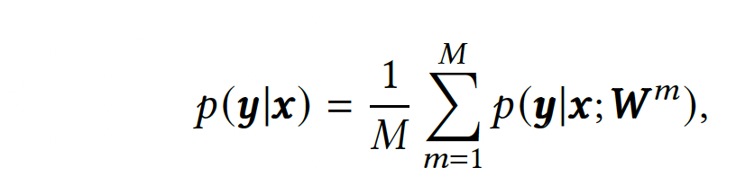
Inference
Majority voting from M best learners

