Slide 1

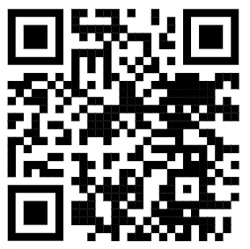
Seminar: Asking AI Better Questions
Eric Kim
Embedded Machine Intelligence Lab (EMIL)
College of Health Solutions, Arizona State University
www.ghasemzadeh.com
Notes:
Most researchers already use AI in some form.
The goal of this talk is not to discuss AI models, architecture, or hype.
The focus is much simpler: how to communicate more effectively with AI systems.
Throughout the seminar, prompting will be treated as a research communication skill.
The central idea is that better questions generally produce more useful answers.

Slide 2
The Current Problem
Current Uses of AI (for us)
Summarization of papers
Writing revision
Code debugging
Experiment planning
Idea brainstorming
Problems to consider
What should the AI do?
What context is needed?
What are the limits?
What format do you want the answer?
How should the answer be verified?
Notes:
This slide explains why the seminar matters.
The issue is not that researchers are avoiding AI.
The issue is that AI is often used without a repeatable way to write strong requests.
A vague prompt can still produce an answer, but the answer may be incomplete, hard to verify, or not useful for the actual research task.
This sets up the next slide, which diagnoses what specifically goes wrong.

Slide 3
What Goes Wrong
Common Missing Pieces
Task:
Context:
Constraints:
Output Format:
Verification:
What Happens if Missing
AI does wrong job
Generic answer
Out of scope
Complex answer
Unverified claims
Notes:
This slide makes the problem concrete.
A prompt can sound reasonable but still fail because the AI does not know the real task, audience, boundaries, or desired output.
For research work, this matters because a vague answer can look useful while still being incomplete, unsupported, or misaligned with the actual goal.
This prepares the audience for Slide 4: prompting is not magic; it is structured instruction.

Slide 4
Prompting Is Not Magic
Prompting is Structured Instruction
Define the task
Give context
Set scope
Specify output format
Get verification
Notes:
This slide reframes the topic.
The point is not to memorize special wording.
The point is to give AI systems the same kind of information a human collaborator would need: task, background, scope, expected output, and ways to check the result.
This prepares the audience for the next slide, where the full research prompt formula is introduced.

Slide 5
A Practical Prompt Checklist
Prompting Components
Task
Context
Constraints
Output
Verification
Guiding Questions
What do I want the AI to do?
What context does it need?
What rules, sources or scope should it cover?
What format should the answer be in?
How should the content be checked?
Notes:
This is the main framework for the seminar.
The point is not that every prompt must be long.
The point is that useful research prompts usually need these five pieces.
If one piece is missing, the AI may still answer, but the answer may be generic, misaligned, hard to use, or difficult to verify.
The rest of the presentation shows how this formula works in literature, writing, coding, and methods tasks.
I do not want to present this as a formal or official framework.
This checklist is my practical synthesis of repeated advice from provider guidance.
OpenAI, Anthropic, and Google all emphasize some version of clear instructions, relevant context, examples or structure, constraints, iteration, and checking.
For this seminar, I am turning that shared advice into a usable research checklist.
The goal is not to memorize an acronym.
The goal is to make research requests clearer and easier to evaluate.

Slide 6
Before and After Examples
Weak Prompt
Summarize this paper.
Stronger Prompt
Summarize this paper for a PhD student deciding whether it is relevant to an applied ML research project. Focus on the research question, dataset, method, evaluation, limitations, and whether the claims are well supported. Use bullet points and separate facts from interpretation.
Added | Why it helps
Task | Specify the type of summary
Context | Names the reader and purpose
Constraints | Limits scope of AI
Output | Bullet pointed format
Verification | Split interpretation and facts
Notes:
This slide shows the checklist in action.
The weak prompt is not useless, but it leaves too much unspecified.
The stronger version gives the AI a clearer job: summarize for a specific research decision.
It also tells the AI what matters: method, dataset, evaluation, limitations, and support for claims.
The point is not to make every prompt complicated.
The point is to include the information needed for the task.

Slide 7
Research Use Case 1: Literature
Weak Prompt
What does this paper say?
Stronger Prompt
Analyze this paper for a literature review. Identify the research question, dataset, method, outcome, validation approach, main limitation, and how it compares to the attached papers. Mark anything that is unclear or not supported by the text.
Added | Why it helps
Task | Paper analysis
Context | For a literature review
Constraints | Compare against attached papers only
Output | Comparison
Verification | Identify unclear/not supported
Notes:
This slide applies the checklist to literature review work.
AI can help organize papers, compare methods, and identify themes.
But it should not be asked to invent consensus or fill missing evidence.
The researcher should specify which sources count, what comparison matters, and how uncertainty should be marked.
This keeps AI useful without outsourcing judgment.

Slide 8
Research Use Case 2: Writing
Weak Prompt
Make this sound better.
Stronger Prompt
Revise this paragraph for clarity and flow while preserving the original scientific meaning. Do not add new claims. Flag any sentence where the evidence seems missing, overstated, or unclear.
Added | Why it helps
Task | Revision
Context | Preserve original meaning
Constraints | No new claims
Output | New sentence with flags
Verification | Identify unclear/missing/overstated
Notes:
This slide applies the prompt checklist to academic writing.
A vague writing request can cause the AI to rewrite too aggressively or change the meaning.
For research writing, the most important constraint is preserving the claim.
The researcher should specify whether the goal is clarity, structure, tone, concision, or citation support.
The AI can suggest improvements, but the researcher decides whether the revised text still says the right thing.

Slide 9
Research Use Case 3: Coding / Methods
Weak Prompt
Write code for my experiment.
Stronger Prompt
Help me design a Python workflow for this experiment. First restate the goal, assumptions, inputs, outputs, and evaluation plan. Then propose code structure. Flag any methodological risks before writing code.
Added | Why it helps
Task | Write code
Context | Workflow for experiment
Constraints | Python
Output | Proposed structure
Verification | Flag risks
Notes:
This slide applies the checklist to coding, methods, and experiment planning.
A common mistake is asking for code too early.
For research code, the logic matters as much as the implementation.
A stronger request asks the AI to clarify assumptions, define inputs and outputs, identify risks, and suggest checks.
This makes the final code more useful and easier to verify.

Slide 10
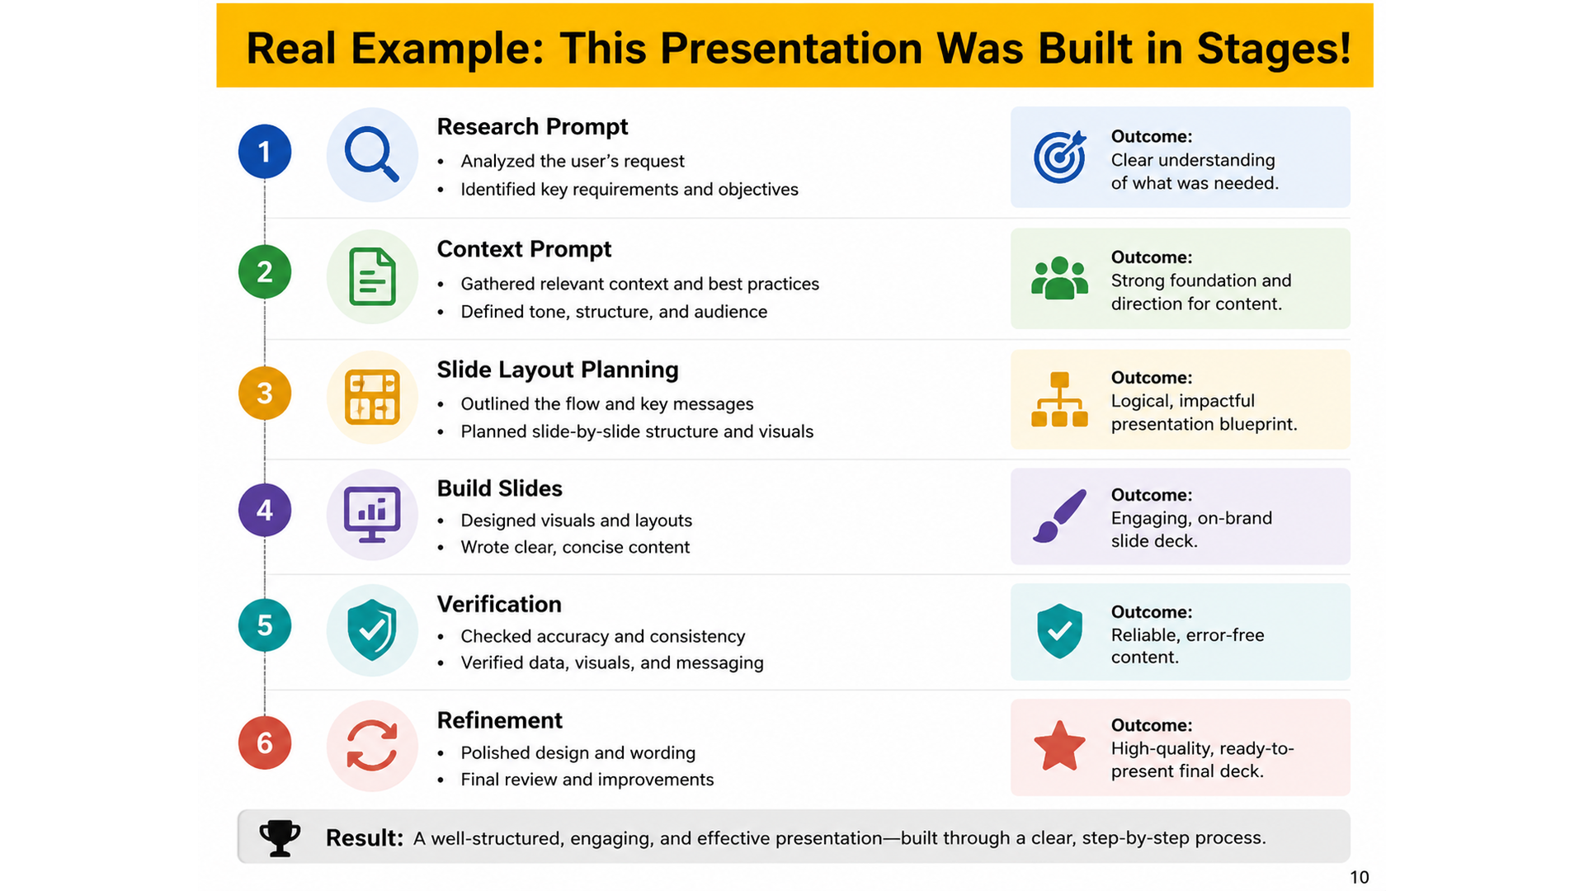
Real Example: This Presentation Was Built in Stages!
Research Prompt
Context Prompt
Slide Layout Planning
Build Slides
Verification
Refinement
Notes:
This slide briefly shows that the presentation itself was created using the same structured approach.
The point is not to make the workflow the main topic.
The point is to show that complex AI-assisted work is easier when broken into stages.
Each stage had a specific purpose: research first, context second, slide plan third, slide drafting after that, and verification throughout.
This also models how researchers can use AI for literature work, writing, coding, or planning without asking one broad, underspecified question.

Slide 11
Verification: Do Not Outsource Judgment
Check
Source
Assumptions
Scope
Evidence
Usefulness
Question
Is this from the source?
What are the assumptions?
Did it complete the task?
Are claims supported?
Is the output useful?
Notes:
This slide adds the necessary guardrail.
Better prompts improve the chance of getting useful answers, but they do not guarantee correctness.
In research work, the final responsibility stays with the researcher.
This is especially important for literature reviews, writing, methods, and code.
A good AI response should still be checked against sources, assumptions, task scope, and evidence.

Slide 12
References
OpenAI. (2026, April 10). Prompting fundamentals. OpenAI Academy.
Anthropic. (n.d.). Prompting best practices. Claude API Docs.
Google Cloud. (2026, June 23). Overview of prompting strategies. Gemini Enterprise Agent Platform Documentation.
Notes:
OpenAI. “Prompt engineering.”
Anthropic. “Prompting best practices.”
Google Cloud. “Overview of prompting strategies.”

