Slide 1
EMIL Seminar Paper Presentation
Eric Kim
Embedded Machine Intelligence Lab (EMIL)
School for Computing and Augmented Intelligence (SCAI)
Ira A. Fulton Schools of Engineering
Arizona State University

Slide 2
Paper Details
Title: Deep Learning for Accurate Diagnosis of Viral Infections through scRNA-seq Analysis: A Comprehensive Benchmark Study
Authors: Ziwei Yang, Biqing Zhu, Tianlong Chen, Zhangyang Wang

Slide 3
Introduction
Task: Distinguish viral infections using single cell RNA sequence (referred to as scRNA-seq) of blood
Goal: Determine best model to identify patterns between infection A vs infection B
Personal Takeaways: UMAP, Evaluation of Models, Batch Control

Slide 4
Problem Statement
We can read gene activity from a variety of immune cells in blood.
Can we use AI models to determine what infection a patient has from the cell readouts?
Comparison of multiple models on real dataset.

Slide 5
Dataset
Composed of Zhu, Waickman, Blish: covid-19, influenza, dengue
Zhu: 20,351
Waickman: 12,839
Blish: 174,753
Preprocessed and filtered
Largest and most comprehensive at the time!

Slide 6
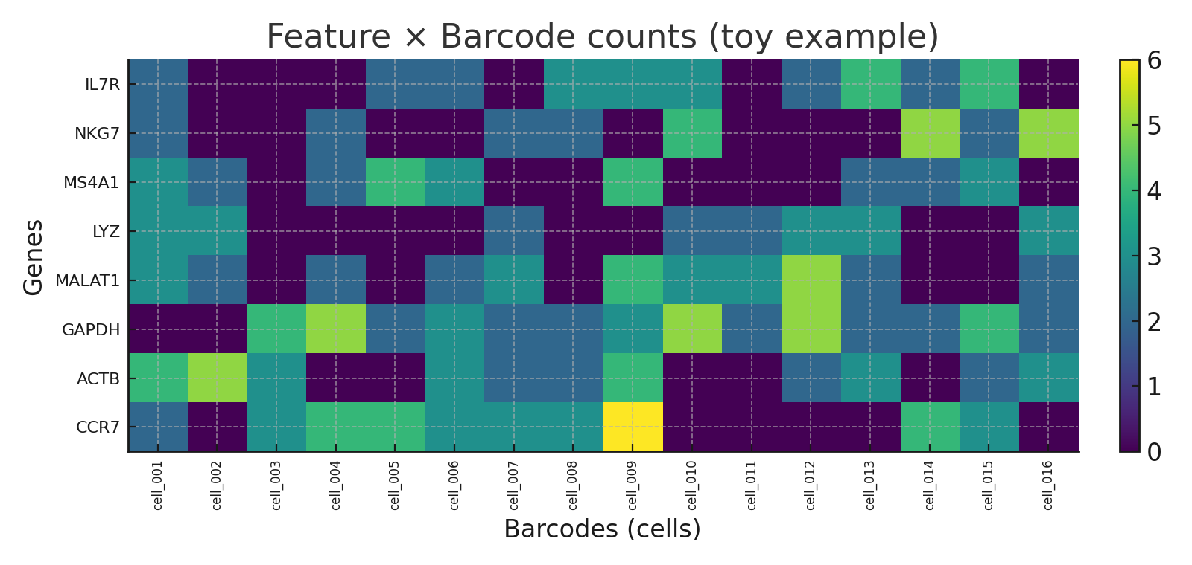
scRNA-seq
Representation of which genes are “on” in a cell
Table format: Genes (Rows) X Cells (Columns), entries are int

Slide 7
Models
PCA: compresses scRNA-seq into summary axes (easy summary)
SAVER: denoises gene counts of each cell, reduce random dropout (noise cleaner)
scVI: prob. cell map with batch handling (similar cell neighbors)
scGPT: LARGE pretrained backbone for gene and cell embeddings (autocomplete for cells)
contrastiveVI: difference focused model (push and pull similar)

Slide 8
Batch Control
Lab/Day/Kit differences that occur can “fake” biology
Metadata should include all this data
Do appropriate splitting according to the metadata
Do batch correction to remove reliance on this metadata

Slide 9
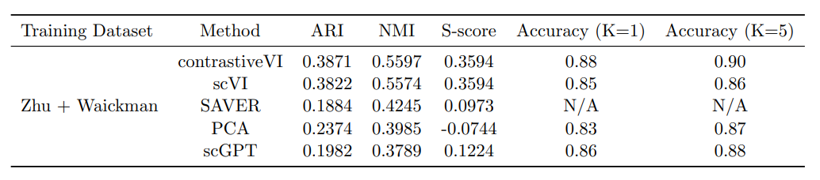
Results
contrastiveVI was the best
scGPT contribution was for batch harmonization
ARI, NMI (clustering match)
K closest neighbors (correct labels)
S-score (how well same labels stick together)

Slide 10
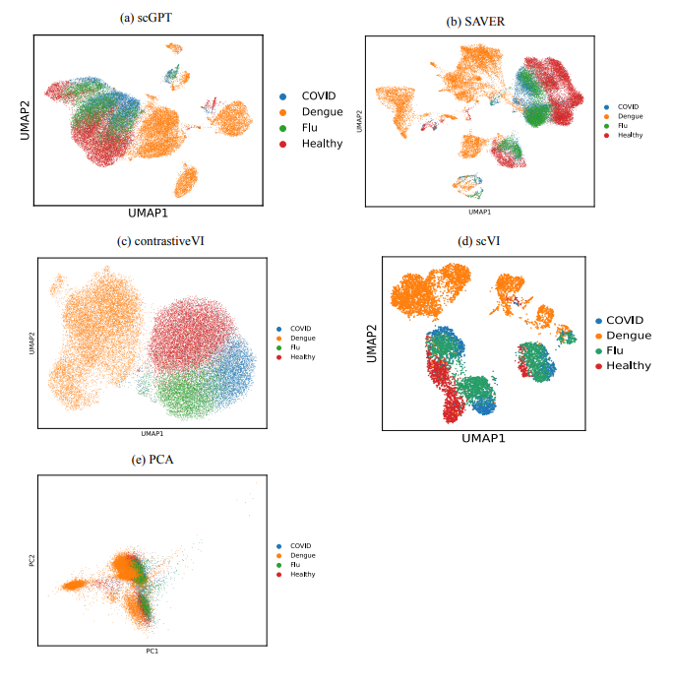
UMAP – Uniform Manifold Approximation and Projection
Visually: 2D – Scatterplot
Reality: Result of a Dimensionality Reduction Algorithm
Purpose: Visual Confirmation of Results

Slide 11
Relevance
Batch Control, what it is and how to deal with it
UMAP, a form of simple reality check on outcome of data
Model Evaluation, use of different models for different purposes
Pipeline, on how to follow similar steps for related project

Slide 12
Reference
Yang, Z., Chen, X., Zhu, B., Chen, T., & Wang, Z. (2025). Deep learning for accurate diagnosis of viral infections through scRNA-seq analysis: A comprehensive benchmark study. Journal of Data-centric Machine Learning Research. https://openreview.net/forum?id=wlH6Np0Um0

