Slide 1
CONCEPT PROPOSAL
Self-hosted room booking
for Cisco RoomOS
Keeping the Cisco panels and video devices. Removing the Webex cloud entirely.
Booking data stays in Exchange Online, reached directly over Microsoft Graph.
Provisioning Mode: Off
Persistent Web App
Manual LED control
Microsoft Graph

Slide 2
STARTING POINT
The constraint, and what we are protecting
Webex is no longer available to us. The hardware and the calendar are.
Webex cloud is out
Cisco hardware stays
Calendar stays in M365
No Control Hub registration, no Hybrid Calendar,
no Webex device management or analytics.
This is a hard constraint, not a preference.
Room Navigator panels and RoomOS video devices
are a significant investment and work well.
We keep every device, including the LED strips.
Room mailboxes in Exchange Online remain the
system of record. Users keep booking in Outlook.
We reach them directly via Microsoft Graph.
The question this concept answers: can a Room Navigator still act as a room booking panel, with occupancy-driven room release, when it is never registered to Webex?
Self-hosted room booking for Cisco RoomOS · concept
2

Slide 3
THE DEVICE DECISION
Three independent settings define a Room Navigator
Each is set locally over the xAPI or the device web interface. No cloud involved.
SETTING
VALUES
WE USE
xCommand Provisioning SetType
PairedToCodec / Standalone
Standalone
Result
A wall panel we own
end to end.
No Webex account.
No Control Hub.
No cloud dependency
in the booking path.
Physical topology — no codec behind the panel
xCommand SystemUnit SetTouchPanelMode
Controller / Scheduler / PersistentWebApp
PersistentWebApp
What the screen runs. Controller needs a codec
xConfiguration Provisioning Mode
Off / Auto / Webex
Off
Off = “customer managed”. This is our zero-cloud switch
Trade-off: in customer-managed mode Cisco documents the entire Bookings xAPI family as not applicable. We therefore build the booking UI ourselves — and Cisco's own setup guide prescribes exactly that.
Self-hosted room booking for Cisco RoomOS · concept
3

Slide 4
CONSEQUENCE
What customer-managed mode gives and takes
Taken from the Cisco Room Navigator (stand-alone) API Reference Guide, D15512.02, RoomOS 11.9.
NOT AVAILABLE · customer managed
AVAILABLE · and officially prescribed
× xCommand Bookings Put / Book / Delete / Get / List
✓ Persistent Web App — full-screen, undismissable
× xCommand Bookings Respond / NotificationSnooze
✓ Local xAPI over WebSocket, HTTP and SSH
× xStatus Bookings Availability / Current Id
✓ UserInterface LedControl Mode: Manual
× xConfiguration RoomScheduler Enabled
✓ LedControl Color Set — Green / Yellow / Red / Off
× The native Cisco Room Scheduler screen
✓ Panel temperature and humidity sensors
× LED auto-driven from booking state
✓ Full local admin, no cloud account
Each is marked “Doesn't apply for a customer
managed Room Navigator”.
Cisco's own customer-managed walkthrough includes
setting LedControl Mode to Manual.
Self-hosted room booking for Cisco RoomOS · concept
4

Slide 5
ARCHITECTURE
One broker, two devices per room, one calendar
Only the calendar lives outside. Everything else runs on your own infrastructure.
MEETING ROOM
CALENDAR SOURCE
Room Navigator
UI + LED
Exchange Online
standalone · outside room
Persistent Web App
Microsoft Graph · app-only
Room Broker
reconciler
occupancy state machine
calendar drivers
Exchange on-prem
EWS · streaming
Graph
RoomOS video device
in room · has its own Navigator
occupancy source only
Google Workspace
sync tokens
sensors
CalDAV
Nextcloud / SOGo
The panel and the video device never talk to each other. The broker is what joins them — replacing the Workspace association that Webex used to provide.
Self-hosted room booking for Cisco RoomOS · concept
5

Slide 6
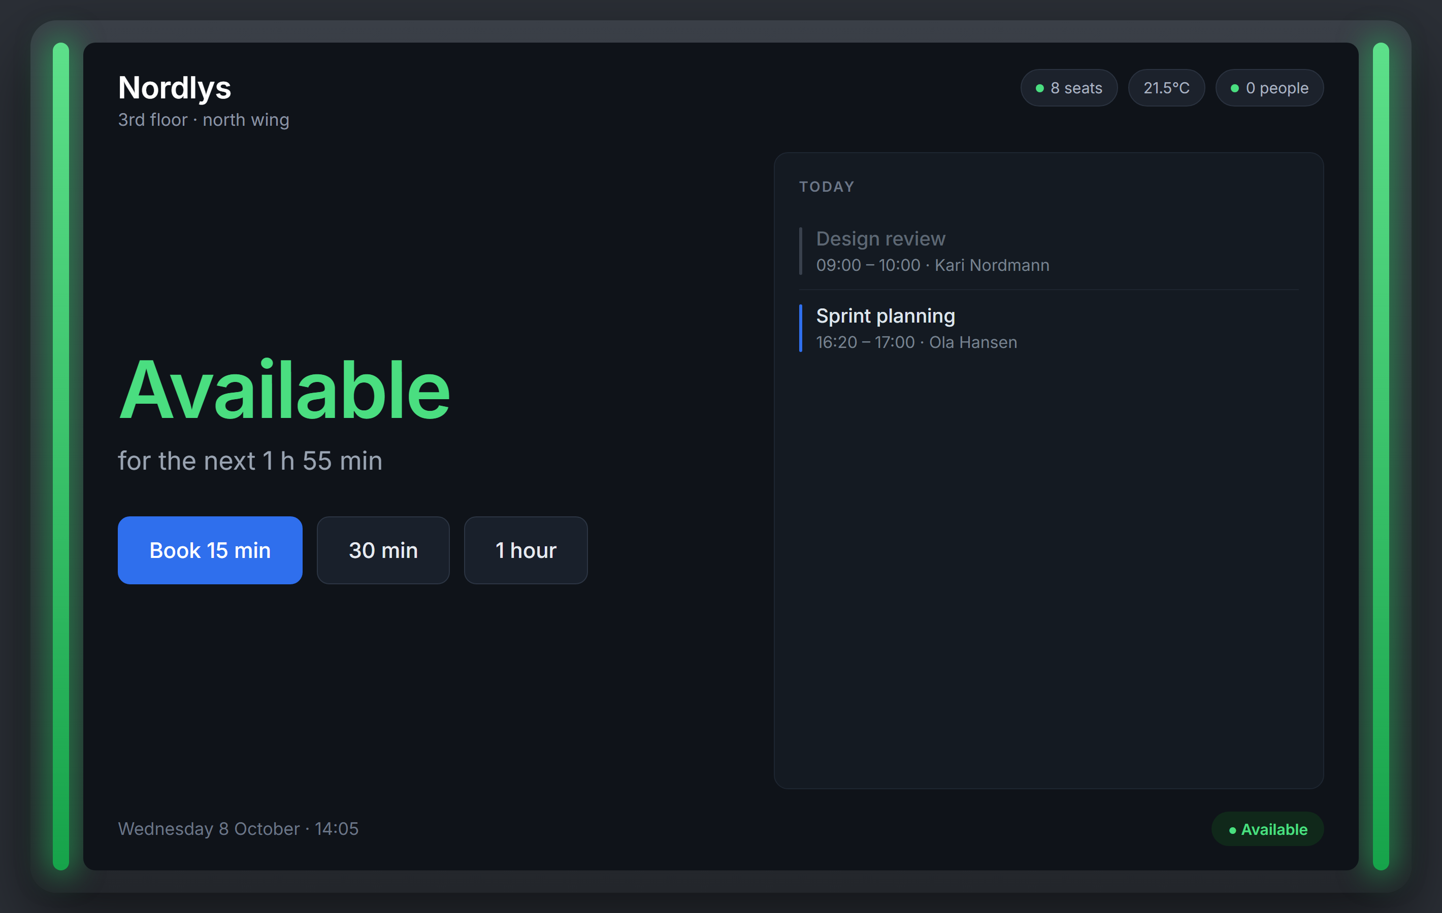
PANEL EXPERIENCE
The panel · available
Room free. LED green. Tapping a duration books the room instantly.
Ad-hoc booking
15 / 30 / 60 min, or a custom slot
Today's agenda
read from the room mailbox via Graph
Panel sensors
temperature and humidity come from the Navigator itself
LED strip
Green — driven by the broker, not by RoomOS
Self-hosted room booking for Cisco RoomOS · concept
6

Slide 7
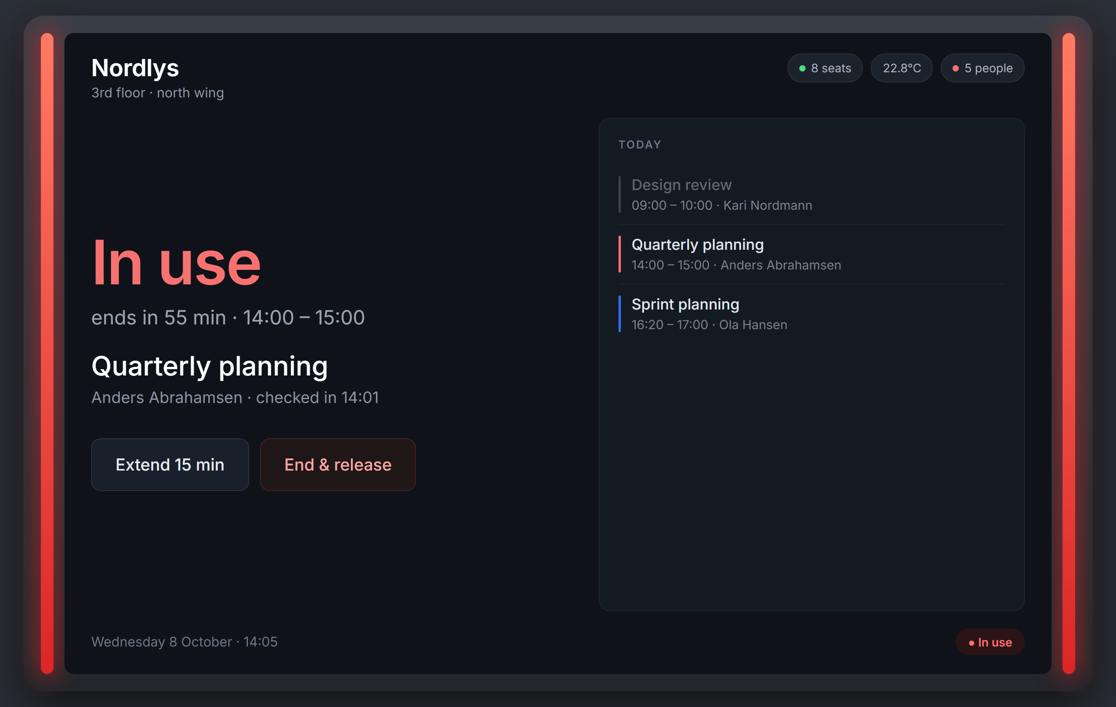
PANEL EXPERIENCE
The panel · in use
Meeting in progress and occupancy confirmed. LED red.
Live occupancy
people count streamed from the in-room video device
Extend
lengthens the booking if the next slot is free
End & release
frees the room immediately for everyone
LED strip
Red — set by the broker on booking start
Self-hosted room booking for Cisco RoomOS · concept
7

Slide 8
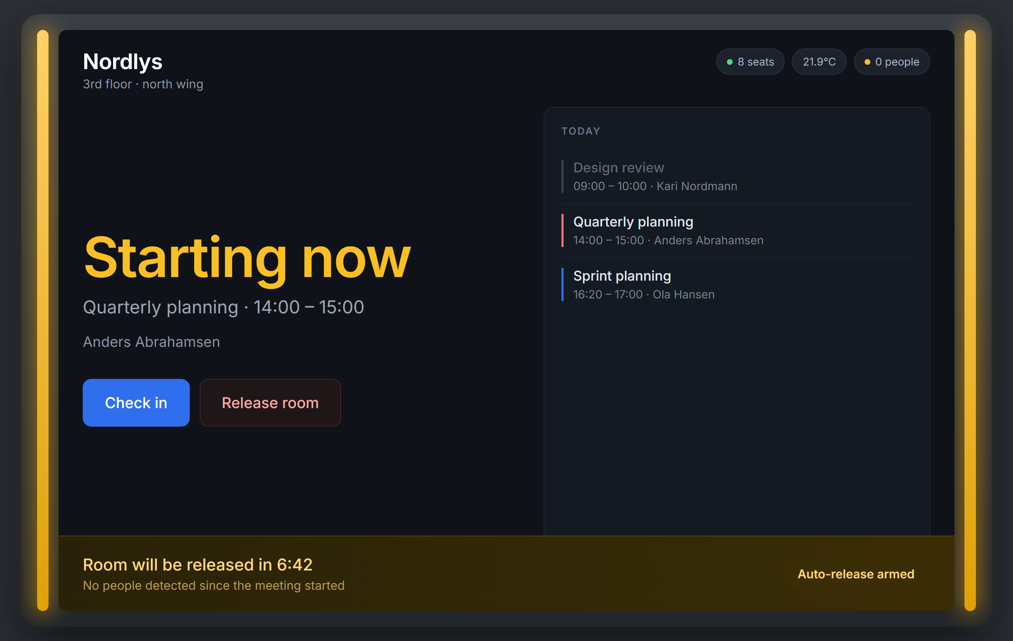
PANEL EXPERIENCE
The panel · check-in and auto-release
Booked but empty. The room is reclaimed if nobody shows up.
Check-in window
configurable, default 10 minutes
Automatic check-in
people count ≥ 1 for one continuous minute
Visible countdown
the user can always claim the room manually
LED strip
Amber — booked, awaiting check-in
Self-hosted room booking for Cisco RoomOS · concept
8

Slide 9
AVAILABILITY INDICATION
The LED strip stays, under our control
Switch the strip to manual once at setup, then drive it from the broker.
xConfiguration UserInterface LedControl Mode: Manual ← set once, part of Cisco's customer-managed setup
xCommand UserInterface LedControl Color Set Color: Green|Yellow|Red|Off
Green
Available
No booking active, room free to take
Amber
Booked, awaiting check-in
Within the check-in window, nobody detected yet
Red
In use
Meeting running, or occupancy confirmed
Off
Out of service
Panel unreachable or room disabled
Cisco's own description of Auto mode is “green: room available, red: room in use” — we reproduce the same semantics, sourced from our calendar and sensor state instead of theirs.
Self-hosted room booking for Cisco RoomOS · concept
9

Slide 10
FLOW 1
Ad-hoc booking from the panel
User taps “Book 15 min” on a free room. Typical end-to-end time: under two seconds.
1
Panel
2
Broker
3
Graph
4
Exchange
5
Broker
6
Panel
User taps a duration in the web app
Receives the request over the local network
Creates the event with the broker as organizer
and the room as a resource attendee
Resource booking attendant accepts or rejects —
this is what prevents double-booking
Re-reads calendarView, updates panel state
Shows “In use” · LED set to Red
Why the broker is the organizer
Why we do not write to the room calendar directly
A room mailbox can only decline its own copy of a meeting. Only the organizer can truly cancel one. Owning the organizer identity is what lets us release a room cleanly later.
Writing straight into the room mailbox bypasses the resource booking attendant, so conflict rules are never evaluated and a room that must never double-book, silently does.
Self-hosted room booking for Cisco RoomOS · concept
10

Slide 11
FLOW 2
Occupancy-driven room release
The ghost-meeting problem: a room booked, nobody turns up, and it stays blocked all afternoon.
Meeting start
Broker arms the check-in window and sets the LED amber
0 – 10 min
Panel shows “Check in”. People count polled from the in-room video device
Someone arrives
People count ≥ 1 for one continuous minute → automatic check-in, LED red
Nobody arrives
30-second countdown shown on the panel, then the room is released
Release
Broker-owned booking is cancelled outright. User-organised booking has the room's copy declined
Room freed
LED back to green, slot immediately bookable by anyone
Honest limitation: for a meeting organised by a user in Outlook we can free the room, but we cannot delete their meeting. They get a decline notice and the entry stays on their own calendar.
Self-hosted room booking for Cisco RoomOS · concept
11

Slide 12
INTEGRATION
Microsoft Graph — Exchange Online
App-only daemon, scoped so it can only ever touch room mailboxes.
Identity & scope
Reading
Writing
· Entra app, client-credentials (app-only) flow
· Place.Read.All — discover rooms
· Calendars.ReadWrite — read and write bookings
· Scoped with RBAC for Applications, so the app reaches only the room mailboxes, never the wider tenant
· calendarView — occurrences already expanded, including modified recurring instances
· calendarView/delta for incremental sync
· Polling every 1–5 min, so no public endpoint and no inbound firewall exposure
· Create as organizer, room as resource attendee
· Exchange arbitrates conflicts natively
· Cancel our own bookings outright
· Decline the room's copy for user-organised ones
Better privacy posture than before: Webex Hybrid Calendar required tenant-wide “read/write calendars in all mailboxes” consent. This design is restricted to the room mailboxes alone.
Self-hosted room booking for Cisco RoomOS · concept
12

Slide 13
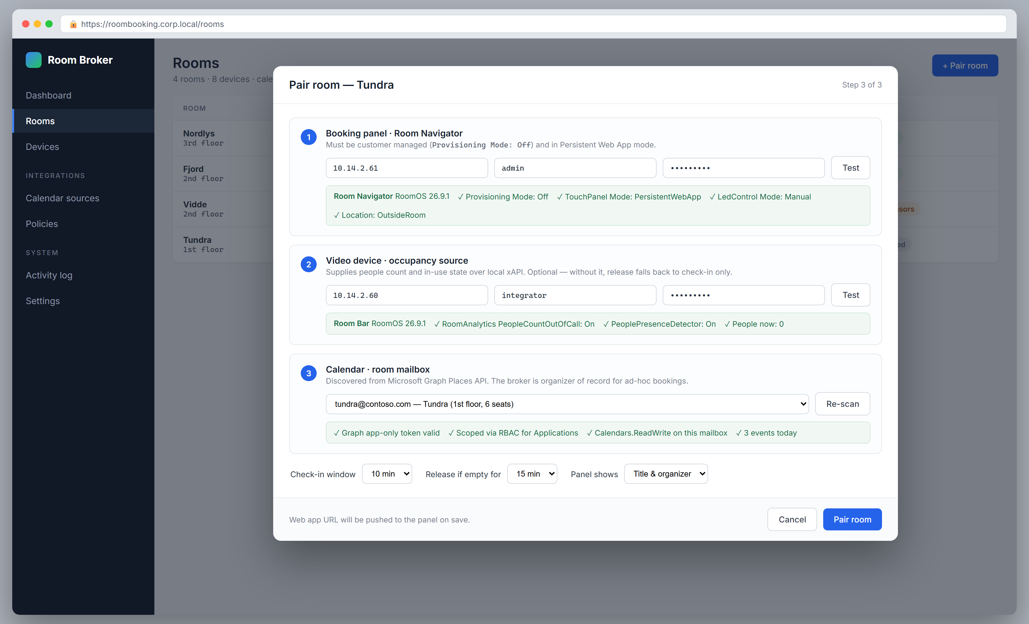
MANAGEMENT
Pairing a panel, a video device and a mailbox
One screen defines a room: which panel, which sensor source, which calendar.
Self-hosted room booking for Cisco RoomOS · concept
13

Slide 14
MANAGEMENT
What pairing actually configures
The broker validates each device on save, so misconfiguration is caught at setup rather than at 09:00 Monday.
Booking panel
Verifies Provisioning Mode: Off, switches the panel to Persistent Web App mode, pushes the web app URL, and sets LedControl Mode to Manual.
Video device
Verifies RoomAnalytics PeopleCountOutOfCall is On, subscribes to people count and presence over the local xAPI. Optional — without it, release falls back to check-in only.
Room mailbox
Picked from rooms discovered through the Graph Places API. Confirms the token is valid and scoped to that mailbox before the room goes live.
Policy
Check-in window, release-if-empty threshold, and how much meeting detail the panel is allowed to display in a public corridor.
Self-hosted room booking for Cisco RoomOS · concept
14

Slide 15
SCOPE
Feature summary
What the concept delivers against what Webex did before.
DELIVERED
LOST WITH WEBEX
✓ Room status on a wall panel, with LED strip
× Cisco's native Room Scheduler screen
✓ Ad-hoc booking from the panel
× One Button To Push on the panel itself
✓ Today's agenda from the room mailbox
× Control Hub device management and firmware
✓ Extend and end-early from the panel
× Webex cloud analytics and workspace insights
✓ Check-in and automatic room release
× Cisco TAC support for the booking experience
✓ Occupancy from the in-room video device
× @webex / @meet keyword meeting rewriting
✓ Temperature and humidity on the panel
✓ Multi-calendar: Graph, EWS, Google, CalDAV
✓ Central management and pairing UI
Self-hosted room booking for Cisco RoomOS · concept
15

Slide 16
BEFORE COMMITTING
Open items and honest risks
Nothing here is a blocker, but each needs a decision or a lab test.
Must be tested on real hardware
Cisco's stand-alone guide dates from April 2024 and has never been revised. The current xAPI schema lists the Bookings family for the Navigator without a customer-managed caveat. Worth one lab test: does Scheduler mode work unregistered? If it does, the native UI comes back on the table.
Ghost meetings on organiser calendars
Releasing a user-organised meeting frees the room but leaves the entry on their calendar. A UX and comms decision, not a technical one.
Sensor accuracy is unpublished
Cisco publishes no figures for people-count latency or false negatives. Characterise in one pilot room before setting an aggressive release threshold.
We own what Cisco used to own
Firmware updates, certificates, panel provisioning and support all become ours. This is the real cost of leaving the cloud, and it is ongoing rather than one-off.
Self-hosted room booking for Cisco RoomOS · concept
16

Slide 17
NEXT STEPS
Proving it in stages
Each stage is independently useful and independently abandonable.
1
2
3
4
5
Spike
Read-only
Booking
Release
Scale
One Navigator, customer managed, Persistent Web App.
Prove the panel renders our UI and the LED responds to
LedControl Color Set.
Graph driver against one room mailbox. Panel shows real
bookings. No writes anywhere.
Ad-hoc booking from the panel, broker as organizer.
Conflict handling via Exchange.
Subscribe to the video device, occupancy state machine,
check-in and auto-release.
Management UI, additional calendar drivers,
monitoring and alerting across all rooms.
1 day
1 week
2 weeks
2 weeks
ongoing
Recommended first move: stage 1. One panel, one afternoon, and it settles the only genuinely open technical question in this deck.
Self-hosted room booking for Cisco RoomOS · concept
17

