Slide 1
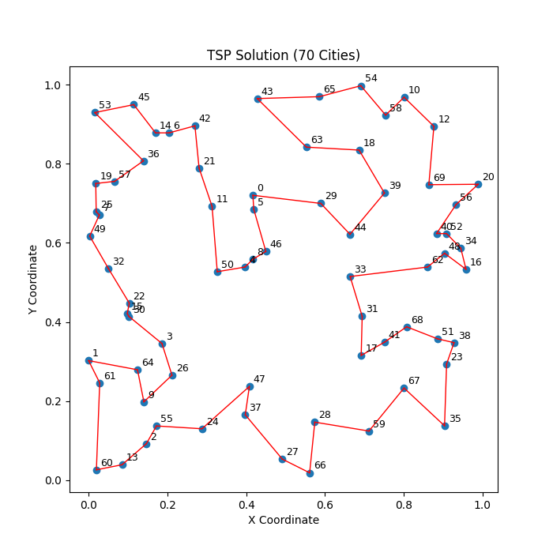
Solver：MIP 求解器——全局最优
MIP +惰性约束求解tsp问题结果展示：
cities | Best solution | Best bound | Best gap | Solve time | Solve node | Solution status
10 | 1.899341 | 1.899341 | 0.00% | 0.11 | 49 | integer optimal (relative gap limit 0.0001)
20 | 3.671153 | 3.671153 | 0.00% | 0.75 | 1626 | integer optimal (relative gap limit 0.0001)
30 | 4.119293 | 4.119293 | 0.00% | 0.14 | 1 | integer optimal (relative gap limit 0.0001)
40 | 4.904319 | 4.904319 | 0.00% | 0.32 | 2 | integer optimal (relative gap limit 0.0001)
50 | 5.69244 | 5.69244 | 0.00% | 17.3 | 5698 | integer optimal (relative gap limit 0.0001)
60 | 6.097422 | 6.097422 | 0.00% | 2251.73 | 523091 | integer optimal (relative gap limit 0.0001)
70 | 6.700277 | 6.700277 | 0.00% | 9619.01 | 1882638 | integer optimal (relative gap limit 0.0001)
对比思路：早停
设置 MIPGap(最优性差距)：
model.setParam('MIPGap', 0.01)
设置 TimeLimit (时间限制):
model.setParam('TimeLimit', 300)

