Slide 1

Case Study Solution
Data Analysis and Machine Learning for business venture
Submitted by: Abaad Murtaza
Source Code: https://github.com/abaadm1/case-study

Slide 2
Case Statement

Slide 3
Case Statement
A marketplace has more than a million users, with DAU (daily active users) around 10k - 20k. The company has now decided to extend its operations as a vendor of high end products. In order to gain new customers (convert old customers to new business offerings) in this new venture, the company will either spend dollars on marketing or attract business to customers already on its parent platform.
The company’s data team has provided you with a sample dataset.
Sample Dataset - Transaction Details
Upon examining the initial data, you are required to perform the following tasks using the full dataset,
Link: Full Dataset

Slide 4
Dataset Exploration

Slide 5
Data Description
The dataset provided had eight fields. Their description is given below:
customer_id: Unique ID of the Customer
acquired_by: How the Customer was acquired in the Parent Product
acquired_date: Date Time of Acquisition
transaction_time: First Completed Transaction
product_type: Type of Product Sold (represented by numbers)
parent_region_id: Higher Region (City/Town)
value: Transactional Amount
child_region_id: Lower Region (Area/Sector)

Slide 6
Key Findings of Dataset
The dataset contains 1,734,054 observations with 8 features each, providing a comprehensive view of the marketplace's transactions and customer information.
Notably, no duplicates were identified in the dataset, ensuring data integrity and accuracy in the analysis.
Among the features, all columns, except product_code and value, were of object datatype, while product_code and value were represented as integers.
During data exploration, it was observed that there were 70 missing values in the acquired_date field, which may require attention during data preprocessing to ensure completeness in the analysis.

Slide 7
Data Preparation
Datetime Conversion for Time-based Analysis:
To ensure consistency and enable time-based analysis, the data types of "transaction_time" and "acquired_date" were converted into the datetime format. This transformation allows for accurate temporal data exploration.
Handling Missing Values:
During the data exploration process, it was observed that 70 observations for 8 unique customers contained missing values.
With a total of 166,764 unique customers in the dataset, a decision was made to remove these 70 rows. This approach preserves data integrity and mitigates potential biases in the analysis.

Slide 8
Feature Engineering
Temporal Data Enhancement:
To gain more insights from time-related features, we extracted the day, month, year, and number of the weekday from both "acquired_date" and "transaction_time" columns. This enriched the dataset with valuable temporal information.
Customer Monetary Value Calculation:
To understand each customer's spending behavior, we accumulated their total spending from the "value" column. This customer-specific monetary value provides a crucial feature for our analysis.
Label Encoding of Categorical Variables:
To prepare categorical variables for feeding into machine learning models, we performed label encoding on "acquired_by," "product_code," and "parent_region_id" columns. This transformation converted categorical values into numeric labels, facilitating their integration into the model later on.

Slide 9
Statistical Analysis
Product Code Distribution:
The dataset comprises 1,733,984 observations with various product codes. The most common product code is 78, with a mean occurrence of 78.1. The minimum product code is 76, and the maximum is 98.
Transaction and Acquisition Time Insights:
The transactions took place predominantly during October 2021, with a mean transaction day of 15.3. The majority of acquisitions also occurred in October 2021, with a mean acquired day of 15.5.
Transactions are evenly distributed throughout the week, with the highest frequency on the third day of the week (Tuesday). Acquisitions are also well-distributed across the week, with the highest frequency on the third day of the week (Tuesday).

Slide 10
Statistical Analysis
Customer Total Value:
The customer_total_value column shows the accumulation of each customer's monetary value, with a mean value of 2,935.1. The maximum value reached is 47,133, indicating some customers made high-value transactions.
Acquisition Source Encoding:
The acquired_by_encoded column is a label-encoded representation of the acquired_by feature, indicating different acquisition sources for customers. The most common encoded value is 0, followed by 1.
Product Code Encoding:
The product_code_encoded column is a label-encoded representation of the product_code feature. The most common encoded value is 2, followed by 0.
Parent Region Encoding:
The parent_region_id_encoded column is a label-encoded representation of the parent_region_id feature. The most common encoded value is 0, followed by 2.

Slide 11
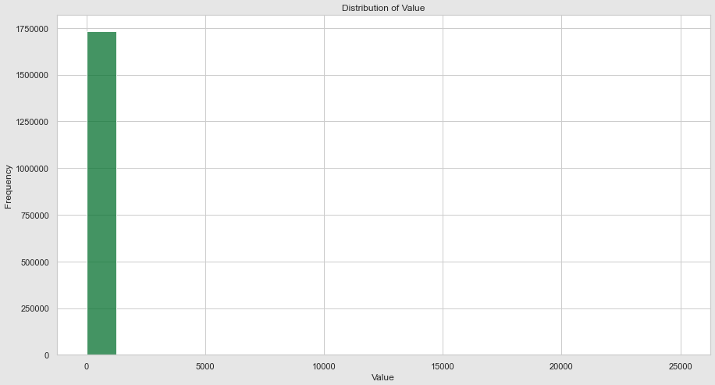
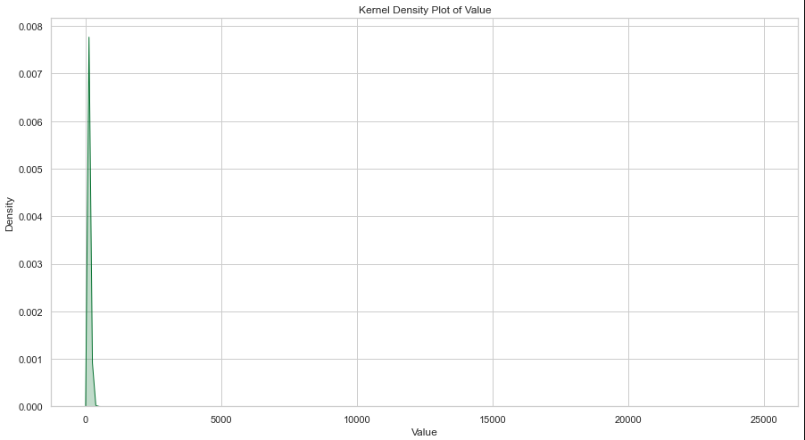
Statistical Analysis
Insight: The skewness of approximately 1.5 indicates a moderate right-skewed distribution. This suggests that there are relatively more lower-value transactions than higher-value ones.

Slide 12
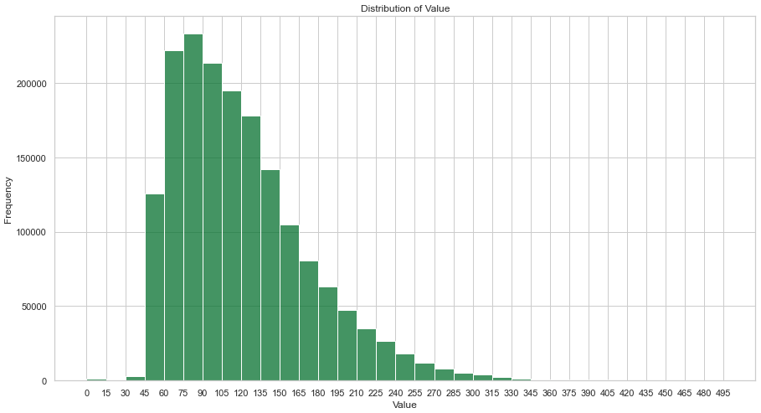
Statistical Analysis

Slide 13
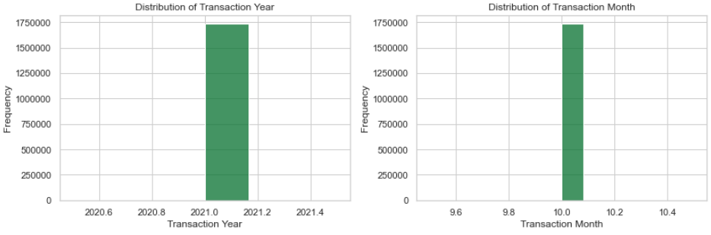
Statistical Analysis
Insight: The transactions only happened in the month of October 2021

Slide 14
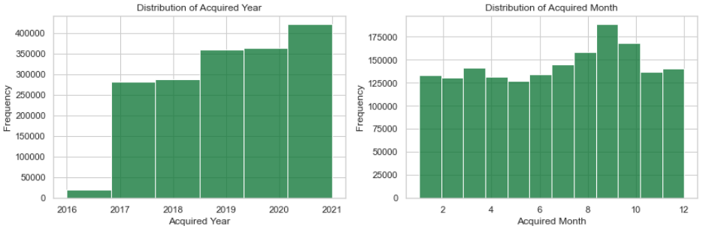
Statistical Analysis
Insight: The Acquisition of customer happened in all months through 2016 to 2021.

Slide 15
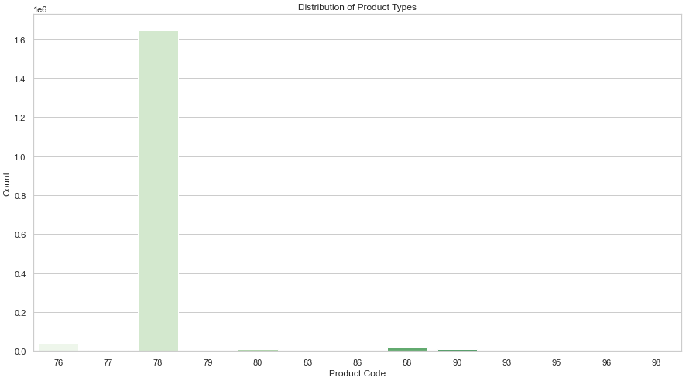
Statistical Analysis
Insight: The product with product code ‘78’ was the most ordered product.

Slide 16
Question # 01
As a Data Analyst, the company requires a way to; 1. Identify User based on Purchase Habits, Spending Ability. 2. Region Based analysis of Transactions and Users. 3. Analysis which will help navigate the direction of this new business.

Slide 17
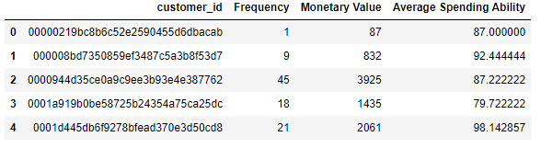
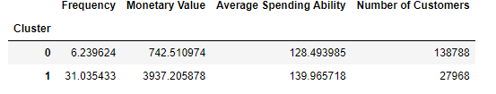
Strategy for Q1 part1
In order to identify user based on Purchase Habits and Spending Ability, Frequency of transactions, monetary value and average spending for each customer were calculated.
A Kmeans algorithm for clustering was implemented to cluster every customer into one of two clusters i.e. K=2
The customers were clustered into two clusters:

Slide 18
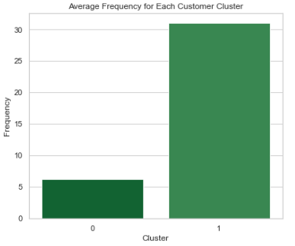
Strategy for Q1 part1
The analysis of these clusters was carried out, which is as follows:
Insight: The customers placed in Cluster 0 were less frequent in transactions.

Slide 19
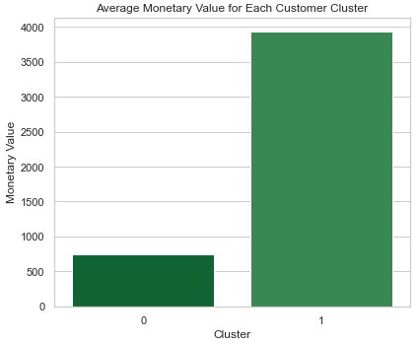
Strategy for Q1 part1
The analysis of these clusters was carried out, which is as follows:
Insight: The average monetary value of customers placed in Cluster 1 was much higher than the customers in Cluster 0.

Slide 20
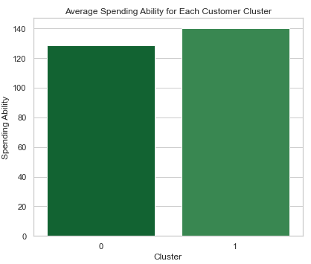
Strategy for Q1 part1
The analysis of these clusters was carried out, which is as follows:
Insight: The average spending of customers placed in Cluster 1 was higher than the customers in Cluster 0.

Slide 21
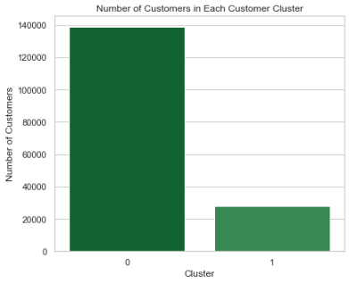
Strategy for Q1 part1
The analysis of these clusters was carried out, which is as follows:
Insight: The number of customers in cluster 0 was way higher then the number of customers in cluster 1.

Slide 22
Answer for Q1 part1
Based on the Analysis of these clusters, based on purchase habit and spending ability, users can be identified as one of two type:
Cluster 0 - Low-Value Customers:
Customers in this cluster have made relatively recent but infrequent purchases with low transactional values. They represent a potential growth opportunity for the company.
Targeted marketing strategies can be employed to increase their engagement and encourage more frequent purchases.
Cluster 1 - High-Value Customers:
This cluster includes customers who have made very recent, frequent, and high-value purchases. They are likely the company's top-tier customers.
To retain these valuable customers, special attention should be given to ensure their ongoing satisfaction and loyalty.

Slide 23
Strategy for Q1 part2
There are three unique parent region namely: 07B, 1EF and 300
The number of Child region within each Parent region is found to be:
Parent Region | Number of Child Regions
300 | 72
1EF | 70
07B | 60

Slide 24
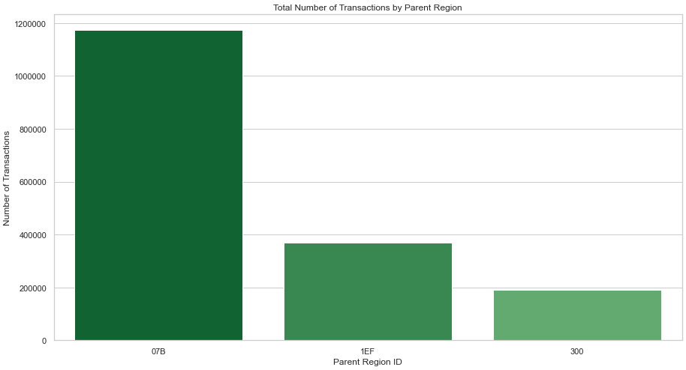
Strategy for Q1 part2
The region based analysis of transactions is shown below:
Insight: There are 3 parent regions with highest number of transactions in the order of ‘07B’ , ‘1EF’ followed by ‘300’.

Slide 25
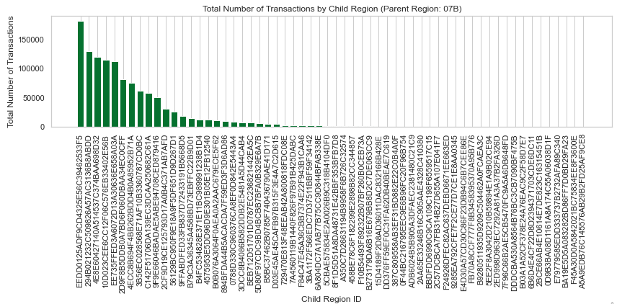
Strategy for Q1 part2
The region based analysis of transactions is shown below:

Slide 26
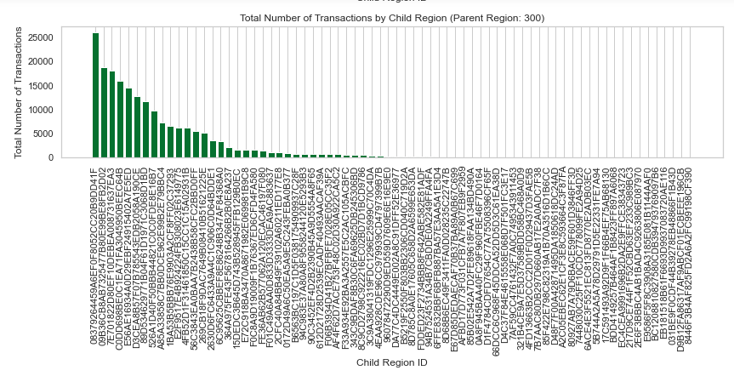
Strategy for Q1 part2
The region based analysis of transactions is shown below:

Slide 27
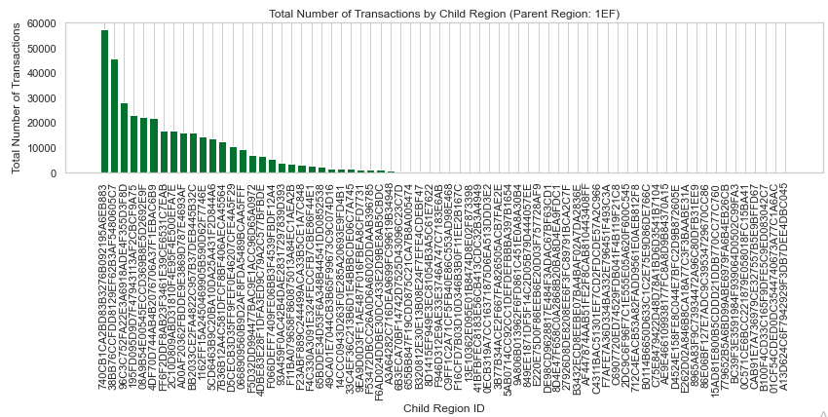
Strategy for Q1 part2
The region based analysis of transactions is shown below:

Slide 28
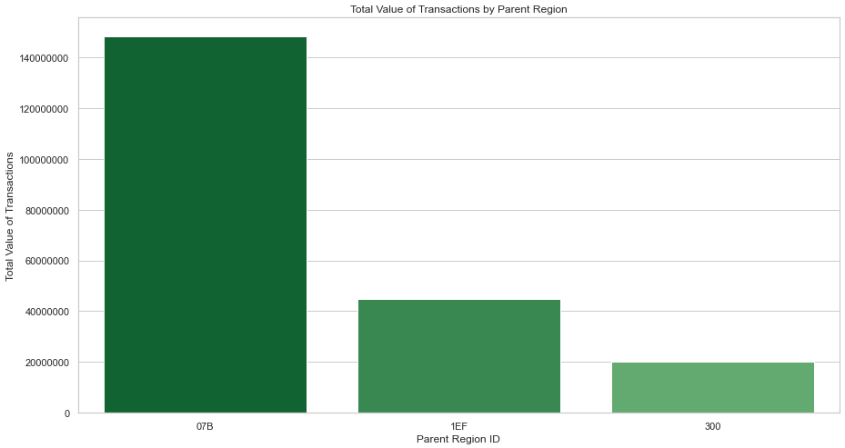
Strategy for Q1 part2
The region based analysis of transactions is shown below:
Insight: The most valued transactions was from‘07B’ and the least valued transactions from‘300’.

Slide 29
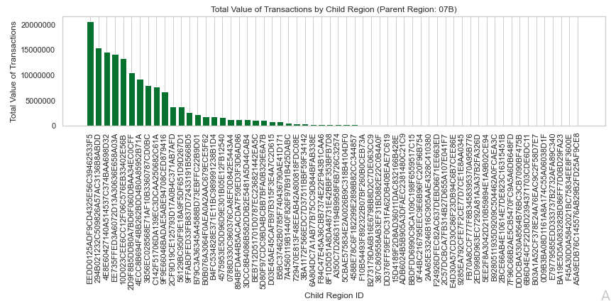
Strategy for Q1 part2
The region based analysis of transactions is shown below:

Slide 30
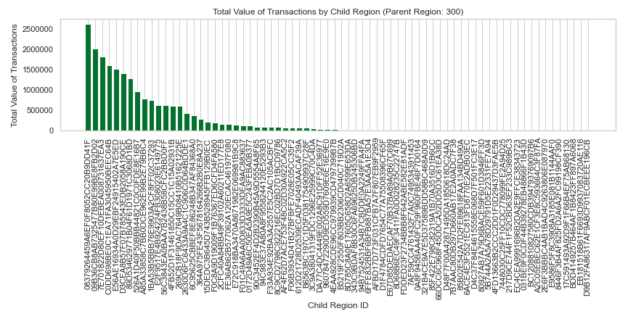
Strategy for Q1 part2
The region based analysis of transactions is shown below:

Slide 31
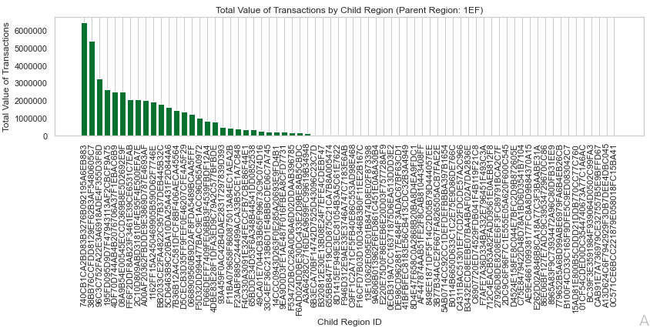
Strategy for Q1 part2
The region based analysis of transactions is shown below:

Slide 32
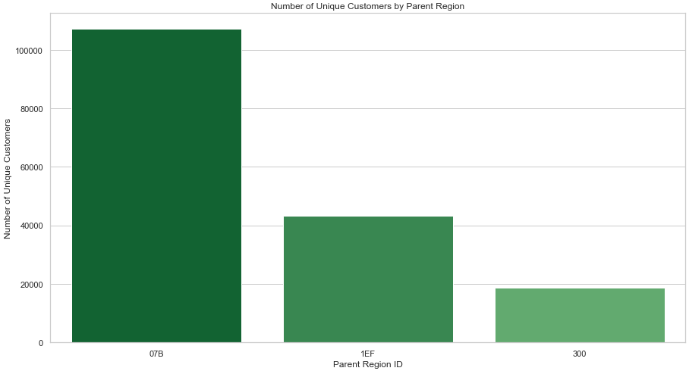
Strategy for Q1 part2
The region based analysis of users is shown below:
Insight: Region ‘07B’ has the most customers while ‘300’ has the least.

Slide 33

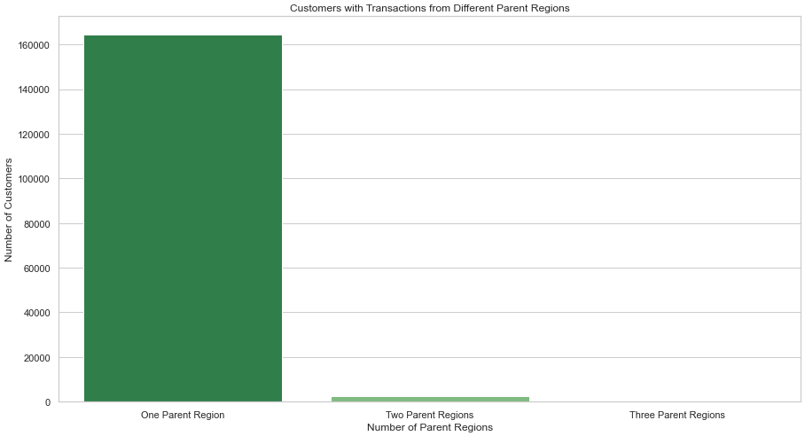
Strategy for Q1 part2
The region based analysis of users is shown below:

Slide 34
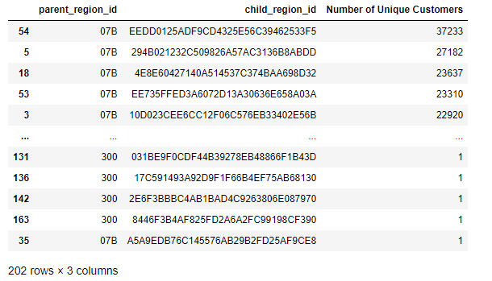
Strategy for Q1 part2
The region based analysis of users is shown below:

Slide 35
Strategy for Q1 part2
The region based analysis of users is shown below:
Insight: Top 3 customers with highest number of transactions.

Slide 36
Answer for Q1 part2
In conclusion, the region-based analysis of users and transactions reveals the significant importance of different regions in terms of both user engagement and transaction volume.
Regarding transactions, it is evident that the region labeled '07B' consistently has the highest number and value of transactions, followed by '1EF,' and finally '300.' These findings indicate that region '07B' is a key area of transactional activity, attracting a large number of users and generating substantial value. Furthermore, within each parent region, specific child regions stand out as the leaders in transactional activity. Notably, the child region 'EEDD0125ADF9CD4325E56C39462533F5' in '07B,' '08379264459A6EF0F8052CC20B9DD41F' in '300,' and '740CB1CA2BD83B3276B092195A6EB883' in '1EF' exhibit the highest number and value of transactions, indicating their significance within their respective parent regions.
Turning to user analysis, the region '07B' emerges as the region with the highest number of customers, followed by '1EF,' while '300' has the lowest number of customers. This implies that region '07B' holds a larger customer base, suggesting a higher level of user engagement and potential market opportunities. Moreover, the analysis reveals that out of a total of 166,756 unique customers, the majority (164,409) have conducted transactions solely within one parent region. However, a smaller number of customers (2,286) have engaged with transactions in two different parent regions, and an even smaller group (61) have interacted with transactions across all three parent regions.

Slide 37
Answer for Q1 part2
In conclusion, the region-based analysis of users and transactions reveals the significant importance of different regions in terms of both user engagement and transaction volume.
Additionally, when examining unique customer distribution within child regions, 'EEDD0125ADF9CD4325E56C39462533F5' stands out as the child region with the highest number of customers, followed by '294B021232C509826A57AC3136B8ABDD' and '4E8E60427140A514537C374BAA698D32.' These child regions represent areas of concentrated user activity, indicating their importance in driving transactional engagement.
Finally, the analysis identifies three customers who stand out for their high transactional activity. The customers with IDs '551d6431af45ada6a2f0ebe6a697ac16,' 'd25f9db28aab0c036901f608c0dd58f2,' and '039f55a883b1c2ebc73b09b6180bcc9f' have demonstrated the highest number of transactions. These customers are associated with specific child regions within '300' and '1EF,' further emphasizing the influence of certain regions in attracting active and valuable users.

Slide 38
Answer for Q1 part3
Based on the insights from Question 1 part 1 and 2, the region-based analysis and the difference between customers acquired offline and online, we can derive the following analysis that will help navigate the direction of the new high-end products business:
Targeting High-Value Customers: The analysis revealed the presence of a cluster of high-value customers who make frequent and substantial purchases. To navigate the direction of the new business, the company should focus on retaining and nurturing these high-value customers. Tailored marketing strategies, loyalty programs, and personalized offers can be designed to keep them engaged and encourage repeat purchases.
Region Selection for Expansion: The region-based analysis highlighted the significance of region '07B' in terms of both transactions and customer base. This region appears to be a hotspot for high-end product demand and user engagement. As the company extends its operations as a vendor of high-end products, it should prioritize region '07B' for initial expansion efforts. The success in this region could provide valuable insights and a solid foundation for further expansion to other regions.

Slide 39
Answer for Q1 part3
Based on the insights from Question 1 part 1 and 2, the region-based analysis and the difference between customers acquired offline and online, we can derive the following analysis that will help navigate the direction of the new high-end products business:
Targeting Online Customers: The analysis indicates a substantial difference between customers acquired offline and online, with a huge quantity associated with offline acquisition. This suggests that the company's parent platform is already attracting a significant number of users, making it an ideal channel to promote and market the new high-end products. By leveraging the existing user base, the company can save on marketing expenses and capitalize on the trust and familiarity that customers already have with the platform.
Focus on Active Child Regions: The analysis identified certain child regions within the parent regions that exhibit high transactional activity and user engagement. These active child regions represent potential growth opportunities for the high-end product business. The company should consider focusing marketing efforts on these specific child regions to tap into the demand and preferences of active users.

Slide 40
Question # 02
As a Data Scientist, the company want to utilize Machine Learning to help:
1. Identify the types of Users who will be a perfect target for the new
company.
2. Identify the susceptible conditions to target and acquire the user.
3. A Predictor which helps tag newly acquired users according to the
a. Location b. Time c. Purchase Amount d. Acquired By
e. Acquisition Time

Slide 41
Strategy for Q2 part1
To identify the types of users who will be a perfect target for the new company, I have employed a supervised classification approach using data labeled as low value and high-value customers (Cluster 0 and 1). Here is a summarized strategy:
Data Preprocessing:
Ensured the data is free of anomalies or missing values.
Split the data into training (80%) and testing (20%) sets for model evaluation.
Standardized the features to bring them to a common scale, avoiding dominance by any particular feature.
Model Selection:
Chose three classification algorithms - Logistic Regression, KNN Classifier, and Random Forest - for the task.
Model Training and Evaluation:
Trained the selected models on the training set.
Evaluated the performance of each model on the test set using accuracy as the evaluation metric.

Slide 42
Strategy for Q2 part1
Model Performance:
Found that the Random Forest model outperformed the other two algorithms, achieving an accuracy of 66.66%.
The model's hyper parameters were tuned to improve its performance.
Saving the Model:
Saved the trained Random Forest model and its associated scaler instance in a pickle file for future use.

Slide 43
Strategy for Q2 part2
The analysis aimed to identify the susceptible conditions influencing user acquisition for the new company's high-end products. The following conclusions were drawn from the preprocessing, class imbalance resolution, correlation analysis, and model training:
Class Imbalance Resolution:
The 'acquired_by' feature, representing user acquisition, showed class imbalance. To tackle this, the dataset was balanced using techniques such as oversampling, undersampling, or SMOTE. The resulting dataset was reduced to 286,560 instances.
Correlation Analysis:
Correlation analysis revealed that 'acquired_year' and 'parent_region_id' significantly influenced the 'acquired_by' feature. These two factors play a vital role in user acquisition.
Model Training and Selection:
The dataset was split into training (80%) and testing (20%) sets.
Features were standardized to prevent bias during model training.
Logistic Regression was selected as the classification model.

Slide 44
Strategy for Q2 part2
Model Performance:
The Logistic Regression model achieved an accuracy of 80.23% on the testing set.
This accuracy indicates the model's ability to predict susceptible conditions affecting user acquisition.

Slide 45
Strategy for Q2 part3
In this phase, the previously trained Logistic Regression model, saved in Q2 Part 1, is utilized to tag newly acquired users based on specific attributes: Location, Time, Purchase Amount, Acquired By, and Acquisition Time. The following steps outline the process:
Model Utilization:
The saved Logistic Regression model is loaded and integrated into a Streamlit application. Streamlit is a Python library used for building interactive web applications for data analysis and visualization.
Streamlit Application:
A user-friendly Streamlit application is created to gather required inputs from users, such as Location, Time, Purchase Amount, Acquired By, and Acquisition Time. Users can input information for newly acquired customers through this application.
Tagging Low-Value or High-Value Customer:
Based on the user-provided information, the Random Forest model is employed to make predictions. The model will classify the newly acquired customer as either a low-value customer or a high-value customer based on the input attributes.

Slide 46
Strategy for Q2 part3
Model Deployment:
The Streamlit application is deployed and hosted, making it accessible through a specific link:
https://case-study-ksvzg5ealagjnbzh9bgmvy-s.streamlit.app/

Slide 47
Thank You

