Slide 1
Tara Exploratory Analysis
Ashley Babjac
Updated: 11/2/21

Slide 2
Main Idea
It would be a major scientific finding to identify features of microbial genomes that are associated with that genome belonging to an uncultured organism
However, there is major phylogenetic bias in the organisms that are uncultured. All 200+ microbial phyla contain uncultured species, but most phyla do not contain cultured species.
Metabolism is strongly correlated to taxonomy, so therefore there’s a strong correlation between whether a species has been cultured and what its genome contains that probably isn’t related to whether it has been cultured
So: is there a way to control for phylogeny, when selecting features that distinguish between cultured and uncultured microbes?

Slide 3
Background
Tara is a global scale project with the goal of studying ocean Microorganisms from the gene to the community level.
Starting in 2008, Tara Oceans collected seawater samples within the epipelagic layer, both from the surface water and the deep chlorophyll maximum (DCM) layers, as well as the mesopelagic zone.
These samples have been sequenced and compiled over the last couple of years into a comprehensive dataset.

Slide 4
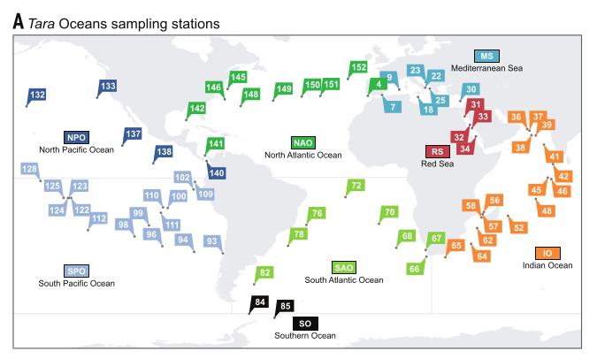
Background

Slide 5
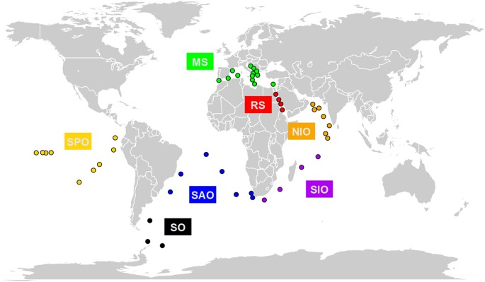
Background
Have labels for 9 ocean regions:
RS (Red Sea)
SO (Southern Ocean)
NAT (North Atlantic)
SAT (South Atlantic)
IO (Indian Ocean)
NP (North Pacific)
SP (South Pacific)
AO (Arctic Ocean)
MS (Mediterranean Sea)

Slide 6
Understanding the data
The dataset I work with specifically is comprised of 124 sites taken from different parts of the ocean
For each site there are:
Vectors of abundances for each organism per site
A set of metadata features (depth, pressure, latitude, longitude, etc.)
The organisms are classified by KO, genus, species, etc.
Multiple organisms can have the same KO
There are roughly a half million samples which condenses down to about 10,000 KO’s

Slide 7
Example of the data
 | latitude | longitude | depth | (more metadata)... | organism1_abundance | organism2_abundance | ... | organismN_abundance
Site 1 | coor1 | coor1 | 15.1 | ... | 0 | 1 | ... | 5
Site 2 | coor2 | coor2 | 1.5 | ... | 4 | 2 | ... | 3
... | ... | ... | ... | ... | ... | ... | ... | ...
... | ... | ... | ... | ... | ... | ... | ... | ...
... | ... | ... | ... | ... | ... | ... | ... | ...
Site N | coor3 | coor3 | 20.6 | ... | 0 | 0 | ... | 0

Slide 8
Current goals
Short term: Can we find “interesting” features associated with clusters of KO’s based on their abundances?
Short term: What KO’s are indicative of particular regions (i.e. can the KO predict the site)?
Long term: Is there a way to control for phylogeny? If so, can we control for phylogeny when selecting features that distinguish between cultured and uncultured microbes?

Slide 9
Initial Pass: Unsupervised clusters
Basically, going to cluster things based on their abundances (i.e. omitting the metadata)
Methods:
Condense down and sum abundance vectors by KO (i.e. if they have the same KO they have the same molecular function and we will treat them the same)
Normalize abundance vectors across sites
Compute a distance matrix using Bray-Curtis statistic
Calculate linkages using Ward’s distance metric
Use CH-index to determine optimal cutoff for cut_tree() and split the dendrogram into N clusters

Slide 10
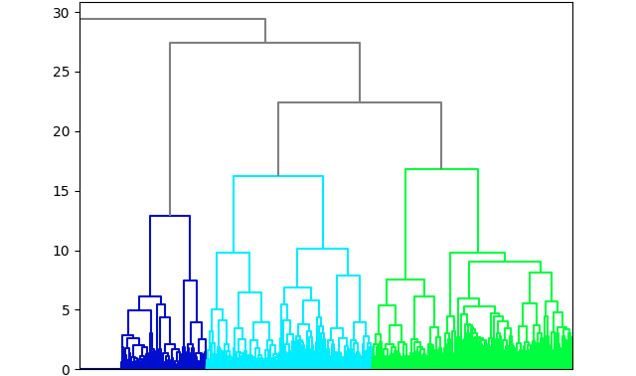
Unsupervised Clusters using condensed KO
Ward’s Distance
Sample KO

Slide 11
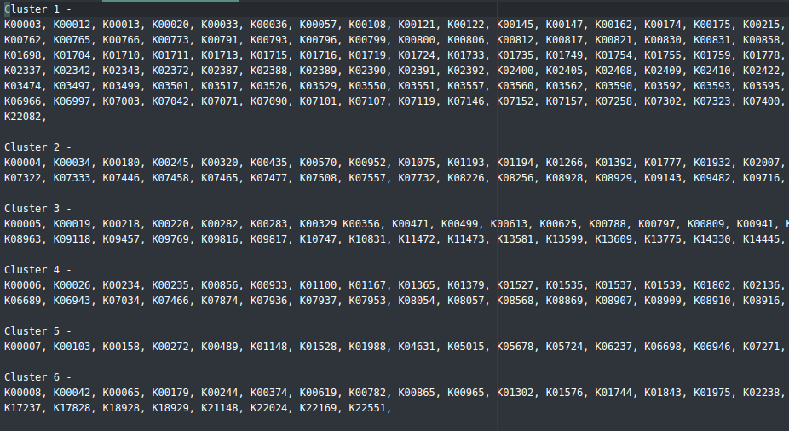
Example Output

Slide 12
Summarizing the Clusters
I ended up with 123 clusters each with roughly 50-300 elements.
I summarized different elements of the metadata on the clusters (i.e. depth, pressure, etc.) and in general saw differences in the averages for the metadata across clusters.
This implies that organisms (and KO’s) with similar abundance profiles show up in sites that have similar metadata characteristics.

Slide 13
Second Pass: SVM
Used standard SVM in Python
For each of the 9 ocean regions we used features (Abundances condensed by KO and metadata) per site to predict the ocean region
SVM is binary so the labels were either it belonged to a site (1) or it did not (0)
70% training and 30% holdout (randomly sampled)
Looked at metrics:
Accuracy - Ratio of the correctly classified data to the total amount of classifications
Precision - What proportion of positive identifications was actually correct?
Recall - What proportion of actual positives was identified correctly?

Slide 14
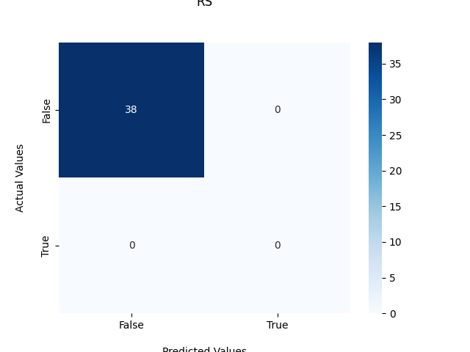
Results: RS
Accuracy: 1.0
Precision: N/A
Recall: N/A

Slide 15

Results: SO
Accuracy: 1.0
Precision: 1.0
Recall: 1.0

Slide 16
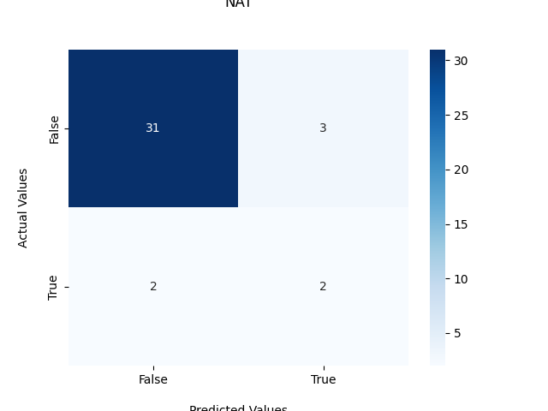
Results: NAT
Accuracy: 0.868421052631579
Precision: 0.4
Recall: 0.5

Slide 17

Results: IO
Accuracy: 1.0
Precision: 1.0
Recall: 1.0

Slide 18
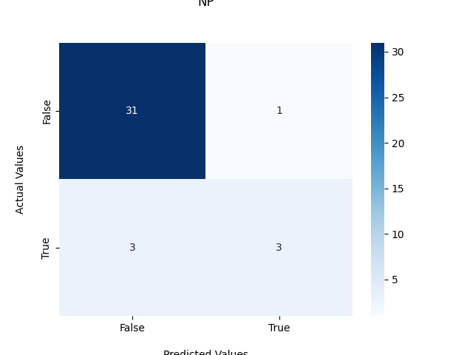
Results: NP
Accuracy: 0.8947368421052632
Precision: 0.75
Recall: 0.5

Slide 19
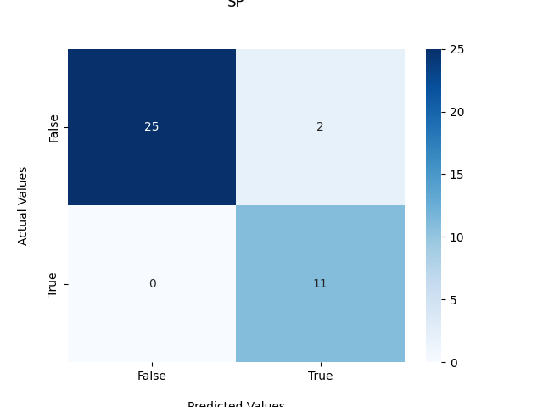
Results: SP
Accuracy: 0.9473684210526315
Precision: 0.8461538461538461
Recall: 1.0

Slide 20
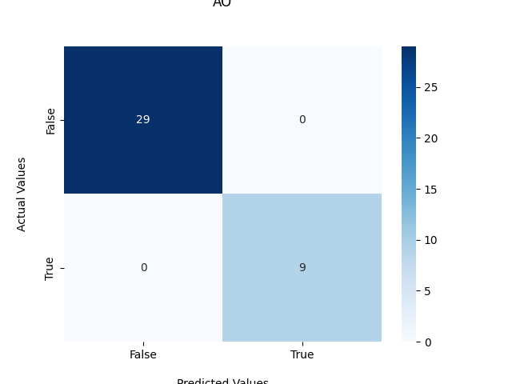
Results: AO
Accuracy: 1.0
Precision: 1.0
Recall: 1.0

Slide 21

Results: SAT
Accuracy: 1.0
Precision: 1.0
Recall: 1.0

Slide 22

Results: MS
Accuracy: 0.9473684210526315
Precision: 0.0
Recall: N/A

Slide 23
Second Pass: Cont
Added in PCA to reduce number of features
Able to reduce down to 4 features and account for 99% of variability
Re-ran same SVM analysis with reduced PCA features
Notes:
Add PCA plot

Slide 24
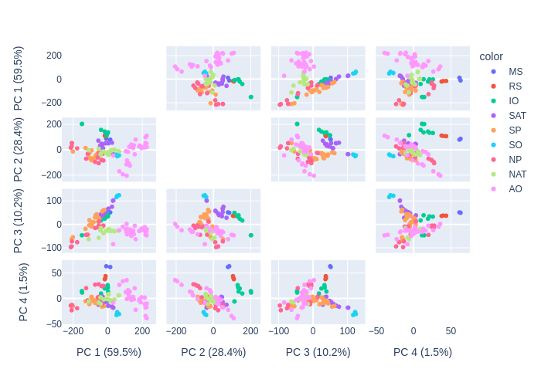
PCA Plot n=4 (99.6% of variability)

Slide 25
Results: RS (+PCA)
Accuracy: 1.0
Precision: N/A
Recall: N/A

Slide 26
Results: SO (+PCA)
Accuracy: 1.0
Precision: 1.0
Recall: 1.0

Slide 27

Results: NAT (+PCA)
Accuracy: 0.8947368421052632
Precision: N/A
Recall: 0.0

Slide 28
Results: IO (+PCA)
Accuracy: 1.0
Precision: 1.0
Recall: 1.0

Slide 29

Results: NP (+PCA)
Accuracy: 0.8157894736842105
Precision: 0.3333333333333333
Recall: 0.16666666666666666

Slide 30

Results: SP (+PCA)
Accuracy: 0.9210526315789473
Precision: 1.0
Recall: 0.7272727272727273

Slide 31
Results: AO (+PCA)
Accuracy: 1.0
Precision: 1.0
Recall: 1.0

Slide 32

Results: SAT (+PCA)
Accuracy: 0.9210526315789473
Precision: 0.6
Recall: 0.75

Slide 33
Results: MS (+PCA)
Accuracy: 0.9473684210526315
Precision: 0.0
Recall: N/A

Slide 34
Fixing the Imbalance Problem
The labels for this are highly unbalanced due to small number of samples across 9 regions
Fix this by oversampling using SMOTE (Synthetic Minority Over-Sampling Technique)

Slide 35
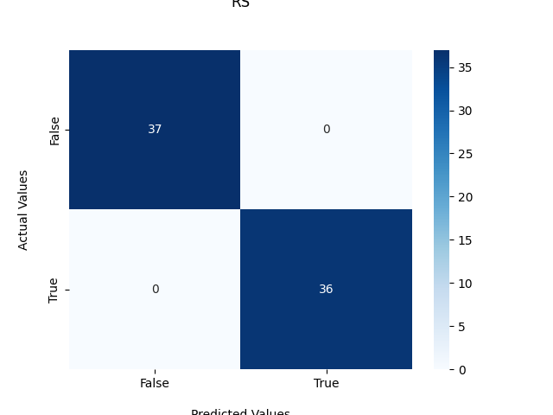
Results: RS (+PCA+SMOTE)
Accuracy: 1.0
Precision: 1.0
Recall: 1.0

Slide 36

Results: SO (+PCA+SMOTE)
Accuracy: 1.0
Precision: 1.0
Recall: 1.0

Slide 37
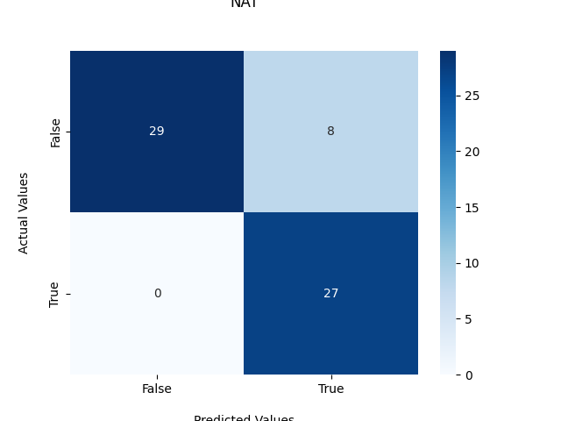
Results: NAT (+PCA+SMOTE)
Accuracy: 0.875
Precision: 0.7714285714285715
Recall: 1.0

Slide 38
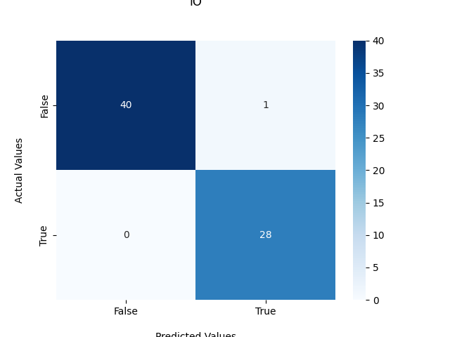
Results: IO (+PCA+SMOTE)
Accuracy: 0.9855072463768116
Precision: 0.9655172413793104
Recall: 1.0

Slide 39
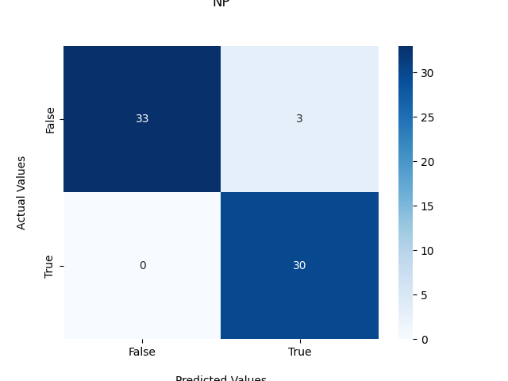
Results: NP (+PCA+SMOTE)
Accuracy: 0.9545454545454546
Precision: 0.9090909090909091
Recall: 1.0

Slide 40
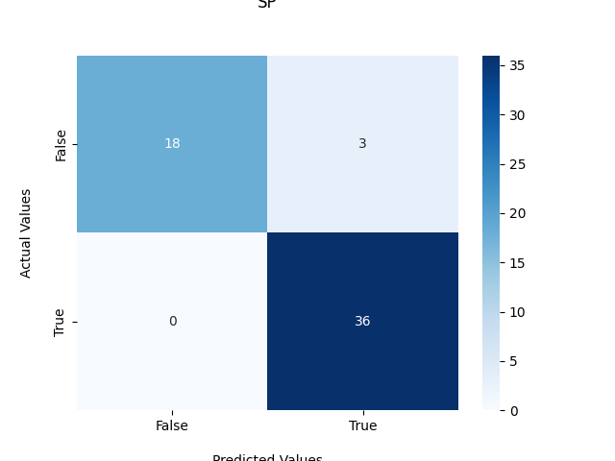
Results: SP (+PCA+SMOTE)
Accuracy: 0.9473684210526315
Precision: 0.9230769230769231
Recall: 1.0

Slide 41
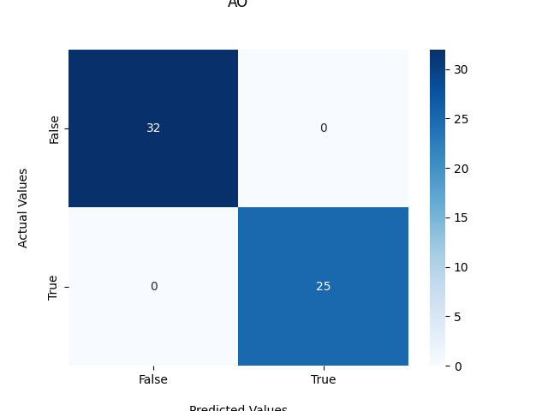
Results: AO (+PCA+SMOTE)
Accuracy: 1.0
Precision: 1.0
Recall: 1.0

Slide 42
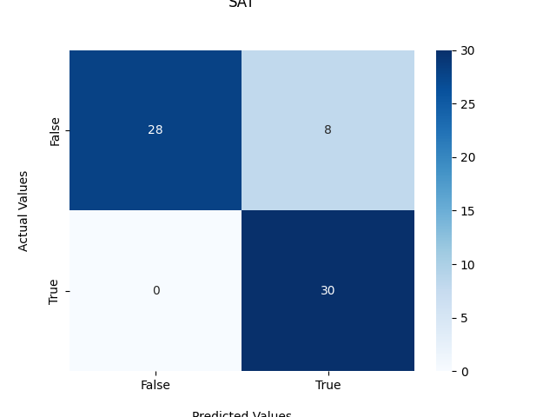
Results: SAT (+PCA+SMOTE)
Accuracy: 0.8787878787878788
Precision: 0.7894736842105263
Recall: 1.0

Slide 43
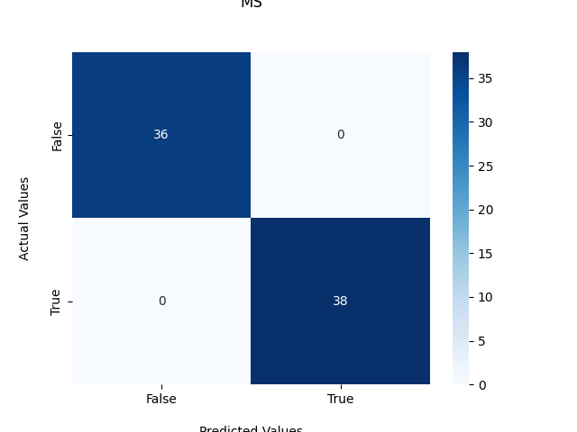
Results: MS (+PCA+SMOTE)
Accuracy: 1.0
Precision: 1.0
Recall: 1.0

Slide 44
Conclusions
We are able to use the abundances/metadata to accurately predict the ocean region
PCA does “represent” 99.6% of variability but it is noisy
Predictions using SVM suffer slightly from the loss in information
Balanced data seems to have roughly the same prediction power

Slide 45
Aside: Autoencoders
Ran a standard autoencoder model on the TARA feature set
Resulted in a loss of ~-800,000
Still working on this….

Slide 46
Current Next Steps:
Continue working on autoencoder model
Begin applying these analyses to cultured/uncultured labels

