Slide 1
Predicting Who is at Risk of Opioid Abuse
Authors
Donna Jarrett Alicia Abrams

Slide 2
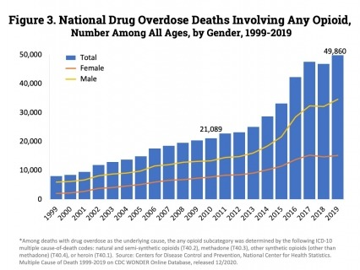
Consequences of Opioid Addiction

Slide 3
Data Source Details
National Survey on Drug Use and Health (NSDUH-2015, 2018, & 2019)
2019 SAMHDA DATA LINK
Began with over 2700 columns & over 56,000 rows for 2019.
Narrowed Focus to 29 columns
We used Linux to reduce file size and the IBM Data Refinery Tool to scrub the data.
Key column => Opioid Abuse in Past Year
Notes:
Study Details:The target population for the 2019 survey was the same as has been defined since the 1991 survey: the civilian, noninstitutionalized population of the United States
According to the National Survey on Drug Use and Health (NSDUH), 2 out of 5 adult Americans are struggling with a substance use disorder.

Slide 4
Tools Used
IBM Cloud Pak for Data
Linux
Excel
R Studio

Slide 5
Prediction Models
2015
Algorithm: XGB Classifier
Accuracy: 0.775
HPO-1, FE, HPO-2
90% Training, 10% Holdout data
2018
Algorithm: XGB Classifier
Accuracy: 0.812
No Enhancements
90% Training, 10% Holdout data
2019
Algorithm: Logistic Regression
Accuracy: 0.996
HPO-1
90% Training, 10% Holdout data
Notes:
Binary classification. What is HPO-1

Slide 6
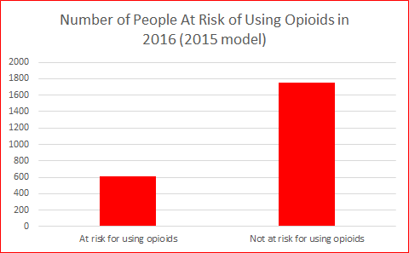
Predictions for 2016

Slide 7
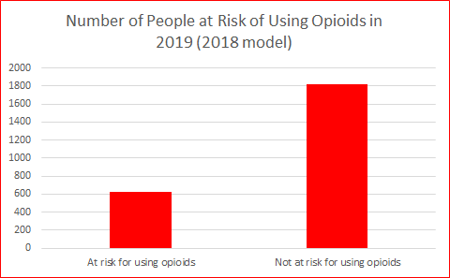
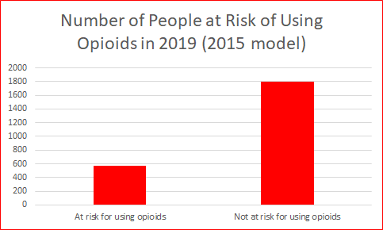
Predictions for 2019
IBM Cloud Pak for Data

Slide 8
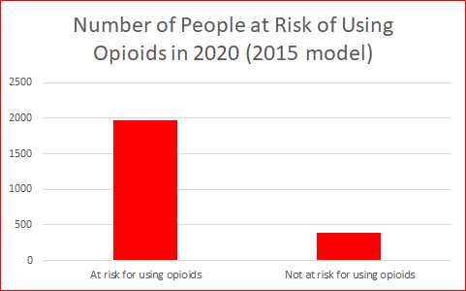
The Predictions for 2020

Slide 9
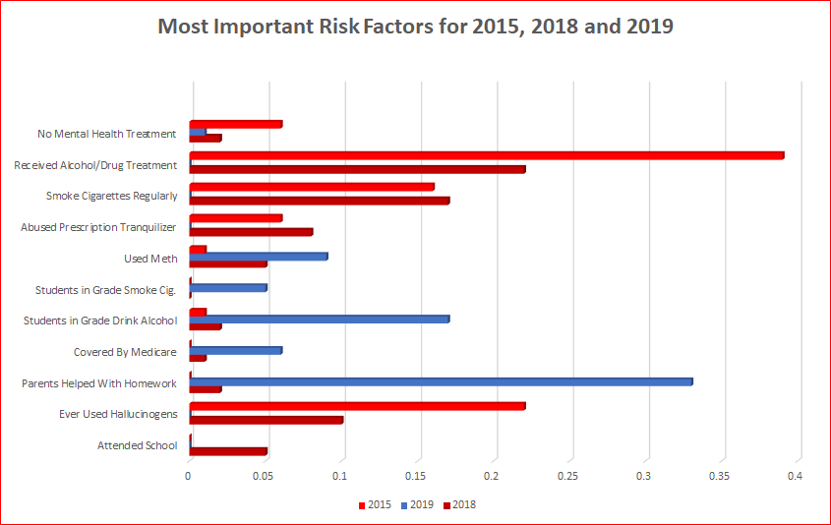

Slide 10
Measuring by Age

Slide 11
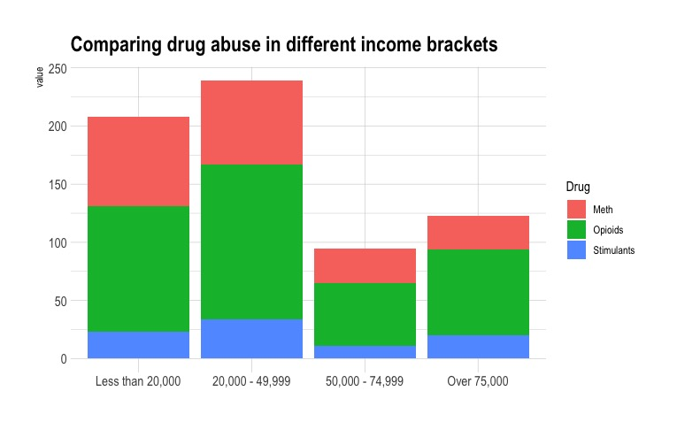

Slide 13
Related Work Comparison
Nipping away at A social crisis
Kayla Matthews - Big Data Helps Predict Substance Abuse
AAC - Genetic & Environmental Factors
NIH - nearly doubled its funding for opioid-related and pain research from almost $600 million to $1.1 billion
Betty Ford - Opioid Overdose Deaths Often Involve Other Drugs

Slide 14
Conclusion
There was an increase the number of people who have risk factors that lead to opioid dependence. If we do not reduce these risk factors, we will eventually see an uptick in the number of opioid users.
Our model is a good start to analyzing the data available but there should be further research
Notes:
While there was not an increase in the number of cases based off of this sample size. There is an increase in the amount of people who used opioids from 2018 to 2019 nationally *** double check this. Cant find the numbers for 2018. for 2019 10.1 million people in the US used opioids. because the data is so complex and ever evolving. There are other risk factors that can be considered, and previous years should be analyzed.

