Slide 1

Welcome
“Terraform your Cloud”
André Bação

Slide 2
Bio
André Bação
Prod Father
Linux Advocate
Devops Engineer @ Marionete

Slide 3
What is Terraform ?

Slide 4
It is an open source tool that codifies APIs into declarative configuration files that can be shared amongst team members, treated as code, edited, reviewed and versioned.

Slide 5
Terraform syntax and interpolation are part of a open source
language and specification called
HCL – Hashicorp Configuration Language.
* HCL is written in Go and looks a bit like NGINX

Slide 6
Terraform enables you to safely and predictably
create, change and improve production infrastructure.

Slide 7
Advantages of Terraform?

Slide 8
Advantages of Terraform?
Hashicorp Terraform |  | AWS CloudFormation
Open source | VS | Closed Source

Slide 9
Advantages of Terraform?
Hashicorp Terraform |  | AWS CloudFormation
Open source | VS | Closed Source
Multi Cloud | VS | Amazon only

Slide 10
Advantages of Terraform?
Hashicorp Terraform |  | AWS CloudFormation
Open source | VS | Closed Source
Multi Cloud | VS | Amazon only
HCL | VS | JSON or YAML

Slide 11
Advantages of Terraform?
Hashicorp Terraform |  | AWS CloudFormation
Open source | VS | Closed Source
Multi Cloud | VS | Amazon only
HCL | VS | JSON or YAML
Managing States | VS | No States

Slide 12
.: Some Concepts :.

Slide 13
Provider
A abstraction of the API/service provider such as:

Slide 14

Provider
A abstraction of the API/service provider such as:

Slide 15

Provider
A abstraction of the API/service provider such as:

Slide 16


Provider
A abstraction of the API/service provider such as:

Slide 17




Provider
A abstraction of the API/service provider such as:

Slide 18




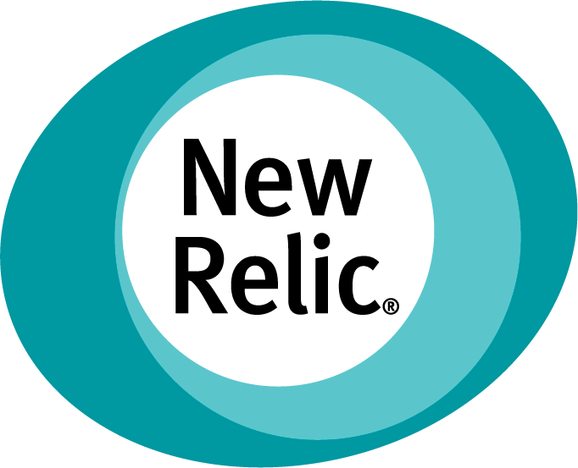

Provider
A abstraction of the API/service provider such as:

Slide 19
Resource
It represents a component of a given provider such as:

Slide 20
Resource
It represents a component of a given provider such as:
    AWS Instance

Slide 21
Resource
It represents a component of a given provider such as:
    AWS Instance
    Bitbucket Repository

Slide 22
Resource
It represents a component of a given provider such as:
    AWS Instance
    Bitbucket Repository
    Cloudflare Record

Slide 23
Resource
It represents a component of a given provider such as:
    AWS Instance
    Bitbucket Repository
    Cloudflare Record
    DigitalOcean Volume

Slide 24
Resource
It represents a component of a given provider such as:
    AWS Instance
    Bitbucket Repository
    Cloudflare Record
    DigitalOcean Volume
    Azure SQL Server

Slide 25
Resource
Resources have both:
        Arguments (inputs)
        Attributes (outputs)
These are specific to each resource.
Resources also have meta-parameters such
as count and lifecycle.

Slide 26
(Resource) Argument
The resource “aws_instance” accepts as input:
          ami
          associate_public_ip_address
          availability_zone
          volume_size

Slide 27
(Resource) Attribute
This is an output or a computed value only available
after the resource creation.
For example: public_ip

Slide 28
Terraform Folder
.
└── terraform
├── main.tf
├── output.tf
└── variables.tf

Slide 29
DigitalOcean Provider Example:
provider "digitalocean" {
token = "${var.do_token}"
}
resource "digitalocean_droplet" "devops" {
image = "ubuntu-16-04-x64"
region = "fra1"
size = "512mb"
name = "devops-tf-1"
}

Slide 30
AWS Provider Example:
provider "aws" {
access_key = "${var.aws_access_key}"
secret_key = "${var.aws_secret_key}"
region = "${var.aws_region}"
}
resource "aws_instance" "master" {
instance_type = "t2.micro"
ami = "ami-e4c63e8b"
}

Slide 31
Variables File:
variable "aws_accesskey" {
description = <<DESCRIPTION
Insert your AccessKey:
DESCRIPTION
}
variable "aws_region" {
description = <<DESCRIPTION
Your Favourite Region:
DESCRIPTION
default = "eu-central-1"
}

Slide 32
Output File:
output "ip" {
value = "${aws_instance.master.public_ip}"
}

Slide 33
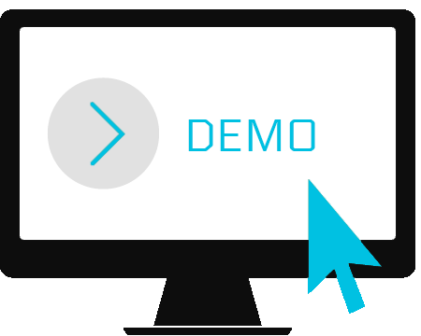



+
+

Slide 35
Q & A

Slide 36


Thank you
andre@bacao.pt
linkedin.com/in/andrebacao

