Slide 1
#UrukChallenge
Compute the number of shekels owed WITHOUT ADDITION OR MULTIPLICATION if we purchased 27 silas of water for 2 minas each, 37 sheep for 17 shekels each, and 5 guards for 5 minas each, and 50 shekels makes 1 mina.
You are a scribe in service to the king, and are very busy, so you cannot take more than 30 seconds.

Slide 2
#UrukChallenge
ANSWER: 4579 shekels, or 91 minas, 29 shekels.
But it sure was hard to do it just by counting...

Slide 3
Cuneiform Arithmetic
Arithmetic was invented by the Sumerians to achieve bureaucratic and economic success, rather than for abstract study.
Aidan Backus
NES 105A

Slide 4
Overview
Timeline
Uruk, Ur III, and Old Babylonian
Babylonian algorithms
Why base-60? “The Technique”
Quadratic equations
Examples of real computations
Administrative Texts from the Archive
Enŭma Anu Enlil

Slide 5
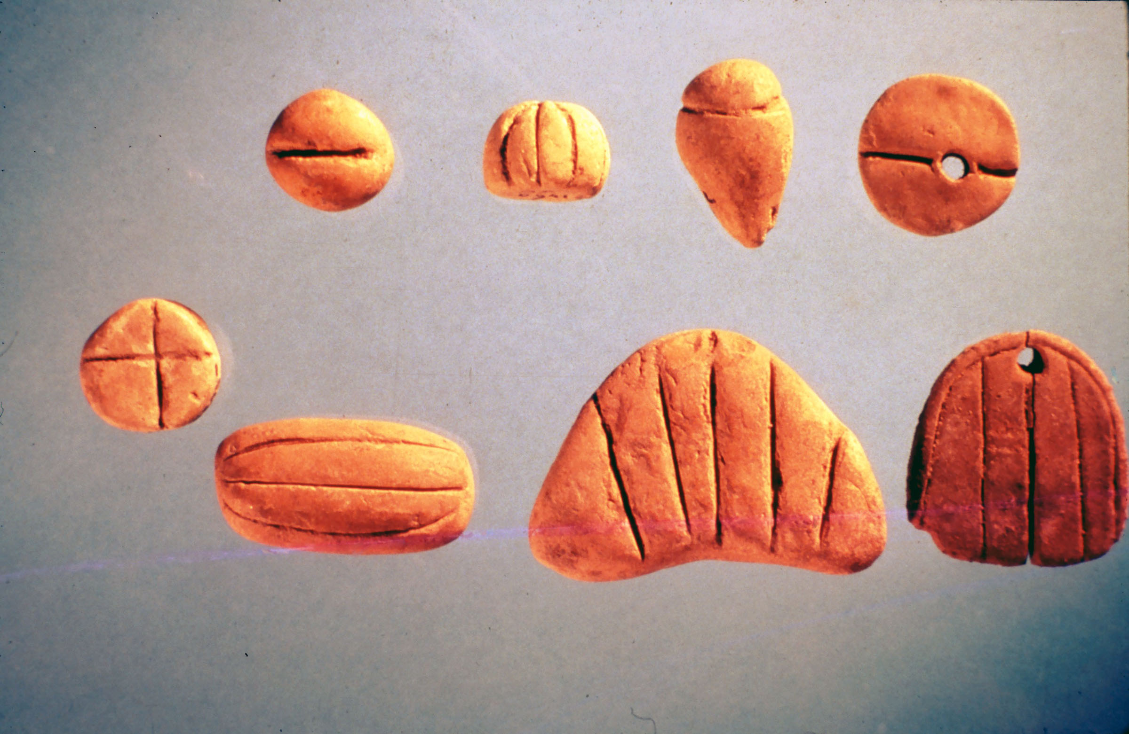
Uruk-era tokens

Slide 6
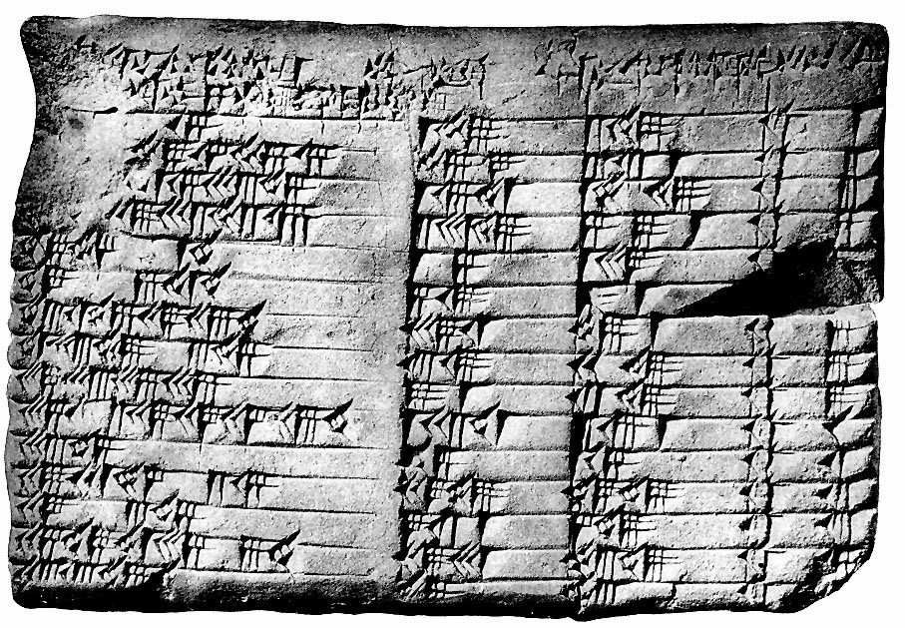
Base-60 number system (Ur III)

Slide 7
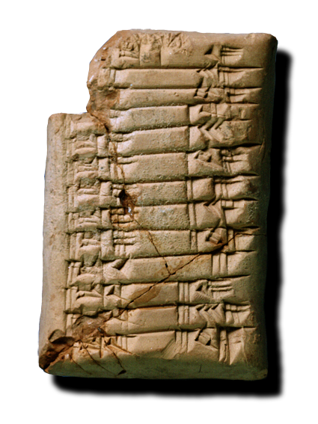
Multiplication tables (Old Babylon)

Slide 8
Units in base 60
Many regular numbers (i.e. divide 60 evenly)
Most unit conversions are regular numbers (6 she (1/360 meter) = 1 shu-si, 30 shu-shi = 1 kush, 6 kush = 1 gi
The Technique: how to divide by 125?
Quadratic equations: Length plus width is 50, area is 600, what are length and width? (Length is always larger than width)
Exponential growth (“doubling time” problems from 2000 BCE)

Slide 9
Administrative Texts of the Archive
Text III:
“1 skirt for the god Rasap of the city of Tunep on the day of taxes; fabrics for the agent of Pududu of the city of Ar’amu as a tax in the city of Adarin; 1 gm-fabric, 1 fine fabric, 1 multicolored skirt for Abu-malik, the son of Enna-Sar, as restitution from the city of Kakmium...”
[22 lines later]
Sum: 22 k-fabrics with double weft, 23 a-fabrics, 4 zara-fabrics, 5 precious fabrics, 27 gs-fabrics

Slide 10
Administrative Texts of the Archive
Text XXIII:
“… 5 silver minas and 50 shekels bartered for 1 gold mina and 10 shekels ...”

Slide 11
Enŭma Anu Enlil
“When Anu and Enlil”
Tablet 14 calculates the number of uš (30 uš = 1 day) between sunset and moonrise on each day of an ideal month
Arithmetic computations, not geometric
Rest is astrological

Slide 12
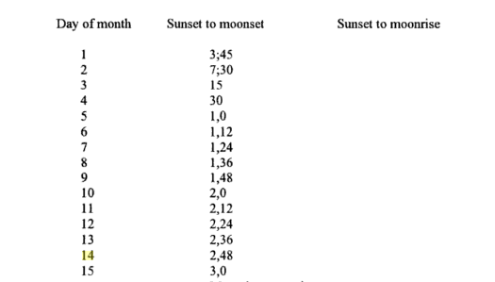
Enŭma Anu Enlil

Slide 13
Enŭma Anu Enlil
"Before Pythagoras: The Culture of Old Babylonian Mathematics." Institute for the Study of the Ancient World. New York University, 12 Nov. 2010. Web. 20 Oct. 2016.
Casselman, Bill. "Plimpton 322." Mathematics 466. University of British Colombia, Fall 2003. Web. 27 Oct. 2016.
Hunger, Hermann, and David Edwin Pingree. Astral Sciences in Mesopotamia. Leiden: Brill, 1999. Print.
Melville, Duncan J. "Mesopotamian Mathematics." St. Lawrence University, 16 Feb. 2003. Web. 20 Oct. 2016.
Swetz, Frank J. "Mathematical Treasure: Mesopotamian Accounting Tokens." Convergence. Mathematical Association of America, Sept. 2012. Web. 20 Oct. 2016.

