Slide 1
Billing System Program
Colin Kay – Project Manager
Albert Badalyan – Database Administrator
Kaleb Martens – GUI Developer
Pagoda Pang – Technical Writer

Slide 2
Objective
The goal of the project is to develop a centralized billing platform for the Law Office of David R. Mugridge. To do so, a software solution was developed with a database backend and a simplified graphic user interface (GUI). The software solution will reduce, or possibly eliminate, the need for a manual billing process and any discrepancies caused by dispersed billing processes.

Slide 3
Key Deliverables
Documentation
User Requirements included in the User Manual
Data Flow Diagram (DFD)
Entity-Relationship Diagram (ERD)
Application
Easy to use GUI
Time-recording capability
Client management capability
User management capability
Database
Microsoft SQL Server 2008 Express with Advanced Services
Relation database with necessary entities and attributes, relationships, views, and stored procedures
Reporting Services
“Application and Order for Payment of Court Appointed Vendor: PGN-90 E05-11”
Report Developed in SQL Server Business Intelligence Development Studio
Reporting Services feature that is part of SQL Server 2008 Express

Slide 4
Obstacles and Constraints
Minimal technological client environment
No Server/Client Network currently in place
Various client technical background
Zero Dollar Budget
Compatibility with current business and technology environment
Less than 4 months to develop and debug
Student access to IDE software and no licensing for professional reporting services or server operating systems

Slide 5
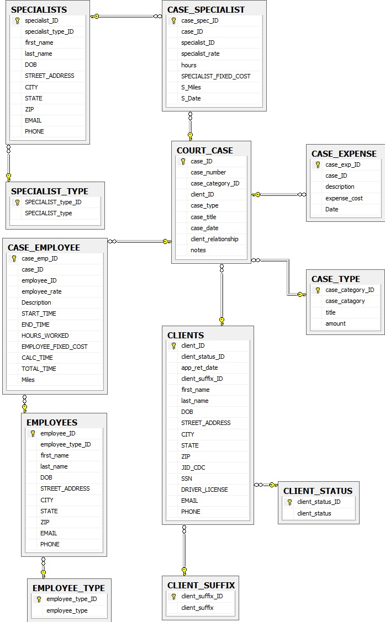
Entity Relationship Diagram

Slide 6
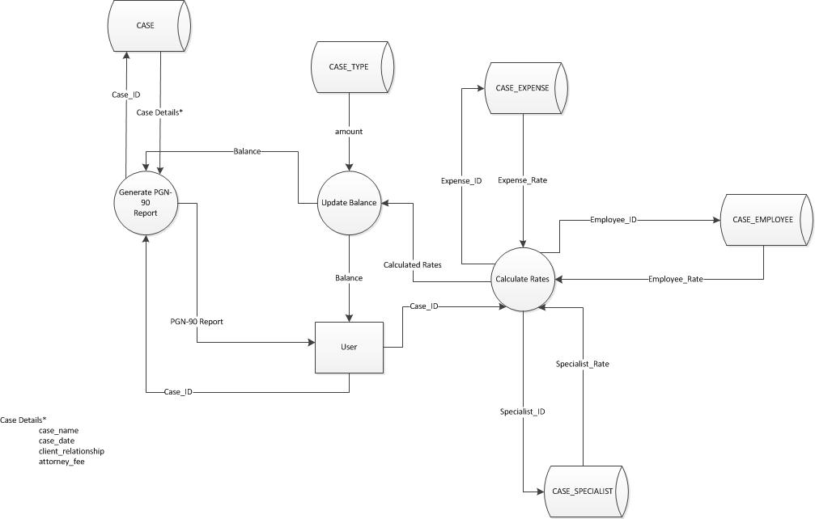
Dataflow Diagram

Slide 7
Application Demonstration

