Slide 1
DRM Billing
Colin Kay – Project Manager
Albert Badalyan – Database Administrator
Kaleb Martens – GUI Developer
Pagoda Pang – Technical Writer

Slide 2
Mugridge Law Firm
Located in Fresno
Specialize in Criminal Law
Emphasis in Criminal Defense and homicide
Since 1986

Slide 3
Interview
Q: How are you guys currently recording/tracking the information?
A: Some by paper and some of the information are on excel sheets and word documents. It's distributed throughout our office.
Q: Why do you guys need this system for? Isn't it better just making regulations and standards in the office to control how much work has been done on each case?
A: It's too hectic; we have about three to four attorneys. Each working on a different case sometimes we forget to even record what we do, because we get sidetrack from all the readings we do.

Slide 4
Survey Results
“There are too many links in the chain in terms of our billing process…”
“There is a billing flaw…”

Slide 5
Current workflow
Each attorney manually records tasks that have been done
Paper, Excel and Word is used for recording tasks and time
Interim Billing

Slide 6

Current problems
Court cases are not tracked properly
Information is scattered
Difficult to manage how much money is left over

Slide 7
Objectives
Centralized Billing System
Generate PGN-90 E05-11 Report
Multi-User
Simplicity

Slide 8
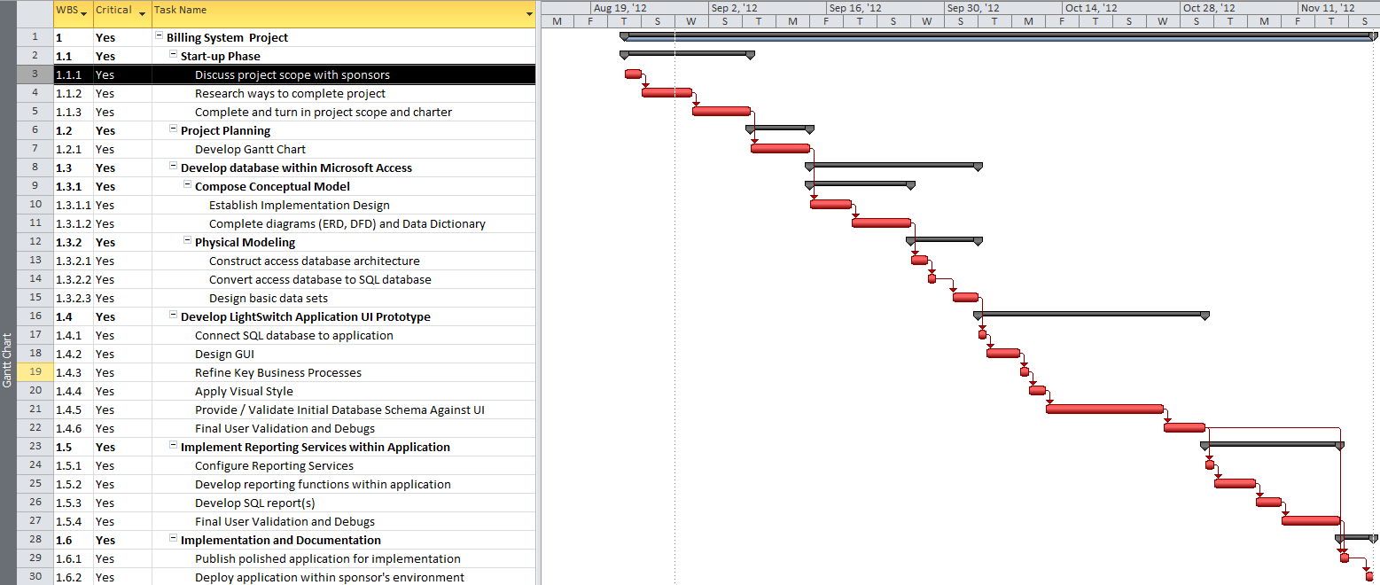
Gantt Chart

Slide 9
Deliverables
Documentation
User Requirements included in the User Manual
Data Flow Diagram (DFD)
Entity-Relationship Diagram (ERD)

Slide 10
Deliverables
Application
Easy to use GUI
Time-recording capability
Client management capability
User management capability

Slide 11
Deliverables
Database
Microsoft SQL Server 2008 Express
Relational Database

Slide 12
Deliverables
Reporting Services
PGN-90 E05-11 Report
Application and Order for Payment of Court Appointed Vendor
SQL Server Business Intelligence Development Studio

Slide 13
Security
Authentication
Authorization
User Management Console
Assign Roles
Read, Write, Update, Delete
Security Administrator

Slide 14
User Requirements
User Requirement 1:
Ability to track and record active/inactive court cases
User Requirement 2:
Ability to log date and time for work and expenses done on cases
User Requirement 3:
Ability to print out a interim PGN-90 E05-11 report with up to date information on a case

Slide 15
Obstacles and Constraints
Minimal technological client environment
No Server/Client Network currently in place
Various client technical background
Zero Dollar Budget
Compatibility
Less than 4 months to develop and debug

Slide 16
Tools and Techniques
Microsoft SQL Server Express 2008
The backend of the application
Reporting Services
Microsoft Visual Studio 2012
Lightswitch
GitHub
File Sharing
GroupMe
Group Texting
Notes:
Lightswitch acts as the front end of the application, provides the UI and allows for some VB scripts.

Slide 17
Data Dictionary

Slide 18
Data Dictionary

Slide 19
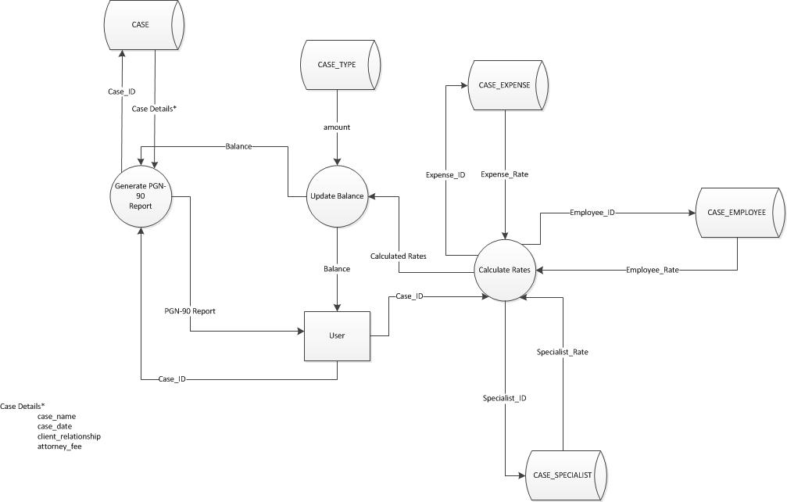
Dataflow Diagram

Slide 20
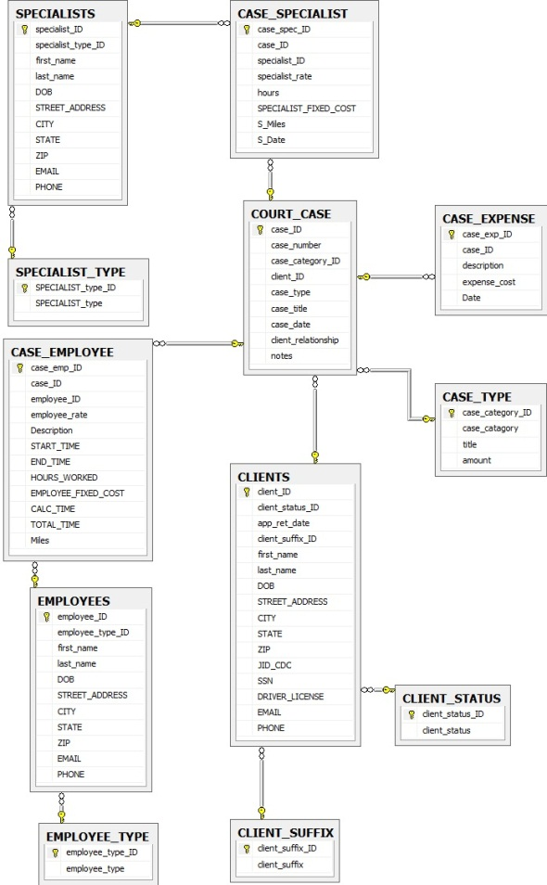
Entity Relationship Diagram

Slide 21
Application Demonstration

Slide 22
Questions?
????
???
??
?

Slide 23
Lessons Learned
Difficult to get the correct answers
Iterative process during designing and developing the application
Elbow grease is needed lots of it

Slide 24
Acknowledgements
Thank you judges, guests, Dr. Kown, classmates, and our sponsors

