Slide 1
Law Firm BPR
Team Members:
Colin Kay – Project Manager
Albert Badalyan – Database Administrator
Kaleb Martens – GUI Developer
Pagoda Pang – Technical Writer

Slide 2
Mudridge Law Firm
Located in Fresno
Specialize in Criminal Law
Emphasis in Criminal Defense and homicide
Represented men and women since 1986

Slide 3
Interview
Q: How are you guys currently recording/tracking the information?
A: Some by paper and some of the information are on excel sheets and word documents. It's distributed throughout our office.
Q: Why do you guys need this system for? Isn't it better just making regulations and standards in the office to control how much work has been done on each case?
A: It's too hectic; we have about three to four attorneys. Each working on a different case sometimes we forget to even record what we do, because we get sidetrack from all the readings we do.

Slide 4
Survey Results
“There are too many links in the chain in terms of our billing process. If we had a single, centrally accessible program we would not have as many problems with billing.”
“There is a billing flaw, in that clerks submit bills to the attorney, who then has a hard time getting those bills to the billing clerk who then subsequently fills out the billing sheets.”

Slide 5
Current workflow
Each attorney manually records tasks that have been done
Paper, Excel and Word is used for recording tasks and time
Report is filled out near the end of the month as a progress report

Slide 6

Current problems
State issued court cases are not tracked properly
Information is scattered from paper documents to computer files
Difficult to manage how much money is left over

Slide 7
Objectives
To develop a centralized billing platform
Consolidate recording/tracking process onto the system
Lessen the amount of paper work

Slide 8
Deliverables
Documentation
User Requirements included in the User Manual
Data Flow Diagram (DFD)
Entity-Relationship Diagram (ERD)

Slide 9
Deliverables
Application
Easy to use GUI
Time-recording capability
Client management capability
User management capability

Slide 10
Deliverables
Database
Microsoft SQL Server 2008 Express with Advanced Services
Relation database with necessary entities and attributes, relationships, views, and stored procedures

Slide 11
Deliverables
Reporting Services
“Application and Order for Payment of Court Appointed Vendor: PGN-90 E05-11”
Report Developed in SQL Server Business Intelligence Development Studio
Reporting Services feature that is part of SQL Server 2008 Express

Slide 12
User Requirements
User Requirement 1: To able to track and record active/inactive court cases
User Requirement 2: To able to log date and time for work and expenses done on cases
User Requirement 3: To be able to print out a monthly PGN-90 E05-11 report with up to date information on a case

Slide 13
Obstacles and Constraints
Minimal technological client environment
No Server/Client Network currently in place
Various client technical background
Zero Dollar Budget
Compatibility with current business and technology environment
Less than 4 months to develop and debug
Student access to IDE software and no licensing for professional reporting services or server operating systems

Slide 14
Tools and Techniques
Microsoft SQL Server Express 2008 with Advanced Services
The backend of the application, used as the database engine and allows for the report to render
Microsoft Visual Studio 2012
Lightswitch acts as the front end of the application, provides the UI and allows for some VB scripts.
GitHub
Allowed for centralized file sharing among team members

Slide 15
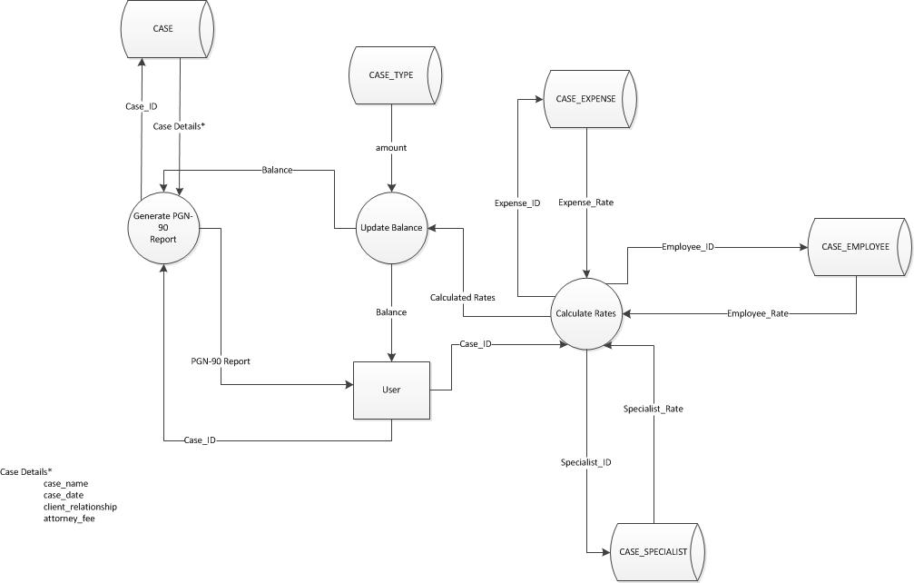
Dataflow Diagram

Slide 16
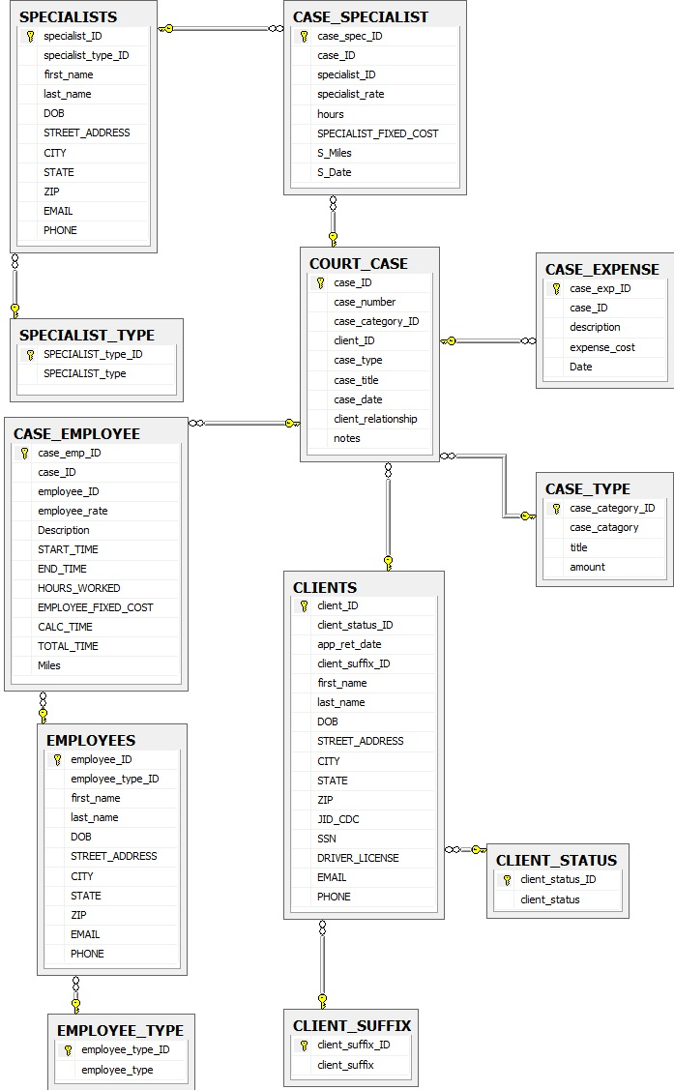
Entity Relationship Diagram

Slide 17
Application Demonstration

Slide 18
Questions?
????
???
??
?

Slide 19
Lessons Learned
Difficult to get the correct answers
Iterative process during designing and developing the application
Elbow grease is needed lots of it

Slide 20
Acknowledgements
Thank you judges, guests, Dr. Kown, classmates, and our sponsors

