Slide 1
http://etd.umsl.edu
The Electronic Thesis and Dissertation Initiative at the University of Missouri – St. Louis

Slide 2
Acknowledgements
Judith Walker de Félix, Dean of the Graduate School
Jerrold Siegel, Associate Vice Chancellor for Information Technology, emeritus
Jim Tom, Associate Vice Chancellor for Information Technology
Amy Arnott, Dean of Libraries

Slide 3
Acknowledgements
Alan Heisel, Graduate Program Director, Department of Communication
ETD available at http://etd.wvu.edu

Slide 4
ETD Development Team
Stephen Wilmas, Information Technology Services
David Gellman, Web Office
Holli Kubly, Web Office
Christopher Dames, University Libraries
David Owens, University Libraries

Slide 5
ETD Test Groups
Dr. Patricia Parker and Mr. John Eimes Department of Biology
Drs. Therese Macan and Lisa Roberts-Zahra, Department of Psychology
Drs. Margaret Cohen and Craig Waddell, College of Education

Slide 6
NDLTD
Networked Digital Library of Theses and Dissertations and its members
http://www.ndltd.org

Slide 7
A few words about publishing
  Academic Publishing
    ETD’s are not intended to take the place of refereed journal publications or books
    ETD’s are to be considered the same as the traditional “publishing” of a thesis or dissertation
  Publishing vs. Submission
    Publishing an ETD does not mean that it was submitted electronically. Submitting an ETD does not mean it will be published electronically

Slide 8
Definition of an ETD
(courtesy Virginia Tech. University)
An ETD is an electronic document that explains the research of a graduate student. The ETD is similar to its paper predecessor. It has figures, tables, footnotes, and references. It has a title page with the authors' name, the official name of the university, the degree sought, and the names of the committee members. It documents the author's years of academic commitment. It describes why the work was done, how the research relates to previous work as recorded in the literature, the research methods used, the results, the interpretation and discussion of the results, and a summary with conclusions.

Slide 9
Definition of an ETD continued
more access to research
  research is available on campus
  research is accessible worldwide
less expense to authors and libraries
  no paper costs
  no physical shelf space
  lower cataloging costs
better presentation of research (not available in paper format)
  addition of multimedia files
  more dynamic presentation of data
  hyperlinks
  programs and code
  other format support

Slide 10
Brief History of ETD
Mid 1980’s Edward Fox, computer science professor at Virginia Tech, looks for ways to disseminate student research on the web.
1993 Virginia Tech develops Monticello Electronic Library Project
1994 SURA institutions choose pdf as standard preservation medium
1996 Virginia Tech pilots ETD submission source:http://www.ndltd.org/info/description.en.html

Slide 11
1998-2004
Over 200 programs launched
NDLTD membership includes
188 Universities
28 Institutions
7 Consortia
29 Countries

Slide 12
OhioLink
Ohio Library and Information Network
Consortium of the Libraries of the Colleges and Universities in Ohio and the Ohio State Library
Ohio Link houses the thesis and dissertation collection for Colleges and Universities in the State of Ohio
http://www.ohiolink.edu

Slide 13
What is the Best Part of ETD’s?

Slide 14
They’re Being Read.

Slide 15
University of Cincinnati Collection
943 ETD’s and 653 on-line abstracts
Average hits between October 2003 and February 2004 was 2,239 times
September 2003, it was accessed 5508 times
March 2004, it was accessed 18, 599 times
Source: http://www.etd.uc.edu/index.cfm?fuseaction=home.stats

Slide 16
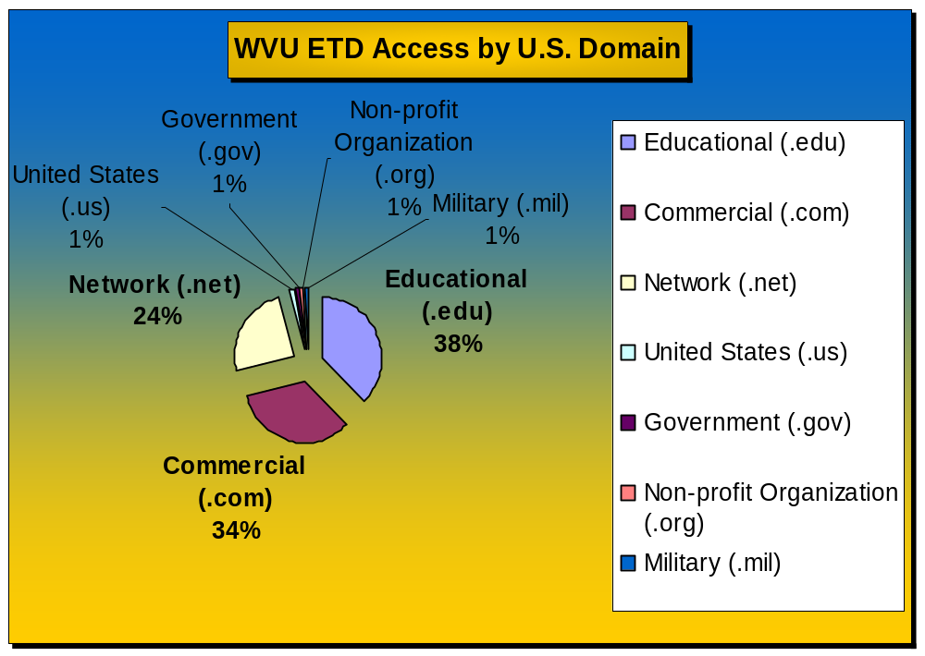
from: http://www.wvu.edu/~thesis/Statistics/WVU_ETD_Stats_02-03.xls

Slide 17
Development of UMSL Initiative
The last piece of paper submitted to the Graduate School is the Oral Defense Report.

Slide 18
Development of UMSL initiative
Theses and Dissertations must be housed on the same server permanently.
The process should work the same if the advisor and student are sharing one computer on campus or if they are in two separate locations.

Slide 19
Development of UMSL initiative
What types of access should be given to the theses and dissertations?
How do we process an ETD if the student can’t publish for legal reasons?
How many pdf’s can a student have and how will they convert documents to pdf?
If we become part of a consortium, how do we “brand” our research?

Slide 20
Access
All theses and dissertation are available for global access unless there is an embargo restricting access.
Embargoed theses and dissertations are unavailable a period of 30 days to 5 years.

Slide 21
PDF and File Issues
Students are allowed one pdf for the thesis or dissertation.
Students may have up to 5 supporting documents (pictures, videos, maps).
Any file type may be uploaded, the Proquest list are the recommended file types.

Slide 22
PDF conversion
Faculty Resource Center
Computer Labs on Campus
Purchase Adobe Acrobat in the Bookstore
www.adobe.com

Slide 23
Ownership and Branding Issues
Standardized Title Page
Standardized Pagination
“Last Name, First Name, UMSL, 2005, p.”

Slide 24




Researcher
UMSL Server
Student
Faculty Advisor
Graduate School
Library

Slide 25
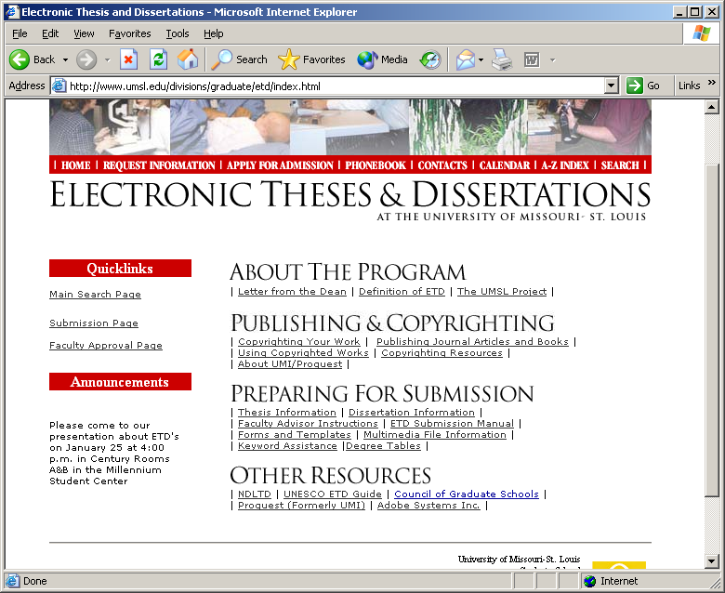

Slide 26
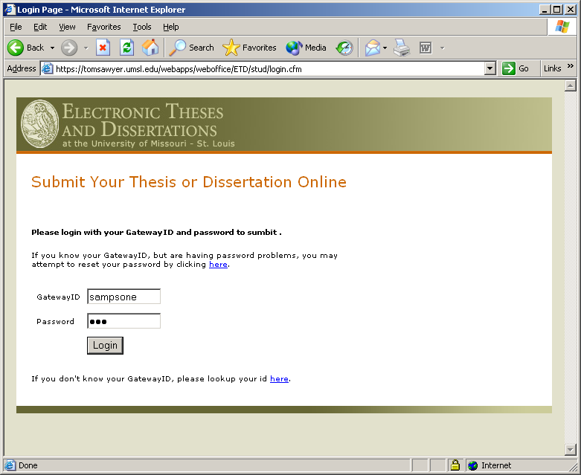

Slide 27
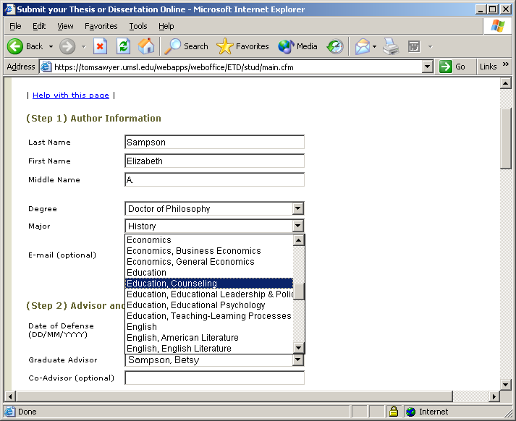

Slide 28
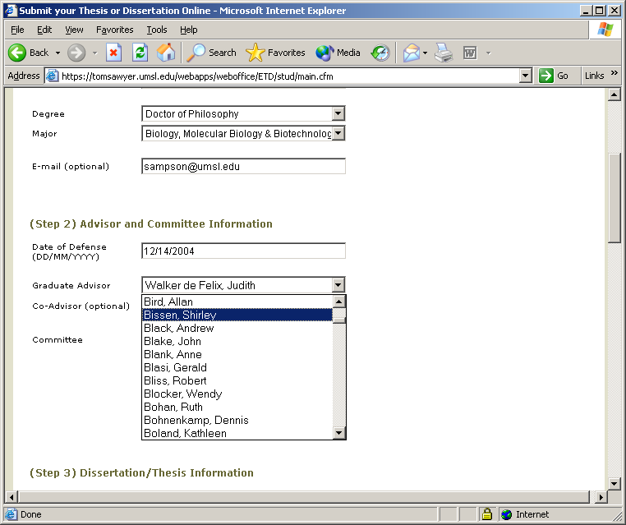

Slide 29
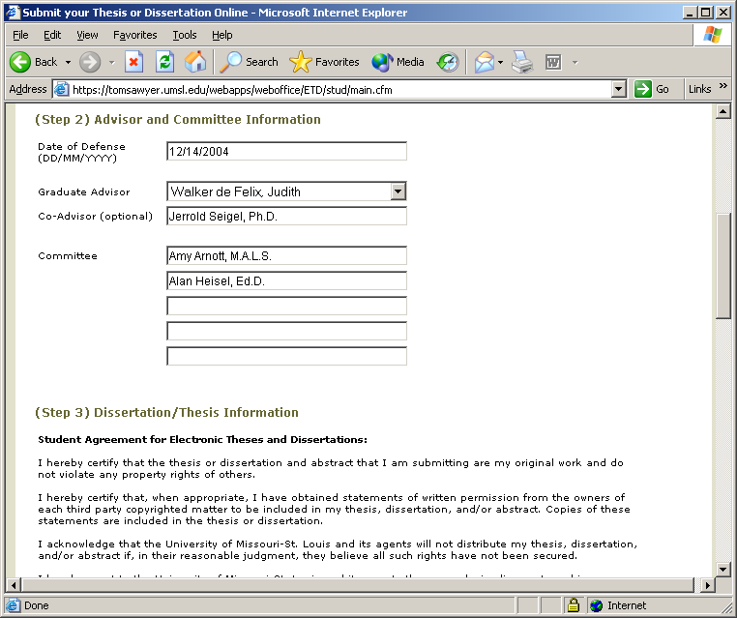

Slide 30
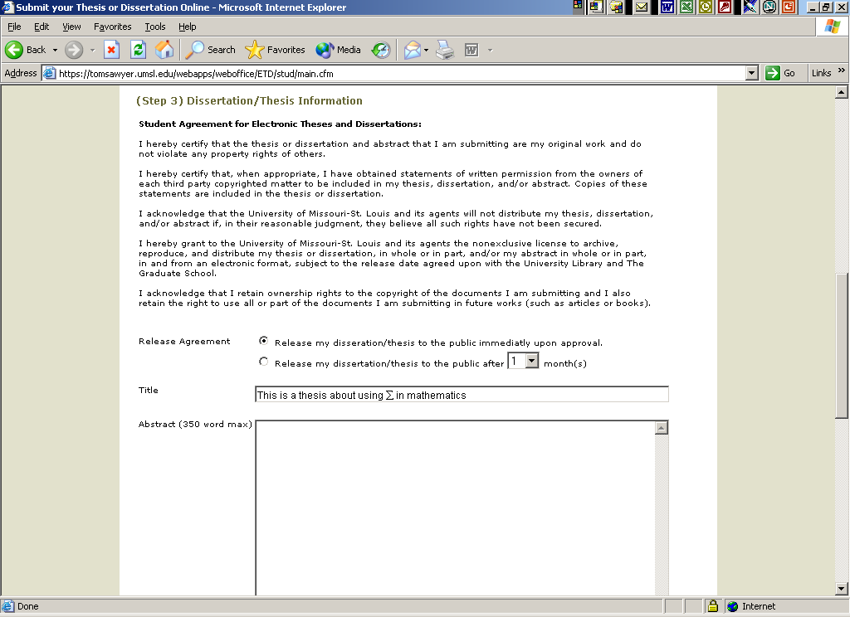

Slide 31
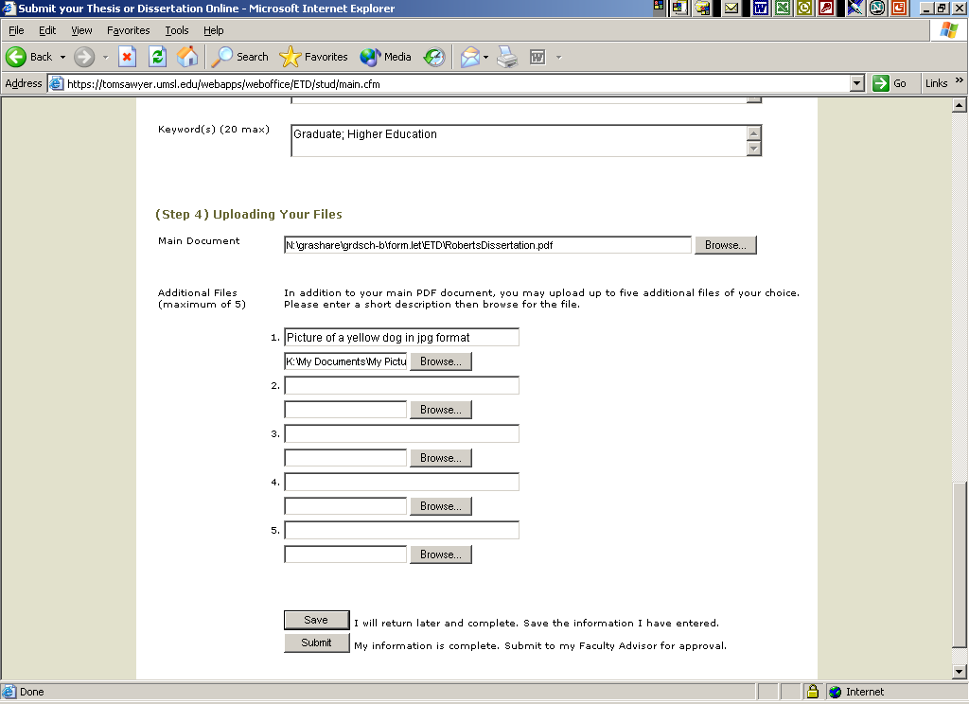

Slide 32
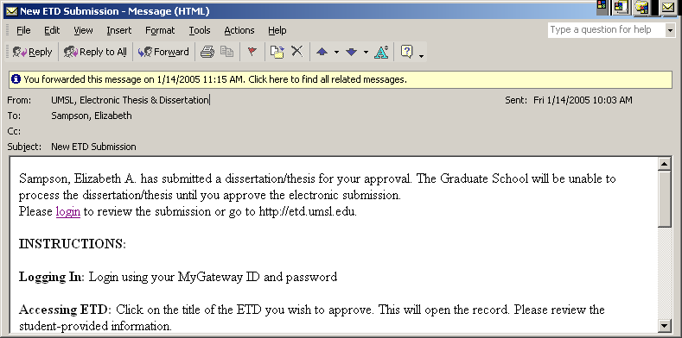

Slide 33
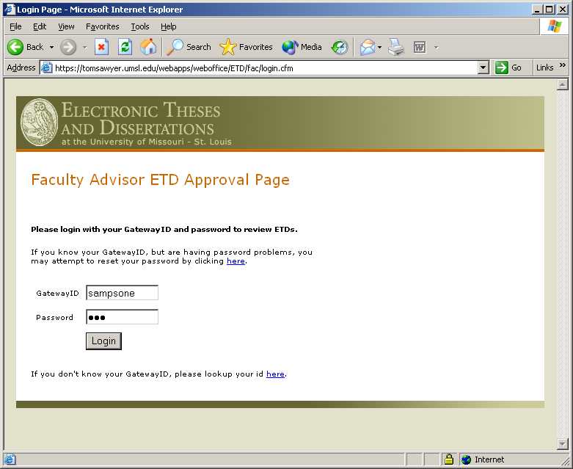

Slide 34
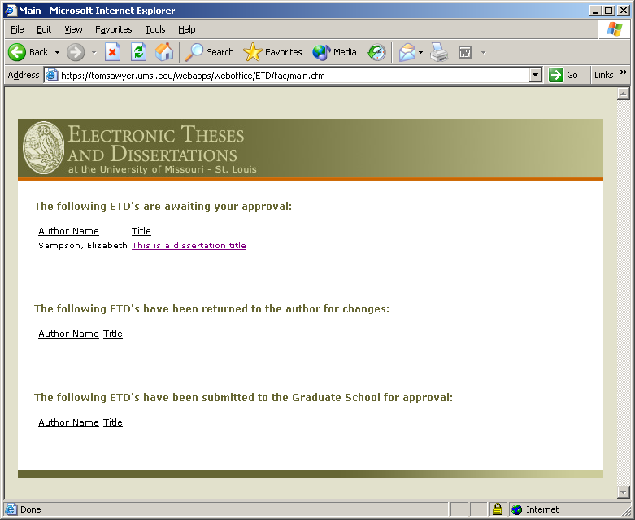

Slide 35
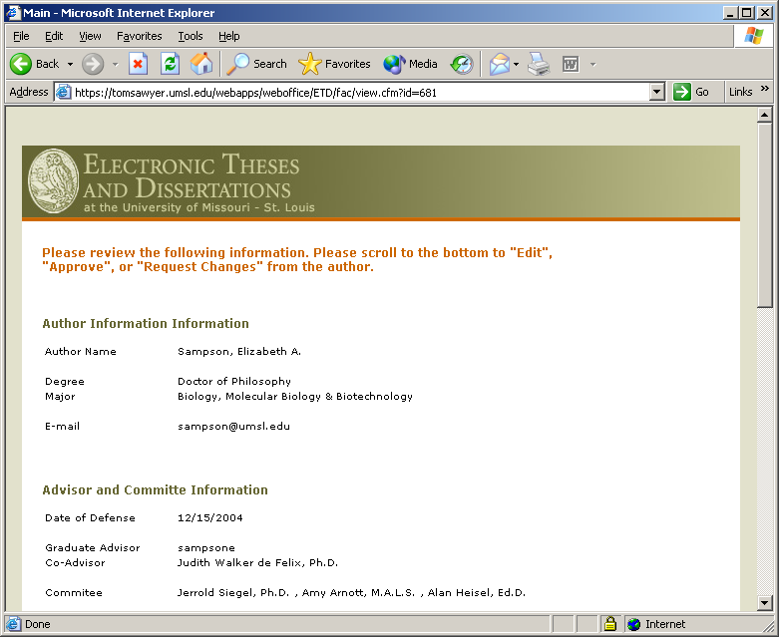

Slide 36
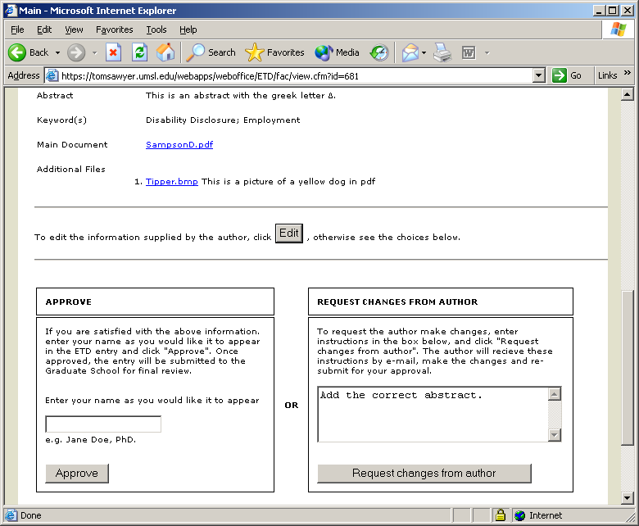

Slide 37
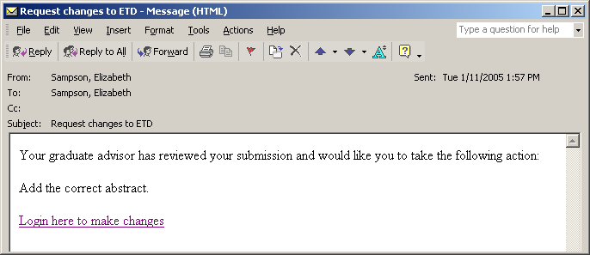

Slide 39
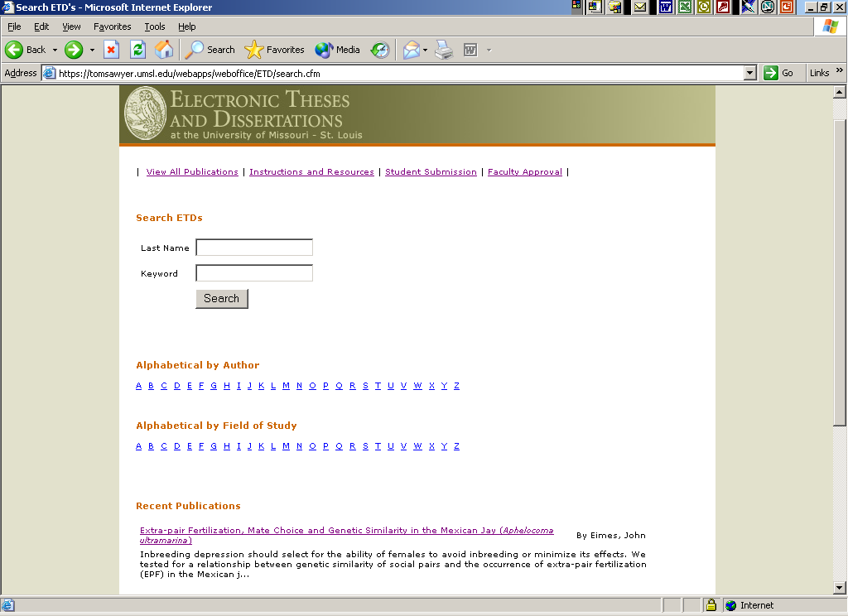

Slide 40
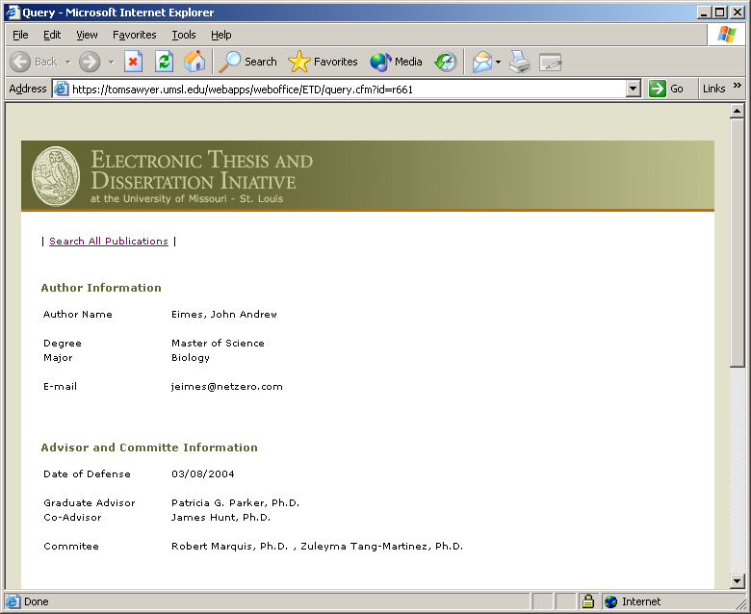

Slide 41
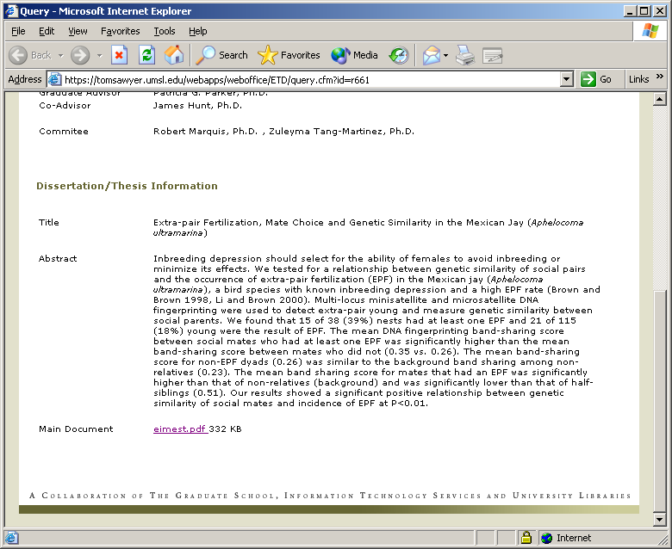

Slide 42
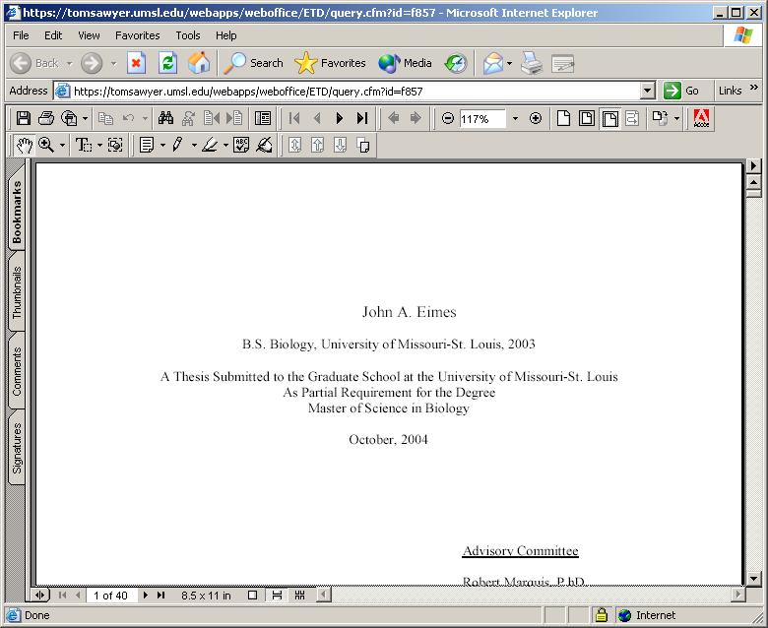

Slide 43
Any Questions?
sampson@umsl.edu
X5900

