Slide 1
Arduino Workshop ‘24
By/ Abdelrahman Badr

Slide 2



WHO AM I ?
LinkedIn Telegram

Slide 3
Workshop Plan
We have a hybrid schedule: three days on-site and two days online. Here's how we'll use them:
Day (1): Digital devices interface
Day (2): Analog devices interface and communication protocol
Day (3): How to use libraries and Q&A
Day (4): If needed
Day (5): If needed

Slide 4

Workshop system
Basically, all examples will be from your projects
All data of workshop will be here: https://github.com/abadr99/Arduino_AZEX_24

Slide 5

Introduction
Notes:
Talk about what is the Arduino and it is considered as an open source
Early Influences (2003-2005):
The groundwork for Arduino was laid at the Interaction Design Institute Ivrea (IDII) in Italy.
Students there found existing microcontrollers expensive and complex.
Hernando Barragán's Wiring platform, created in 2004 as a Master's thesis project, provided a foundation for a simpler approach.
Birth of Arduino (2005):
Massimo Banzi, David Cuartielles, and others at IDII built upon Wiring to create Arduino in 2005.
The name "Arduino" came from a bar in Ivrea frequented by the founders.
The goal was to make electronics development easier for students and non-engineers.
Evolution and Growth (2005-Present):
The first widely available Arduino board, the Diecimila, arrived in 2007.
Arduino's open-source hardware and software fostered a large and active community.
The Arduino family expanded with various boards catering to different needs and functionalities.
In 2012, the Due became the first Arduino board with a 32-bit processor, offering increased power.
Arduino continues to evolve, with the recent release of Arduino IDE 2.0 in September 2022.
Challenges and Impact:
Despite its success, Arduino faced legal disputes regarding trademarks in the 2010s.
Today, Arduino remains a significant player in democratizing electronics and inspiring creativity.

Slide 6

Arduino is a microcontroller !

Slide 7
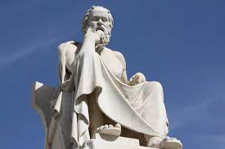
Micro-controller philosophy
All circuit components have to be connected with the controller i.e. Arduino

Slide 8
What Should I Connect ?
As discussed before all hardware components have to be connected to the Arduino.
How ?!
First of all we have to know that Arduino has multiple types of pins to match all types of hardware.
We have three main types:
Digital Pins:
Input : 0 ¬ 13
Output: 0 ¬ 13
Analog Pins:
Input: A0 ¬ A5
Output: 3, 5, 6, 9, 10, 11
Special Purpose Pins

Slide 9
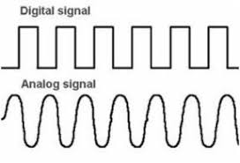
Digital Signals vs. Analog Signals

Slide 10
Interface With Digital Devices (HW side)
Determine the type of connected device (in this case will be digital)
Determine the pins that should be connected to the device

Slide 11
Interface With Digital Devices (SW side)
Can you remember the layout of Arduino IDE ?!

Slide 12
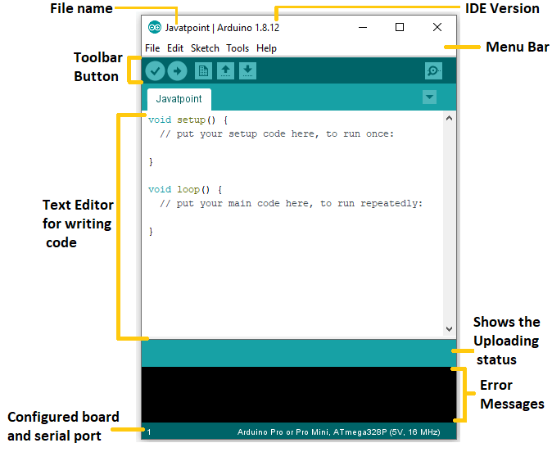
Arduino IDE layout

Slide 13
Interface With Digital Devices (SW side)
Set-up the device pins by setting the pins as digital input or output pins
Digital Input: pinMode(pinNumber, INPUT);
Digital Input: pinMode(pinNumber, OUTPUT);
Deal with pins according to the project
Digital Input: Read incoming value to the pin
int x = digitalRead(pinNumber); (NOTE: X will be either zero or one)
Digital Output
Output zero: digitalWrite(pinNumber, LOW);
Output 5V: digitalWrite(pinNumber, HIGH);

Slide 14
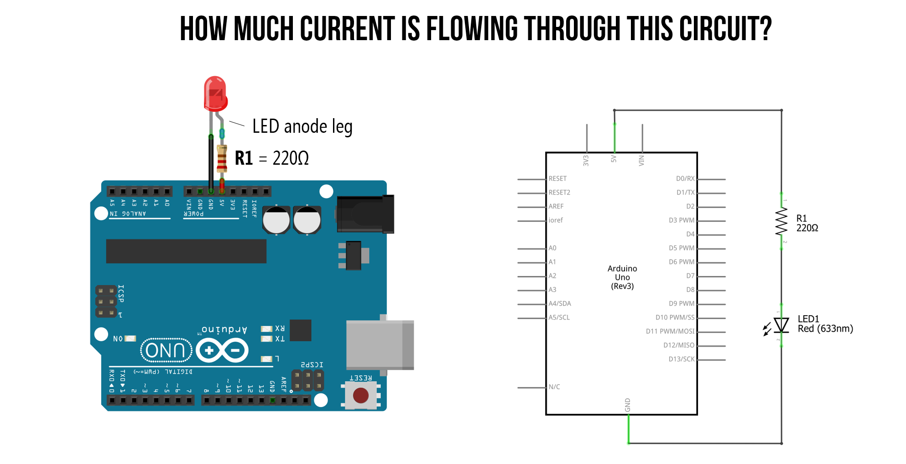
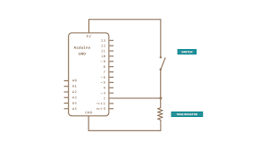
Example1: Control LED with Push-Button

Slide 15
IR
https://circuitdigest.com/microcontroller-projects/interfacing-ir-sensor-module-with-arduino
An infrared proximity sensor or IR Sensor is an electronic device that emits infrared lights to sense some aspect of the surroundings and can be employed to detect the motion of an object. As this is a passive sensor, it can only measure infrared radiation. This sensor is very common in the electronic industry and if you’ve ever tried to design an obstacle avoidance robot or any other proximity detection-based system, chances are you already know about this module, and if you don’t, then follow this article as here we will discuss everything about it.

Slide 16
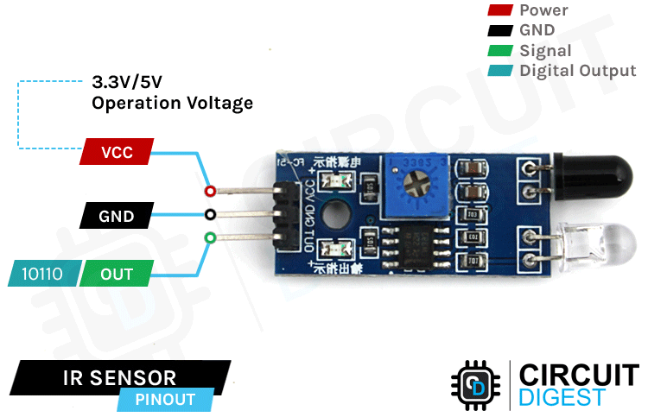

Slide 17
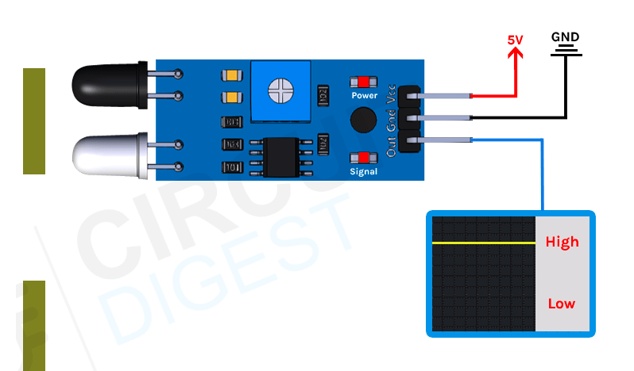
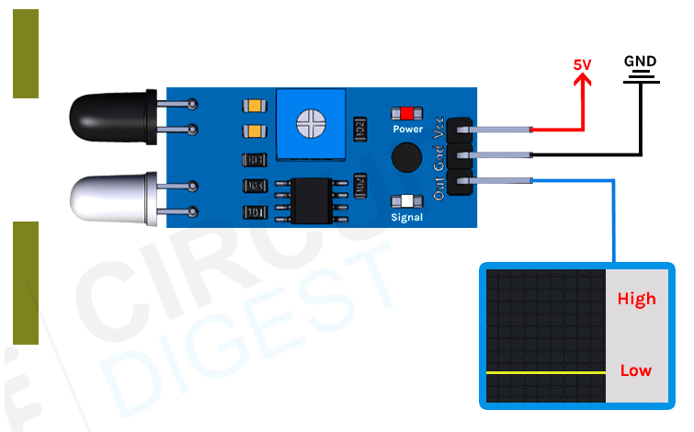
IR
The working of the IR sensor module is very simple, it consists of two main components: the first is the IR transmitter section and the second is the IR receiver section. In the transmitter section, IR led is used and in the receiver section, a photodiode is used to receive infrared signal and after some signal processing and conditioning, you will get the output.
An IR proximity sensor works by applying a voltage to the onboard Infrared Light Emitting Diode which in turn emits infrared light. This light propagates through the air and hits an object, after that the light gets reflected in the photodiode sensor. If the object is close, the reflected light will be stronger, if the object is far away, the reflected light will be weaker. If you look closely toward the module. When the sensor becomes active it sends a corresponding Low signal through the output pin that can be sensed by an Arduino or any kind of microcontroller to execute a particular task. The one cool thing about this module is that it has two onboard LEDs built-in, one of which lights on when power is available and another one turns on when the circuit gets triggered.

Slide 18
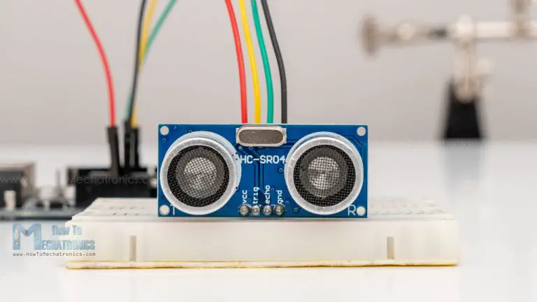
Ultrasonic
https://howtomechatronics.com/tutorials/arduino/ultrasonic-sensor-hc-sr04/
The HC-SR04 is an affordable and easy to use distance measuring sensor which has a range from 2cm to 400cm (about an inch to 13 feet).

Slide 19
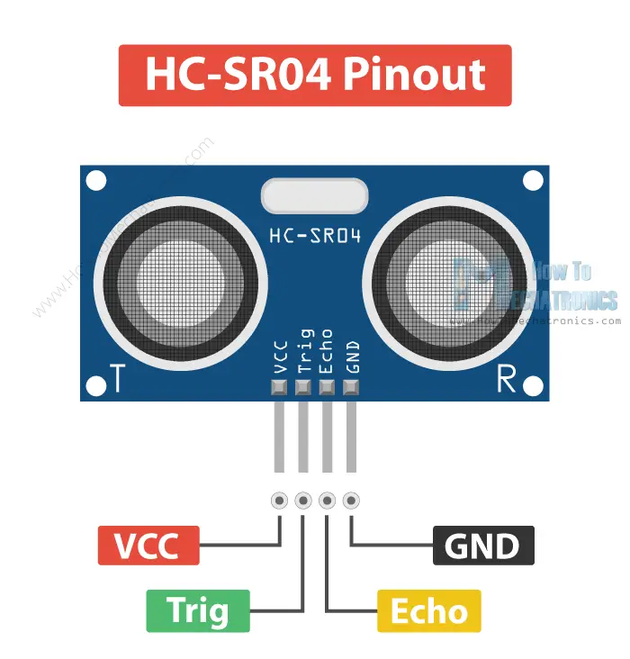
Ultrasonic
The sensor has 4 pins. VCC and GND go to 5V and GND pins on the Arduino, and the Trig and Echo go to any digital Arduino pin. Using the Trig pin we send the ultrasound wave from the transmitter, and with the Echo pin we listen for the reflected signal.

Slide 20
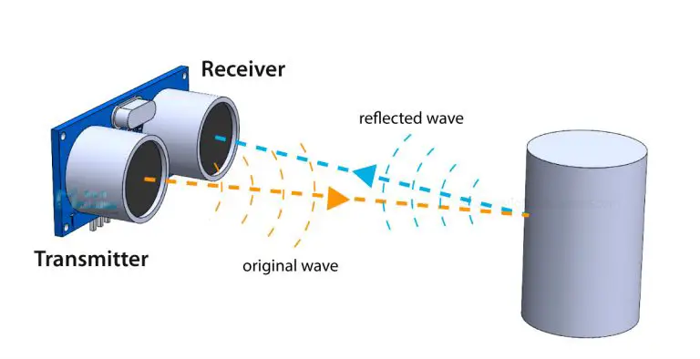
Ultrasonic
It emits an ultrasound at 40 000 Hz which travels through the air and if there is an object or obstacle on its path It will bounce back to the module. Considering the travel time and the speed of the sound you can calculate the distance.
Distance = Speed x Time
We actually know both the speed and the time values. The time is the amount of time the Echo pin was HIGH, and the speed is the speed of sound which is 340m/s. There’s one additional step we need to do, and that’s divide the end result by 2. and that’s because we are measuring the duration the sound wave needs to travel to the object and bounce back.

Slide 21
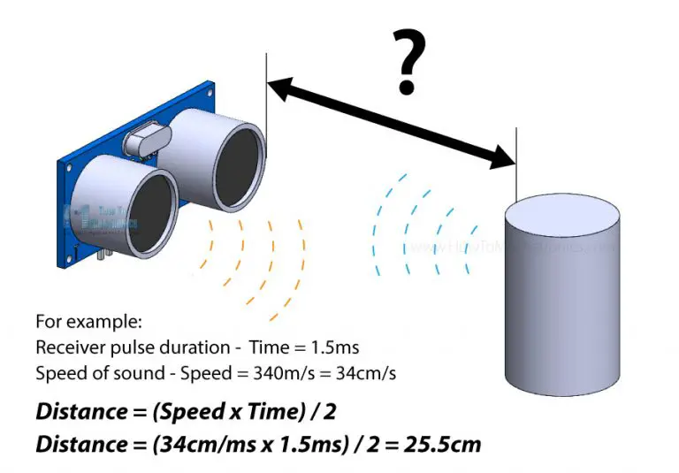
Ultrasonic

Slide 22
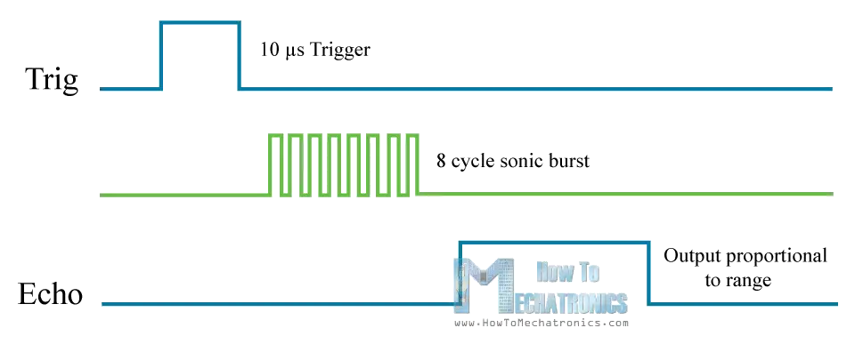
Ultrasonic

Slide 23
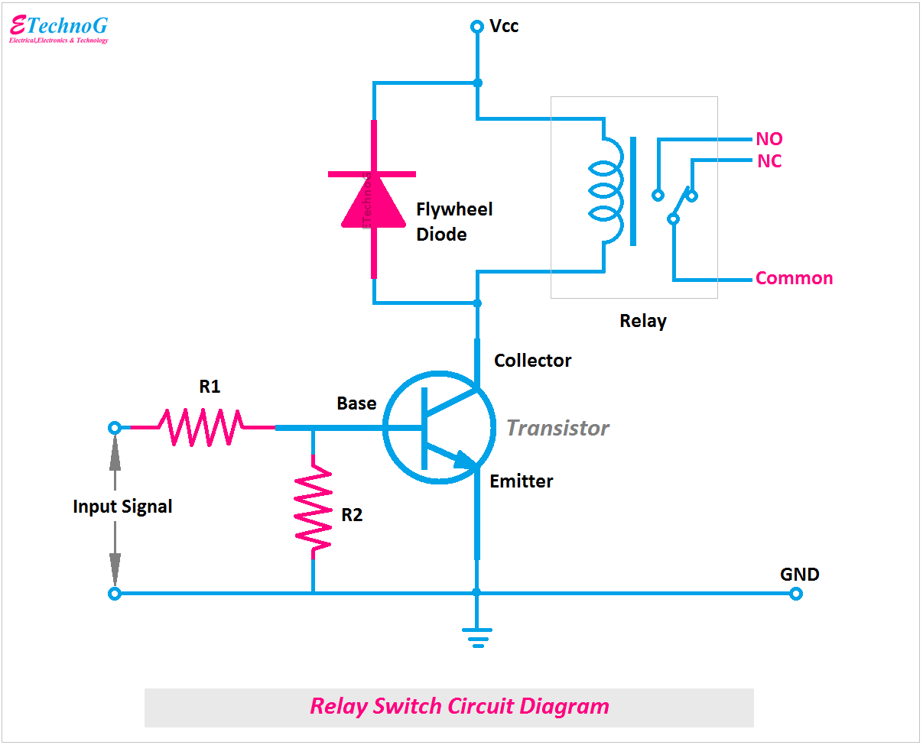
Relay

Slide 24
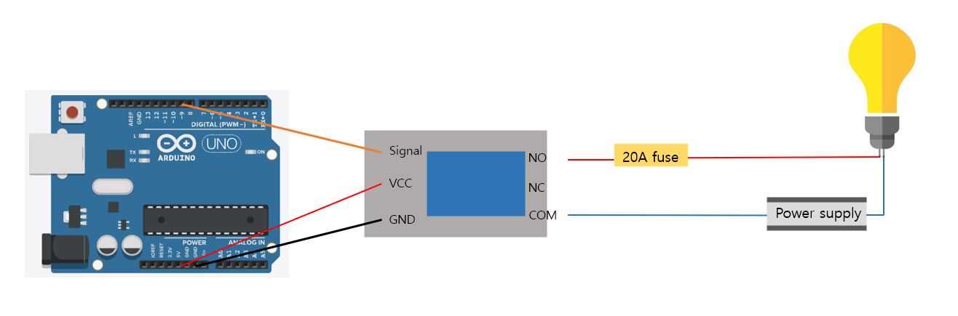
Relay
One of the most important applications of relay is water pump

Slide 25
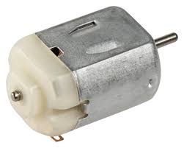
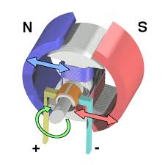
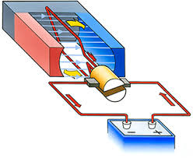
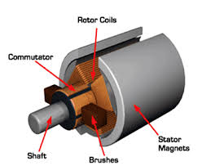
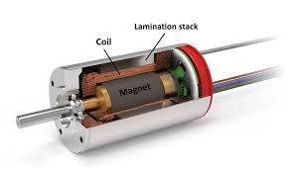
DC Motors

Slide 26
Why Motor drivers
To avoid Arduino damage
To control speed
To control directions

Slide 27
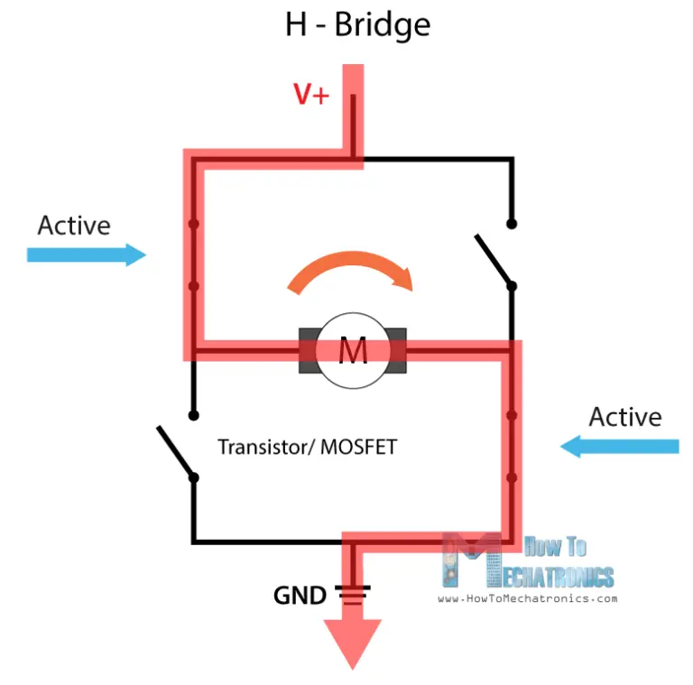
DC Motors (L298N Motor Driver)

Slide 28
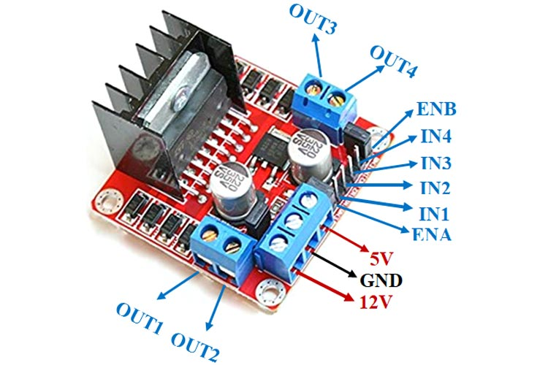
DC Motors (L298N Motor Driver)
The L298N is a dual H-Bridge motor driver which allows speed and direction control of two DC motors at the same time. The module can drive DC motors that have voltages between 5 and 35V, with a peak current up to 2A.

Slide 29
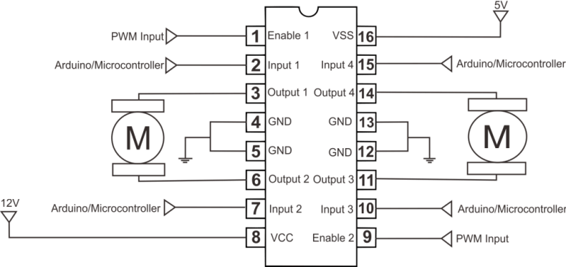
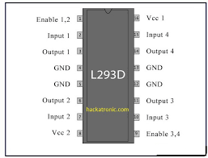
DC Motors (L293D Motor Driver)

