Slide 1
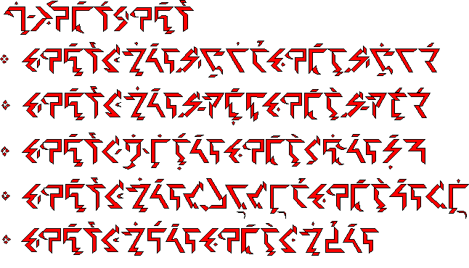
Investigating Ithkuil
Michael G. Phillips

Slide 2
Main claim:
“The findings of cognitive science and cognitive linguistics since the 1980s show that human cognition gives rise to and processes far more information than is overtly expressed by natural human languages. Theoretically, it should be possible to design a human-usable language that overtly expresses more (or “deeper”) levels/aspects of human cognition than are found in natural human languages” (Quijada 2012).

Slide 3
Part I: Ithkuil’s Grammar
Word Formation & Grammatical Categories
Plexity and the UNIPLEX/DUPLEX configurations
Prototype Theory and the NOMIC Perspective
Fuzzy Sets and the MULTIFORM configuration
Conceptual Metaphors and the REPRESENTATIONAL Context
Gestalt Psychology and the COHERENT configuration
Cognitive Grammar and Notion on Iconicity in Ithkuil

Slide 4
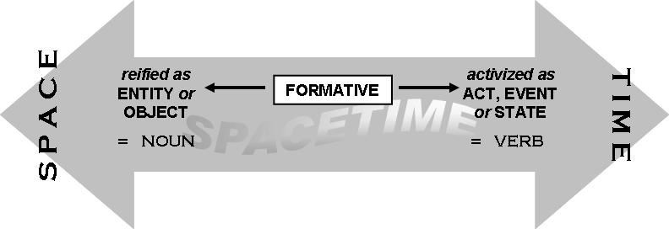
Word Formation:
Two parts of speech: formatives and adjuncts

Slide 5
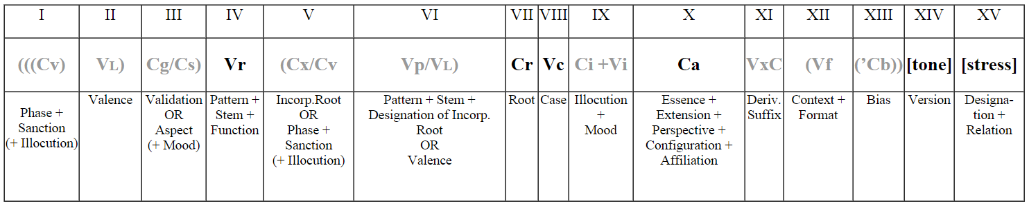
Grammatical Categories
Forming formatives:

Slide 6
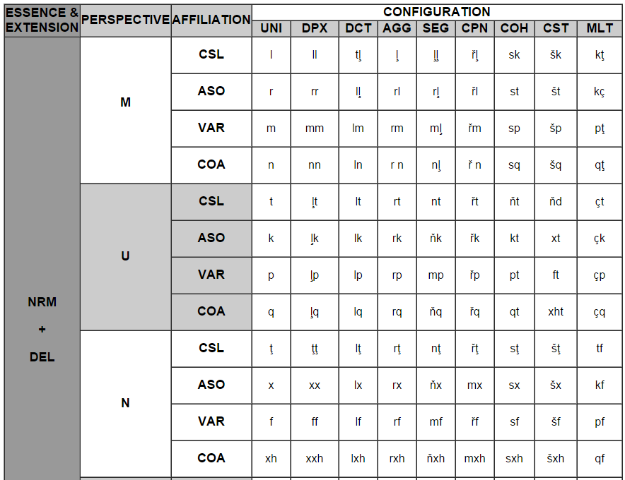
Example of Grammatical Affixes

Slide 7


Plexity and UNIPLEX/DUPLEX
Plexity - a category for identifying a quantity’s state of articulation into equivalent elements. (Talmy 2002)
UNIPLEX - configuration for “one” manifestation
DUPLEX - configuration for two (binary) manifestation(s)

Slide 8
Prototype Theory and NOMIC perspective
Prototypes - “those members of a category that most reflect the redundancy structure of the category as a whole” (Rosch 1978)
Nomic - a category for expressing prototypes (archetypal elements representing a group or set)
(express general concepts)

Slide 9

Fuzzy Sets and the MULTIFORM
Fuzzy Sets - “More often than not, the classes of objects encountered in the real physical world do not have precisely defined criteria of membership” (Zadeh 1965)
MULTIFORM - describe objects with varying degrees of membership of a given conceptual set.

Slide 10
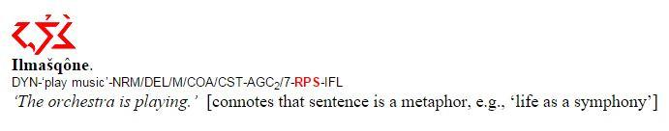
Metaphor and REPRESENTATIONAL Context
Handling metaphors using grammar:

Slide 11
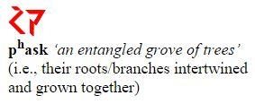

Gestalts and the COHERENT/COMPOSITE
Gestalt - The mind’s formation of a central “whole” from the summation of parts and vice versa.
COHERENT - multiple connected elements
COMPOSITE - non-similar elements

Slide 12
A notion on Iconicity in Ithkuil
Iconicity - How word order influences the reflected order of perception for listeners in developing an understanding of the speaker.
Jane got married and had a baby.
Jane had a baby and got married.
“Ithkuil does not display iconicity. While the order of words in an Ithkuil phrase or sentence may coincidentally reflect a temporal or causative sequence of events, this is not by syntactic design. Because of the myriad means available in Ithkuil to morphologically distinguish sequence, cause-and-effect, resulting states, and the distinction of recipients from directional goals, no iconicity patterns are required.” (Quijada 2012)

Slide 13
Part II: Language Optimality
Language Evolution
Ambiguity
Limitations and Domains of Language

Slide 14
Language Evolution
Little is known about language evolution
Consider that language evolved as a spandrel (by product)
If language is simply a byproduct, how can it be efficient for human communication vs a language which has been purposefully designed for maximum cognitive descriptiveness?

Slide 15
Ambiguity: a “bug” or a “feature”?
Disadvantage: Higher potential for miscommunication
Advantage: Re-use easy words to make language more human-usable (less complex)
(Context for disambiguation)
Consider: “mean”

Slide 16
Ambiguity
As the descriptive and cognitive conciseness of a language increases, so does the morphological complexity of said language.
As the general ambiguity of a language increases, so does the simplicity of said language. Natural languages tend to strike a balance.

Slide 17
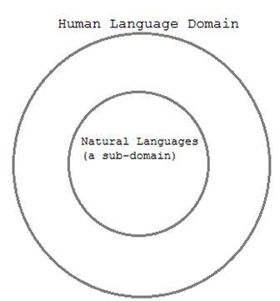
The Limitations and Domain of Language
Language can be defined by its limitations.
Some limitations include: qualia, production, and descriptive expression.
These limitations define a domain,
within which all languages exist.
(including the most optimal language)

Slide 18
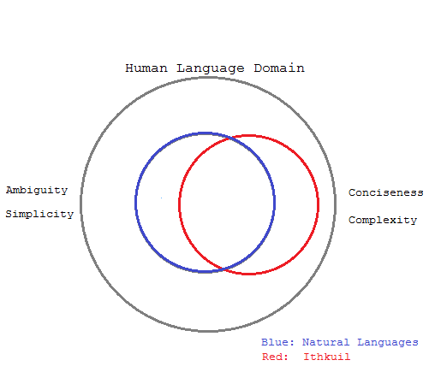
We can use this domain to identify natural languages as well as Ithkuil, in terms of the concepts previously discussed:

Slide 19
Conclusions
to Part I: Ithkuil is capable of expressing deeper levels of human cognition
to Part II: the most “optimal” language is a language that can strike “balance” between linguistic and cognitive expression

Slide 20
Ük^{h}u ettàlûk!

