Slide 1
Wine data analysis author: Akanchha bagla Revision number: 1.0 last date of revision: May 30, 2022
High level document

Slide 2
TABLE OF CONTENTS
Document Version Control
Abstract
Introduction
General Description
Design Details
Functional Architecture
Optimization
Optimization
KPIS
KPIS
Deployment

Slide 3
DOCUMENT VERSION CONTROL
Date Issued | Version | Description | Author
May 30, 2022 | 1.0 | Abstract, Introduction, General Description | Akanchha Bagla
REVIEW
Date Issued | Version | Reviewer | Comments
APPROVAL
Date Issued | Version | Approved By | Comments

Slide 4
ABSTRACT
With a variety of wine being produced in various parts of the world - climate, soil, type of produce, etc. are some of the factors that affect the taste and texture of the wine. The objective of this project is to evaluate how the price and points associated with a broad variety of wines vary based on the above factors.

Slide 5
1. Introduction
Why this High Level Design Document: The purpose of this High-Level Design (HLD) Document is to add the necessary detail to the current project description to represent a suitable model for coding. This document is also intended to help detect contradictions prior to coding, and can be used as a reference manual for how the modules interact at a high level.
The HDL will:
Present all of the design aspects and define them in detail
Describe the user interface being implemented
Describe the hardware and software interfaces
Describe the performance requirements
Include design features and the architecture of the project
List and describe the non-functional attributes like:
Security
Reliability
Maintainability
Portability
Reusability
Application compatibility
Resource utilization
Serviceability
Scope: The HLD documentation presents the structure of the system, such as the database architecture, application architecture (layers), application flow (Navigation), and technology architecture. The HLD uses non-technical to mildly-technical terms which should be understandable to the administrators of the system

Slide 6

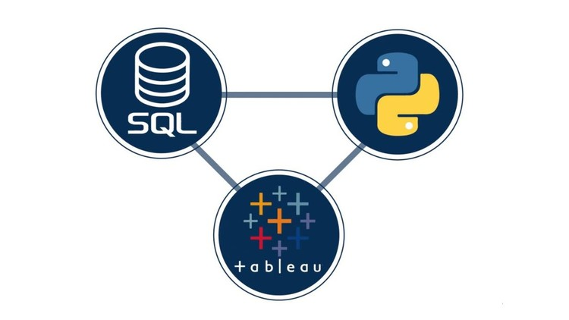

2. GENERAL DESCRIPTION
2.1 Product Perspective and Problem Statement:
The wine industry generally has been very proactive about dealing with climate change from capturing fermentation carbon to trailing new varieties. The objective is to evaluate how these climatic and fermenting factors affect the ratings and price of the wide variety of wines sourced from different countries around the world.
2.2 Tools Used:
Business Intelligence tools and libraries such as Python, Tableau, SQL, GitHub, Numpy, Pandas, Excel are used to build the whole framework.

Slide 7
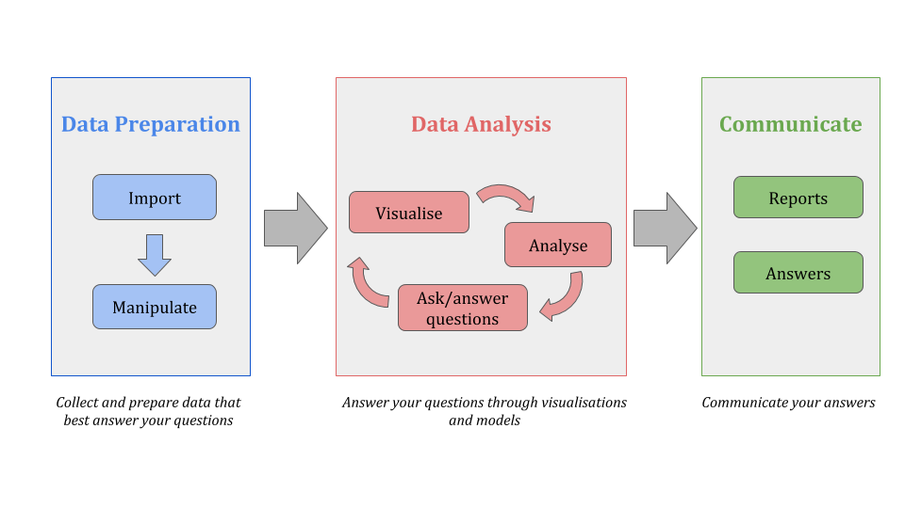
3. Design Details
3.1 Functional Architecture

Slide 8
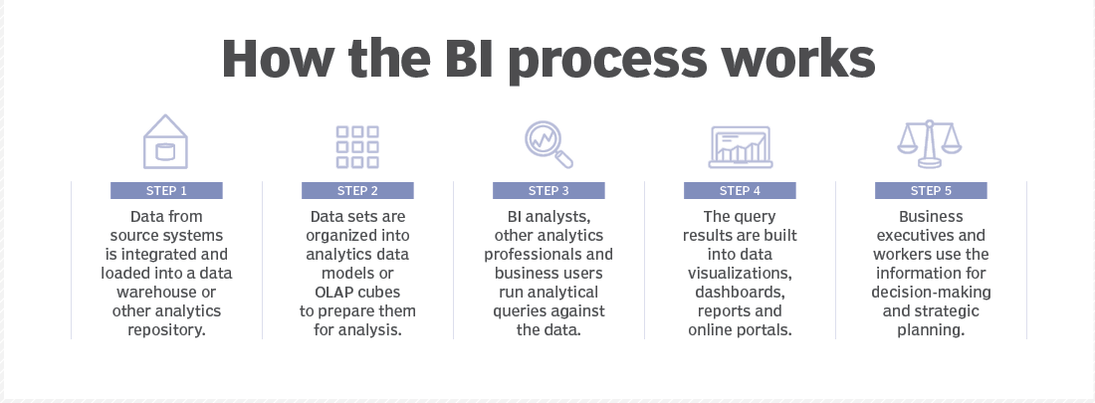
3. Design Details
3.1 Functional Architecture

Slide 9
3. Design Details
3.2 Optimization:
Your data strategy drives performance
• Minimize the number of fields
• Minimize the number of records
• Optimize extracts to speed up future queries by materializing calculations, removing columns and the use of accelerated views
Reduce the marks (data points) in your view
• Practice guided analytics. There’s no need to fit everything you plan to show in a single view. Compile related views and connect them with action filters to travel from overview to highly-granular views at the speed of thought.
• Remove unneeded dimensions from the detail shelf.
• Explore. Try displaying your data in different types of views.
Limit your filters by number and type
• Reduce the number of filters in use. Excessive filters on a view will create a more complex query, which takes longer to return results. Double-check your filters and remove any that aren’t necessary.
• Use an include filter. Exclude filters load the entire domain of a dimension, while include filters do not. An include filter runs much faster than an exclude filter, especially for dimensions with many members.
• Use a continuous date filter. Continuous date filters (relative and range-of-date filters) can take advantage of the indexing properties in your database and are faster than discrete date filters.
• Use Boolean or numeric filters. Computers process integers and Booleans (t/f) much faster than strings.
• Use parameters and action filters. These reduce the query load (and work across data sources).

Slide 10
3. Design Details
3.2 Optimization:
Optimize and materialize your calculations
Perform calculations in the database
Reduce the number of nested calculations.
Reduce the granularity of LOD or table calculations in the view. The more granular the calculation, the longer it takes.
LODs - Look at the number of unique dimension members in the calculation.
Table Calculations - the more marks in the view, the longer it will take to calculate.
Where possible, use MIN or MAX instead of AVG. AVG requires more processing than MIN or MAX. Often rows will be duplicated and display the same result with MIN, MAX, or AVG.
Make groups with calculations. Like include filters, calculated groups load only named members of the domain, whereas Tableau’s group function loads the entire domain.
Use Booleans or numeric calculations instead of string calculations. Computers can process integers and Booleans (t/f) much faster than strings. Boolean>Int>Float>Date>DateTime>String

Slide 11

4. KPIs
Dashboards will be implemented to display and indicate certain KPIs and relevant indicators for the wine price and points.
As and when, the system starts to capture the historical/periodic data for a user, the dashboards will be included to display charts over time with progress on various indicators or factors.

Slide 12
4. KPIs
4.1 KPIs (Key Performance Indicators):
Key indicators displaying a summary of the wine price and points and its relationship with different metrics
Impact of Variety on Price across Country
Impact of Winery on Price across Country
Influence of taster on Price
Average Price across Country
Average Price across Provinces of US
Average Price- top 10 Countries
Average Price- top 10 Provinces
Impact of Variety on Points across Country
Impact of Winery on Points across Country
Influence of taster on Points
Average Points across Country
Average Points across Provinces of US
Average Points - top 10 Countries
Average Points - top 10 Provinces
Average Price Vs. Average Points
Price distribution by points

Slide 13
5. Deployment
Prioritizing data and analytics couldn’t come at a better time. Your company, no matter what size, is already collecting data and most likely analyzing just a portion of it to solve business problems, gain competitive advantages, and drive enterprise transformation. With the explosive growth of enterprise data, database technologies, and the high demand for analytical skills, today’s most effective IT organizations have shifted their focus to enabling self-service by deploying and operating Tableau at scale, as well as organizing, orchestrating, and unifying disparate sources of data for business users and experts alike to author and consume content.
Tableau prioritizes choice in flexibility to fit, rather than dictate, your enterprise architecture. Tableau Server and Tableau Online leverage your existing technology investments and integrate into your IT infrastructure to provide a self-service, modern analytics platform for your users. With on-premises, cloud, and hosted options, there is a version of Tableau to match your requirements.

Slide 14
The Dashboarding for this project has been done on Tableau Desktop and deployed on Tableau Public

