Slide 1
Wine data analysis author: Akanchha bagla Revision number: 1.0 last date of revision: May 30, 2022
LOW level DESIGN document

Slide 2
TABLE OF CONTENTS
Document Version Control
Introduction
Architecture
Data Description
Architecture Description
Architecture Description
Architecture Description- Data Gathering , Cleaning , Analysis
Architecture Description- Reporting & Modelling
Architecture Description- Deployment

Slide 3
DOCUMENT VERSION CONTROL
Date Issued | Version | Description | Author
May 30, 2022 | 1.0 | Introduction, Architecture | Akanchha Bagla
REVIEW
Date Issued | Version | Reviewer | Comments
APPROVAL
Date Issued | Version | Approved By | Comments

Slide 4
1. Introduction
1.1 What is Low-Level design document?
The goal of the LDD or Low-level design document (LLDD) is to give the internal logic design of the
actual program code for the wine review analysis. LDD describes the class diagrams
with the methods and relations between classes and programs specs. It describes the modules so
that the programmer can directly code the program from the document.
1.2 Scope
Low-level design (LLD) is a component-level design process that follows a step-by-step refinement
process. The process can be used for designing data structures, required software architecture,
source code and ultimately, performance algorithms. Overall, the data organization may be
defined during requirement analysis and then refined during data design work.

Slide 5
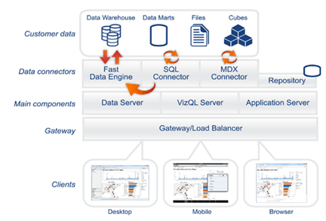
2. Architecture

Slide 6
2. Architecture
2.1 Data Description:
The Wine Dataset columns:
Country: The Country where the wine is sourced from.
Description: How the wine smells, swirls, tastes and the flavors.
Designation: Way to identify the wine types depending on grape variety or style.
Points: 95-100 Classic: a great wine, 90-94 Outstanding: a wine of superior character and style, 85-89 Very good: a wine with special qualities, 80-84 Good: a solid, well-made wine.
Price: Price of the wine
Province: The province where wine is produced.
Region_1 : The region where wine is produced.
Region_2: The sub-region where wine is produced.
Taster Name: The name of the taster/ sommelier.
Taster Twitter handle: Twitter account name of the tasters.
Title: Name and year of the wine.
Variety: Type of wine depending on its description of taste and flavor.
Winery: The origin of wine, a place where it was grown and fermented, the start to end process.
Only available for few Countries

Slide 7
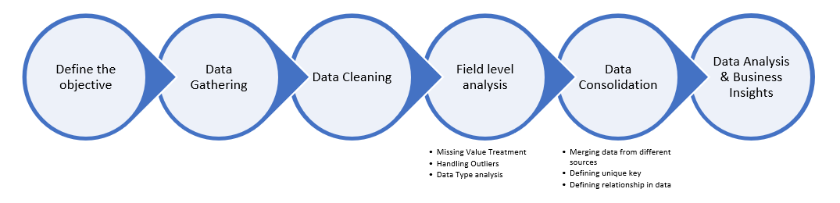
2. Architecture
2.2 Architecture Description

Slide 8
2. Architecture
2.3 Architecture Description
Define the Objective: The objective of this project is to evaluate how the price and points associated with a broad variety of wines vary based on factors like taste, smell and flavors.
Data Gathering: The datasets used for this study is available on → Wine Review Data
Data Cleaning: Data cleaning is the process of fixing or removing incorrect, corrupted, incorrectly formatted, duplicate, or incomplete data within a dataset.
Remove duplicate or irrelevant observations
Outliers Detection and Removal
Renaming required attributes
Handling Skewed Data
Field Level Analysis: Handling Null/Missing Values, Filtering unwanted outliers,
Data Consolidation: Merging data from different sources. Defining unique keys. Defining relationship in data, Data type analysis.
Data Analysis & Business Insights: Data Analysis refers to the critical process of performing initial investigations on data to discover patterns, spot anomalies, test hypothesis and to check assumptions with the help of summary statistics and graphical representations.

Slide 9
2. Architecture
2.3 Architecture Description
Reporting: Reporting is a most important and underrated skill of a data analytics field. Because being a Data Analyst you should be good in easy and self- explanatory report because your model will be used by many stakeholders who are not from technical background.
High Level Design Document (HLD)
Low Level Design Document (LLD)
Architecture
Wireframe
Detailed Project Report
Power Point Presentation
Modelling: Data Modelling is the process of analyzing the data objects and their relationship to the other objects. It is used to analyze the data requirements that are required for the business processes. The data models are created for the data to be stored in a database. The Data Model's main focus is on what data is needed and how we have to organize data rather than what operations we have to perform.

Slide 10
2. Architecture
2.3 Architecture Description
Deployment:
We created a Power BI Dashboard

