Slide 1
Cross Origin Resource Sharing

Slide 2
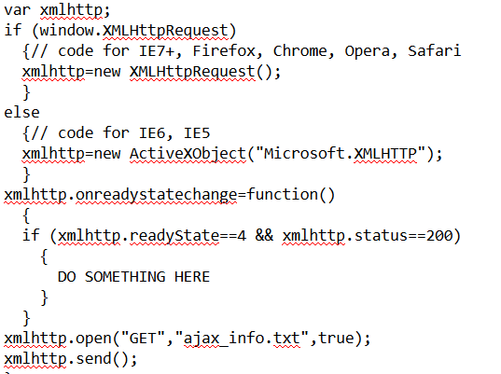
AJAX & XMLHTTPRequest (XHR)
AJAX = Asynchronous JavaScript and XML.
Allows for dynamic web applications
XHR = “An API available to web browser scripting languages such as JavaScript. It is used to send HTTP or HTTPS requests to a web server and load the server response data back into the script”
“World Wide Web Consortium published a Working Draft specification for the XMLHttpRequest object on April 5, 2006”

Slide 3
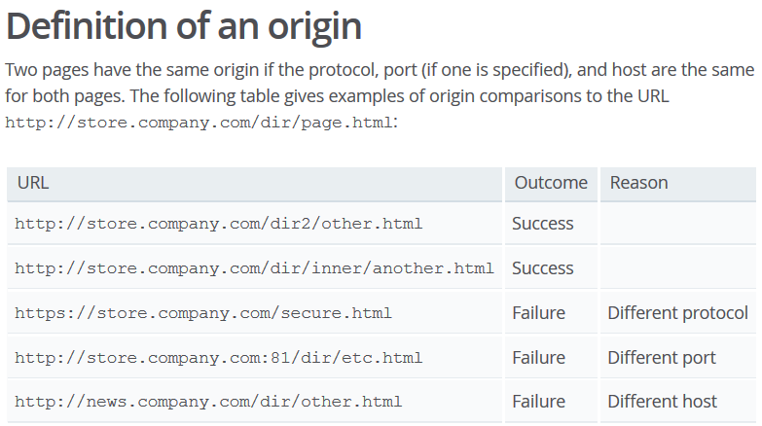
Same Origin Policy
“same-origin policy dates back to Netscape Navigator 2 in 1995.”
“restricts how a document or script loaded from one origin can interact with a resource from another origin.”
Enforced by browser

Slide 4
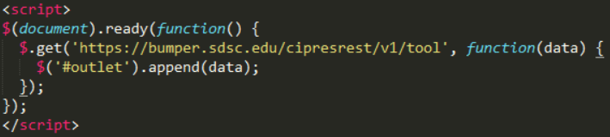
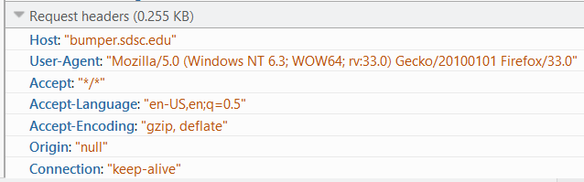
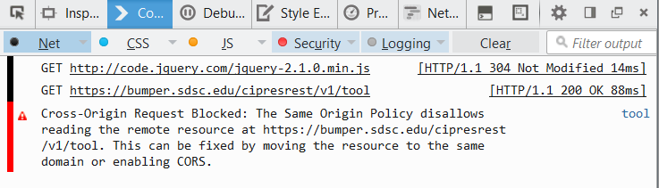
The API Problem
Web application origin is different from API host origin.
Conflict with same origin policy.

Slide 5
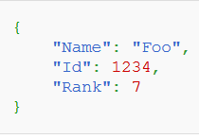
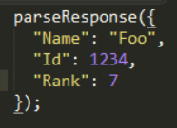

Solution: JSONP
JSONP = JSON with Padding
Script tag does not respect Same-Origin Policy.
Dynamically inject script element into dom
Set script source as target url
Wrap payload in existing function call (padding)

Slide 6
Problems with JSONP
“Including script tags from remote servers allows the remote servers to inject any content into a website”
MOST IMPORTANT: Only works with GET requests

Slide 7
Solution: Cross Origin Resource Sharing (CORS)
“mechanism which provides a way for web servers to support cross-site access controls, which enable secure cross-site data transfers.”
Recommended by the Web Applications Working Group within the W3C (The World Wide Web Consortium)
adds new HTTP headers
allow servers to describe set of origins that are permitted to access information
Allows servers to specify permitted HTTP request methods

Slide 8
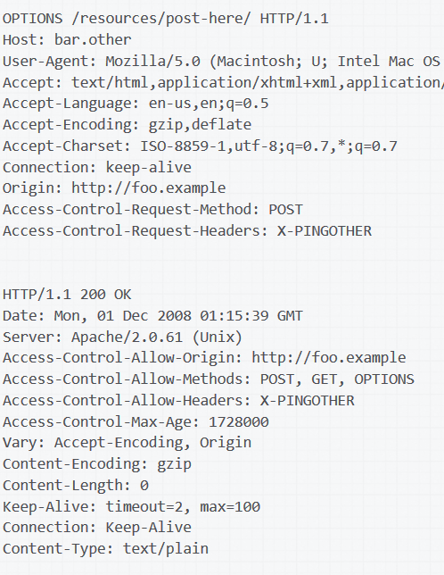
CORS Preflight Request
“preflighted” requests
POST used to send request data with a Content-Type other than application/x-www-form-urlencoded, multipart/form-data, or text/plainmethods, ie: XML
Methods other than GET, HEAD or POST ie: PUT, DELETE, etc.
"first send an HTTP request by the OPTIONS method to the resource on the other domain, in order to determine whether the actual request is safe to send.”

Slide 9

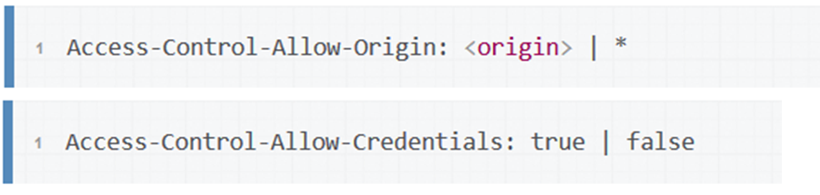



CORS (continued)
Request Headers
Response Headers

Slide 10

Option 1: Allow all origins
Proposed Solution
Problem
Allow requests to be made from any origin
No control over where requests can be made: vulnerable to CSRF attacks
MOST IMPORTANT: “when responding to a credentialed request, server must specify a domain, and cannot use wild carding” ie: no support for Basic Auth

Slide 11
Option 2: Echo Origin
Proposed Solution:
Problem
Dynamically set “Allow origin” response header to request origin.
Allows for use of credentials
Still no control over where requests can be made
More work server-side

Slide 12
Option 3: Whitelist origins
Proposed Solution
Problem
Have user provide a list of origins he/she will be using
Include origins in whitelist
Scan whitelist on request and dynamically set “Allow Origin” header
Allows for use of credentials
Ensures origins are from registered users
More work server side (maintain whitelist & dynamically set header)
More work for user

