Slide 1
CSE204 Project
LYRICS BASED SONG CLASSIFICATION BY ARTIST
Antonia Baies
Aarrya Saraf

Slide 2
GETTING THE DATA
PRE-PROCESSING THE DATA
BUILDING THE MODELS
RESULTS

Slide 3
GETTING THE DATA

Slide 4
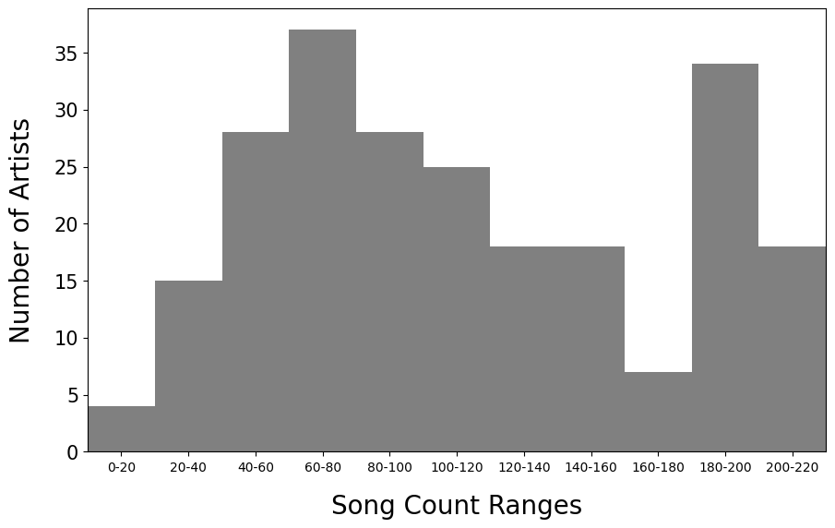
GETTING THE DATA
Scraped our own data:
Number of songs : 26164
Number of artists : 232
Average number of songs per artist : 112
Max. number of songs per artist: 201
Min. number of songs per artist: 2

Slide 5
PRE-PROCESSING THE DATA

Slide 6
PRE-PROCESSING THE DATA
1) “Computer friendly” data
We've got...
Foreign policy [x3]
We've got...
Foreign policy
Foreign policy
Foreign policy
[2x:]
I miss you when the lights go out
It illuminates all of my doubts
Pull me in, hold me tight, don't let go
Baby, give me light
I miss you when the lights go out
It illuminates all of my doubts
Pull me in, hold me tight, don't let go
Baby, give me light
I miss you when the lights go out
It illuminates all of my doubts
Pull me in, hold me tight, don't let go
Baby, give me light
[Ed Sheeran (Leto):]
We'll go all night
Two-steppin' with the woman I love
SONG DISCARDED

Slide 7
PRE-PROCESSING THE DATA
2) Tokenization + stemming
Hoo-haa
Am I losing you?
Hoo-haa
Am I losing you?
I saw you yesterday
You're up with someone new
The things people say
Oh, tell me they're not true
Is she just a friend?
Or is this the end?
Oh, what will I do?
Am I losing you?
Hoo-haa
Am I losing you?
It hurts to realize
I'm not the only one
Are you telling lies?
Am I a figure of fun?
I still got my pride
The tears I must hide
Oh, what will I do?
Am I losing you?
[['hoohaa'], ['am', 'i', 'lose', 'you'], ['hoohaa'], ['am', 'i', 'lose', 'you'], ['i', 'saw', 'you', 'yesterday'], ["you'r", 'up', 'with', 'someon', 'new'], ['the', 'thing', 'peopl', 'say'], ['oh', 'tell', 'me', "they'r", 'not', 'true'], ['is', 'she', 'just', 'a', 'friend'], ['or', 'is', 'thi', 'the', 'end'], ['oh', 'what', 'will', 'i', 'do'], ['am', 'i', 'lose', 'you'], ['hoohaa'], ['am', 'i', 'lose', 'you'], ['it', 'hurt', 'to', 'realiz'], ["i'm", 'not', 'the', 'onli', 'one'], ['are', 'you', 'tell', 'lie'], ['am', 'i', 'a', 'figur', 'of', 'fun'], ['i', 'still', 'got', 'my', 'pride'], ['the', 'tear', 'i', 'must', 'hide'], ['oh', 'what', 'will', 'i', 'do'], ['am', 'i', 'lose', 'you’]]

Slide 8
PRE-PROCESSING THE DATA
3) Cleaning the dataset
Duplicates : same title + same artist
Covers : same title + different artist + more than 80% of similarity
Intros and outros
Songs too short (<50 words)
Artists with not enough data (<90 songs)

Slide 9
PRE-PROCESSING THE DATA
3) Cleaning the dataset
Duplicates : same title + same artist
Covers : same title + different artist + more than 80% of similarity
Intros and outros
Songs too short (<50 words)
Artists with not enough data (<90 songs)
Number of songs : 19329
Number of artists : 133
Average number of songs per artist : 145

Slide 10
PRE-PROCESSING THE DATA
4) Getting numerical features
Shape:
- Number of lines
Number of words
Number of words per line

Slide 11
PRE-PROCESSING THE DATA
4) Getting numerical features
Structure:
- Title in song
Type-Token Ratio (TTR)
Lines similarity (>50% similarity)

Slide 12
PRE-PROCESSING THE DATA
4) Getting numerical features
Structure:
- Title in song
Type-Token Ratio (TTR)
Lines similarity (>50% similarity)
With your good credit
The worm will find a way
With your good credit
The rat will find a way

Slide 13
PRE-PROCESSING THE DATA
4) Getting numerical features
Style:
POS tags
Chunk tags

Slide 14
PRE-PROCESSING THE DATA
4) Getting numerical features
POS tags :
‘N’ : noun
‘V’ : verb
‘ADV’ : adverb
‘ADJ’ : adjective
‘DET’: determinant
‘PRON’: pronoun
Style:
POS tags
Chunk tags

Slide 15
PRE-PROCESSING THE DATA
4) Getting numerical features
POS tags :
‘N’ : noun
‘V’ : verb
‘ADV’ : adverb
‘ADJ’ : adjective
‘DET’: determinant
‘PRON’: pronoun
Chunk tags :
‘GPE’: Geopolitical Entity (countries, cities, states…)
‘PERSON’: individuals or groups of people
‘ORGANIZATION’: companies, institutions
‘LOCATION’: specific places or locations
‘FACILITY’: buildings, structures
‘GSP’ :General Single Purpose
Style:
POS tags
Chunk tags

Slide 16
PRE-PROCESSING THE DATA
4) Getting numerical features
Vocabulary:
Slang words frequency
Rare words frequency
TF-IDF

Slide 17
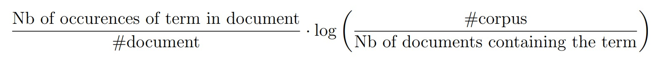
PRE-PROCESSING THE DATA
4) Getting numerical features
Vocabulary:
Slang words frequency
Rare words frequency
TF-IDF

Slide 18
PRE-PROCESSING THE DATA
4) Getting numerical features
Vocabulary:
Slang words frequency
Rare words frequency
TF-IDF
Now we split !
Training size : 16194
Testing size : 2841

Slide 19
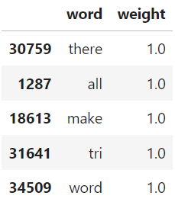
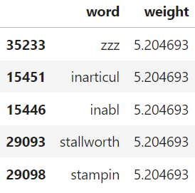
PRE-PROCESSING THE DATA
4) Getting numerical features
35234 words :
Vocabulary:
Slang words frequency
Rare words frequency
TF-IDF

Slide 20
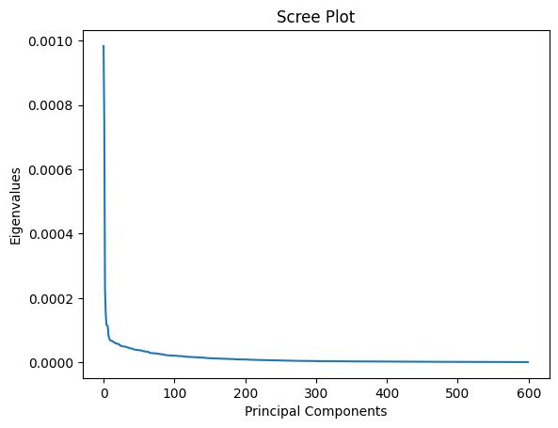
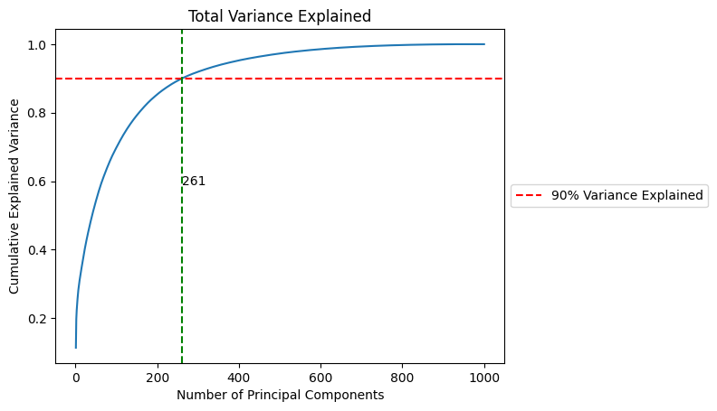
PRE-PROCESSING THE DATA
4) Getting numerical features
Keep the 200 first principal components

Slide 21
PRE-PROCESSING THE DATA
4) Getting numerical features
Semantics:
Regressive Imagery Dictionary (RID)
Sentimental analysis : polarity
and subjectivity

Slide 22
PRE-PROCESSING THE DATA
4) Getting numerical features
Semantics:
Regressive Imagery Dictionary (RID)
Sentimental analysis : polarity
and subjectivity
PRIMARY | Need
 | Sensation
 | Defensive
 | Regressive
 | Icarian Imagery
SECONDARY | Abstraction
 | Social Behavior
 | Instrumental Behavior
 | Restraint
 | Temporal Reference
EMOTIONS | Positive Affect
 | Anxiety
 | Sadness
 | Affection
 | Aggression

Slide 23
PRE-PROCESSING THE DATA
4) Getting numerical features
Semantics:
Regressive Imagery Dictionary (RID)
Sentimental analysis : polarity
and subjectivity
PRIMARY | Need
 | Sensation
 | Defensive
 | Regressive
 | Icarian Imagery
SECONDARY | Abstraction
 | Social Behavior
 | Instrumental Behavior
 | Restraint
 | Temporal Reference
EMOTIONS | Positive Affect
 | Anxiety
 | Sadness
 | Affection
 | Aggression
PRIMARY : 25.301205 %
SECONDARY : 42.168675 %
EMOTIONS : 32.530120 %

Slide 24
PRE-PROCESSING THE DATA
SECONDARY:TEMPORAL REFERENCES 17
now old sometimes sometimes sometimes sometimes time yesterday time sometimes sometimes sometimes sometimes sometimes sometimes sometimes sometimes
EMOTIONS:AFFECTION 13
married friend like like love love like love like love like love love
EMOTIONS:AGGRESSION 10
hate fight hurts hurts hate fight hurts hurts hurts hurts
PRIMARY:REGRESSIVE COGNITION:CONCRETENESS 7
back out away over out away over
SECONDARY:ABSTRACTION 6
true guess why know compares known
SECONDARY:SOCIAL BEHAVIOR 6
reminded said reminded said said said
SECONDARY:INSTRUMENTAL BEHAVIOR 5
found find find find find
PRIMARY:SENSATION:VISION 5
light blue see blue see
EMOTIONS:ANXIETY 3
shy worries cares

Slide 25
PRE-PROCESSING THE DATA
4) Getting numerical features
Semantics:
Regressive Imagery Dictionary (RID)
Sentimental analysis : polarity
and subjectivity

Slide 26
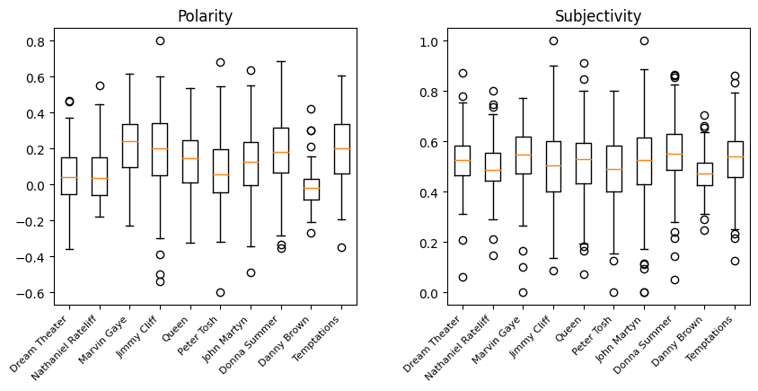
PRE-PROCESSING THE DATA
4) Getting numerical features
Semantics:
Regressive Imagery Dictionary (RID)
Sentimental analysis : polarity
and subjectivity

Slide 27
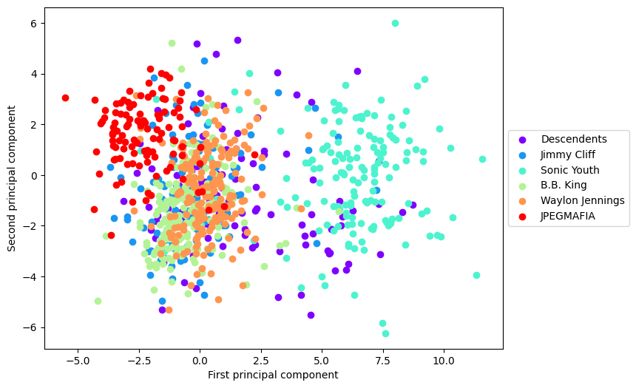
PRE-PROCESSING THE DATA
Total : 273 features

Slide 28
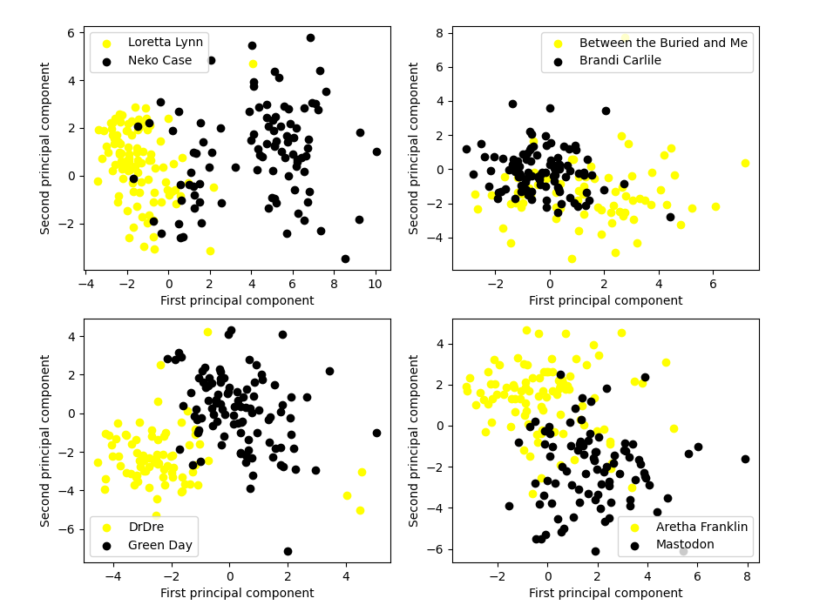
PRE-PROCESSING THE DATA

Slide 29
BUILDING THE MODELS

Slide 30
BUILDING THE MODELS
1) CNN
GloVe embedding:
Words becomes numerical vectors
Arithmetic with words
('woman', array([-0.51821 , -0.13809 , -0.41185 , -0.13133 , 0.0035659, -0.31205 , -0.31242 , -0.43538 , -0.27017 , -1.1338 , 0.19282 , -0.23786 , 0.0028892, -0.027078 , 0.14747 , -0.051265 , 0.089021 , -0.12337 , -0.40892 , -0.39197 , -0.5665 , 0.40684 , -0.057313 , 0.18613 , -0.33095 , -0.25243 , 0.33452 , -0.23104 , -0.0099149, 0.24269 , -0.57504 ,…
KING - QUEEN + WOMAN =

Slide 31
BUILDING THE MODELS
1) CNN
GloVe embedding:
Words becomes numerical vectors
Arithmetic with words
('woman', array([-0.51821 , -0.13809 , -0.41185 , -0.13133 , 0.0035659, -0.31205 , -0.31242 , -0.43538 , -0.27017 , -1.1338 , 0.19282 , -0.23786 , 0.0028892, -0.027078 , 0.14747 , -0.051265 , 0.089021 , -0.12337 , -0.40892 , -0.39197 , -0.5665 , 0.40684 , -0.057313 , 0.18613 , -0.33095 , -0.25243 , 0.33452 , -0.23104 , -0.0099149, 0.24269 , -0.57504 ,…
KING - QUEEN + WOMAN = MAN

Slide 32
BUILDING THE MODELS
1) CNN
'lose’
'hoohaa’
'lose’
'saw’
'yesterday’
‘up’
'someon’
'new’
'thing’
'peopl’
‘say’
.
. .
Embedded song

Slide 33
BUILDING THE MODELS
1) CNN
'lose’
'hoohaa’
'lose’
'saw’
'yesterday’
‘up’
'someon’
'new’
'thing’
'peopl’
‘say’
.
. .
Truncated song
.
. .
Embedded song

Slide 34

BUILDING THE MODELS
1) CNN
.
. .

Slide 35
BUILDING THE MODELS
1) CNN
.
. .
. . .

Slide 36
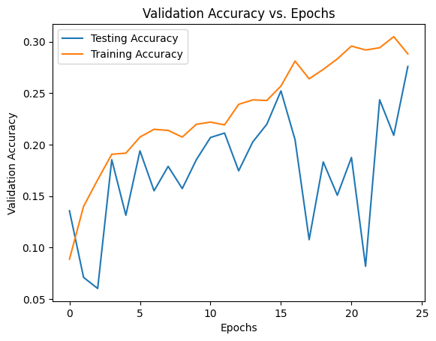
BUILDING THE MODELS
1) CNN
For 16 artists : 30% accuracy
Realistically not usable for a higher number of artists

Slide 37

BUILDING THE MODELS
2) LOGISTIC REGRESSION
Approach : binary classification
Probability of belonging to this artist

Slide 38
BUILDING THE MODELS
2) LOGISTIC REGRESSION
Approach : binary classification
0.2
0.6
0.1
0.6
0.8

Slide 39
BUILDING THE MODELS
2) LOGISTIC REGRESSION
Approach : binary classification
0.2
0.6
0.1
0.6
0.8

Slide 40
BUILDING THE MODELS
2) LOGISTIC REGRESSION
Approach : binary classification
Top k : prediction is correct if true artists is in the top k most probable artists
0.2
0.6
0.1
0.6
0.8

Slide 41

BUILDING THE MODELS
2) LOGISTIC REGRESSION
Additional features:
$$\frac{Feature −Artist^{′}s mean}{Artist^{′}s standard deviation}$$
Helps for high variance

Slide 42
BUILDING THE MODELS
2) LOGISTIC REGRESSION
Additional features:
$$\frac{Feature −Artist^{′}s mean}{Artist^{′}s standard deviation}$$
Helps for high variance
TF-IDF Vector: cosine similarity

Slide 43

BUILDING THE MODELS
Bagging !
2) LOGISTIC REGRESSION
Additional features:
$$\frac{Feature −Artist^{′}s mean}{Artist^{′}s standard deviation}$$
Helps for high variance
TF-IDF Vector: cosine similarity

Slide 44
RESULTS

Slide 45
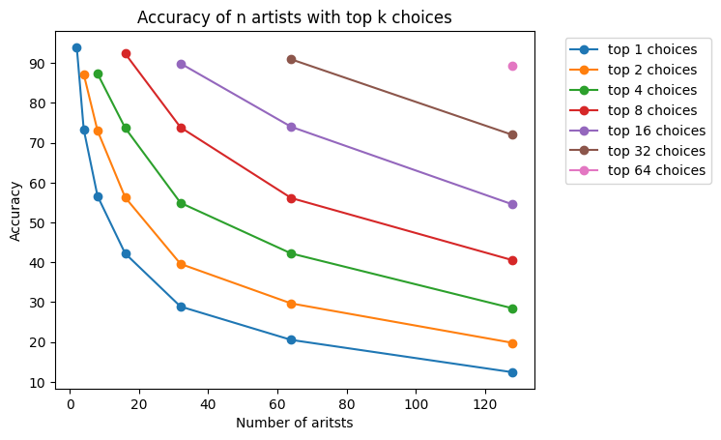
RESULTS

Slide 46
RESULTS
16 artists :
Top 1 : 42%
Top 4 : 73%
N = 16

Slide 47
RESULTS
16 artists :
Top 1 : 42%
Top 4 : 73%
N = 128
128 artists :
Top 1 : 15%
20 times better than a random guess

Slide 48
RESULTS
16 artists :
Top 1 : 42%
Top 4 : 73%
95%
128 artists :
Top 1 : 15%
20 times better than a random guess

Slide 49
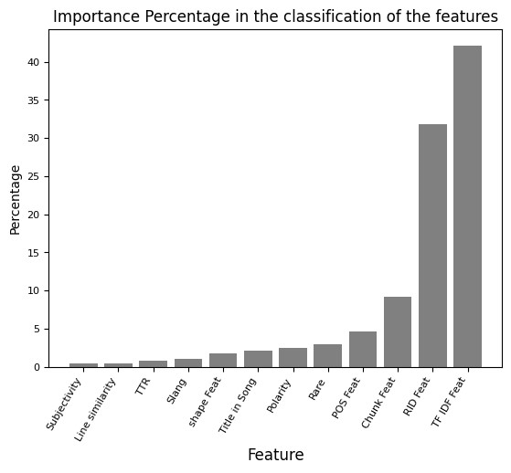
RESULTS

Slide 50
RESULTS
Most misclassified artists | Least misclassified artists
Violent Femmes, Laura Marling, Ed Sheeran, Average White Band, Etta James Pointer Sisters | Cannibal Corpse, Steve Earle, Eminem, J. Cole, JPEGMAFIA, James Taylor, Behemoth, Freddie Gibbs

Slide 51
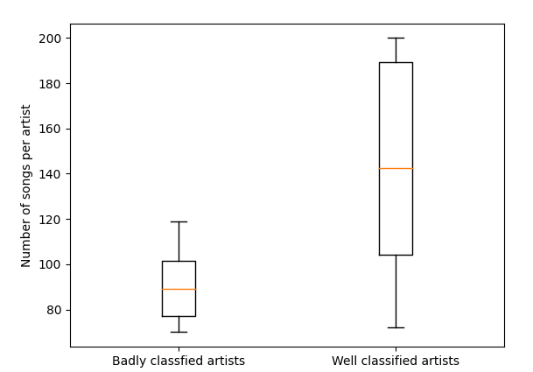
RESULTS
Most misclassified artists | Least misclassified artists
Violent Femmes, Laura Marling, Ed Sheeran, Average White Band, Etta James Pointer Sisters | Cannibal Corpse, Steve Earle, Eminem, J. Cole, JPEGMAFIA, James Taylor, Behemoth, Freddie Gibbs
Why ?

Slide 52
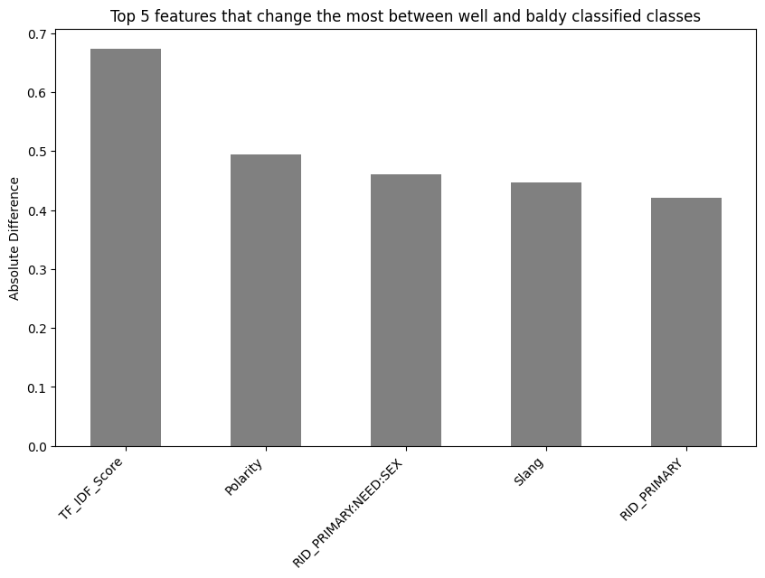
RESULTS
Most misclassified artists | Least misclassified artists
Violent Femmes, Laura Marling, Ed Sheeran, Average White Band, Etta James Pointer Sisters | Cannibal Corpse, Steve Earle, Eminem, J. Cole, JPEGMAFIA, James Taylor, Behemoth, Freddie Gibbs
Why ?

Slide 53
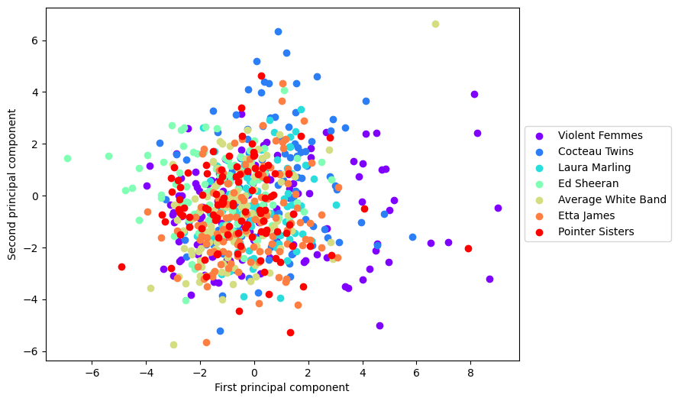
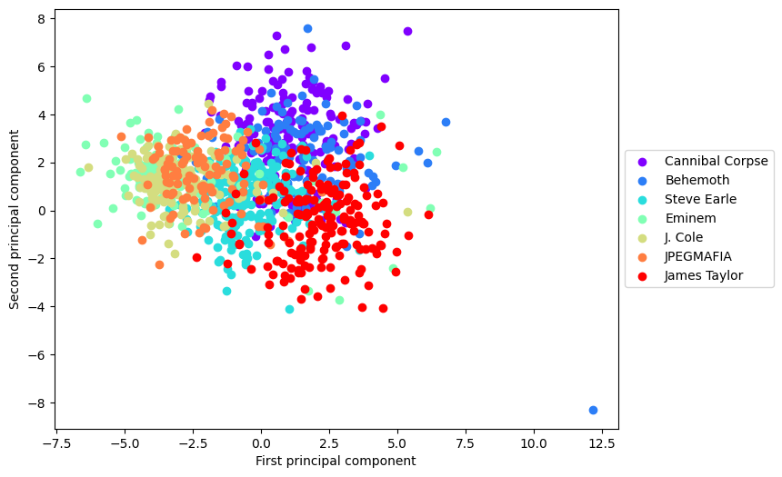
RESULTS
Most misclassified artists | Least misclassified artists
Violent Femmes, Laura Marling, Ed Sheeran, Average White Band, Etta James Pointer Sisters | Cannibal Corpse, Steve Earle, Eminem, J. Cole, JPEGMAFIA, James Taylor, Behemoth, Freddie Gibbs

Slide 54
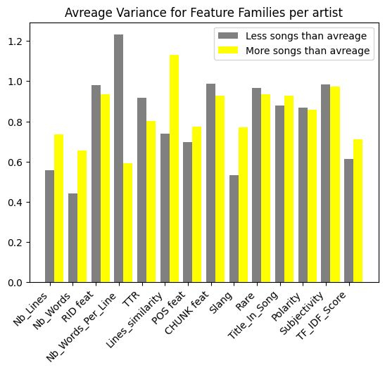
RESULTS

