Slide 1

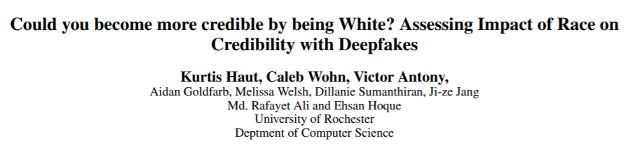
SURVEY PAPER PRESENTATION
Abhishek Bais
Graduate student comp SCI, SJSU

Slide 2
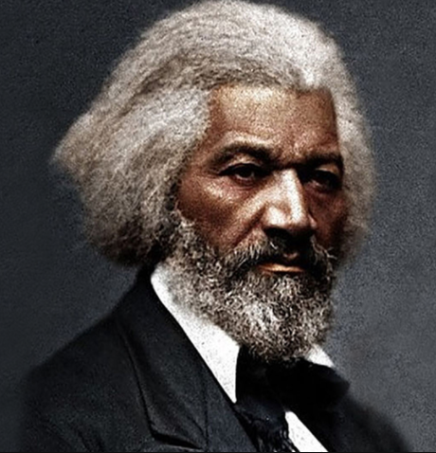
“Right is of no Sex — Truth is of no Color — God is the Father of us all, and we are all brethren.” ~ FREDERICK DOUGLASS (1847)

Slide 3
As protests and conversations over #blacklivesmatter dominate the news headline, the big question remains, “Is truth and justice color-blind? Are white people perceived as more credible?”
THIS STUDY ATTEMPTS TO FIND ANSWERS

Slide 4
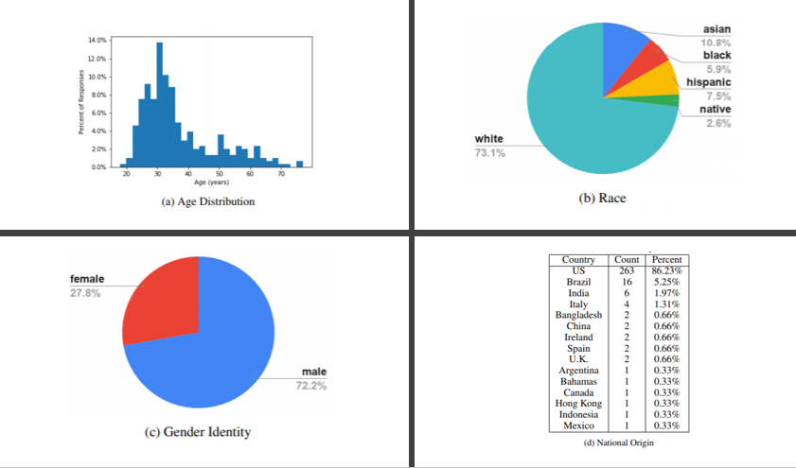
STUDY PARTICIPANTS
800 COLLEGE STUDENTS
THE SELF REPORTED DEMOGRAPHIC PROFILE OF 305 OF THOSE 800 PARTICIPANTS

Slide 5
Study methodology
IMAGE CONDITION
each participant was shown a still image of a black and a white person, generated using Cycle Generative Adversarial Networks (CycleGAN), made to hear identical audio clip
ASKED SURVEY QUESTIONS
VIDEO CONDITION
each participant was shown an original video of a darker-skinned South Asian speaker with subtle changes made to the face area using deepfacelab
ASKED SURVEY QUESTIONS

Slide 6
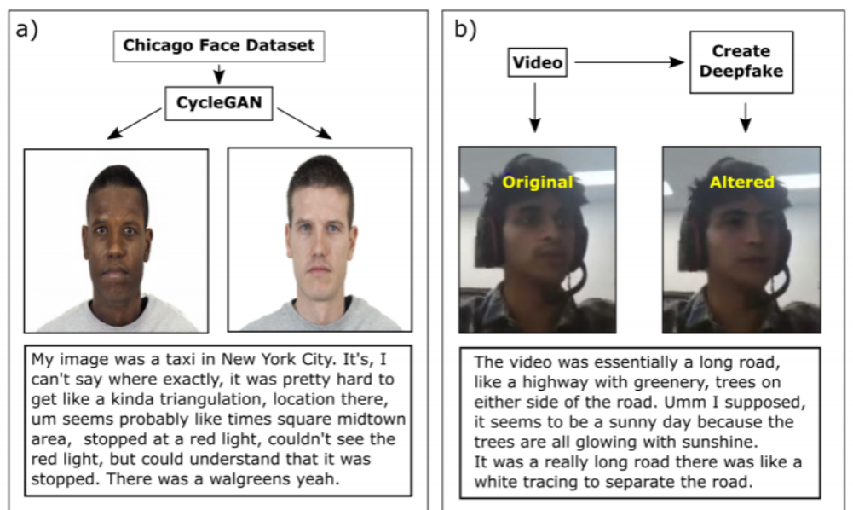
Audio transcripts
IMAGE CONDITION
VIDEO CONDITION

Slide 7
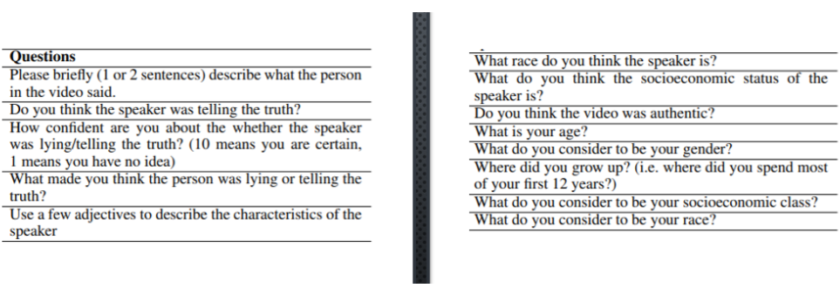
Survey questions

Slide 8
Analysis of survey responses
UNDERSTAND DIFFERENCES IN PERCEIVED CREDIBILITY BY RACE
3 STEPS
FILTER-OUT RESPONSES WHERE SPEAKER’S RACE INCORRECTLY IDENTIFIED
PERFORM PROPORTIONS-Z TEST TO COMPARE DIFFERENCES IN PERCEIVED CREDIBILITY
PERFORM SENTIMENT ANALYSIS TO UNDERSTAND RATIONALE OF RESPONSES

Slide 9

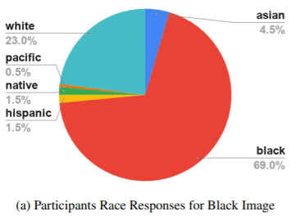
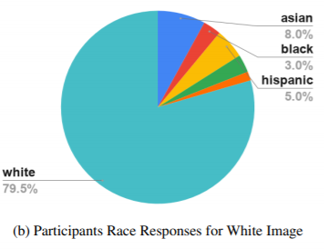
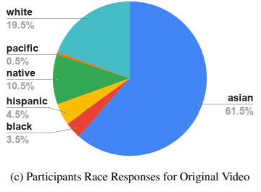
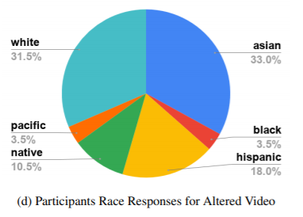
PARTICIPANT RESPONSES TO “What race do you think the speaker is?”

Slide 10
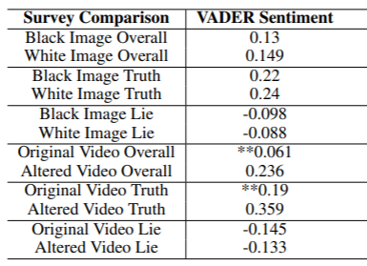
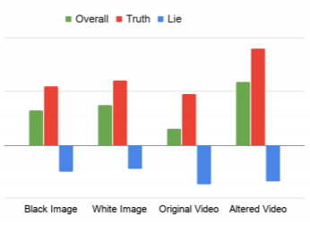
Sentiment analysis on “What made you think the person was lying or telling the truth?”
** INDICATES P < 0.01

Slide 11
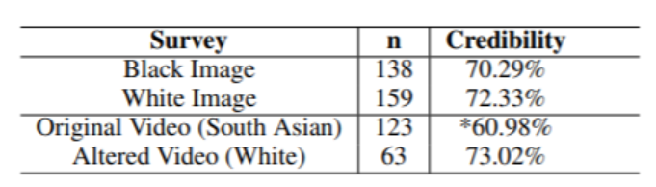
Credibility analysis “Credibility” is the percent of responses that believed the speaker was telling the truth * indicates p < .05

Slide 12
Summary of findings
IMAGE CONDITION
72.3% PERCEIVED WHITE SPEAKER WAS TRUTHFUL
70.3% PERCEIVED BLACK SPEAKER WAS TRUTHFUL
VIDEO CONDITION
73% PERCEIVED WHITE SPEAKER WAS TRUTHFUL
61% PERCEIVED DARK-SKINNED S.ASIAN SPEAKER WAS TRUTHFUL
SENTIMENT ANALYSIS
WHITE SPEAKERS HAD HIGHER POSITIVE SENTIMENT

Slide 13
CONCLUSIONS
MODERN AI PROVIDES TOOLS SUCH AS CYCLE GENERATIVE ADVERSARIAL NETWORKS(CYCLEGAN) AND DEEPFACELAB TO HELP FIND ANSWERS TO DIFFICULT QUESTIONS PERTAINING TO RACE, UNCONCIOUS BIAS AND PERCEIVED CREDIBILITY
IT IS TIME TO LET DATA AND NOT EMOTIONS DRIVE DECISIONS TO FIND SOLUTIONS TO THESE DIFFICULT QUESTIONS TO LEAVE A BETTER PLANET FOR OUR CHILDREN
“YOU ARE NOT JUDGED BY THE HEIGHTS YOU HAVE RISEN, BUT FROM THE DEPTHS YOU HAVE CLIMBED” ~FREDERICK DOUGLASS

