Slide 1

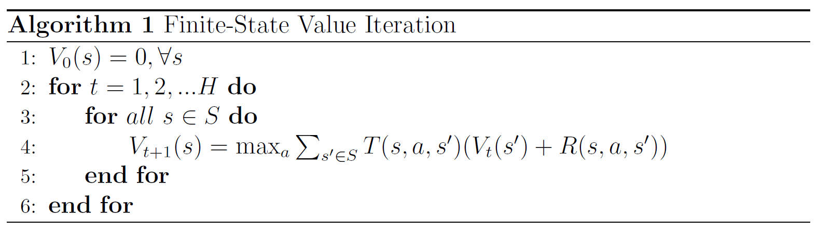
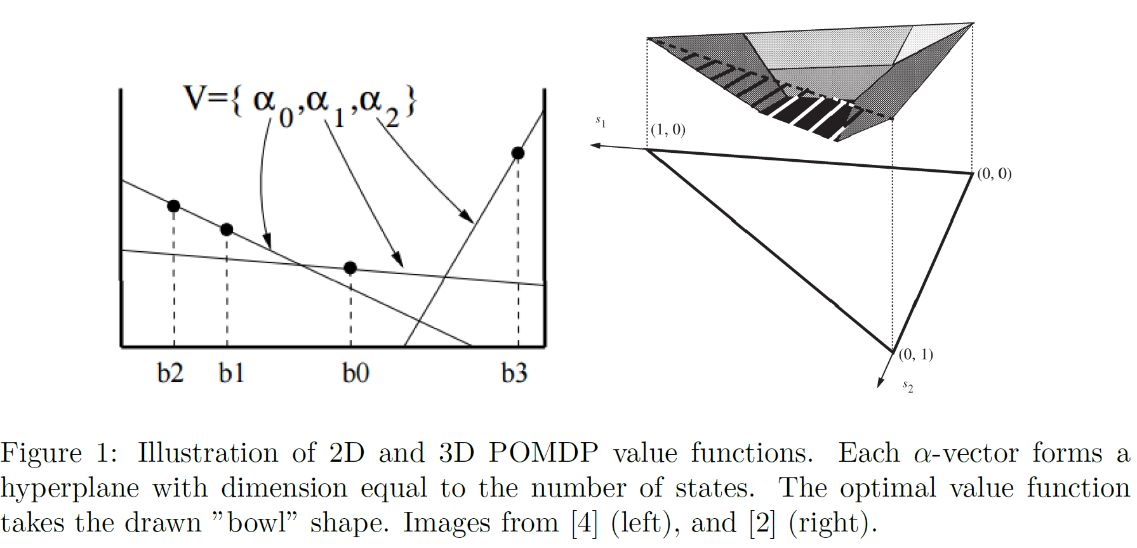
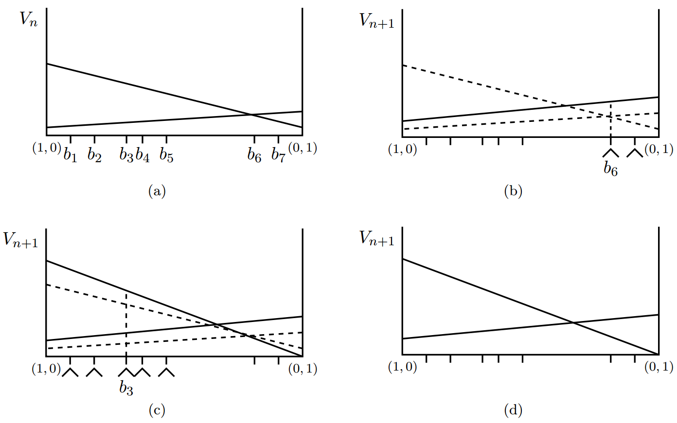
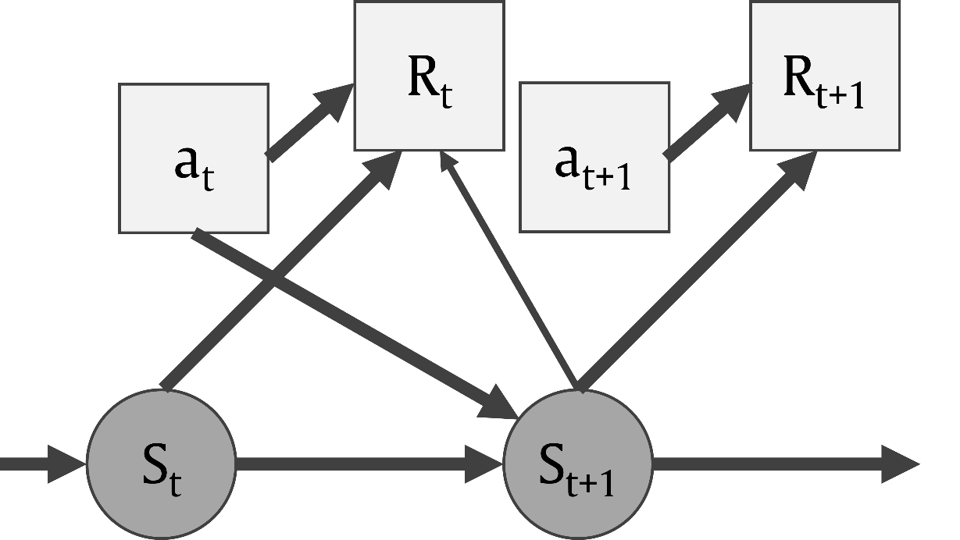
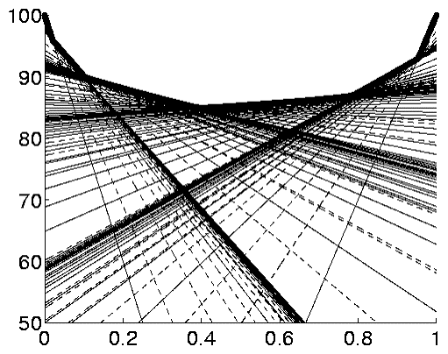
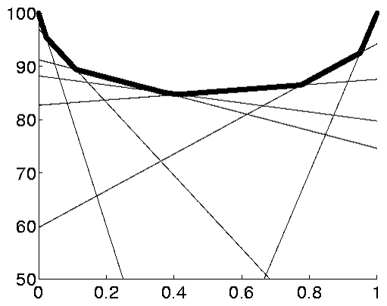
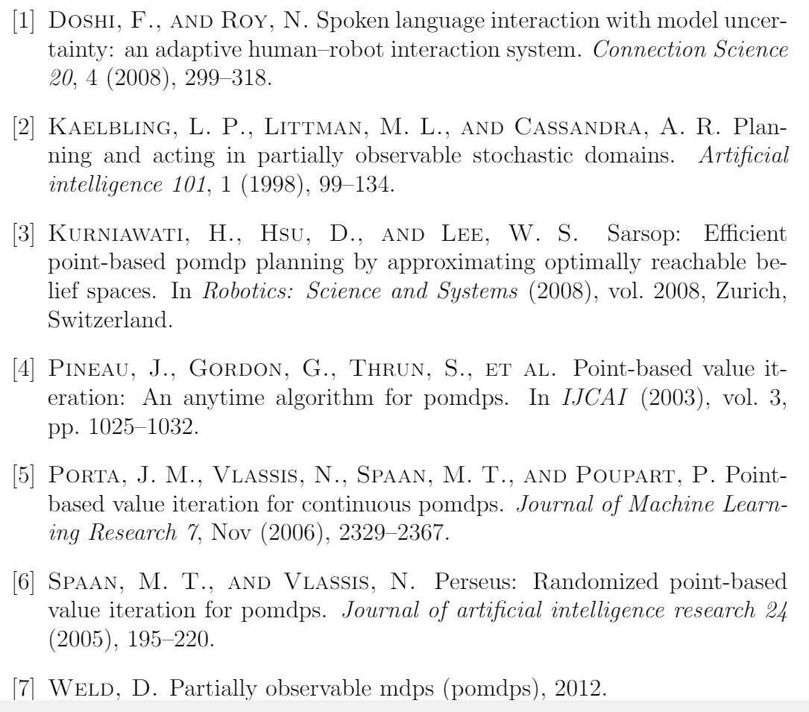
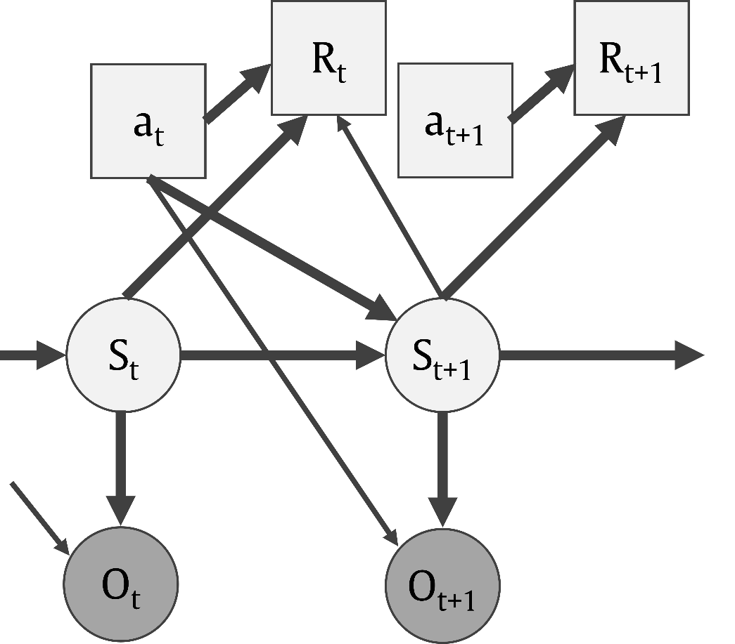
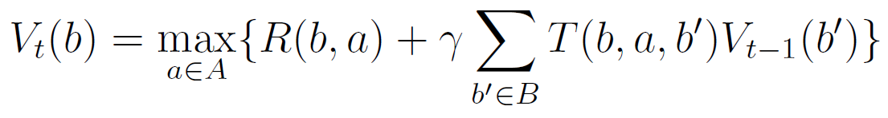
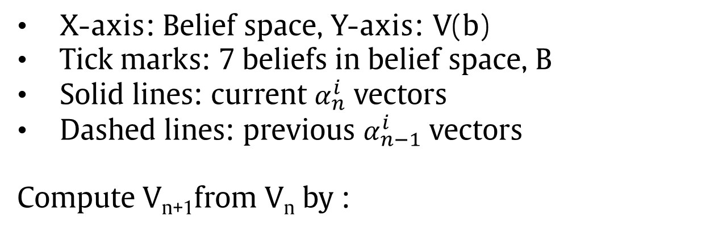
A Survey of Point-Based Value Iteration
Algorithms for Solving POMDPs
Andrea Bajcsy
Abstract: A key problem in designing autonomous systems is taking input from the environment and producing actions that allow the system to reach a goal. In most real-world settings, actions have stochastic effects on the environment and the state of the environment is only partially observable. Partially Observable Markov Decision Processes (POMDPs) are an expressive and mathematically concrete framework that allows us to optimize decision problems with partial observability. However, POMDPs are hindered by computational intractability. Thus, good approximation techniques are needed in order to leverage the modeling power of POMDPs with realistic computation. The goal of this survey is two-fold: (1) analyze the foundations of solving POMDPs with value iteration and point-based approximations and, (2) analyze a POMDP-based model of human internal state in the context of human-robot interaction.
Introduction & Motivation
Value Iteration Algorithm
Randomized PBVI for POMDPs [6]
Conclusion
As autonomous systems begin to leave the assembly lines and actually interact with humans, there comes a need to model and predict humans actions and internal belief state in human-robot interaction settings. Partially Observable Markov Decision Processes (POMDPs) provide a solid mathematical framework for optimizing decision problems with partial observability. This is a desired characteristic in robotics applications where autonomous systems often operate under uncertain and dynamic environments.
However, POMDPs are often computationally intractable, taking hours to compute an exact solution even for POMDPs with only a dozen states [3]. This leads to POMDPs being unusable for modeling realistic robotics problems. While computing exact solutions to POMDPs remains difficult, point-based POMDP algorithms have provided fast approximate solutions for POMDPs even with hundreds of states [3].
In the PERSEUS algorithm only a random subset of belief points get updated. The claim is that a single update can ultimately improve many points in the belief set.
X-axis: Belief space, Y-axis: V(b)
Tick marks: 7 beliefs in belief space, B
Solid lines: current $α_{n}^{i}$ vectors
Dashed lines: previous $α_{n−1}^{i}$ vectors
Compute V_{n+1}from V_{n} by :
Value function at stage n
Sample b₆
Add α = update(b₆) to V_{n+1}
This improved value of b₆ and b₇
Background: MDPs & POMDPs
Markov Decision Processes (MDPs)
Point-Based Value Iteration [4]
Point-Based Value Iteration [4]
S: set of world states
A: set of actions
T: state-trans func
R: reward func
Sample b₃
Add α = update(b₃) to V_{n+1}
This improved value of b₁ through b₅
Value of all b has improved
Value Function (discrete):
Exact value function
Point Based Value Iteration
Human-Robot Interaction Systems & PBVI
By keeping alpha-vector for each belief point, PBVI preserves the piece-wise linearity and convexity of the value function. Figures from [6].
References
Partially Observable Markov Decision Processes
(POMDPs)
Intuition: an agent should only spend time computing solutions to parts of the belief space that can actually be encountered by interacting with the environment
Selecting Belief Points:
Stochastically simulates step forward for each action to produce new belief set B’
For each b’ in B’, measures L1 distance to B
If b’ in B → discards b’ point, else keeps b’
Efficient Point-based Value Updates:
Modifies traditional Bellman update such that only one α-vector is kept for each belief point:
S: set of world states
A: set of actions
T: state-trans func
R: reward func
O: set of observ.
Ω: observ. model
Value Function (discrete):

Slide 2
R_{t}
R_{t+1}
a_{t}
a_{t+1}
S_{t}
S_{t+1}
O_{t}
O_{t+1}

Slide 3
R_{t}
R_{t+1}
a_{t}
a_{t+1}
S_{t}
S_{t+1}

