Slide 1
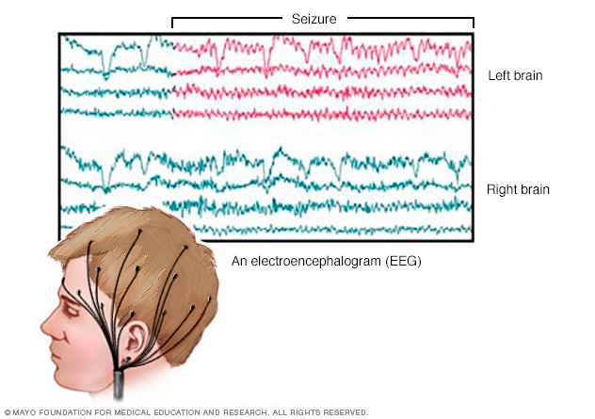
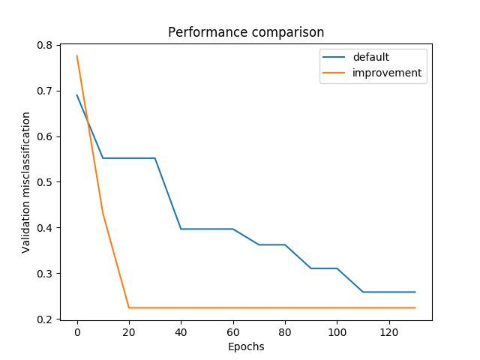
Optimization of ConvNet for EEG data Andre Bajorat, Konstantina Galani, Pablo de Andres
Project goals
Find the best configuration for a Convolutional Network built for seizure detection
Focused on the deep architecture
Tasks
Define a configuration space.
Modify training to take a configuration and output validation error.
Find the best configuration.
Plot the improvement.
About the network
Decode movements from raw EEG data
Two architectures, a deep network and a shallow one.
Available on git.io/vNh8p
Implementation
SMAC
Optimized over 21 parameters
750 configurations for 80 epochs each
Results
Slight improvement
Faster convergence
n_filters, batch_norm_alpha, filter_length
Available on git.io/vATdw

